Slide 1
BUILDING MOMENTUM TO A GLOBAL ECONOMIC COLLAPSE The Untold Story of the Inevitable Consequences of Centuries of Entrenched Privilege
EPISODE 6

Slide 2
Barach Obama’s Depression Presidency

Slide 3
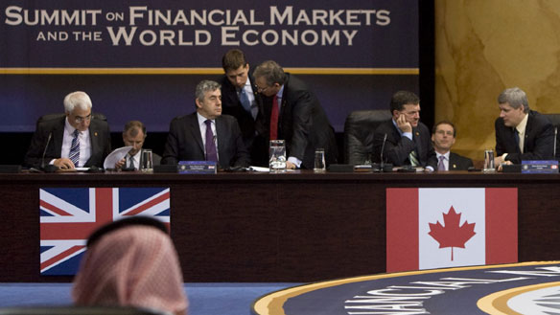
Written by
Edward J. Dodson, M.L.A.

Slide 4
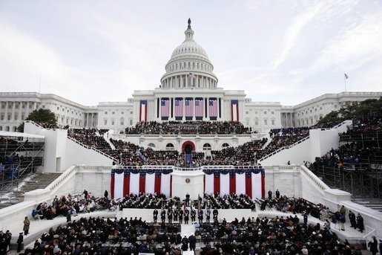
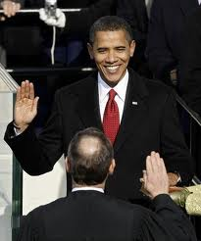
Notes:
When Barach Obama came into office in 2009, I hoped the new administration – with strong support from the Congress – would introduce real reforms to the financial system. However, despite a large body of economic literature on the issues, I knew his economic advisers would ignore the role land speculation had played bringing on the property market crash and the recession. I was not disappointed.

Slide 5
Notes:
5
Somehow, our government officials must be made to understand that long-standing public policies and tax laws have favored speculative investment behavior over the production of goods and services. Achieving sustainable economic growth, and full employment without inflation requires a level of objective reanalysis of economic theory and public policy options that is not likely to come from either Democratic or Republican leaders or their think tanks.

Slide 6
TRIGGER
LAND SPECULATION AND LAND HOARDING
Notes:
6
The most important fact of our economic system is that land hoarding and land speculation are heavily subsidized by low effective rates of taxation. These subsidies allow net imputed income streams associated with nature – whether locations in cities and towns or resource laden lands -- to be capitalized into higher and higher land prices. The stress that skyrocketing land prices put on an economy will – every 18 to 20 years -- TRIGGER an economic crisis.

Slide 7
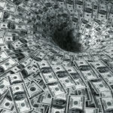
TRIGGER
Notes:
7
Dysfunctional land markets are fueled by our equally dysfunctional system of banking and credit allocation. The U.S. banking laws authorize the Federal Reserve Banks to introduce new currency into the economy in exchange for government debt. Our currency is, in effect, a promise to pay nothing in particular. Pumping additional credit and currency into the economy always, eventually, reduces the purchasing power of the currency. Savers are harmed. Debtors benefit – at least in the short run.

Slide 8
Notes:
8
What we are left with, unfortunately, are conditions that will bring on yet another credit-fueled and speculation-driven property market cycle. There is nothing in the economic stimulation package that recognizes the fundamental causes of the meltdown of the property markets and the resulting failure of a growing number of financial institutions. Without dramatic systemic reforms to our economic system, history is doomed to be repeated.

Slide 9
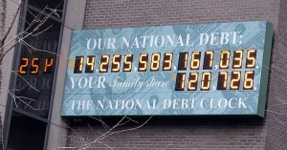
Notes:
Absent reform of how government raises its revenue by taxation, government continued to borrow from those who had the greatest ability to pay, then imposed taxes on the less affluent in order to service a skyrocketing national debt.

Slide 10
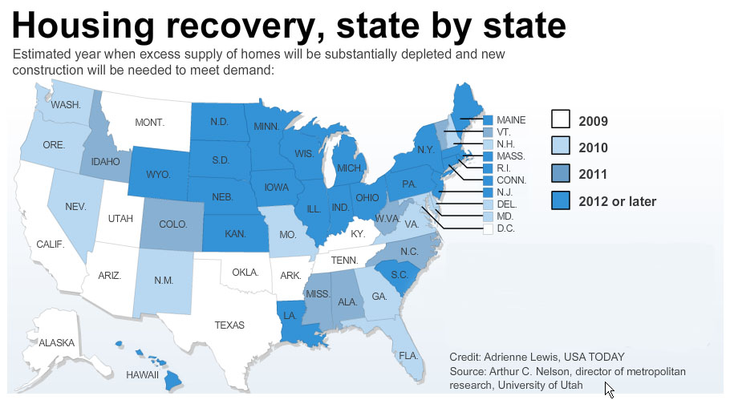
Notes:
With the recession, land prices in some markets declined sufficiently to permit builders to acquire land at a cost that permitted construction of housing people could afford. However, stagnant household incomes and high unemployment are preventing the property markets from a renewed inflationary upswing in prices; or, what is generally referred to by economists interviewed in the media as a “housing recovery.”

Slide 11
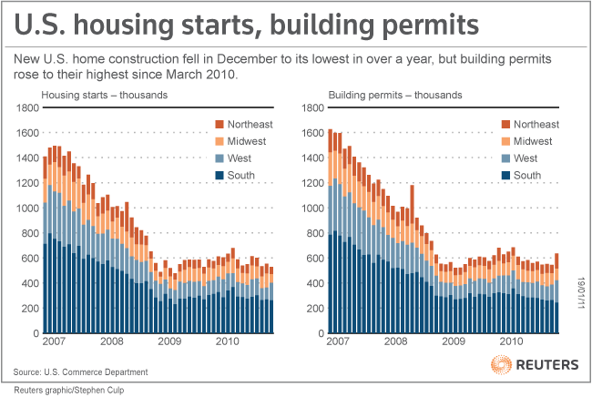
Notes:
As these charts indicate, the annual number of new residential properties being constructed stabilized at around 600,000. The median home price, the point at which half of all homes are sold for more and half are sold for less, increased all around the U.S. in March of 2011. Yet, property prices in the Northeast in February were down by 3.0 percent from 2010. Prices in the Midwest were down by over 7 percent, in the South by 6.6 percent, and in the West by over 11 percent.

Slide 12
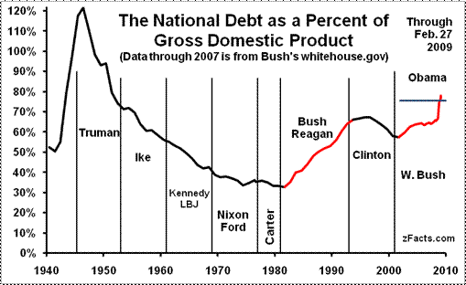
Notes:
Economists employed by successive U.S. administrations and congresses compliantly made the case that the escalating national debt was not a threat to economic stability because debt had not increased when measured against the size of the economy.

Slide 13
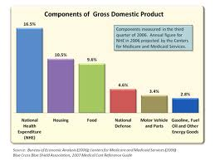
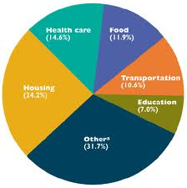
Notes:
A serious problem with this perspective was that the measure of economic growth relied upon by economists – Gross Domestic Product – includes virtually every dollar spent by government, whether obtained by taxation or from borrowings.

Slide 14
Joseph Stiglitz
Notes:
Last year, Joseph Stiglitz issued a report of almost 300 pages criticizing Gross Domestic Product as a measure of social welfare and proposing a variety of alterations and alternatives. In an opinion piece from September 2009, he wrote:

Slide 15
“In many cases, GDP statistics seem to suggest that the economy is doing far better than most citizens' own perceptions. …”
Notes:
“In many cases, GDP statistics seem to suggest that the economy is doing far better than most citizens' own perceptions. …”

Slide 16
“Moreover, the focus on GDP creates conflicts: political leaders are told to maximise it, but citizens also demand that attention be paid to enhancing security, reducing air, water, and noise pollution, and so forth – all of which might lower GDP growth.”
Notes:
“Moreover, the focus on GDP creates conflicts: political leaders are told to maximise it, but citizens also demand that attention be paid to enhancing security, reducing air, water, and noise pollution, and so forth – all of which might lower GDP growth.”

Slide 17
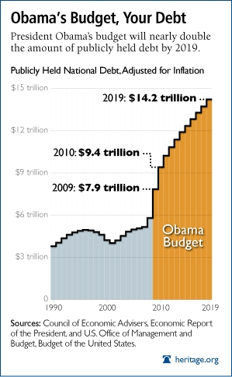
Notes:
The question few asked was whether the U.S. would be able to service its skyrocketing national debt. The CBO estimated that the total national debt would be $17.27 trillion dollars by 2019 under the current federal budget, versus $14.4 trillion forecasted by the Council of Economic Advisers. The reality turned out to be worse. As interest rates increase, the government’s ability to service this debt will require either a dramatic increase in taxation or an erosion in the value of the U.S. dollar – perhaps both.

Slide 18
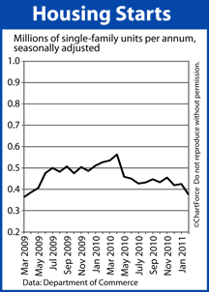
Notes:
2010 was the worst year for housing starts since the federal government began tracking the data in 1959. The ripple effect throughout the U.S. economy was considerable, given the extent to which employment, goods production and services had been dependent upon a robust housing market.

Slide 19
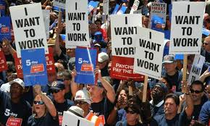
Notes:
The April 2011 monthly unemployment figures put the official unemployment rate increased at 9.0% with a gain in total jobs of 244,000. Government employment actually fell by 24,000.

Slide 20
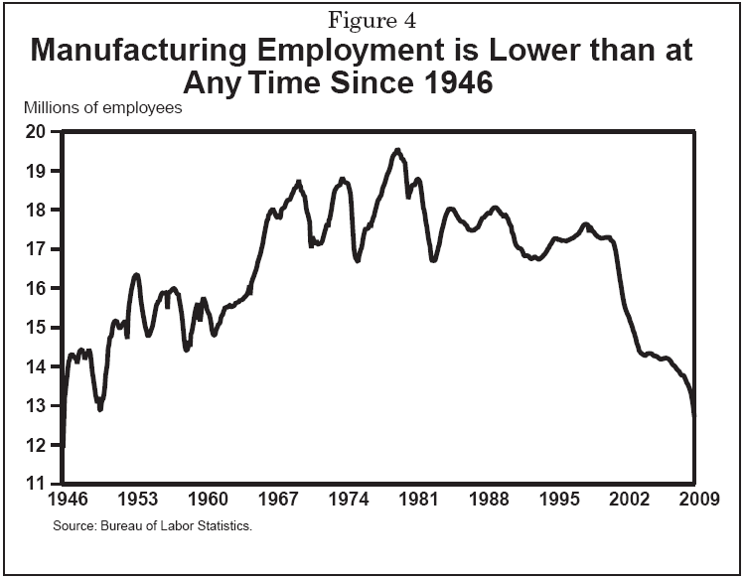
Notes:
However, our economy was not and is not replacing the lost manufacturing employment with jobs that have equal levels of compensation and benefits.

Slide 21
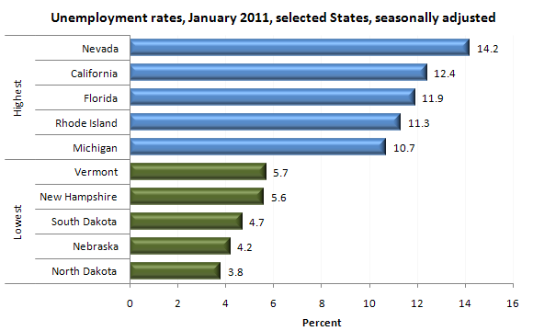
Notes:
Nevada continued to experience the highest level of unemployment, at over 14 percent, with North Dakota reporting the lowest level of unemployment at 3.8 percent.

Slide 22
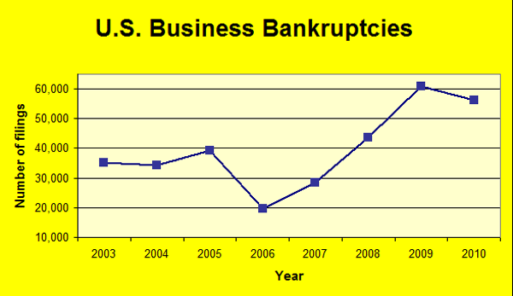
Notes:
U.S. business bankruptcies declined only slightly in 2010 from 2009.

Slide 23
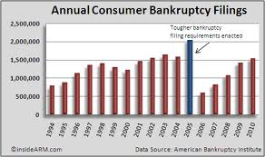
Notes:
Analysts were forecasting that some 1.5 million people would file for personal bankruptcy during 2011. Since the financial crisis began in 2007, the number of people filing for bankruptcy protection approached the total number before bankruptcy laws were tightened in 2005.

Slide 24
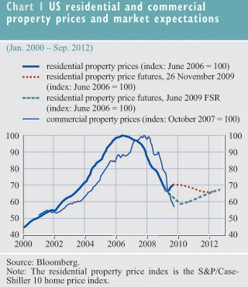
Notes:
In many markets across the United States, the prices of commercial properties continued to decline, although the rate of decline slowed.

Slide 25
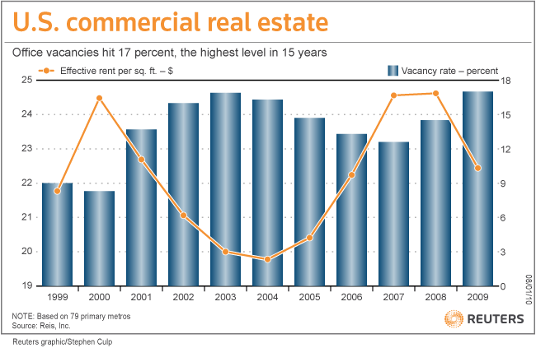
Notes:
Part of the story was apparent in the high vacancy rates experienced in some large metropolitan markets. The U.S. office vacancy rate hit a 15-year high in the fourth quarter of 2009, and landlords slashed asking rents by the largest amount since at least 1980. Office vacancy rates averaged 16.5 percent; however, rates in New York City and Honolulu – the lowest in the U.S. -- were around 8 to 9 percent.

Slide 26
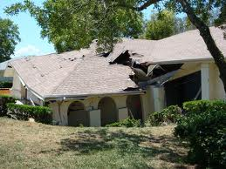
Notes:
By 2010 or 2011 there was widespread hope that residential property markets would recover lost value but not escalate as they did during the last cycle. What crashed, of course, were land markets. And, unless the capitalization of location rental values could be prevented, the anticipation of profits to be gained from land speculation would trigger another cycle of volatile land prices. Rising land prices bailed out some homeowners and some mortgage investors, but the effects on the general population and our very structurally-weak economy have set the stage for the next financial and economic meltdown.

Slide 27
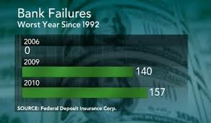
Notes:
For 2010, the number of bank failures rose to 157, the highest number of bank failures since 1992 and surpassing 2009 which saw a total of 140 bank failures. Furthermore, 860 institutions were on the FDIC’s problem banks list, as of September 30, 2010, the highest number since 1992. The estimated cost to the FDIC of these bank failures totaled $22.4 billion. The FDIC's contingent loss reserve, which covers the costs of bank failures, declined from $27.5 billion to $21.3 billion during the third quarter, primarily as a result of these bank failures.

Slide 28
Notes:
What we have experienced in the last six or seven years is, in my assessment, little more than pushing off into the near future an economic collapse of historic proportions. With the time that remains, I suggest we enter into a serious public dialogue on the systemic reforms needed to soften the almost certain economic and social implosion with which we are faced.

Slide 29
End of Episode 6

