Slide 1
Understanding our Political Economy

Slide 2
INSTRUCTOR
Edward J. Dodson, M.L.A.
email contact:
edod08034@gmail.com

Slide 3
LECTURE 10
Lessons of Urban Land Markets

Slide 4
Notes:
Of the total 2.3 billion acres of land in the United States, some 60 million acres are occupied by our cities and towns.

Slide 5
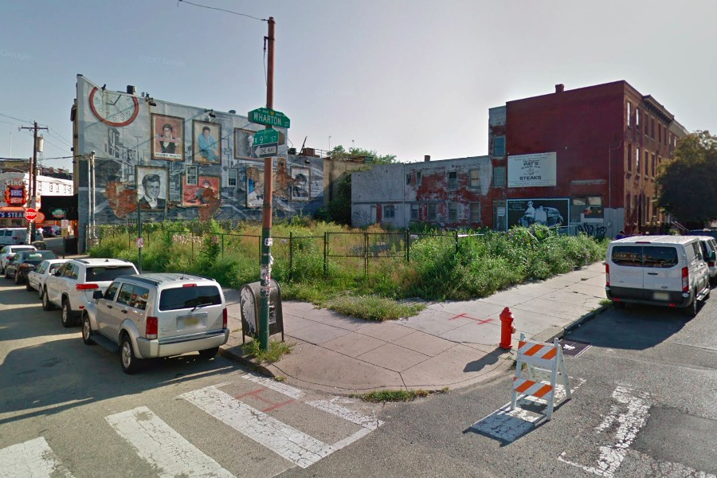
Notes:
In the City of Philadelphia there are a reported 40,000 parcels identified by the city as vacant. These lots represent a valuable but wasted resource for homes, businesses, recreation and public services. Nearly every city and town suffers from similar underutilization of its landed area.

Slide 6
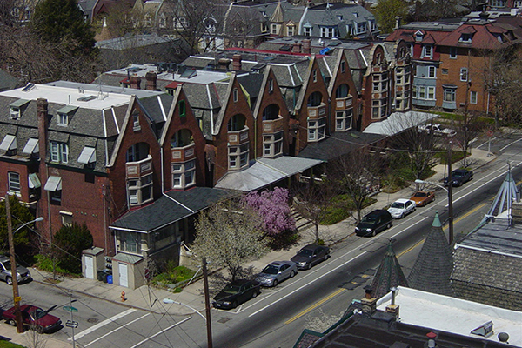
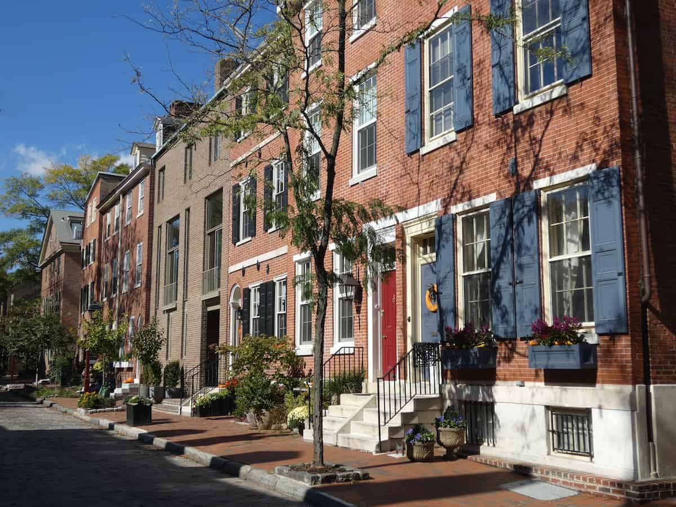
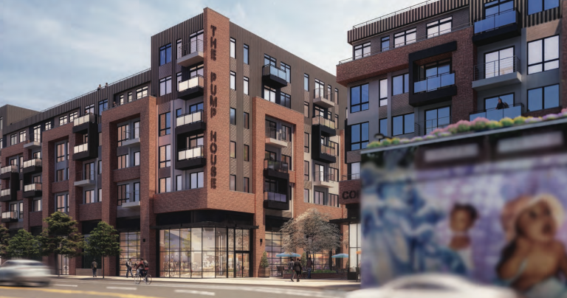
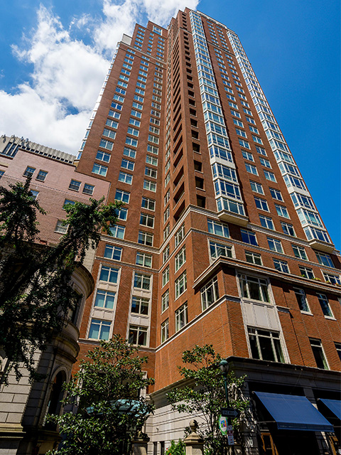
Notes:
We also have very diverse types of residential development, influenced by multiple factors associated with location.

Slide 7
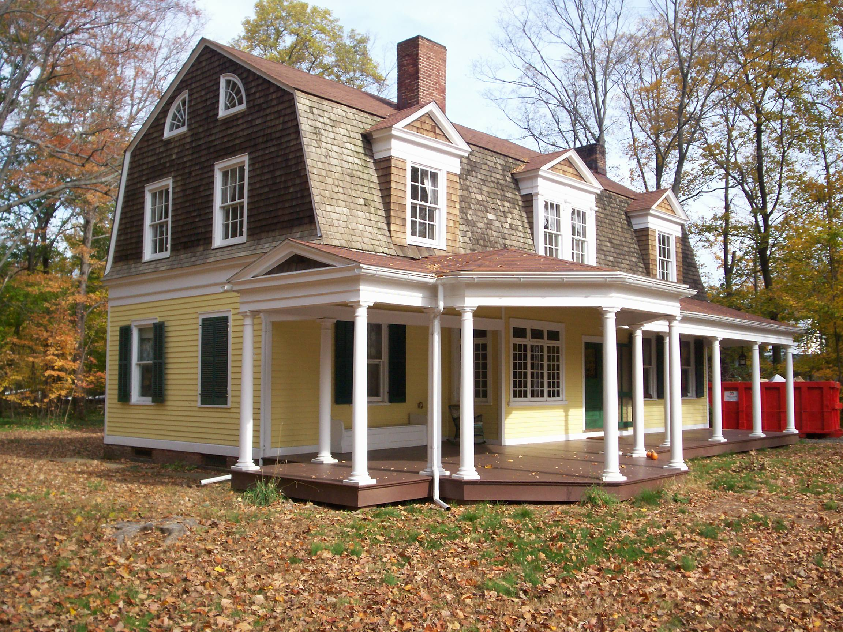
Notes:
Newer housing units have gotten larger and larger even as the average household size has steadily declined from 3.7 people to 2.6 people. Developers offer more standard features in homes, more frequently on small parcels of land.

Slide 8
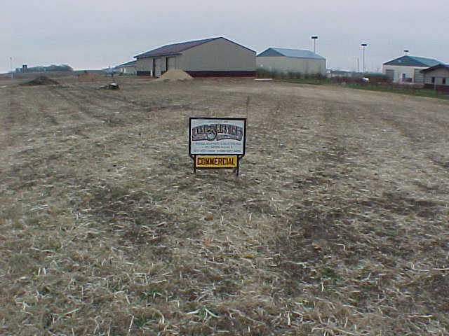
Notes:
If a homebuyer wants more acreage, generally speaking, the option is to go further and further from the older suburbs of most cities. As land values climbed during the 1990s, developers adopted other strategies to reduce the land cost component of each housing unit constructed:

Slide 9
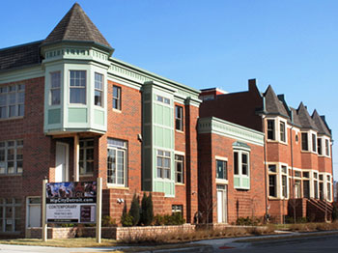
Notes:
One solution is to gain approval for higher density development. Another response is:

Slide 10
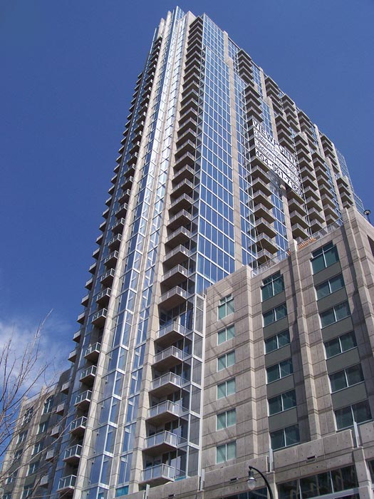
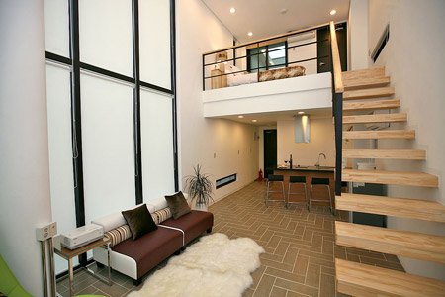
Notes:
To build upward. And, in many neighborhoods where land values have skyrocketed …

Slide 11
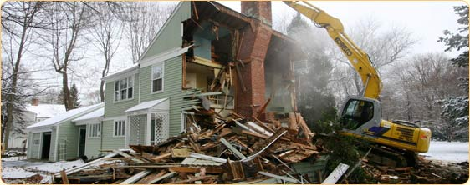
Notes:
Perfectly good residential properties are demolished and replaced with much larger structures designed for a much more affluent buyer. Such replacements are to be expected when rising land values dictate a higher, better use for land than the existing structure provides.

Slide 12
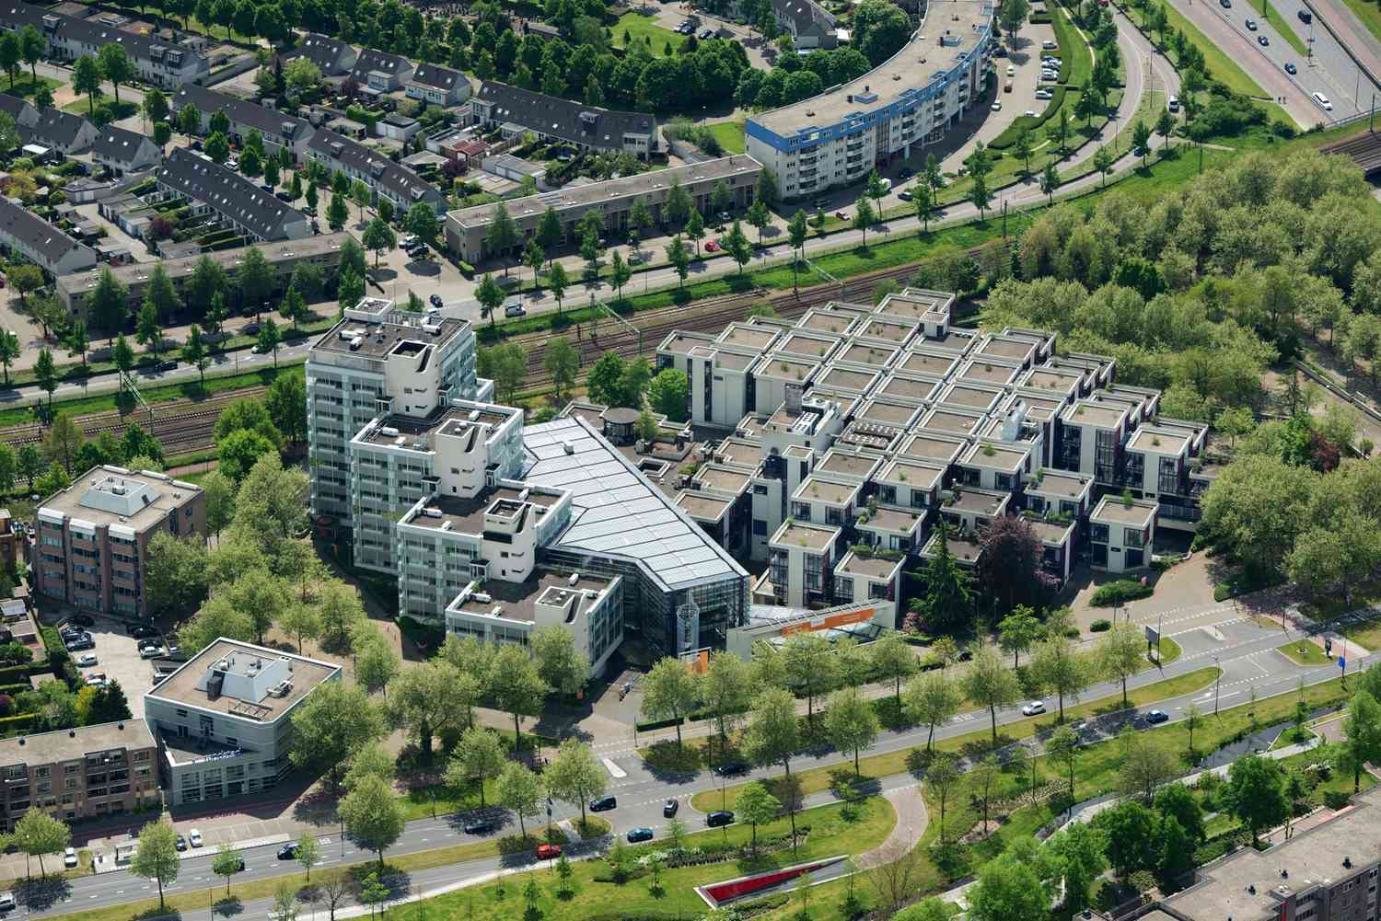
Notes:
Along major roadways, the changing land use is often from residential to commercial. Houses are torn down to be replaced by office buildings, retail shopping or multi-story condominiums and apartment buildings.

Slide 13
Notes:
And, then, there is the special case of a handful of cities, where the most expensive parts of the cities attract wealthy purchasers of second homes. As one market analyst has observed about Manhattan property:

Slide 14
“The insatiable demand to acquire any parcel in Manhattan for development has been supported by worldwide attention from many different first-time purchasers from abroad. …”
Notes:
"The insatiable demand to acquire any parcel in Manhattan for development has been supported by worldwide attention from many different first-time purchasers from abroad.”

Slide 15
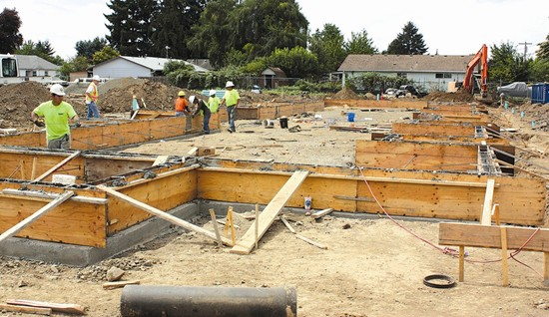
Notes:
Below the top 5 percent of U.S. households as measured by net worth, for most Americans the majority of their net worth is in a residential property, some portion of which is the value of a home and some of which is the value of the land beneath the home. Here is a look at that portion of net worth that is land value.

Slide 16
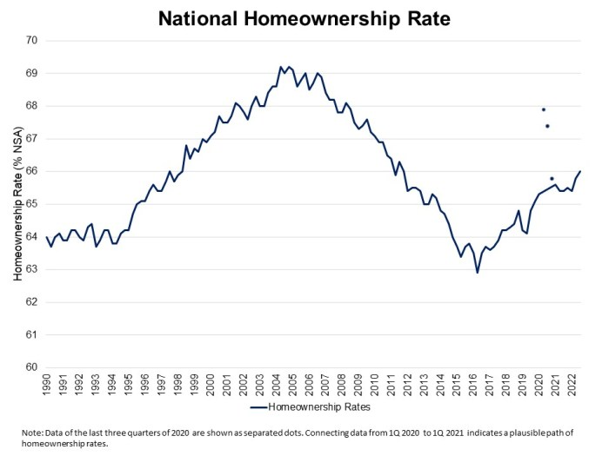
Notes:
After falling from a high of 69 percent in 2007, the rate of homeownership in the U.S. has climbed back up to 66 percent. Millions of households lost their residential property to foreclosure or were forced by prolonged unemployment to sell and become renters. Hundreds of thousands of others have experienced either periodic or long-term homelessness.

Slide 17
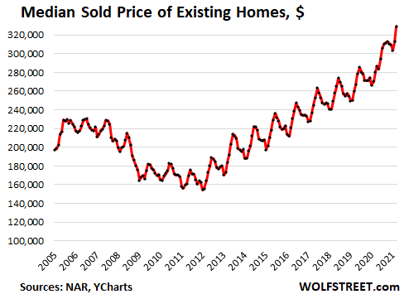
Notes:
The national median existing single-family home price reached $393,000 by the end of 2022. For all types of existing properties the median sales price was $359,000. Despite higher mortgage interest rates, property prices have not fallen back for a couple of reasons. In fact, they increased each month for 131 months thru January of 2023.

Slide 18
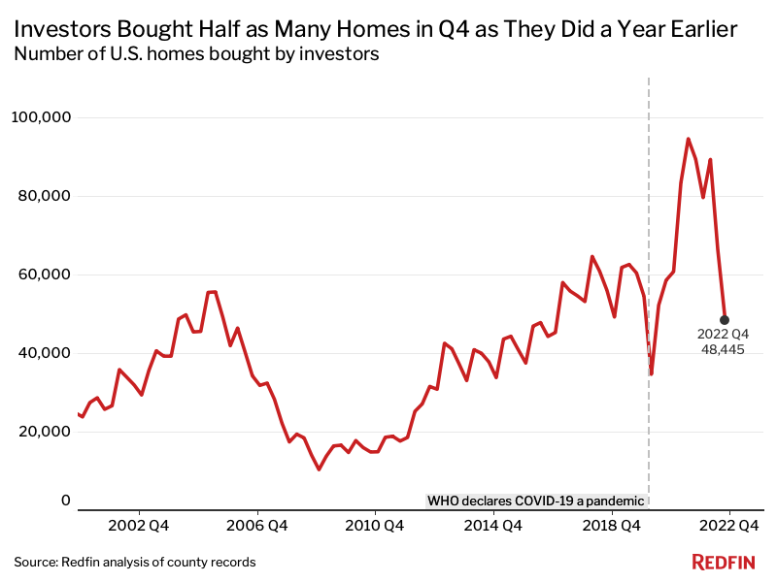
Notes:
One reason is that people who obtained mortgage loans at record low rates of interest are now about to sell in the current rate environment. Also, demand continues to outpace the construction of new residential properties. As this chart shows, investors have since the end of the last property market cycle in 2010 each year acquired hundreds of thousands of residential properties. Analysts forecast that by 2030 they will hold around 7.6 million properties, or more than 40 percent of all single-family rents.

Slide 19
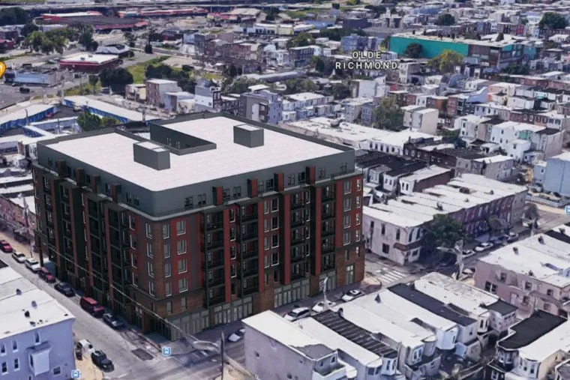
Notes:
We can make a rough calculation of how much in land value there is under all of the residentially-improved land. Statistics are not available on the number of vacant residential lots across the United States, although there is some vacant but developable land everywhere.

Slide 20
$359,000 (median price of a residential property
40% as a conservative land-to-total-value ratio
$143,000 is the median land value per residential property
$143,000 multiplied by the total households in the United States (124 million) = $17.8 trillion
$17.8 TRILLION
Notes:
If we use 35% as the land-to-total value ratio for our median price of $185,000, we get a median land value of $63,525. Multiply this figure by the number of households in the United States and we get a rough idea of the total residentially-developed land value.

Slide 21
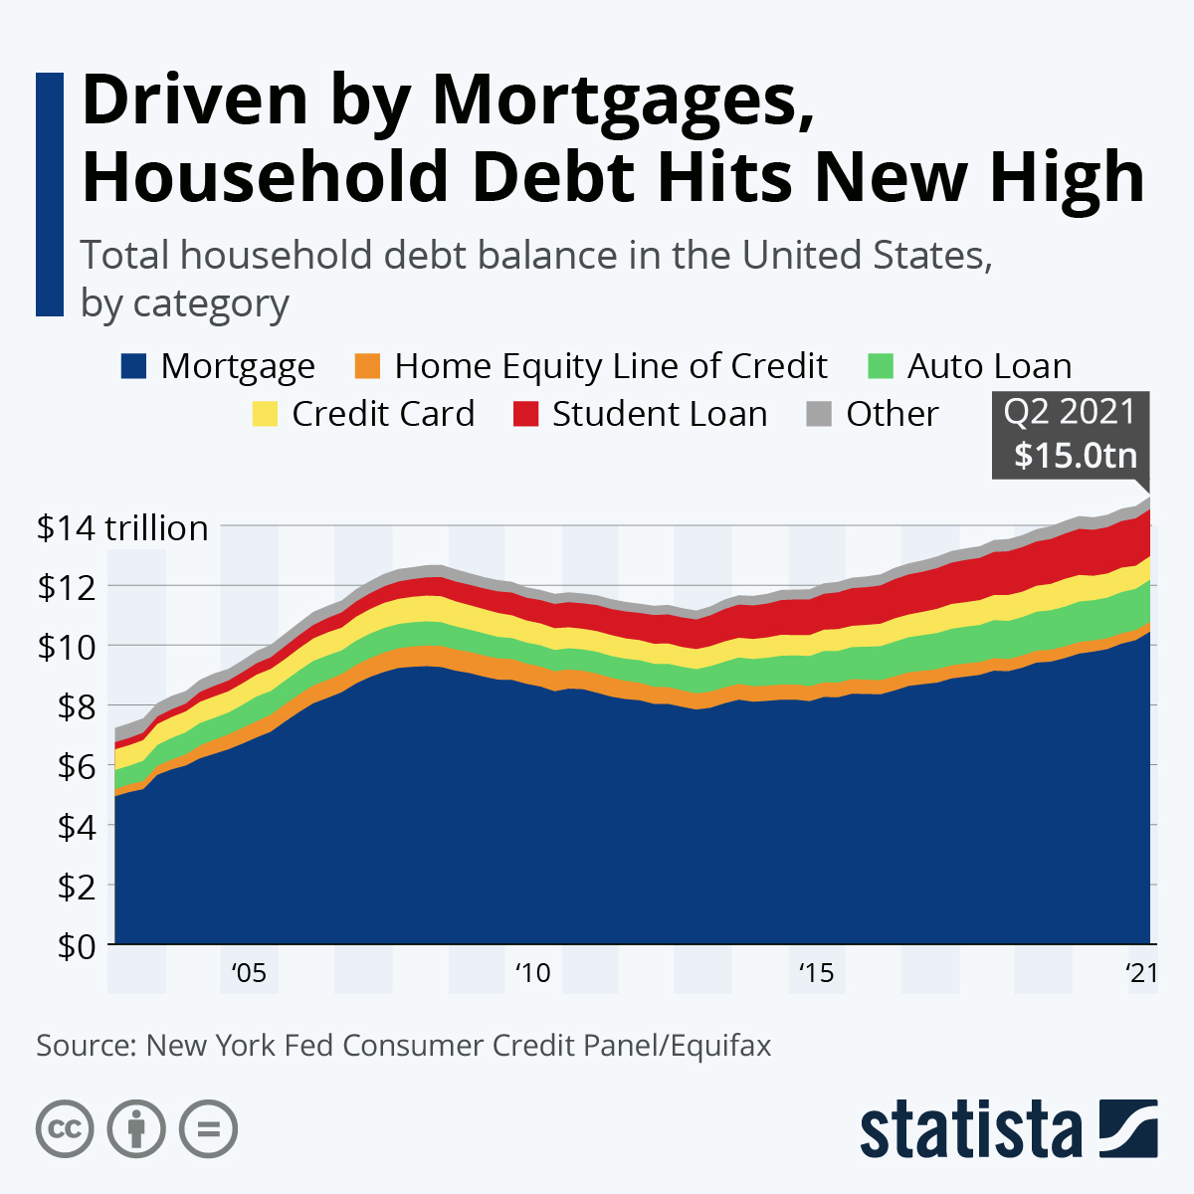
Notes:
As property prices resumed their climb after 2010, so did the aggregate mortgage loan debt of U.S. households. At the end of June 2022, the total reached $11.4 trillion. The average loan balance was around $220,400. However, the combination of amortization of loan principal and rising land values raised average home equity to $185,000.

Slide 22
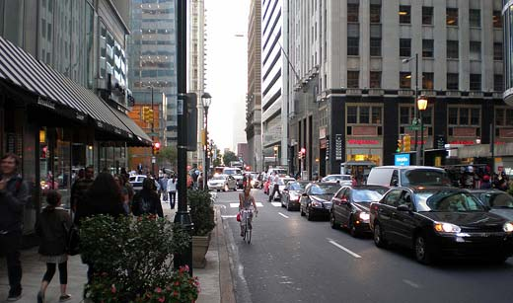
Notes:
As large as the value of residential property might seem, this value is but a small portion of the land value in the financial districts of our cities.

Slide 23
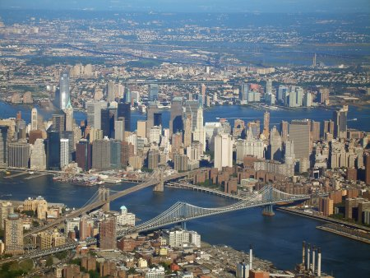
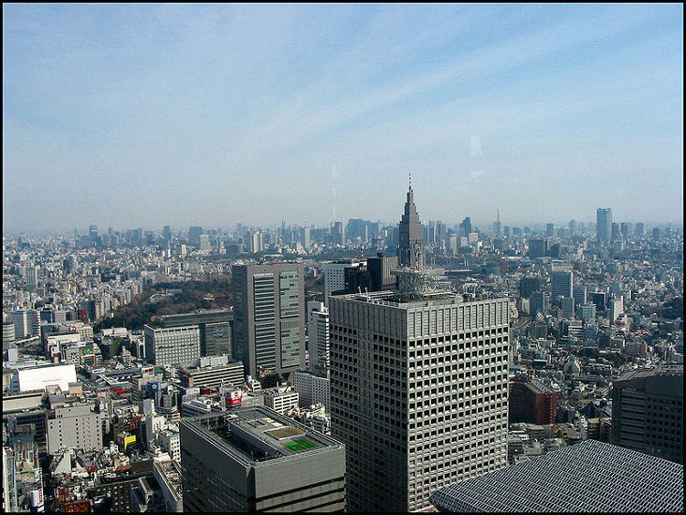
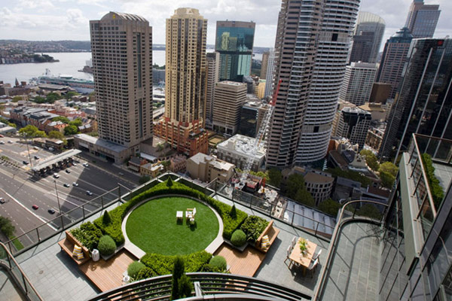
Notes:
The higher land values become, the higher we build to lessen the cost per square foot of the buildings we need for commerce and residences. Higher income individuals and high revenue businesses bid up the price for centrally-located property.

Slide 24
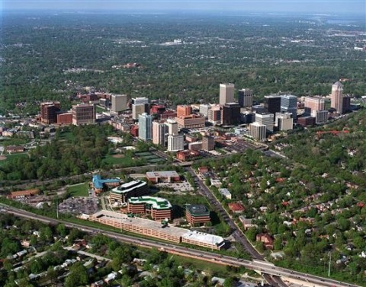
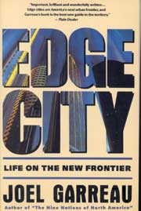
Notes:
Others are forced to the periphery or leave the region altogether in an effort to lower costs of living, costs of doing business and to protect profit margins. One result, as described by author Joel Garreau, is the creation of the “edge city.” When land prices threaten to absorb too much of the income of businesses and individuals, an economic crash – recession or depression -- is the result.

Slide 25
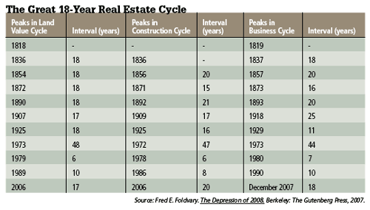
Notes:
Research by economics professor Fred Foldvary supported the direct correlation between property market cycles and the recurring experience of economic booms-and-busts.

Slide 26
Steve Hanke, Johns Hopkins University
Notes:
Professor Steve Hanke, at Johns Hopkins University commented on Fred Foldvary’s research as follows:

Slide 27
“These data talk, and the most interesting thing they say is that every 18 years we can expect the culmination of a credit-fueled real estate and ensuing business cycle. This, of course, doesn't imply that all recessions are preceded by a real estate cycle. It only says that all real estate cycles have spawned economic downturns. …”
Notes:
“These data talk, and the most interesting thing they say is that every 18 years we can expect the culmination of a credit-fueled real estate and ensuing business cycle. This, of course, doesn't imply that all recessions are preceded by a real estate cycle. It only says that all real estate cycles have spawned economic downturns. …”

Slide 28
“This knowledge has allowed for some prescient forecasts. The prize in that department goes to Prof. Fred Foldvary who wrote in 1997: ‘the next major bust, 18 years after the 1990 downturn, will be around 2008, if there is no major interruption such as a global war’."
Steve Hanke. “The Great 18-Year Real Estate Cycle,” Globe Asia. February, 2010
Notes:
“This knowledge has allowed for some prescient forecasts. The prize in that department goes to Prof. Fred Foldvary who wrote in 1997: ‘the next major bust, 18 years after the 1990 downturn, will be around 2008, if there is no major interruption such as a global war’."

Slide 29
END OF LECTURE 10

