Slide 1
Understanding our Political Economy

Slide 2
INSTRUCTOR
Edward J. Dodson, M.L.A.
email contact:
edod08034@gmail.com

Slide 3
LECTURE 12
The Current State of Land Markets

Slide 4
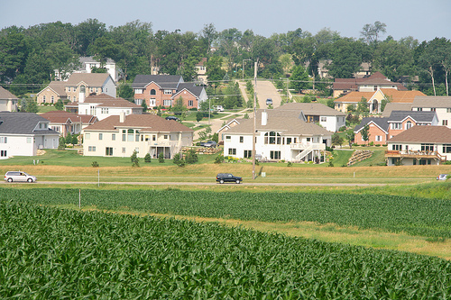
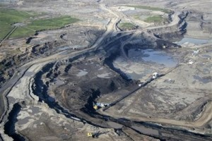
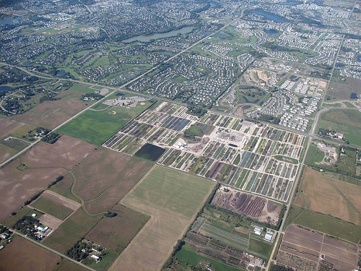
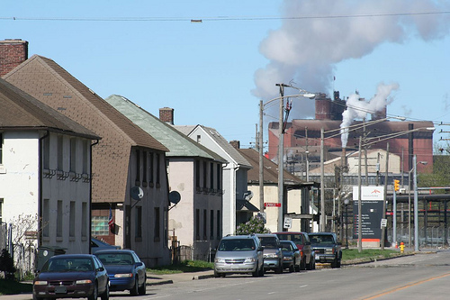
Notes:
There are many different types of land markets operating in any society. In every city and town there exists competing potential uses for land parcels, and these land uses change over time and with increases or decreases in population. Metropolitan regions include agricultural and resource-extraction lands competing with seemingly endlessly sprawling suburban development.

Slide 5
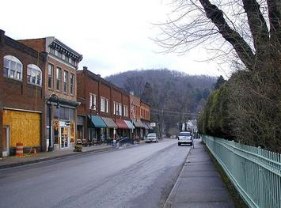
Notes:
Rural regions contain smaller population centers and an even greater variety of resource extracting activities, as well as parks and restricted-access preserves. And yet, the same dynamics operate to return rent – whether imputed or actually collected – to the individual or entity controling land.

Slide 6
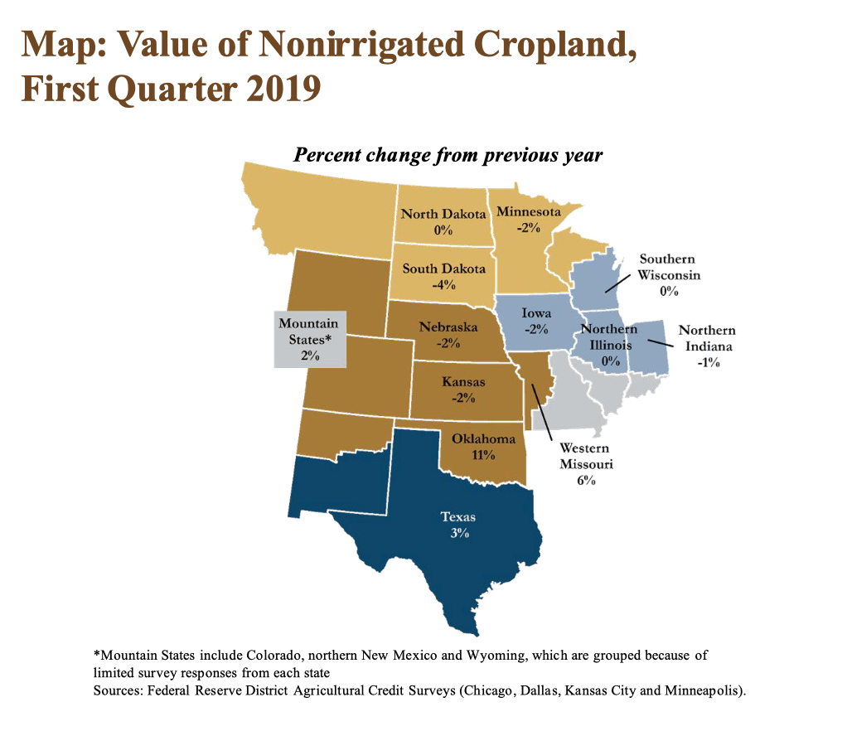
Notes:
The value of farmland comes from the fertility that nature provides, nurtured by adequate rainfall, temperate climate and other factors.

Slide 7
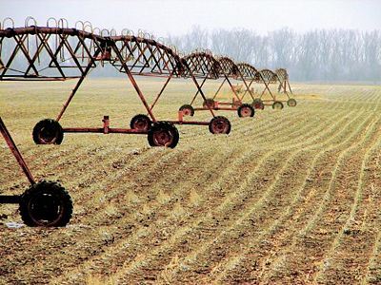
Notes:
Additionally, farmland’s rental value and selling price is also supported by public subsidies. For example, if government subsidizes the cost of bringing water to land for irrigation, the subsidy is capitalized by market forces into higher land prices. The difference between the full cost of delivering the water and what the farmer pays is, in effect, an imputed income stream to the farmer. One result is that the high cost of land is a huge entry barrier for young farmers, who are forced to take on high levels of debt.

Slide 8
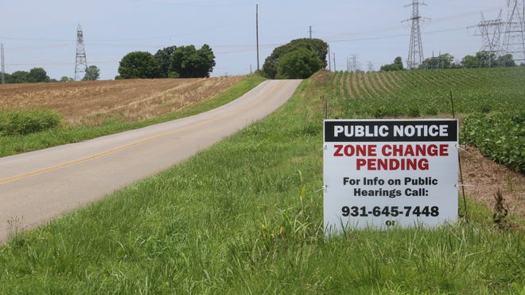
Notes:
As land prices in suburban communities close to cities climb, developers have a strong financial incentive to acquire outlying, agriculturally-zoned land and seek rezoning for development of housing or other uses.

Slide 9
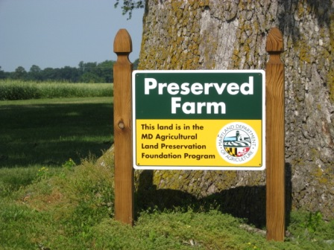
Notes:
To protect the existing land use, the public is frequently asked to approve bond funding in order raise the cash to purchase development rights from owners.

Slide 10
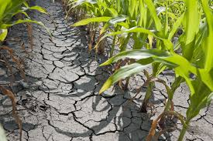
Notes:
Drought is a growing problem in parts of the United States. Flooding is the problem elsewhere. Seasonal changes in temperature ranges are creating further challenges for farmers. And, of course, banks located in the hardest-hit agricultural regions are exposed to potential heavy loan losses and insolvency. These are patterns that have repeated again and again.

Slide 11
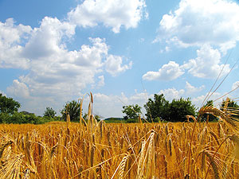
Notes:
Adequate water, natural fertility, overall weather, nearness of transportation to markets, and other variables all contribute to the value of agricultural land.

Slide 12
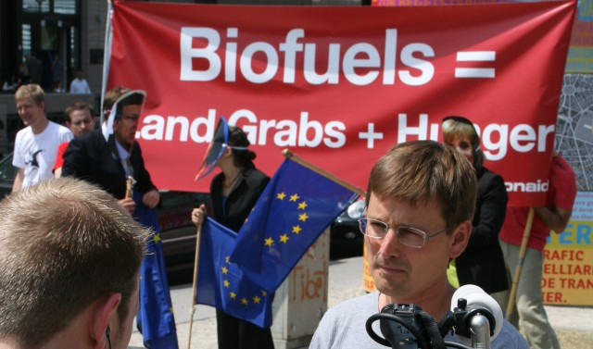
Notes:
Globally, private companies and investment managers have been acquiring quality agricultural land at a frantic pace. In January of 2012, a report issued by GRAIN, a small international non-profit organisation that works to support small farmers and social movements in their struggles for community-controlled and biodiversity-based food systems, explained:

Slide 13
“In the aftermath of the financial crisis, so-called alternative investments, such as infrastructure or farmland, are all the rage. Farmland itself is touted as providing a hedge against inflation. And because its value doesn't go up and down in sync with other assets like gold or currencies, it allows investors to successfully diversify their portfolios.”
Notes:
“In the aftermath of the financial crisis, so-called alternative investments, such as infrastructure or farmland, are all the rage. Farmland itself is touted as providing a hedge against inflation. And because its value doesn't go up and down in sync with other assets like gold or currencies, it allows investors to successfully diversify their portfolios.”

Slide 14
Neil Harl
Notes:
The importance of land value in the nominal statistics on individual wealth is pointed to by professor of agriculture and life sciences at Iowa State University, Neil Harl, :

Slide 15
“While U.S. land values have fluctuated in recent years, it is reasonably clear that investors in the United States (including producer-investors) are capitalizing part of the returns from commodity production into land values. It is equally clear that investors (including producer-investors) are capitalizing part of the expected government subsidy payments into land values. …”
Notes:
“While U.S. land values have fluctuated in recent years, it is reasonably clear that investors in the United States (including producer-investors) are capitalizing part of the returns from commodity production into land values. It is equally clear that investors (including producer-investors) are capitalizing part of the expected government subsidy payments into land values. …”

Slide 16
“... Likewise, it is empirically verifiable in virtually all metropolitan areas, certainly in all metropolitan areas that are expanding horizontally, that expected economic benefits from development are being capitalized into land values, well before the conversion in land use occurs.”
Neil E. Harl. “Competitiveness in Production of Agricultural Commodities: What Not to Consider”
Notes:
“Likewise, it is empirically verifiable in virtually all metropolitan areas, certainly in all metropolitan areas that are expanding horizontally, that expected economic benefits from development are being capitalized into land values, well before the conversion in land use occurs.”

Slide 17
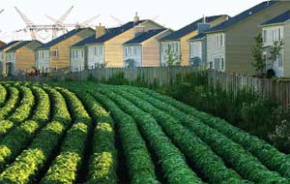
Notes:
And, in fact, one of the benefits of speculating in land zoned for agricultural use is the almost universally-low assessment of the land for tax purposes. Thus, developers are able to land bank with minimum drains on their cash flow or financial reserves.

Slide 18
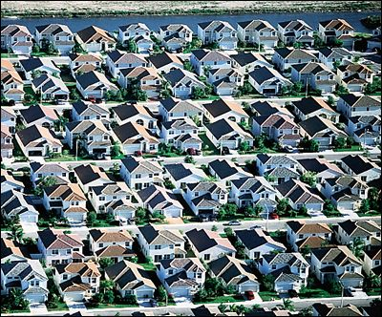
Notes:
Sprawling development also intensifies our human footprint on the earth, often altering or destroying the habitat of other species.

Slide 19
Notes:
Today, we are learning by experience that the loss of habitat for predators contributes to an explosion in the population of other very destructive and/or disease-carrying species.

Slide 20
Notes:
Even in our residential neighborhoods, a major problem shared by farmers is the disappearance of bees and other insects beneficial to plants.

Slide 21
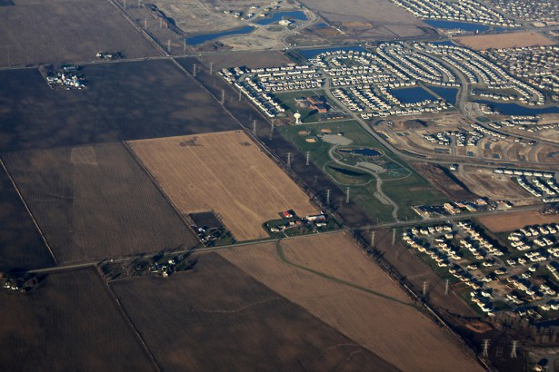
Notes:
More than 31 million acres of U.S. agricultural land have been lost to sprawling development since 1982. Another 175 acres of farm and ranchland are lost EVERY HOUR to make way for development.

Slide 22
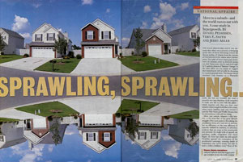
Notes:
A Brookings Institution senior fellow observed back in 1999 that there are many obstacles in the path of curbing sprawling development:

Slide 23
“Urban sprawl in the United States is also hard to slow, much less roll back, because numerous government policies actively encourage it. …Consider federal tax policy. ...”
Notes:
“Urban sprawl in the United States is also hard to slow, much less roll back, because numerous government policies actively encourage it. …Consider federal tax policy. ...”

Slide 24
“The current system hits earnings and savings, while interposing preferences for selected economic activities such as home-buying or the bond issues that finance new sports stadiums, industrial parks and malls. This blend of incentives frequently over-stimulates the exodus of population and jobs from central cities to outlying areas.”
Pietro S. Nivola. “Make Way for Sprawl,” The Washington Post, 1 June 1999
Notes:
“The current system hits earnings and savings, while interposing preferences for selected economic activities such as home-buying or the bond issues that finance new sports stadiums, industrial parks and malls. This blend of incentives frequently over-stimulates the exodus of population and jobs from central cities to outlying areas.”

Slide 25
Notes:
Among our most valuable natural resources are our forested lands. There are over 750 million acres of forest land in the United States. Some 18 million acres of forest was added between 1990 and 2020.

Slide 26
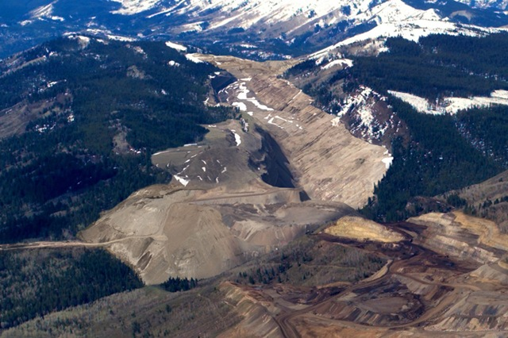
Notes:
Mining companies hold claims to 5.6 million acres of public land. Many paid less than $1 an acre for this land, or as little as $0.62 in yearly rental fees per acre. There are no provisions for payment to the federal government for gold, silver and other precious metals taken from public land. Nearly 200 companies control at least 10,000 public acres. Foreign companies hold 21% of the claims.

Slide 27
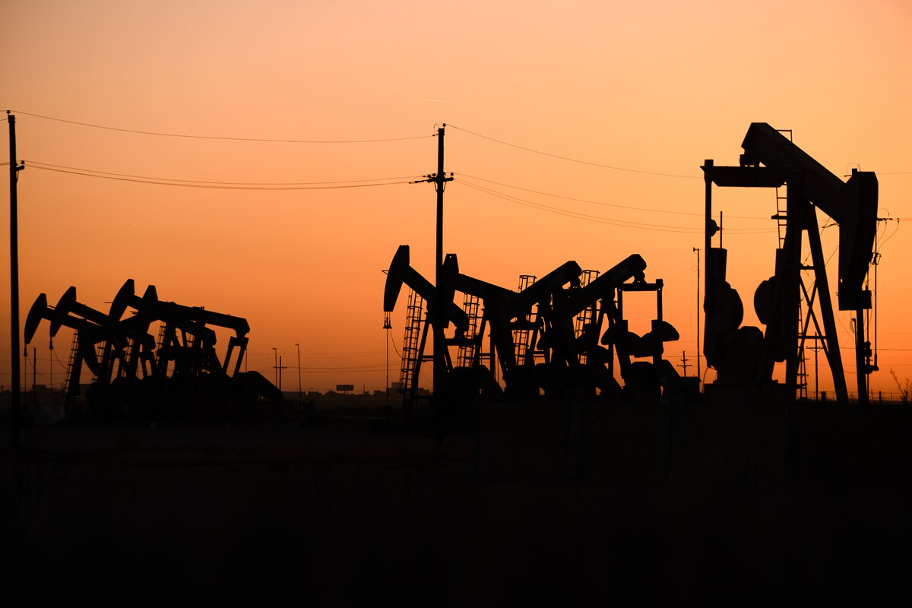
Notes:
Revenues from oil and natural gas leases on onshore federal lands totaled $4.2 billion in 2019. In 2022 the Department of the Interior announced that an additional 144,000 acres would be offered for lease, but at royalty fees more in line with higher rates charged by private landowners and states. One side-effect: the U.N. Intergovernmental Panel on Climate Change reported that drilling on federal land offshore is responsible for almost a quarter of the United States’ greenhouse gas emissions.

Slide 28
Mason
Gaffney
Fred
Foldvary
Nicolaus
Tideman
Notes:
A small number of economists, including those listed here, and others who seek change in the way government raises its revenue have attempted to calculate the total amount of rent from all sources that should be captured to pay for public goods and services – and, as is the case in Alaska, provide an income supplement to all citizens. Much of this proposed revenue has been privatized for generations. The list of the sources of rent is a long one, including:

Slide 29
Locations in our cities and towns – for businesses, residences and institutions
Agricultural land
Mineral, timber, grazing, and fisheries
The broadcast spectrum for television and radio
Internet domain names
Licenses that restrict competition (e.g., taxi services and liquor licenses)
Rights of way for utility lines, for routes taken by airplanes and for landing and takeoff time slots
Notes:
Locations in our cities and towns – for businesses and residences; agricultural land; mineral, timber, grazing, and fisheries; the broadcast spectrum for television and radio; internet domain names; licenses that restrict competition (for example, taxi services and liquor licenses); and rights of way for utility lines, for routes taken by airplanes, for landing and takeoff time slots.

Slide 30
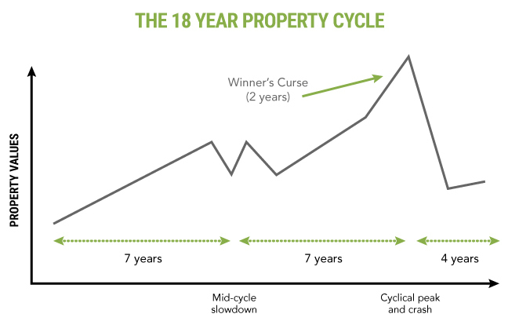
Notes:
The research by this small group of economists who embrace the methodology of the political economy, confirms that as the 18-year land market cycle comes closer to its peak, the signs are clear that a serious correction is coming.

Slide 31
Notes:
Owners of newly-constructed and nearly-completed office buildings compete for business tenants on the basis of superior amenities. As leases expire in older buildings, tenants decide to move into the new buildings even though the costs might be greater. If vacancy rates are high, business tenants may be able to negotiate a reduction in existing lease fees in return for a commitment to remain in place.

Slide 32
Notes:
To save facility costs, companies begin to move some functions to other, less costly locations – or out-source those functions completely to other, sometimes overseas, companies.

Slide 33
Notes:
At some point near the end of the land market cycle, businesses find profit margins beginning to fall. They begin to reduce staff and attempt to sublease office space no longer needed. The dominoes begin to fall in an unwelcome direction and more and more buildings face rising vacancy rates.

Slide 34
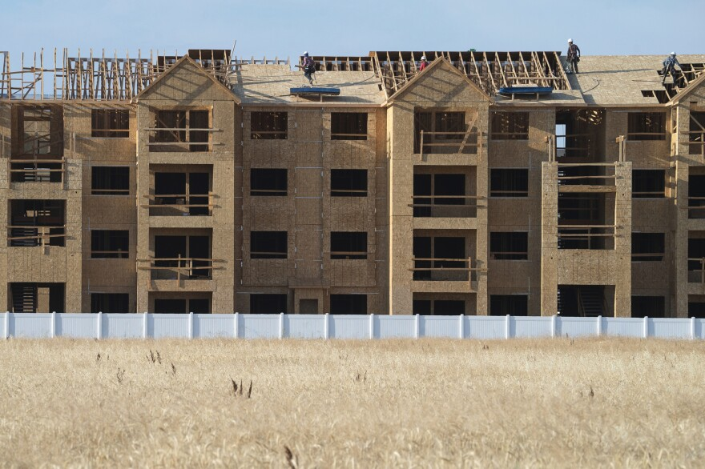
Notes:
Developers default on construction loans, turning over half-finished buildings to lenders at a time when buyers with strong financial positions are fewer and fewer and willing to pay far less than what the original owner paid for the tract of land and the cost to construct the building.

Slide 35
Notes:
Residential property markets have been unstable in the United States since the 1970s, when land prices began to increase faster than the household incomes of many Americans. Demand far outpaced supply as the millions of young adults began to form new households.

Slide 36
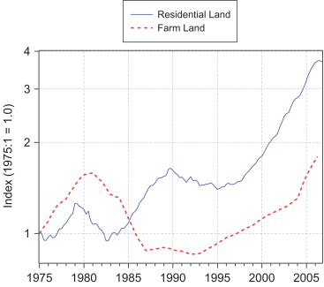
Notes:
As land and property prices inched upward and sometimes surged year after year, mortgage lenders and investors responded by lowering down payment requirements and adopting more flexible creditworthiness criteria. When accompanied by a reduction in interest rates or increases in household income, the result was for land markets to capitalize the windows of increased affordability into higher land prices. Note the dramatic rise in the price of residential land as the nation approached the 2007 financial and economic crisis.

Slide 37
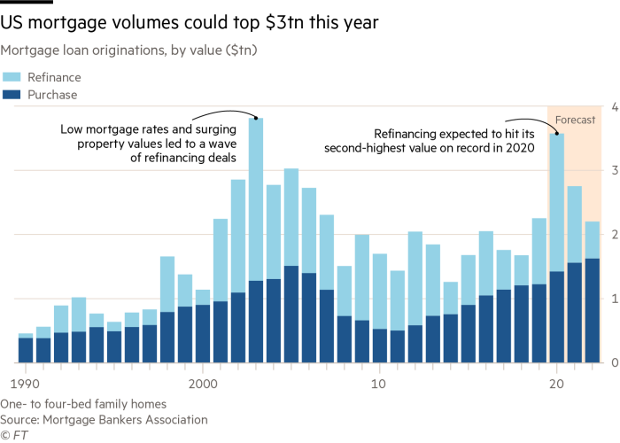
Notes:
In order to maintain transaction volume levels, even more innovations in financial terms were adopted by investors in mortgage loans. Adjustable rate mortgage loans and even interest only mortgage loans became commonplace. Then, beginning in 2010 the key driver was the continuous drop in mortgage interest rates, which triggered refinance volumes.

Slide 38
Notes:
As land prices have continued to climb and climb, one option offered to potential homebuyers is to separate ownership of the land parcel from the housing unit. The homeowners pays an annual fee to lease the land, owning only the housing unit. The obvious advantage is the much lower cash down payment and/or amount of mortgage debt to be carried. On the other hand …

Slide 39
Notes:
Owning residential land generally results over time in an increase in household net worth. While the housing unit depreciates while requiring ongoing expenditures for maintenance and major expenditures every decade or so for system replacement, land values almost always increase because of the tax advantages given to owning land.

Slide 40
END OF LECTURE 12

