Slide 1
Understanding our Political Economy

Slide 2
INSTRUCTOR
Edward J. Dodson, M.L.A.
email contact:
edod08034@gmail.com

Slide 3
LECTURE 14
Real World Experience with the
Taxation of Land’s Rental Value

Slide 4
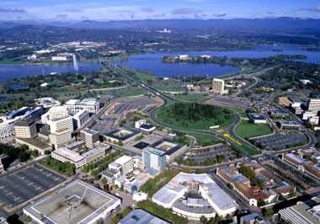
Notes:
From the time of Henry George’s campaigns around the world for the public collection of land rent, legislation has been adopted in some countries to achieve this objective. Australians, for a time, seemed on a path to the Single Tax. When the federal capital of Canberra was established, title to the city’s land was retained as public property, allocated to individuals and businesses under a leasehold arrangement.

Slide 5
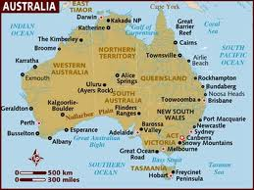
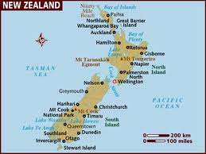
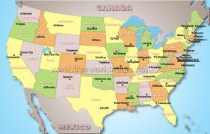
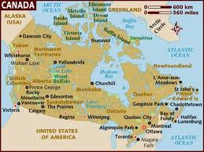
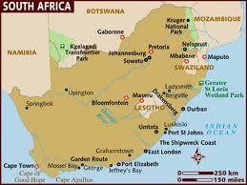
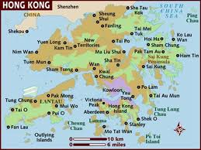
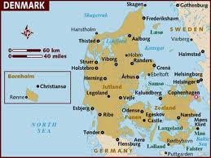
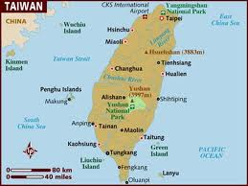
NEXT?
Notes:
In addition to Australia, Canada, Denmark, New Zealand, South Africa, Taiwan and the United States each have some degree of experience capturing rents via taxation. In the case of Hong Kong, all privately-developed land is leased by the province to private interests, the ground rents collected paying for public goods and services in lieu of taxes on buildings, income and commerce.

Slide 6
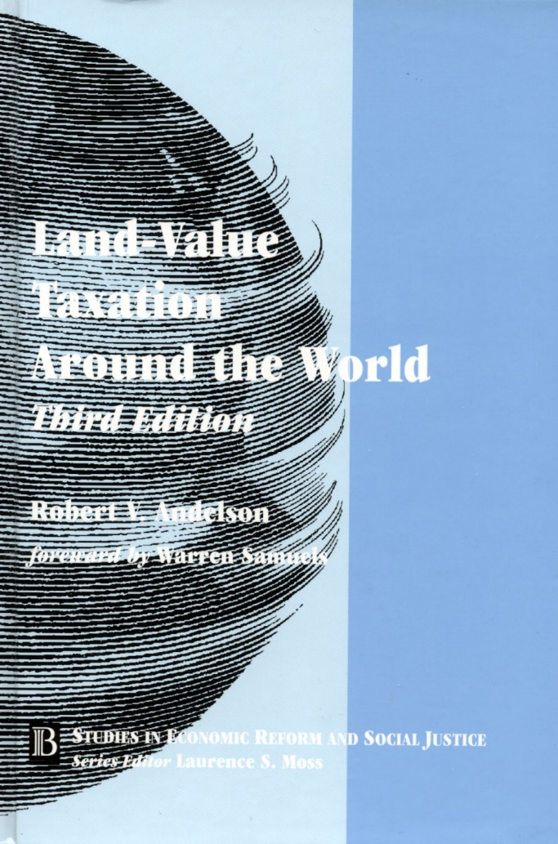
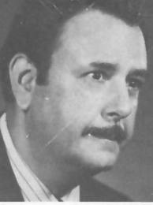
Notes:
The story of “Land Value Taxation Around the World,” has been captured in a volume edited by Auburn University professor of philosophy, Robert V. Andelson. This volume provides what is certainly the definitive analysis of the debates and struggles over how government ought to raise needed revenue. In the Introduction, Professor Andelson makes an extremely critical point regarding anticipated outcomes of the public collection of land’s rental value:

Slide 7
“Were a site’s rent to be socially appropriated in full for the foreseeable future, its capital or selling value would be extinguished, but the site would continue to bear non-speculative rent since its ability to do so is in no way affected by whether that rent be appropriated by society, on the one hand, or by a private owner, on the other.”
Notes:
“Were a site’s rent to be socially appropriated in full for the foreseeable future, its capital or selling value would be extinguished, but the site would continue to bear non-speculative rent since its ability to do so is in no way affected by whether that rent be appropriated by society, on the one hand, or by a private owner, on the other.”

Slide 8
Notes:
There have been a number of intentional communities created incorporating Henry George’s proposals, at least to some extent. Most of these intentional communities were organized with the land held in common and leased to individual members. One of the most successful, Fairhope, on Mobile Bay in Alabama, was founded 1894. Within a decade the community had grown in size to 4,000 acres.

Slide 9
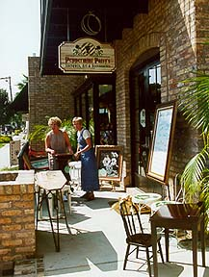
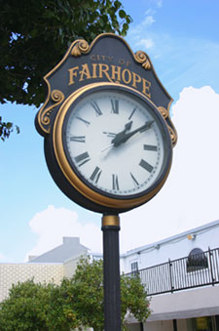
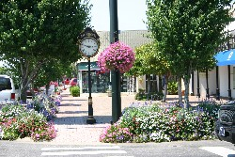
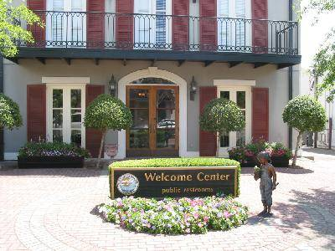
Notes:
There are today some 1,700 leaseholders, and the immediate area has a population of 17,000.

Slide 10
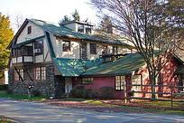
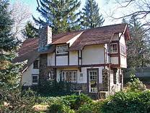
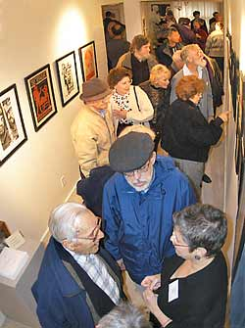
Notes:
Another enclave with a limited application of Henry George’s ideas was called “Free Acres, “ in New Jersey. Similar leasehold communities founded in the 1920s in Massachusetts and Maine, did not survive. Three small communities that have survived and prospered are the towns of Arden, Ardentown and Ardencroft, founded in 1900 on 300 acres of land near Wilmington, Delaware.

Slide 11
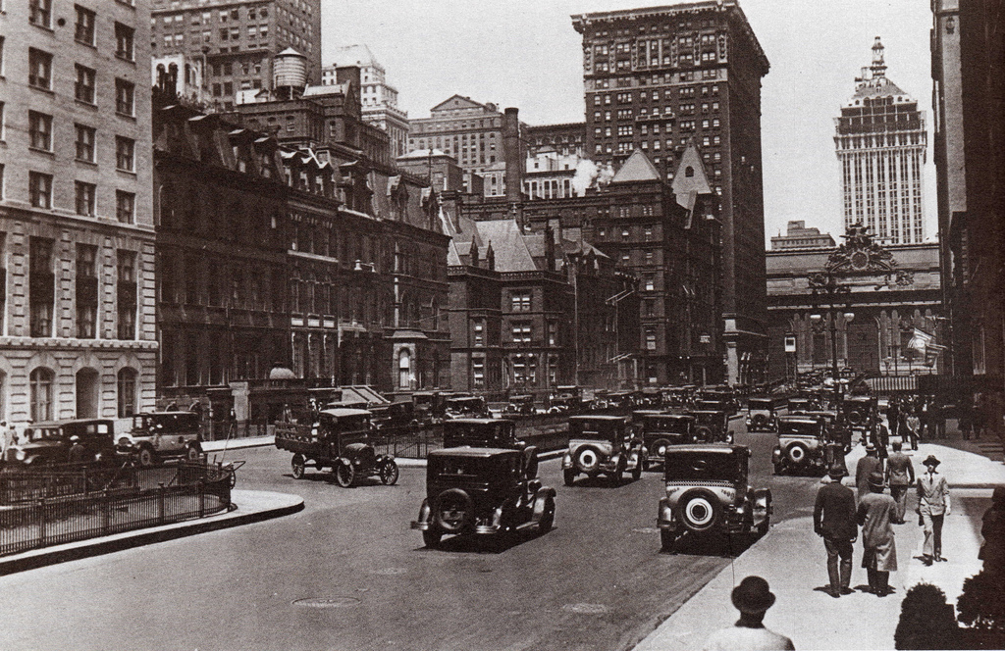
Notes:
In 1921, New York City exempted all new residential buildings from taxation. The exemption continued for ten years on each building. Only the underlying land parcels were subject to taxation. What followed was a significant building boom, with nearly $1 billion (over $13 billion dollars in today’s money) in new construction occurring during the period of exemptions, which were phased out after 1926.

Slide 12
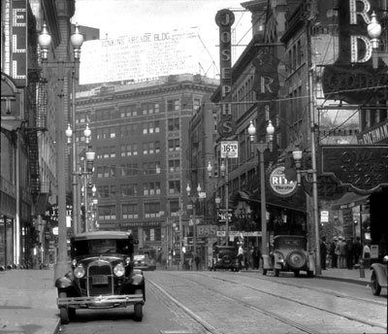
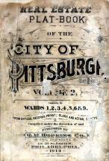
Notes:
What became known as the Graded Tax Law went into effect in the City of Pittsburgh on the first of January 1914, by which time the Department of Assessors had completed Pittsburgh’s first separate assessment of land and buildings as required by the act. Scranton, at the eastern end of Pennsylvania, also took advantage of the local option to adopt its own Graded Tax Law.

Slide 13
Notes:
Third-class cities in Pennsylvania were granted the same local option in 1951 as granted to Pittsburgh and Scranton. Twenty years ago, as a result of continued public interest work by the Philadelphia-based Center for the Study of Economics and other activists, the Pennsylvania legislature passed legislation extending local option authority for the two-rate property tax to boroughs and school districts as well.

Slide 14
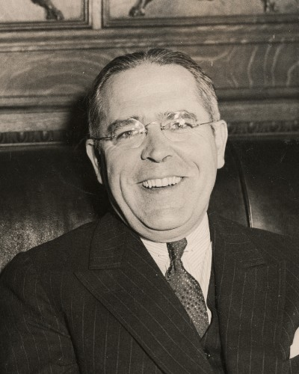
David L. Lawrence
Notes:
David L. Lawrence, served as mayor of Pittsburgh from 1946 through 1959, when he was then elected governor of Pennsylvania. Lawrence had this to say about the effects of the two-rate property tax on Pittsburgh:

Slide 15
“There is no doubt that the tax law has been a good thing for Pittsburgh. It has discouraged holding vacant land for speculation and provides an incentive for building improvements."
Notes:
"There is no doubt that the tax law has been a good thing for Pittsburgh. It has discouraged holding vacant land for speculation and provides an incentive for building improvements.“

Slide 16
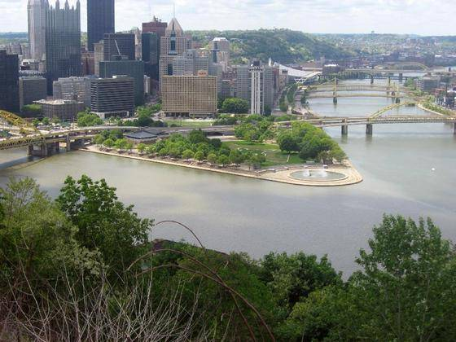
Notes:
By 1983, the rate of taxation on land values in Pittsburgh had been increased to 15.15%, the building tax rate reduced to 2.7%. Pittsburgh enjoyed high employment, stable housing costs, and a vital and improving downtown – despite the ongoing decline of the steel industry. In 1985, Rand McNally rated Pittsburgh as “America’s most livable city.” Unfortunately, all was not well under the surface.

Slide 17
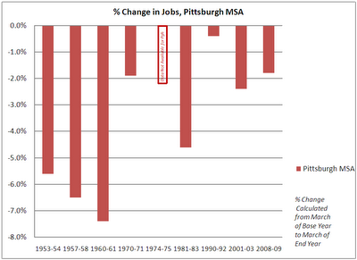
Notes:
Between 1980 and 1983, the Pittsburgh Region lost over 85,000 jobs – almost 1 out of every 10 jobs that existed at the time. More than half of that occurred in a single year; then, in March 1983, the region lost another 45,000 jobs, or 5.2% of what was already a diminished job base in 1982. That was more than double the rate of job loss nationally that year. The tax advantage given to property improvements by Pittsburgh’s city government could not overcome these regional problems.

Slide 18
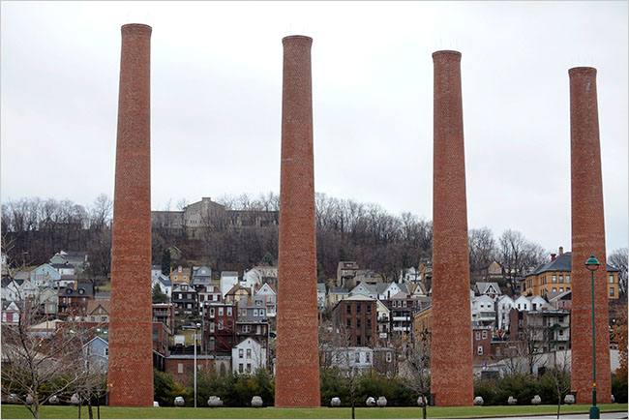
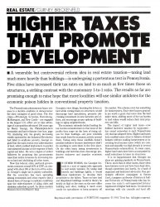
Notes:
In 1983, Fortune Magazine writer Gurney Breckenfeld, examined Pittsburgh’s experience with the two-rate property tax in an article titled “Higher Taxes That Promote Development.” The main message of the article was that given the modest effective level of the tax structure in Pittsburgh, the results were impressive and should be expanded.

Slide 19
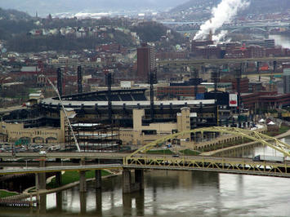
Notes:
Pittsburgh’s City Council was hard-pressed to raise needed revenue and was persuaded that the best way to do so was to increase the tax rate on assessed land values rather than increase the wage tax or taxes on already-stressed businesses. The move not only balanced the city’s budget but also stimulated additional investment in downtown development.

Slide 20
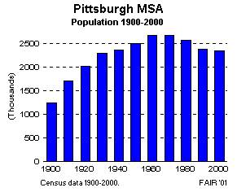
Notes:
For a variety of reasons, the entire Pittsburgh region continued to lose population, as occurred in many other northern industrial regions. In 1960, there were 2.4 million people in the metropolitan region, of which 604,000 lived in the city of Pittsburgh. Today, the region has a population of 2.3 million, but the population of Pittsburgh has fallen to around 310,000.

Slide 21
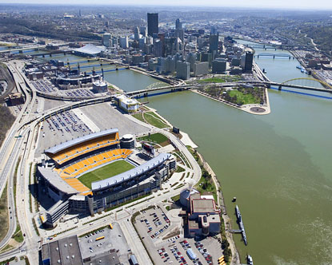
Notes:
Thus, a modest shift in the city’s property tax rates – noting that neither the school district nor the county followed the city in the move to a two-rate structure -- was not enough of a change in public policy to bring people back to live in the city or attract significant numbers of new residents. Civic leaders looked for other ways to revitalize the city, including the controversial public funding of new professional sports stadiums.

Slide 22
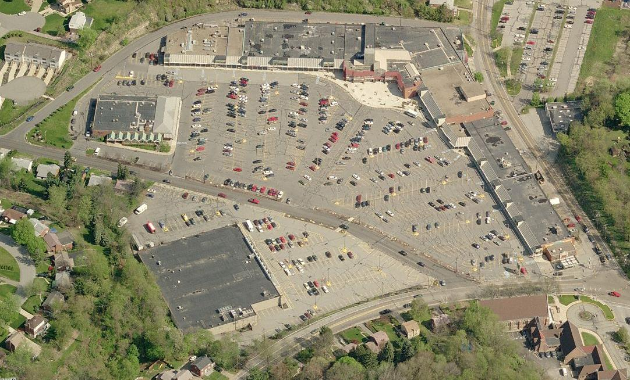
Notes:
The attractiveness of suburban tract housing on a quarter acre or larger land parcel continued to pull people to the farthest reaches of the region. Exempting buildings altogether from the tax base, while raising the rate of taxation on land values high enough to balance government budgets might have worked, but this option was not considered. One consequence has been the rapid spread of asphalt and sprawling development over the countryside.

Slide 23
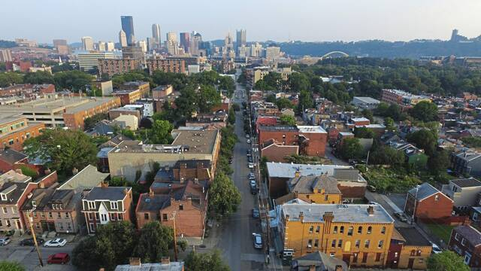
Notes:
The latest population statistics for the Pittsburgh metropolitan area reveal a continued decline, in part because the region’s population is older than either state or national averages. Even so, in 2019 Pittsburgh was named the third most livable city in the United States by an independent research organization.

Slide 24
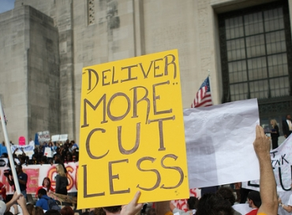
Notes:
When cities lose population, a significant portion of those who remain tend to be those less able to relocate and, therefore, at least somewhat dependent on receipt of public assistance. Where does the revenue come from? Cities try to increase the tax rate on real estate, they try to increase taxes on businesses, on tourists and on professional sporting teams and events. When these measures prove insufficient or ineffective, they lobby for revenue sharing from state and federal government.

Slide 25
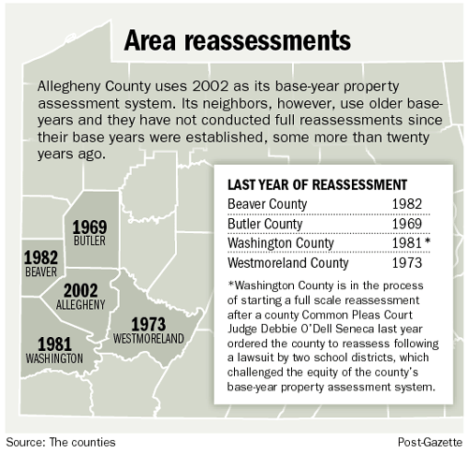
Notes:
During the late 1990s, Allegheny County officials were forced by court order to undertake a county-wide reassessment of property. Early in 2001, new valuations were issued on some 552,000 properties, resulting in an aggregate increase of 48% over previous assessments. The county had not updated assessments with current market data for nearly four decades. Despite the public outcry, many assessments were still well below full market value in some neighborhoods.

Slide 26
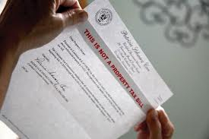
Notes:
The County Property Assessment Oversight Board was deluged with 90,000 appeals. This resulted in a second reassessment, which lowered the total increase to just 11%. However, even this second reassessment generated 90,000 new appeals. What then happened in the City of Pittsburgh was very unfortunate, but politically expedient.

Slide 27
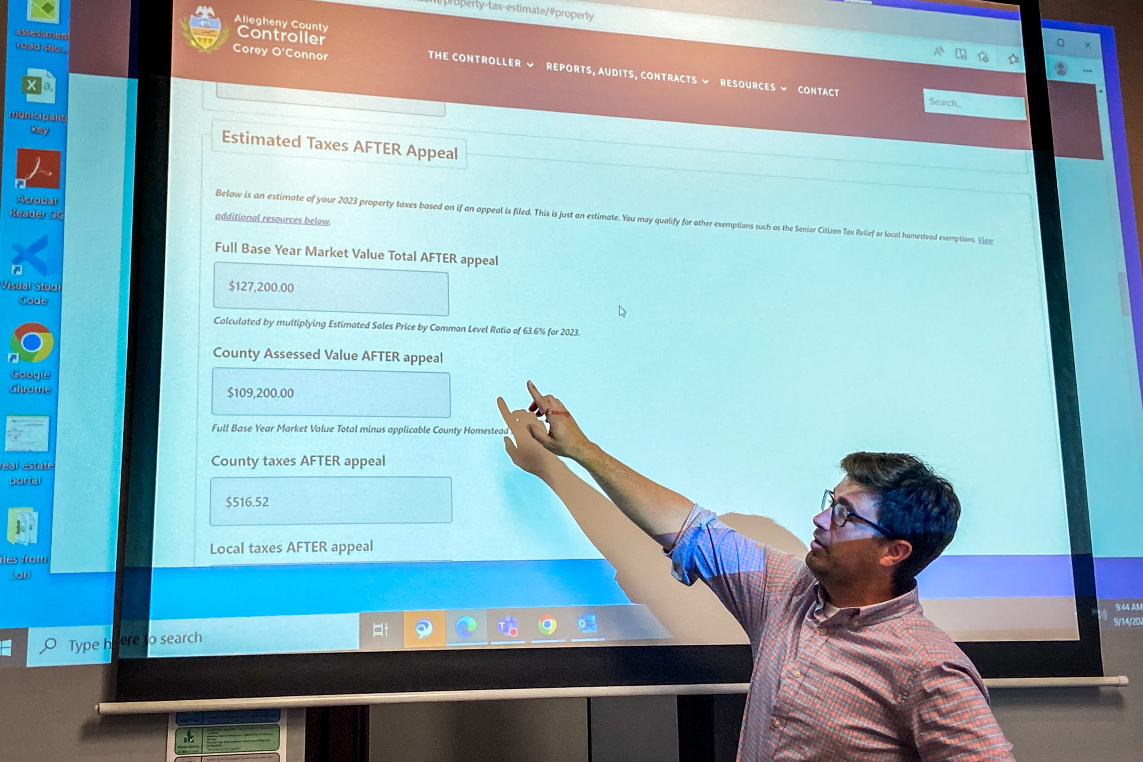
Notes:
When city residents received their new assessment notices, they discovered that the market value of their property values had increased by an average of 54 percent. The proportion of value assigned to land had risen from below 20 percent countywide to above 25 percent (still, in many cases, far below the market value of land), and the total market value of residential properties and their share of the total increased significantly. Citywide, land values nearly doubled, rising to $2.8 billion.

Slide 28
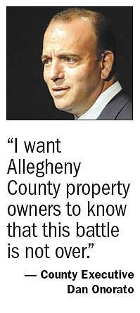
Notes:
The then County Executive, Dan Onorato, rallied to the cause of his fellow property owners, declaring: “I want Allegheny County proeprty owners to know that this battle is not over.”

Slide 29
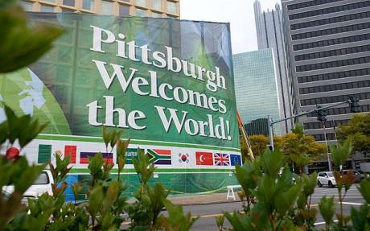
Notes:
As a result of the new county assessments, property values increased so much that the city was forced to slash the tax on land from 184.50 mills to 31.37 mills and the tax on improvements from 32 to 5.44 to comply with a state law that caps real estate tax revenue increases to 5 percent a year. In the process, the effectiveness of the two-rate property tax structure was significantly weakened.

Slide 30
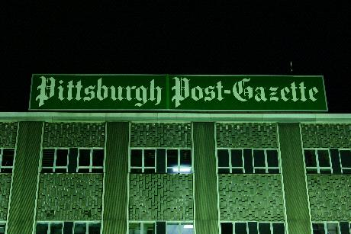
Notes:
Yet, critics found a high degree of inconsistencies in the new assessments. The Post-Gazette, Pittsburgh's main daily newspaper, found that properties with houses and lots selling for between $10,000 and $32,500 were assessed, on average, at 168 percent of their actual market value. The properties in neighborhoods occupied by higher income households were assessed either closer to or below actual market value.

Slide 31
Raymond L. Richman
Notes:
In 2002, Raymond L. Richman, professor emeritus of public and international affairs at the University of Pittsburgh, concluded:

Slide 32
“What we are dealing with here is gross incompetence in the assessment administration and/or arrogant disregard of the law.”
Raymond L. Richman. “The Reassessment,” Pittsburgh Tribune Review, professor emeritus of public and international affairs at the University of Pittsburgh. 7 April, 2002
Notes:
“What we are dealing with here is gross incompetence in the assessment administration and/or arrogant disregard of the law.”

Slide 33
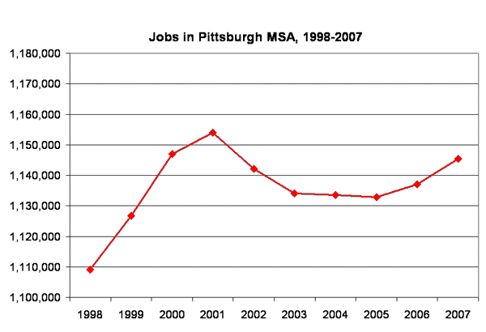
Notes:
Faced with public outrage over new property assessments, Pittsburgh’s elected officials -– in a decision designed to quiet the public -- abandoned the two-rate property tax structure. The return to a single-rate form of property tax only worsened a bad situation. Land owners (and land speculators) were rewarded with reduced taxes. Owners of commercial and retail buildings were penalized with higher taxes. Businesses began to leave the city, often leaving the region as well.

Slide 34
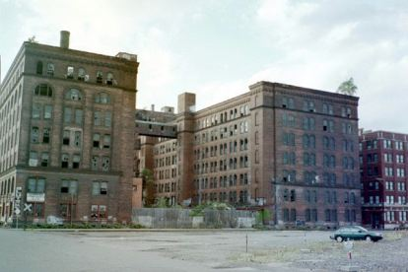
Notes:
The effect of this rescission was to lower the amount of tax revenue derived from land value; however, the overall rate had to be increased to meet budgetary needs. Most residential and business property owners ended up with higher tax burdens than under the two-rate approach, while owners of vacant and underutilized land parcels were rewarded.

Slide 35
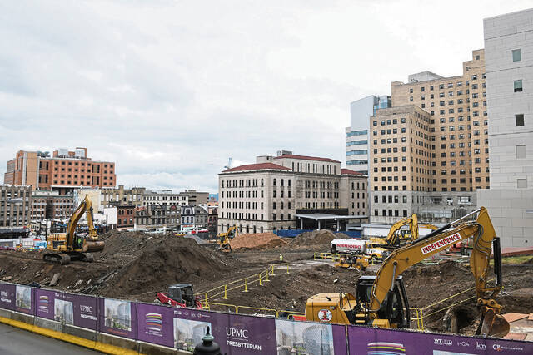
Notes:
Almost immediately, construction activity fell.

Slide 36
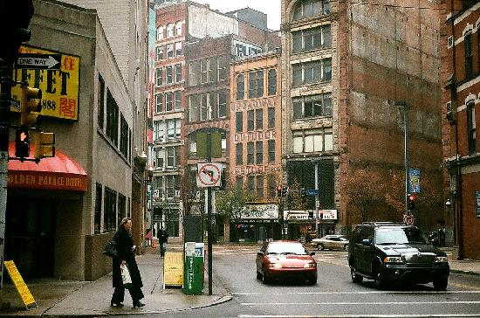
Notes:
Interestingly, as many other cities fell victim to recession, Pittsburgh did somewhat better. For one thing, according to the city’s controller, Michael Lamb, Pittsburgh “never had a housing crisis.” Foreclosures were much lower than in many other cities, and residential property prices remained “relatively stable” – at affordable levels, a legacy of the two-rate property tax.

Slide 37
Notes:
Another positive factor was that PNC Financial, the dominant bank in the region, avoided exposure to derivatives and high-risk mortgage-backed securities and thereby weathered the national recession better than many other financial institutions. And, in fact, PNC invested in new construction in downtown Pittsburgh.

Slide 38
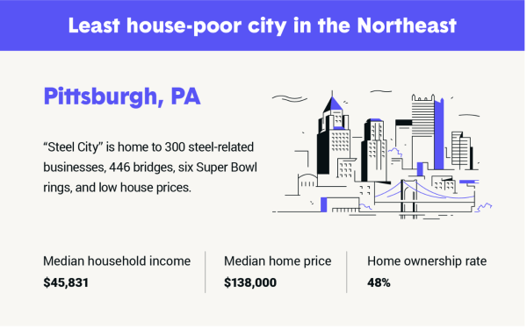
Notes:
The population of Allegheny County has rebounded during the last decade, increased by more than 27,000 new residents. Fueled by record low mortgage interest rates, property prices climbed upward. The median price of an existing single-family property in January of 2022 was $240,000, falling to $224,900 in January of this year. Property values in the City of Pittsburgh rose an average of 3.5 percent each year during the 2012-2022 period. Even so, the cost of living is reported to be 13 percent below the national average.

Slide 39
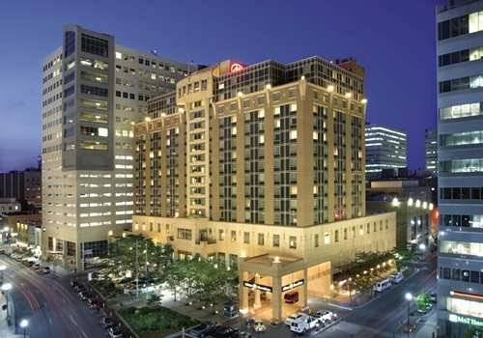
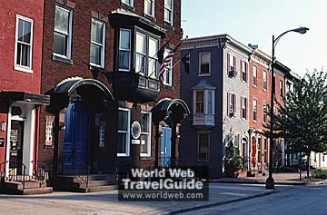
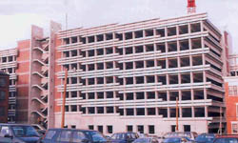
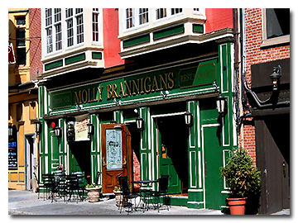
Notes:
Despite what happened in Pittsburgh, a growing list of Pennsylvania cities have continued to move along the two-rate property tax path. Harrisburg, the state capital, is one of the cities with significant experience. The city (but not the school district or county) today taxes assessed land values at a rate six times higher than that applied to improvement values.

Slide 40
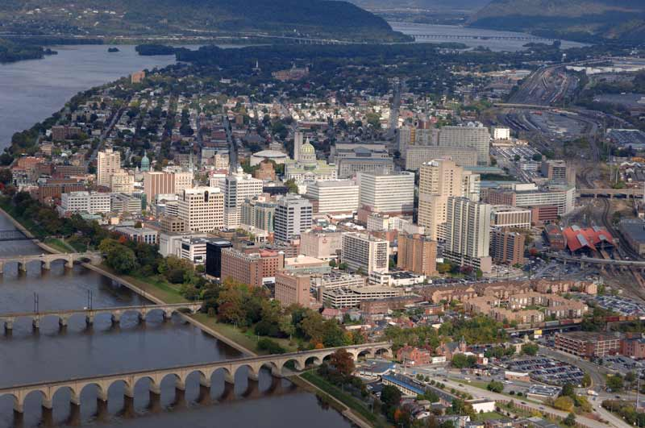
Notes:
Harrisburg was described 20 years ago as the second most distressed city in the nation. Over the next two decades, with continuous increases in the tax rate on land values, the city attracted over $3 billion in new investment.

Slide 41
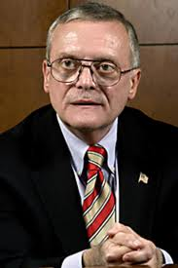
Stephen R. Reed
Notes:
Harrisburg’s former Mayor, Steven Reed, considers the two-rate property tax structure an important component to the city’s overall management. A few years before leaving office at the end of 2009, he stated:

Slide 42
“Harrisburg continues in the view that a land value taxation system, which places a much higher tax rate on land than on improvements, is an important incentive for the highest and best use of land ... and continues to be one of the key local policies that has been factored into this initial economic success here.”
Notes:
“Harrisburg continues in the view that a land value taxation system, which places a much higher tax rate on land than on improvements, is an important incentive for the highest and best use of land ... and continues to be one of the key local policies that has been factored into this initial economic success here.”

Slide 43
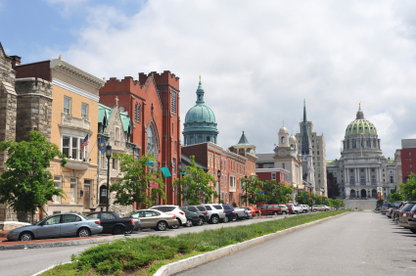
Notes:
Harrisburg’s relatively low rate of taxation on property improvements and high rate on land values is certainly a factor in the city’s residential property market. Property prices in Harrisburg have been far more stable in recent years than in Pennsylvania as a whole, and much more stable – at a lower median price – than the nation.

Slide 44
Notes:
However, an unfortunate decision by city officials to issue bonds to construct a major trash incinerator, a project that did not go as planned, placed Harrisburg’s financial stability in jeopardy.

Slide 45
Wanda R.D. Williams
Notes:
The current mayor, Wanda Williams, has identified the building of new affordable housing units and modernizing the city’s aged sewer and stormwater systems as top priorities. Harrisburg’s two-rate property tax structure is one of the city’s fiscal assets.

Slide 46
Notes:
The Collingswood, New Jersey-based Center for the Study of Economics today performs detailed studies for cities on the potential impact of changing to a two-rate property tax on all categories of property owners. CSE President Joshua Vincent and his team are working with officials and civic leaders in cities, boroughs and school districts in Pennsylvania, Virginia, Maryland, Connecticut and other states to examine the benefits of the two-rate system.

Slide 47
END OF LECTURE 14

