Slide 1
Understanding our Political Economy

Slide 2
LECTURE 15
Improving How Government Raises Revenue

Slide 3
Notes:
One of the great tragedies of modern civilizations is that governments everywhere obtain most revenue from sources that should not be taxed or taxed very lightly. This brings us back to the effect of taxation on each of the three factors of production: land, labor and capital goods.

Slide 4
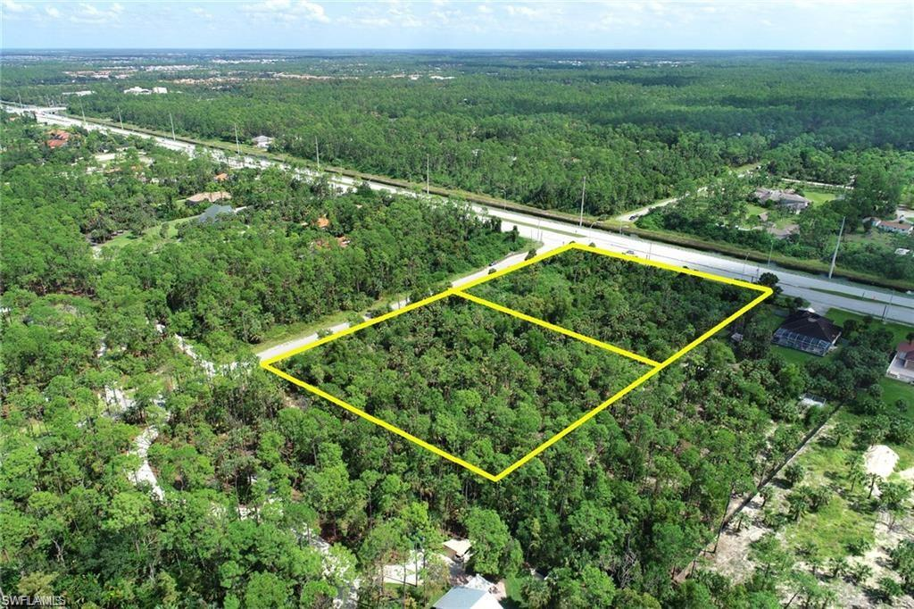
Notes:
Land is a factor of production with characteristics quite distinct from those of labor, capital goods or even credit. Public policy must recognize these distinctions by implementing the societal capture of the differences in output that comes from the advantage gained by control of some parts of nature over other parts of nature. This output is rent.

Slide 5
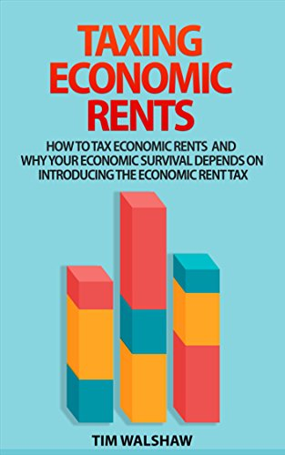
Notes:
As the subject of this book by Tim Walshaw argues, our economic survival depends on the taxation of economic rents.

Slide 6
“TAXES ON ECONOMIC RENTS are considered by economist to be an ‘ideal’ tax. That means that there are no distortions when the tax is applied. The currently applied taxes have distortions that shift the burden of the tax onto the economically weak, reduce investment, reduce growth, increase unemployment, and apply an invisible ‘tax on tax’ that reduces the possible amount of tax revenue can be raised. …”
Notes:
“TAXES ON ECONOMIC RENTS are considered by economist to be an ‘ideal’ tax. That means that there are no distortions when the tax is applied. The currently applied taxes have distortions that shift the burden of the tax onto the economically weak, reduce investment, reduce growth, increase unemployment, and apply an invisible ‘tax on tax’ that reduces the possible amount of tax revenue can be raised. …”

Slide 7
“Economic rent taxes are free of these harmful effects. From the age of the Pharaohs bad tax design has repeatedly led to economic collapse, civil wars and total disaster. Economic rent taxes could prevent this happening again.”
Notes:
“Economic rent taxes are free of these harmful effects. From the age of the Pharaohs bad tax design has repeatedly led to economic collapse, civil wars and total disaster. Economic rent taxes could prevent this happening again.”

Slide 8
Notes:
We have learned the reasons why Henry George’s crusade to remove all taxation save that on land’s rental values failed to become the law of the land. Today, our society – every society – taxes nearly every person’s income, nearly every exchange of goods and services, and nearly every form of property and asset. These are heavy burdens on the kinds of activities and assets we need and ought to encourage.

Slide 9
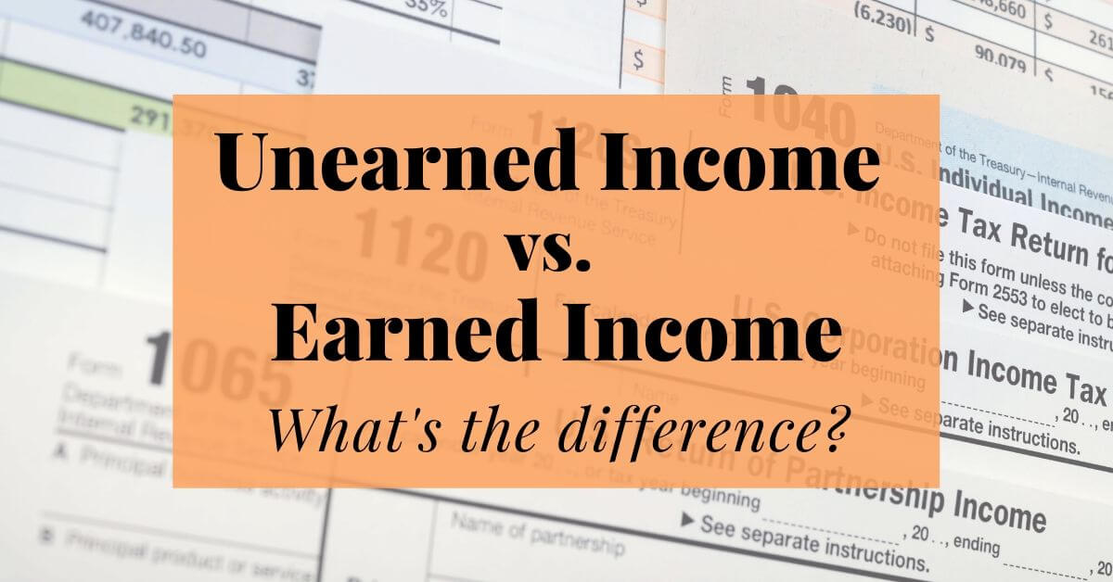
Notes:
Tax laws make almost no distinction between income that is “earned” – by actually producing goods and providing services – and “unearned” – obtained by speculation in land, natural resources, financial instruments and other legal claims on property.

Slide 10
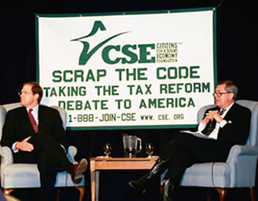
Notes:
There have been a number of proposals to restructure the individual income tax, the most common being an attempt to combine tax simplification with equalization as a percentage of income. The calls are for a “flat tax.” Critics argue that a flat tax is regressive. More significantly, it would leave untaxed the huge amount of income that is rent, that is speculation-derived and is unearned.

Slide 11
Notes:
For the year 2022, all federal revenue from the income tax came from 60 percent of U.S. households. This indicates that the income tax is progressive; however, within the tax code are many provisions that allow very high income individuals to escape paying much if any tax.

Slide 12
Notes:
A simplified but progressive tax structure would shift the burden of taxation more heavily onto unearned income flows, a high percentage of which is rent-derived.

Slide 13
Notes:
The heart of this proposal is that all individual incomes up to the national median (or state median in states that tax income) would be exempt from taxation. There would be no other exemptions or deductions permitted.

Slide 14
Notes:
So, what should reform of the income tax look like?

Slide 15
FIRST: Exempt all individual incomes up to the national median
Notes:
The first change I propose is to exempt all individual incomes up to the national median. The national median is well above the poverty level, but is still a very modest income. Assume an individual median income of $54,000 – close to the number in 2022.

Slide 16
There would be no other exemptions or deductions under the tax code
All individual incomes up to $54,000 would be exempt from taxation
Notes:
All incomes up to $54,000 would be exempt from taxation. There would be no other exemptions or deductions under the tax code.

Slide 17
Individuals with special hardships would apply for assistance from the appropriate social welfare agencies
Above $54,000 higher ranges of income would be taxed at increasing rates – sufficient to balance the federal budget
Notes:
Individuals with special hardships would apply for assistance from the appropriate social welfare agencies. Above $37,500, higher ranges of income would be taxed at increasing rates, sufficient to balance the federal budget.

Slide 18
Congress would set the tax rates and ranges of income subject to each rate
This would be done as part of the budgeting process
An objective would be to raise sufficient revenue to balance the budget
The national debt would be gradually retired
Notes:
The U.S. Congress would have to determine the tax rates and ranges of income subject to each rate as part of the budgeting process, ideally with the objective of raising sufficient revenue to balance the budget. Again, this revenue objective would include funds to begin repayment of the nation’s outstanding debt. For purposes of example, let’s assume the progressivity of rates would be as follows:

Slide 19
Notes:
This would be accomplished in a generation by refunding all maturing government bonds with fully amortizing bonds that return both interest and principal to investors. An alternative does exist (with a high degree of risk). That is for the U.S. Treasury to issue currency and use this new currency to pay off bond holders.

Slide 20
The income ranges and tax rates might look as follows. For incomes:
Greater than $54,000 up to $100,000: 5%
Greater than $100,000 up to $150,000: 10%
Greater than $150,000 up to $300,000: 15%
Greater than $300,000 up to $500,000: 20%
Notes:
Here, for purposes of example only, is how the now structure might work. Above $54,000 up to $100,000, the rate would be 5%; above $100,000 up to $150,000, 10%; above $150,000 to $300,000, 15%; above $300,000 up to $500,000, 20%.

Slide 21
Notes:
These modest rates of taxation cover the overwhelming majority of taxpayers in the United States who earn the great majority of their incomes by economically-productive activities – producing goods or providing services. Above this level, almost all incomes are derived from passive investment activity and from speculation in the stock, bond and commodities markets, in precious metals, in property, and in land.

Slide 22
For incomes:
Greater than $500,000 up to $1 million: 25%
Greater than $1 million up to $5 million: 30%
Greater than $5 million up to $10 million: 35%
Greater than $10 million up to $25 million: 40%
and so on…
Notes:
Above $500,000 up to $1 million, 25%; above $1 million up to $5 million, 30%; above $5 million up to $10 million, 35%; above $10 million up to $25 million, 40%, and so on. Depending on revenue needs, the Federal government may need to return to the highest marginal tax rates in effect up until the late 1970s.

Slide 23
Notes:
There would be no special rates applied to income derived from the sale of assets (so-called “capital gains”), for one simple reason: actual capital goods rarely sell for more than their cost of acquisition. Capital goods depreciate over time. What is today called a “capital gain” is almost always a gain derived from rent-seeking speculation in financial and other markets.

Slide 24
Notes:
If we are to continue to raise revenue by taxing business entities, then a similar graduated tax structure could be implemented to encourage both job-creation and efficiency.

Slide 25
Exempt small businesses from the tax base
Replace the business profits tax with a low, graduated rate of taxation on gross revenue
Notes:
Inasmuch as most new jobs are created by small businesses with stronger ties to the communities in which they operate, we ought to encourage small businesses by exempting them from taxation to a great extent. One way to achieve this objective is to abandon the business profits tax in favor of a low, graduated rate of taxation on gross revenue. Again, as an example of how this progressive structure would work:

Slide 26
Business revenue up to, say, $500,000, would be exempt from taxation
Revenue greater than $500,000 up to $2,000,000 would be taxed at 1%
Revenue greater than $2,00,000 up to $5 million would be taxed at 1.5%
Revenue greater than $5 million up to $25 million would be taxed at 2.0%
And so on…
Notes:
Again, for purposes of example, business revenue up to, say, $500,000, would be exempt from taxation; revenue greater than $500,000 up to $2,000,000 would be taxed at 1%; revenue greater than $2,00,000 up to $5 million would be taxed at 1.5%; revenue greater than $5 million up to $25 million would be taxed at 2.0%; and so on…

Slide 27
Notes:
Other than the basic exemption of the first $500,000 in revenue, there would be no other deductions for expenses incurred. This would mean that efficient businesses with lower expenses per unit of revenue would be rewarded with higher profits. Companies would no longer be able to expense the compensation packages awarded to executives, eliminating the existing benefit of passing the costs onto other taxpayers.

Slide 28
TAX RELIEF
For
PEOPLE WHO PRODUCE GOODS and
PROVIDE SERVICES
Notes:
It is important to remember that the above analysis is merely an example based on arbitrary rates applied to these ranges of individual and business income. My own hope is that because the highest incomes are, by the definition I have provided, unearned, that the highest marginal tax rates would be set a good deal higher. To make the structure even more progressive, the amount of income exempted could be set at 150% or 200% of the national median. Two-income households would experience significant increases in disposable income, remembering, however, that they would continue to be subject to city and state taxes in income.

Slide 29
Who Owns the Planet?
Who Captures the Rent?
It’s Only MONOPOLY!
Notes:
Forbes magazine reports that the wealth of America’s 735 billionaires increased from $1.9 trillion in 2011, to a combined total of $4.7 trillion. Elon Musk is reported to be the wealthiest person in the world.

Slide 30
END OF LECTURE 15

