Slide 1
Understanding our Political Economy

Slide 2
INSTRUCTOR
Edward J. Dodson, M.L.A.
email contact:
edod08034@gmail.com

Slide 3
LECTURE 16
Private Leasing of Public Lands

Slide 4
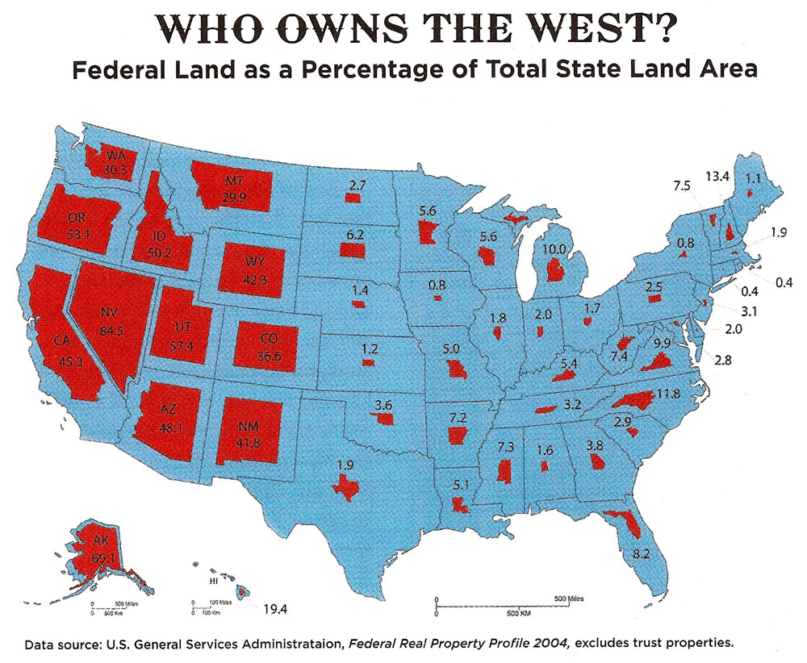
Notes:
Another important additional source of revenue could come from competitive bidding for the leasing of public lands by private individuals and interests. At present, leases are awarded under conditions that seldom yield to us – the public -- the full market rental value of the lands in question. Speculators frequently obtain leases with the expectation of selling their leasehold interest for a profit.

Slide 5
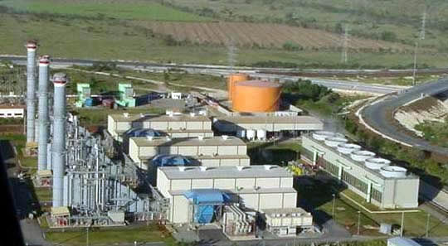
Notes:
One current example of the problem is Cogentrix Solar Services, a subsidiary of Goldman Sachs. Cogentrix has no experience in the development solar energy but holds leases on nearly half the Nevada acreage for which applications have been filed.

Slide 6
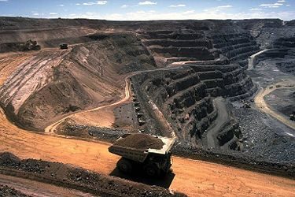
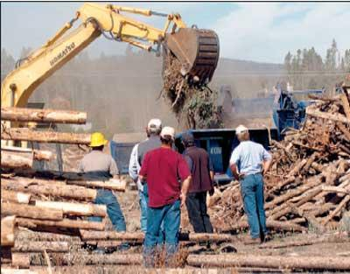
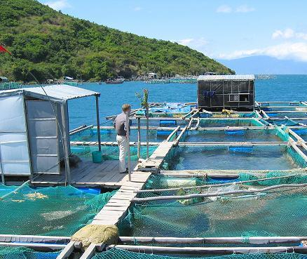
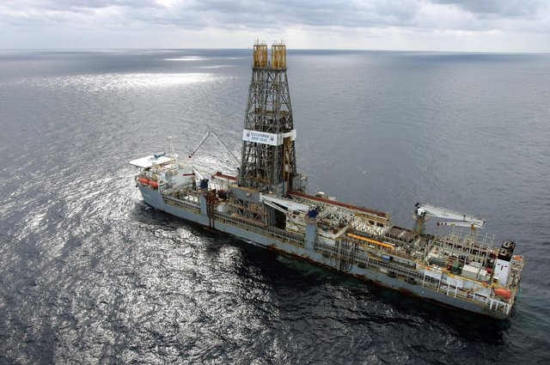
Notes:
Today, six percent of total U.S. oil production and 8 percent of natural gas production comes from federal lands. Leases are auctioned, and the government sets a reserve price that specifies the lowest acceptable bid. Critics have shown that the terms of these leases are not delivering a fair return to taxpayers. The Biden administration has at least taken some steps to lift leasing fees to the level charged by states and private landowners.

Slide 7
END OF LECTURE 16

