Slide 1
Understanding our Political Economy

Slide 2
INSTRUCTOR
Edward J. Dodson, M.L.A.
email contact:
edod08034@gmail.com

Slide 3
LECTURE 17
Vision for a New Future
Notes:
Now, let’s explore what the future might look like if the measures proposed are actually adopted.

Slide 4
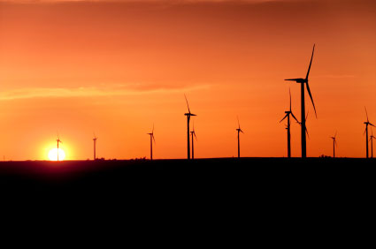
Searching for the Just Society
Notes:
Ideally, the real value of studying political economy is the process of discovering a system of socio-political arrangements and institutions that promises a just society. As we have learned, economists – with notable exceptions -- are not necessarily the best guides.

Slide 5
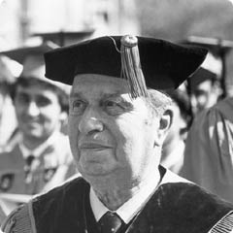
Mortimer J. Adler
Notes:
In addition to the analysis provided by Henry George, one of the most insightful modern era philosophers we can turn to is Mortimer J. Adler.

Slide 6
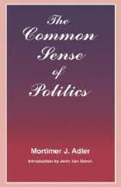
Notes:
Mortimer Adler in many of his works offered remarkable insights into what constitutes the just society. In a book titled The Common Sense of Politics, he writes:

Slide 7
“[T]he common good for which men associate in the larger community cannot be achieved if each of them insists upon retaining his complete autonomy. Some portion of it must be surrendered to establish an authority for making rules and reaching decisions binding on all by their free consent.”
Mortimer J. Adler. The Common Sense of Politics, p.77
Notes:
“[T]he common good for which men associate in the larger community cannot be achieved if each of them insists upon retaining his complete autonomy. Some portion of it must be surrendered to establish an authority for making rules and reaching decisions binding on all by their free consent.”

Slide 8
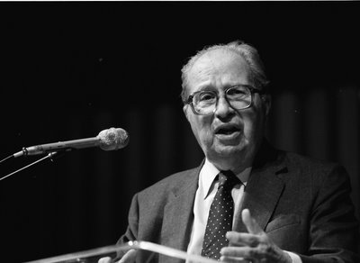
Notes:
Adler agrees with John Locke that societies are formed by individuals coming together in voluntary association. To protect individual liberty, however, we must give up a degree of freedom.

Slide 9
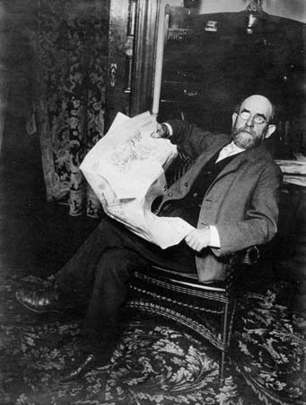
Henry George
Notes:
Similarly, Henry George sought to find something within our behavior that was generally observable across both time and space that exceeded the appropriate limits of our freedom. His discovery is that:

Slide 10
“Political economy proceeds from the following simple axiom: People seek to satisfy their desires with the least exertion.”
Henry George. Progress and Poverty, p.6
Notes:
“Political economy proceeds from the following simple axiom: People seek to satisfy their desires with the least exertion.”

Slide 11
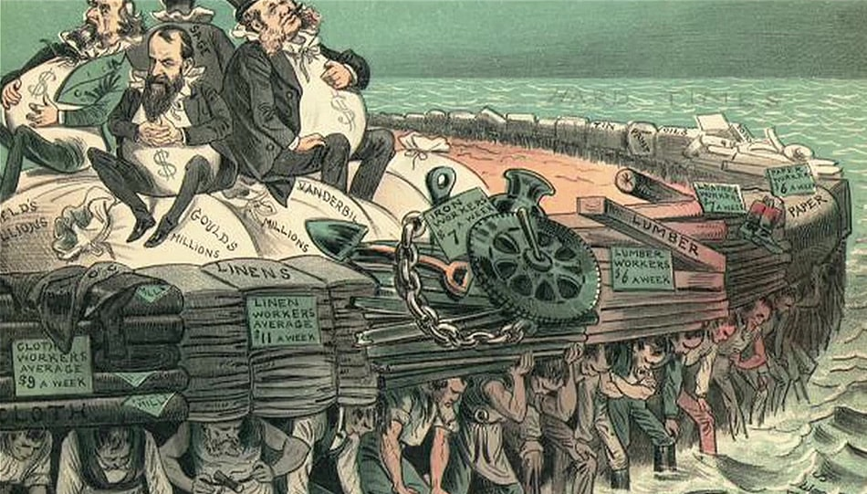
Notes:
In so doing, we exhibit a strong tendency to where possible monopolize access to nature – and to gain and hold control of political decision-making.

Slide 12
Notes:
Recognizing that neither our behavior, nor our motives, are always consistent with the highest principles, Mortimer Adler acknowledged the need for law and its enforcement:

Slide 13
“When it is said that the ideal is as little government as possible, the controlling principle is liberty rather than justice. This explains the falsity of Jefferson’s maxim, that that government governs best which governs least. …”
Mortimer J. Adler. The Common Sense of Politics, p.130
Notes:
“When it is said that the ideal is as little government as possible, the controlling principle is liberty rather than justice. This explains the falsity of Jefferson’s maxim, that that government governs best which governs least. …”

Slide 14
“The truth of the matter is that that government governs best that governs most justly, regardless of the amount of government that is required to achieve the fullest possible realization of the ideal of justice.”
Mortimer J. Adler. The Common Sense of Politics, p.130
Notes:
“The truth of the matter is that that government governs best that governs most justly, regardless of the amount of government that is required to achieve the fullest possible realization of the ideal of justice.”

Slide 15
Notes:
Adler also explains that the conditions for a decent human existence require securing and protecting of what he describes as subsidiary natural rights:

Slide 16
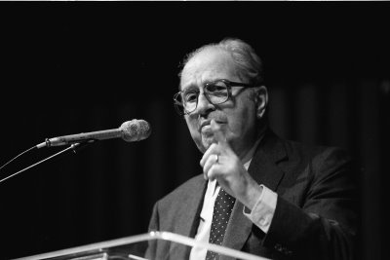
“… rights to life, security and life and limb, a decent livelihood, freedom from coercion, political liberty, educational opportunities, medical care, [and] sufficient free time for the pursuits of leisure.”
Mortimer J. Adler. The Common Sense of Politics, p.26
Notes:
“… rights to life, security and life and limb, a decent livelihood, freedom from coercion, political liberty, educational opportunities, medical care, [and] sufficient free time for the pursuits of leisure.”

Slide 17
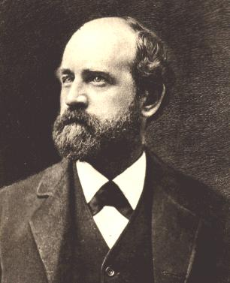
Henry George
Notes:
Although Henry George firmly believed in democracy, he also realized that majority rule and even consensus decision-making were not sufficient:

Slide 18
“Political equality does not, in itself, prevent inequality arising from private ownership of land. Furthermore, political equality – when coexisting with an increasing tendency toward unequal distribution of wealth – will ultimately beget either tyranny or anarchy.”
Henry George. Progress and Poverty, p.288
Notes:
“Political equality does not, in itself, prevent inequality arising from private ownership of land. Furthermore, political equality – when coexisting with an increasing tendency toward unequal distribution of wealth – will ultimately beget either tyranny or anarchy.”

Slide 19
Notes:
Furthermore, Henry George believed the reforms he proposed would set into motion a dramatic and constructive change in human behavior:

Slide 20
“We propose to readjust the very foundation of society. …Most notably, government could be vastly simplified. A similar saving would occur in the administration of justice. …With poverty ended, morality would grow stronger, reducing other business of [the] courts.”
Henry George. Progress and Poverty, p.254
Notes:
“We propose to readjust the very foundation of society. …Most notably, government could be vastly simplified. A similar saving would occur in the administration of justice. …With poverty ended, morality would grow stronger, reducing other business of [the] courts.”

Slide 21
Notes:
George also felt the goals of socialists could be achieved without the confiscation of legitimate private property that socialists were inclined to embrace:

Slide 22
“Government would change its character and become the administrator of a great cooperative society. …Give labor its full earnings and expanded opportunity. Take, for the benefit of the whole community, that which the growth of the community creates. Then poverty would vanish.”
Henry George. Progress and Poverty, pp. 255, 257
Notes:
“Government would change its character and become the administrator of a great cooperative society. …Give labor its full earnings and expanded opportunity. Take, for the benefit of the whole community, that which the growth of the community creates. Then poverty would vanish.”

Slide 23
Notes:
His analytical journey brought Henry George to formulate a natural law, the law of human progress. He describes here what he saw as a possible future:

Slide 24
“Association in equality is the law of human progress. …People progress by cooperating with each other to increase the mental power that may be devoted to improvement. …”
Notes:
“Association in equality is the law of human progress. …People progress by cooperating with each other to increase the mental power that may be devoted to improvement. …”

Slide 25
“Mental power, the motor of social progress, is set free by association – or perhaps “integration” may be a more accurate term. In this process, society becomes more complex. Individuals become more dependent upon each other. Occupations and functions are specialized.”
Henry George. Progress and Poverty, pp. 277, 279
Notes:
“Mental power, the motor of social progress, is set free by association – or perhaps “integration” may be a more accurate term. In this process, society becomes more complex. Individuals become more dependent upon each other. Occupations and functions are specialized.”

Slide 26
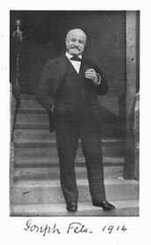
Notes:
Activists have been struggling to implement Henry George’s proposals for over 140 years, with advances here and retreats there. The soap manufacturer Joseph Fels was only one of several wealthy individuals who devoted nearly all of his share of a family’s fortune to the effort.

Slide 27
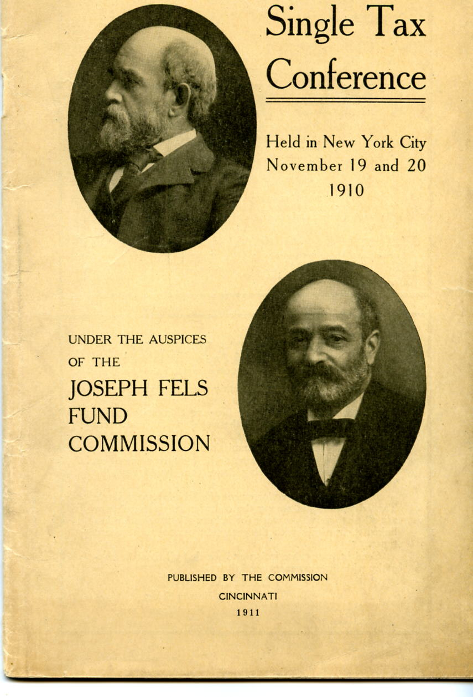
Notes:
He established the “Joseph Fels Fund Commission” to organize global conferences to promote the Single Tax idea. He also provided funds to groups for the acquisition of land and establishment of experimental communities that incorporated the community collection of land rent.

Slide 28
Notes:
What all agreed on was that justice, as well as the goals of a sustainable and peaceful planet, demand fundamental changes in how government raises its revenue. Where competition-limiting licenses are granted by government, the exchange value of such licenses – deeds to land being just one form of license -- must be captured as public revenue.

Slide 29
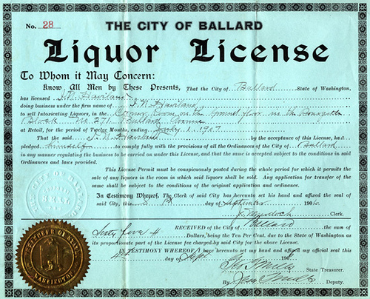
Notes:
Many licenses issued by government restrict competition by limiting the supply. A liquor license is a perfect example of how the resale value of the license (and not the physical inventory or building in which the business is located) if not captured by the community, is capitalized into a selling price: USA Today reported in back in 2006 that:

Slide 30
“In Boston, the only way to get a license is to buy another establishment's, and prices have shot up. A liquor license can cost more than $275,000; a beer and wine license goes for $50,000 to $100,000.”
USA Today, October 2006
Notes:
“In Boston, the only way to get a license is to buy another establishment's, and prices have shot up. A liquor license can cost more than $275,000; a beer and wine license goes for $50,000 to $100,000.”

Slide 31
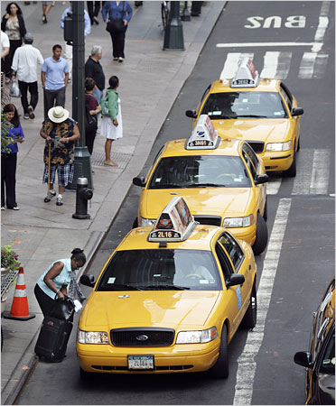
Notes:
Another form of economic license with a strong secondary market is the taxi medallion. Many communities also allow only a limited number of vehicles to provide taxi services to the public. The resale price for these licenses, or taxi medallions, was until the arrival of competition from Uber, often hundreds of thousands of dollars.

Slide 32
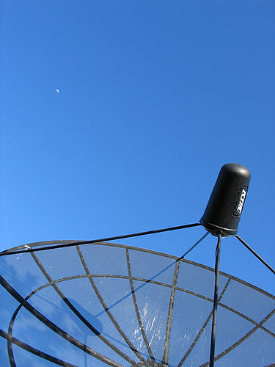
Notes:
Another higher lucrative market for licenses exists for frequencies on the broadcast spectrum. In 2008, the Federal Communications Commission sold 1,099 licenses nationwide for local and regional coverage areas for frequencies in the 700-megahertz range, which is currently used for local over-the-air TV.

Slide 33
Notes:
Each license grants exclusive use for 10 years. Bidders put up a total $131.5 million. And, as one would expect, the market value of these licenses immediately increased. Very little of this increase in value was captured by the Federal government through the taxation of business profits.

Slide 34
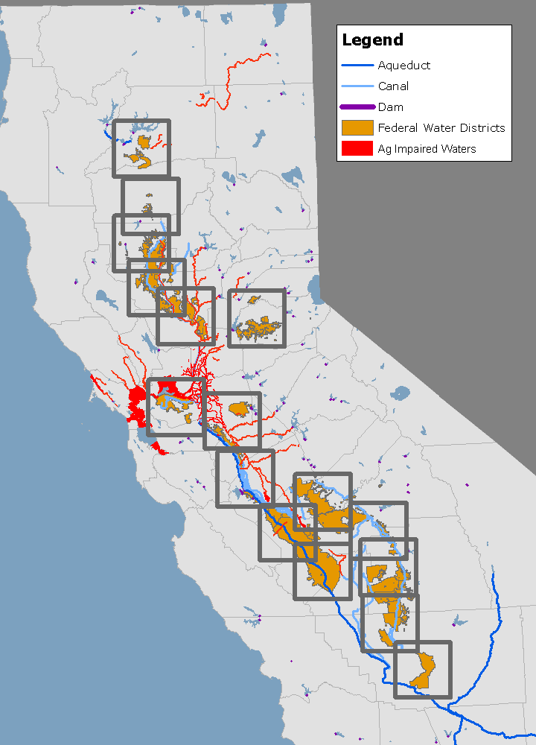
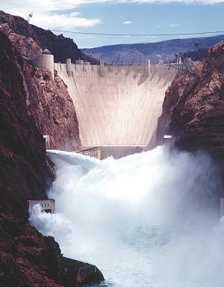
Notes:
Another area of enormous subsidy is arid land made fertile by water brought in from great distances at a fraction of the actual cost paid in taxes by the general public. At a time when California water is scarce and expensive, taxpayers guarantee Central Valley farms an abundant and cheap supply through a subsidy worth around $500 million a year.

Slide 35
Notes:
What about the time allocated to airlines for the takeoff and landing of their planes? Only so many planes can take off and land during periods of high air traffic. So, the best way to ration this scarce resource is to use competitive bidding. Foregoing this potential source of revenue, many airports in the United States receive subsidies from the Federal Aviation Administration.

Slide 36
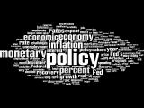
Notes:
So, to sum up this course, there are many serious issues we ought to be considering regarding our system political economy. Politics does, indeed, dictate economic outcomes. And, from the very beginning of the founding of the United States, the laws of the land have distributed privilege to a few at the expense of the many.

Slide 37
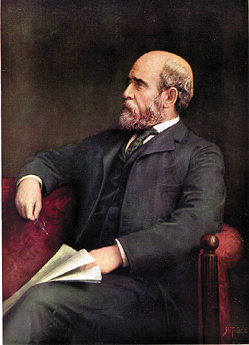
Henry George
Notes:
We end with one more insight from Henry George:

Slide 38
“The regression of civilization, after a period of advance, may be so gradual that it attracts no attention at the time. Indeed, many mistake such a decline for advancement. Many … things … indicate our civilization has reached a critical point – unless a new start is made toward equality. ...”
Notes:
“The regression of civilization, after a period of advance, may be so gradual that it attracts no attention at the time. Indeed, many mistake such a decline for advancement. Many … things … indicate our civilization has reached a critical point – unless a new start is made toward equality. Inequality is the necessary result of material progress wherever land is monopolized. Inequality cannot go much further without carrying us into a downward spiral so easy to start and so hard to stop.”

Slide 39
“Inequality is the necessary result of material progress wherever land is monopolized. Inequality cannot go much further without carrying us into a downward spiral so easy to start and so hard to stop.”
Henry George. Progress and Poverty, pp. 292-293
Notes:
“Inequality is the necessary result of material progress wherever land is monopolized. Inequality cannot go much further without carrying us into a downward spiral so easy to start and so hard to stop.”

Slide 40
END OF LECTURE 17

Slide 41
THE END

