Slide 1
Understanding our Political Economy

Slide 2
INSTRUCTOR
Edward J. Dodson, M.L.A.
email contact:
edod08034@gmail.com

Slide 3
LECTURE 3
Essential Elements of Political Economy

Slide 4
Notes:
When Henry George was writing Progress and Poverty, his reading of other political economists convinced him that a major problem with their analyses was the inconsistent use of terms. He was committed to be clear in his use of terms and to provide and adhere to the definitions he believed were consistent with a fundamental understanding of the scientific principles involved. He started with clearly defining what were then considered to be the three factors of production: land, labor and capital.

Slide 5
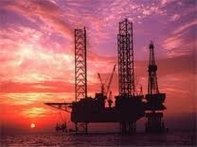
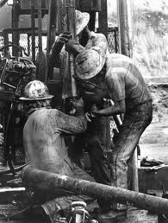
LAND
LABOR
CAPITAL GOODS
LAND
Notes:
Our definition of political economy in this course is that it is the science that examines the means by which wealth is produced and distributed to the three factors of production – land, labor and capital. And, by capital, we are referring to tangible goods used in the production of other goods, so I will use the term “capital goods” in this analysis.

Slide 6
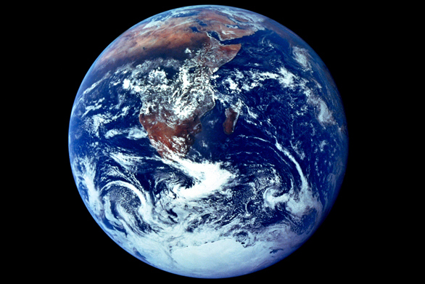
Notes:
The term “land” takes in the entire natural world, including our atmosphere and all other natural assets.

Slide 7
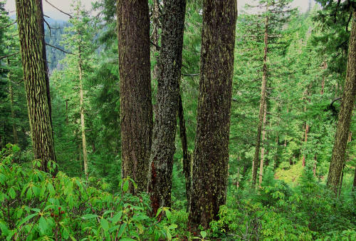
Notes:
Thus, land includes the forests, …

Slide 8
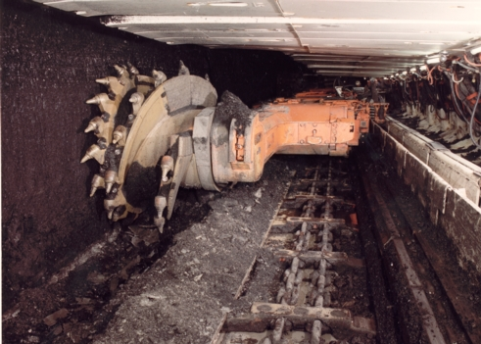
Notes:
natural resource-laden lands and the resources these lands hold, …

Slide 9
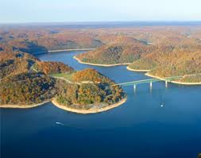
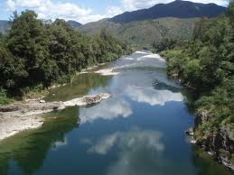
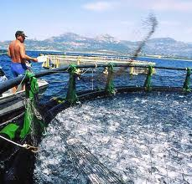
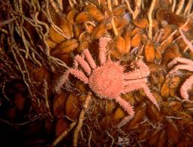
Notes:
the seas and sea beds, rivers, lakes, and all the plants and animals contained therein …

Slide 10
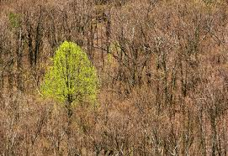
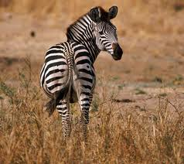
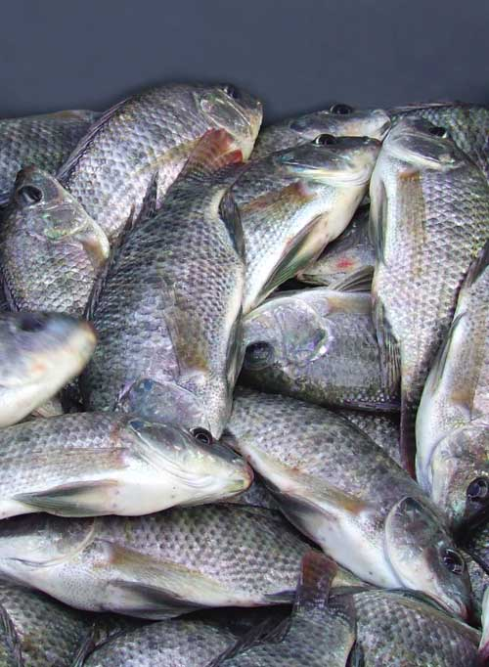
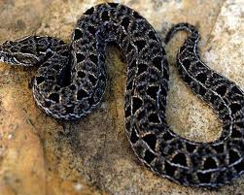
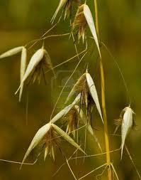
Notes:
all non-domesticated plants and animals that inhabit the planet, …

Slide 11
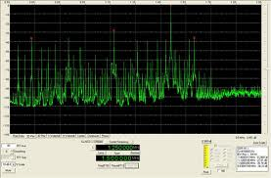
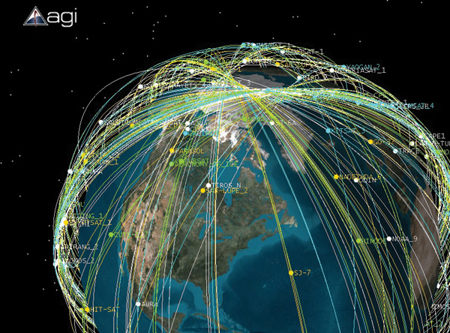
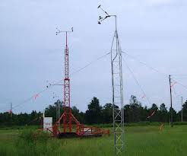
Notes:
the broadcast spectrum for radio and television transmission, air lanes for travel by airplanes or satellite paths in space …

Slide 12
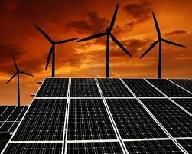
Notes:
Wind and solar energy to be captured and utilized, and …

Slide 13
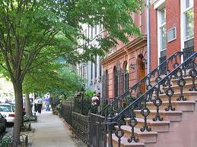
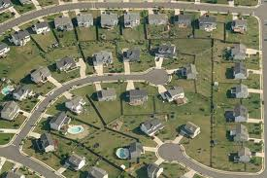
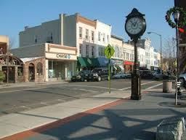
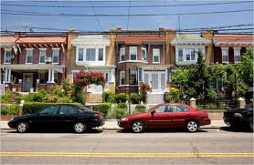
Notes:
The parcels of land on which we build our cities and towns where we live, play and engage in commerce.

Slide 14
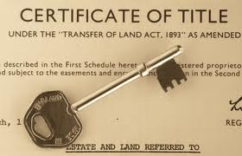
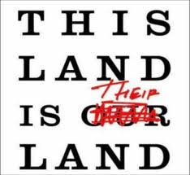
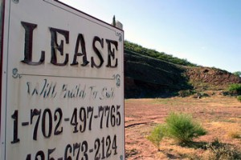
Notes:
How access to nature is granted or awarded is a primary concern of the political economist. Central moral questions are involved. Is access to land – to nature -- a right or a privilege? Should control over land be exclusive or conditional, awarded by competitive auction under a leasehold arrangement or deeded by governments and thereafter sold owner to owner?

Slide 15
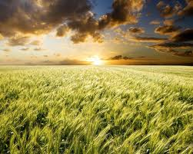
Cost of Production = ZERO
Notes:
An important characteristic of nature is that nature has a zero cost of production in terms of our labor and capital goods. Thus, nature is appropriately identified as the source of what we produce. Nature exists independent of human labor.

Slide 16
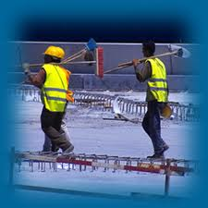
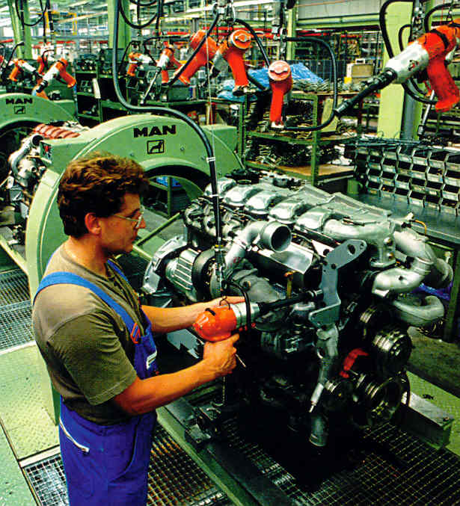
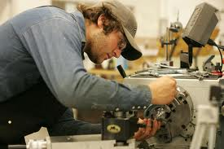
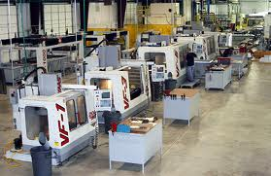
Notes:
We are an active factor of production and are referred to as labor. What we produce may or may not be capital goods, depending on what we do with what we produce. What we consume immediately does not enter into political economy. Its consumption eliminates the potential for any alternative use in the production of something else.

Slide 17
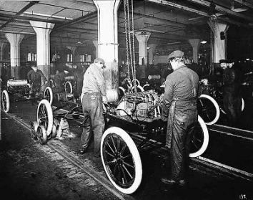
Notes:
With the introduction of increasingly sophisticated tools and machinery, our capital goods have become very efficient. Production processes evolved to become very specialized, incorporating methods that required the division of labor into narrower and narrower activities.

Slide 18
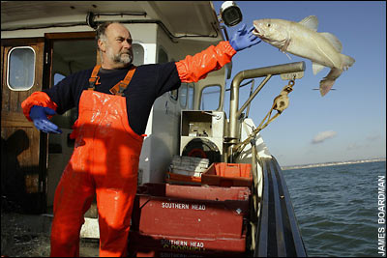
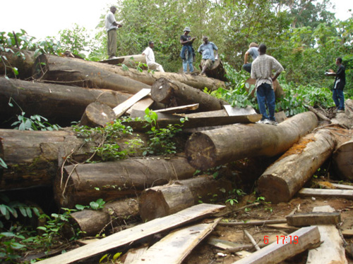
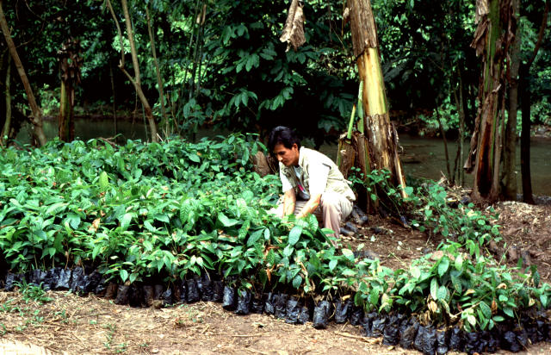
Forms of Labor PRIMARY to Production
Resource extraction
Agriculture
Timber harvesting
Fishing
Hunting
Notes:
Thus, to help describe the contributions of particular types of labor, political economy further divides labor into categories based on the closeness of labor’s direct application to land and natural resources. These primary types of labor include resource extraction, agriculture, timber harvesting, fishing and hunting.

Slide 19
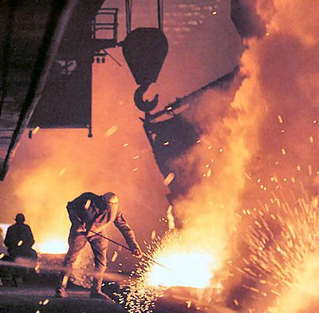
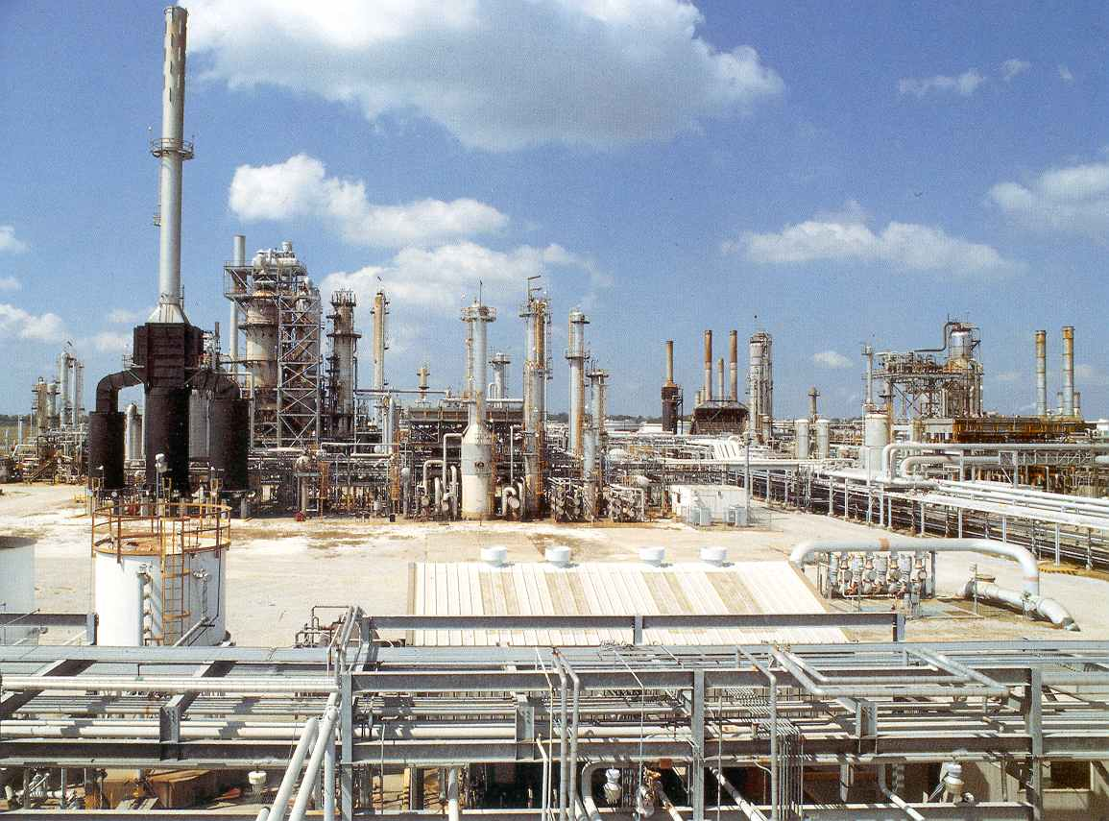
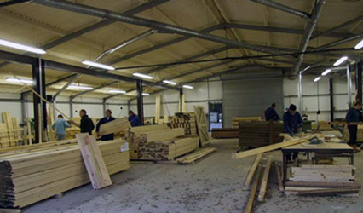
Forms of Labor SECONDARY to Production
Milling
Refining
Combining
Processing
Notes:
Once raw materials are produced, a secondary category of labor is engaged in milling, refining, combining and processing of materials.

Slide 20
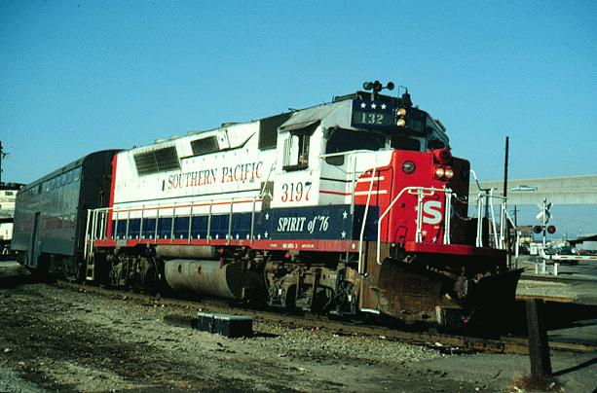
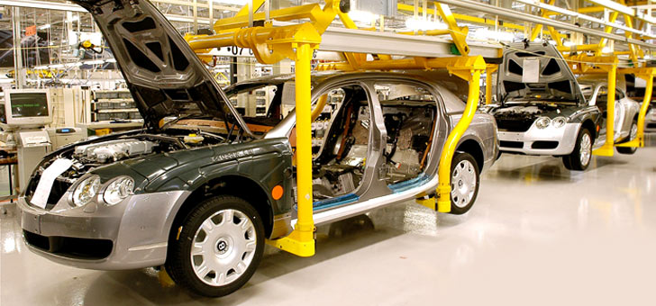
Forms of Labor TERTIARY to Production
Manufacturing
Assembly
Transportation
Notes:
And finally, materials are put into form when they are ready for use in manufacturing and assembly of finished goods, which are then transported to their final destinations for sale and consumption.

Slide 21
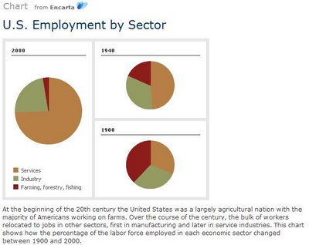
Services
Services
Services
Notes:
Also essential to our modern economic system are service-providers. The size of the service sector of the U.S. economy continues to expand, even as we produce here or import from abroad more goods than ever before.

Slide 22
Notes:
In fact, the line between goods production and providing services is often very blurred. Architects and engineers are very much engaged in production. Accountants and lawyers, bankers and financial advisers, as well as insurers, are less so but are involved in the securing of financing and other contractual relationships meeting the needs of all parties involved.

Slide 23
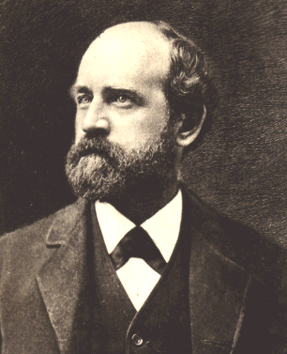
Notes:
Henry George discusses the value of services to wealth production as follows:

Slide 24
“Labor always produces either wealth (which may or may not be capital) or services. Only in an exceptional case of misadventure is nothing produced.”
Progress and Poverty, p.33.
Notes:
“Labor always produces either wealth (which may or may not be capital) or services. Only in an exceptional case of misadventure is nothing produced.”

Slide 25
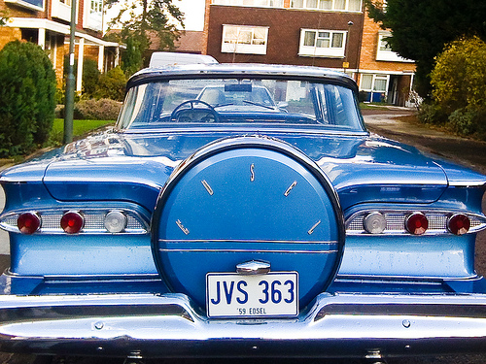
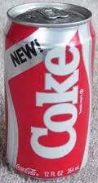
Notes:
Misadventure more frequently results in the production of goods no one chooses to exchange money (or other goods or services for) or at least for which no one will exchange enough of equal value to cover the costs of production.

Slide 26
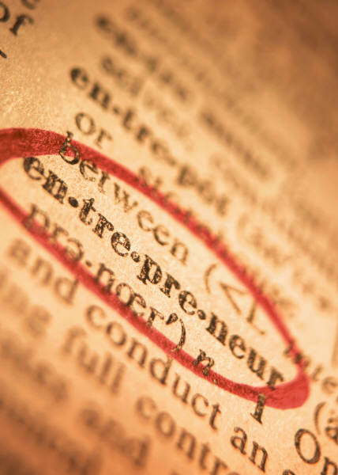
Notes:
Economics -- but not political economy -- generally treats entrepreneurship as a special form of labor and a factor of production in its own right. In our study of political economy, the differences in individual ability are treated as the basis for specialization and the division of labor. People tend to gravitate to what they do best or have a natural inclination toward. Thus, given the same access to land and to capital goods, some individuals will be more productive than others. Some will devote their labor to business organization and management.

Slide 27
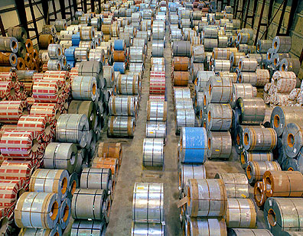
Notes:
When we talk about wealth in political economy, we are dealing with the tangible goods produced that serve as the storehouse we can draw on to combine with other goods or simply consume. Labor applied to Land produces some form of good. However, to be COUNTED as wealth, the good must meet specific criteria. It must:

Slide 28
Be the product of labor with or without the assistance of other (capital) goods
Have exchange value in the marketplace; and
Satisfy some human desire
Notes:
Be the product of labor with or without the assistance of other (capital) goods; Have exchange value in the marketplace; and Satisfy some human desire

Slide 29
Notes:
A common question that arises in the study of political economy is whether money is wealth. Later in this course we will explore the subject in some depth. For now, our definition of wealth means that some forms of assets commonly thought of as wealth and that have an exchange value in markets are not considered wealth. These include:

Slide 30
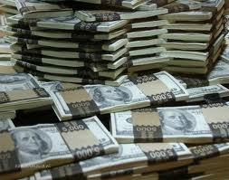
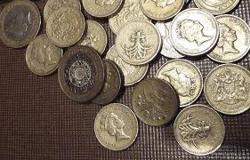
Notes:
Currency and coinage. They are mediums of exchange that allow holders to acquire actual wealth more easily than by the bartering of labor for goods or other services.

Slide 31
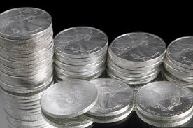
Notes:
Gold and silver have historically been both commodities and -- when converted into coinage -- money that has a high intrinsic value. Precious metals -- as coinage or bullion -- have often backed paper currency in circulation. And, of cource, gold and silver have always been held by investors as hedges against the declining purchasing power of paper currencies issued by governments or banks.

Slide 32
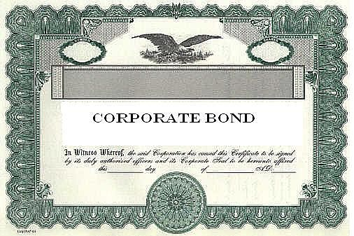
Notes:
Also, other legal claims on material goods, such as mortgages and bonds fall outside the definition of what is wealth.

Slide 33
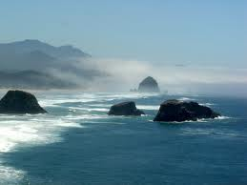
Notes:
Most importantly, land is not included in our definition of wealth for the basic reason that nature is not produced by human labor. Nature is the source of all wealth, but is not itself wealth – even though access to much of nature commands a price charged by those who own or control land.

Slide 34
Notes:
In prehistoric times, most of what we produced was almost immediately consumed. Much of what we produced was lost because of the inability to preserve and store wealth. The amount we produced was small because people had not yet discovered how to convert wealth into effective tools – into capital goods – to facilitate greater wealth production per unit of labor.

Slide 35
Notes:
The introduction of new and more effective forms of capital goods brought on important changes in the overall organization of societies.

Slide 36
Notes:
The extended life and usefulness of capital goods – such as buildings, machinery and other equipment – is what allows for the high standard of material well-being at least some of us experience.

Slide 37
Notes:
In the most basic sense, each of us requires access to the earth to survive. Thus, Henry George argues that the earth must be treated as a commons, accessible by all, and under rules that guarantee full equality of opportunity.

Slide 38
Our Shared Commons?
Notes:
If the earth is, in fact, our shared commons, this should have become a governing principle of systems of property law in every society. Other than the oceans (so far), however, most of the planet is claimed by some people to the exclusion of others. The challenge is how to allocate access to portions of the earth, protect what we produce with our labor as our private property, but prevent some from gaining a monopolistic degree of control over land and natural resources.

Slide 39
(Supply of land)
Notes:
Among economists today, there are some who do argue that land must be treated as a distinct factor of production and that land markets operate quite differently from markets for labor and capital goods. A key difference is that the supply of land is fixed by nature; that is, it’s supply is inelastic. Changes in the market price for land will not result in an increase in the total supply. This is reflected on a supply-demand chart by a vertical supply curve. In fact, under current economic policies the supply curve for land is leftward leaning. As prices demanded increase, those who hold land have a financial incentive to hold it idle and off the market.

Slide 40
LAND SPECULATORS
WANTED
Notes:
The failure to distinguish land from capital goods under property law and taxation policies is the most serious consequence of the confusion created by neoclassical economics. As we will discuss in some detail, the result has been to encourage and reward speculation in all forms of land while imposing heavy tax burdens on labor and the owners of real capital goods.

Slide 41
END OF LECTURE 3

