Slide 1
The State of the United States
ECONOMY AND SOCIETY

Slide 2
Compiled with commentary
by Edward J. Dodson, M.L.A.
June 2018
Notes:
What follows is an updated analysis of the state of the United States economy and important measurements of the overall strength of our society. Within this presentation I provide what I believe are a number of reasoned recommendations for changes in public policy to address the boom-to-bust character of our economic system and the growing level of income and wealth inequality that threatens our very democracy. Additional proposals for systems change are offered to achieve sustainable use of our natural resources.

Slide 3
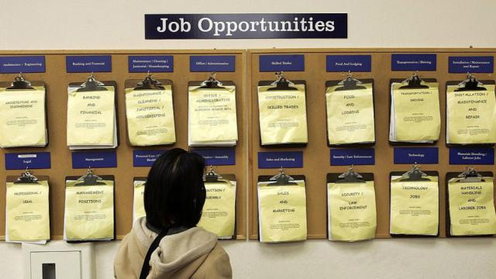
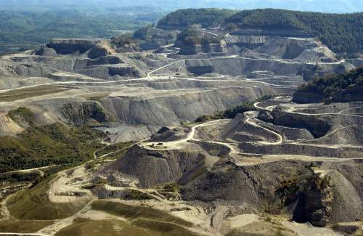
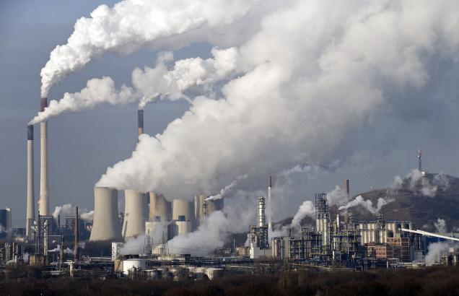
Notes:
More than ever before, we are a society divided over whether and how we can create sufficient employment opportunities for a growing population, at living wages and with measures in place that will not merely reduce but actually eliminate environmental degradation.

Slide 4
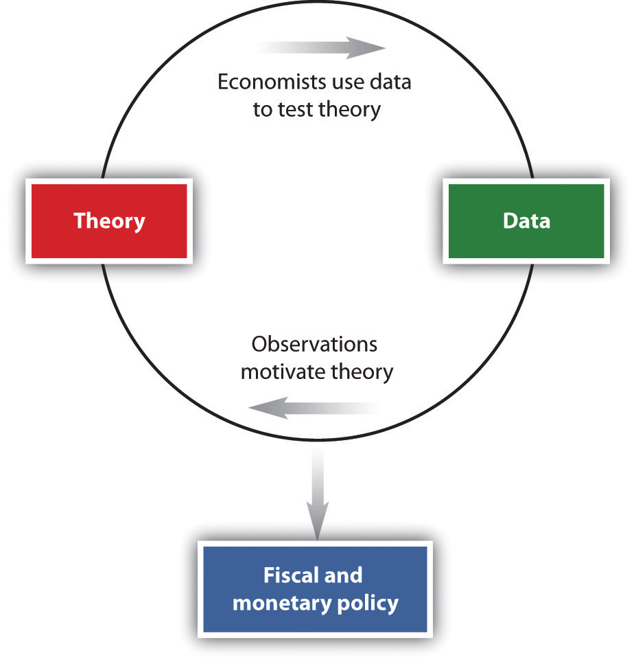
Notes:
When one examines what occurs in the real world, there is strong evidence that economic theory is in need of correction, and that public policies derived from accepted theory must be changed. I will explore these issues further as I proceed.

Slide 5
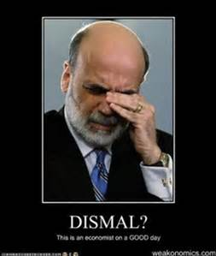
Notes:
It is no secret that the discipline of economics has been the subject of increasing criticism for the failure of most economists to provide meaningful insights into the causes of our boom-to-bust prone economic system. For many reasons, economics has long been referred to as the dismal science or not a science at all.

Slide 6
Notes:
The list of critics of economics as a discipline and of its value in the real world is long and growing, from within and without the field.

Slide 7
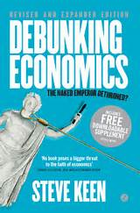
Notes:
One of the most vocal critics today is Professor Steve Keen of Kingston University, London, author of Debunking Economics, in which he writes:

Slide 8
“… If you look at mainstream economics there are three things you will not find in a mainstream economic model – Banks, Debt, and Money. How anybody can think they can analyze capital while leaving out Banks, Debt, and Money is a bit to me like an ornithologist trying to work out how a bird flies whilst ignoring that the bird has wings.”
Notes:
“… If you look at mainstream economics there are three things you will not find in a mainstream economic model – Banks, Debt, and Money. How anybody can think they can analyze capital while leaving out Banks, Debt, and Money is a bit to me like an ornithologist trying to work out how a bird flies whilst ignoring that the bird has wings.”

Slide 9
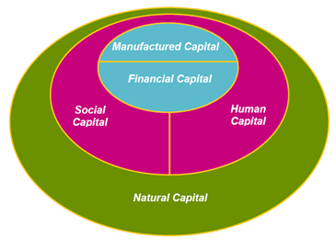
Notes:
An important question I would put to Professor Keen is his definition of “capital.” Economists and their predecessor political economists too often failed to explain what they meant when they wrote about capital. Actual capital goods – buildings, machinery, technologies – have characteristics quite distinct from currency or its digital equivalent, or what is broadly thought of as “financial capital.” The failure to make these distinctions makes scientific analysis impossible.

Slide 10
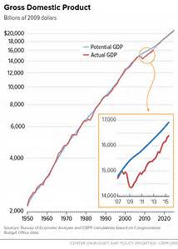
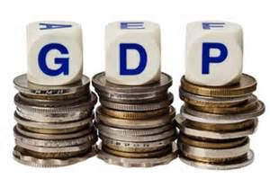
Notes:
Another problem is the interpretation of statistics. Economists and most mainstream analysts consistently point to the measurement labeled Gross Domestic Product to indicate the extent to which our economy is growing. An increase in GDP is automatically considered a positive indicator.

Slide 11
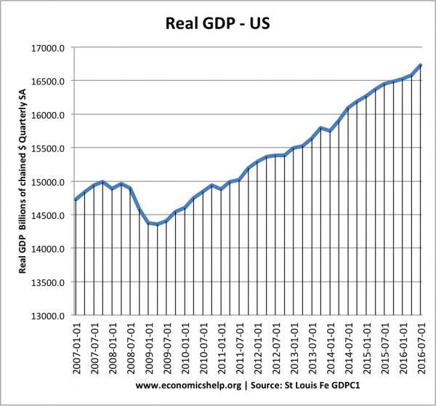
Notes:
In reality, relying on GDP as a measurement of the health of the economy is problematic. GDP includes all spending by government regardless of the source of funding – whether from taxes, borrowing or monetary expansion by the Federal Reserve System. More than this, there is no qualitative judgment regarding what the spending is for. During 2017 the GDP spending in the United States – adjusted for inflation -- was reported to be $19.385 trillion. [Source: Economy Watch]

Slide 12
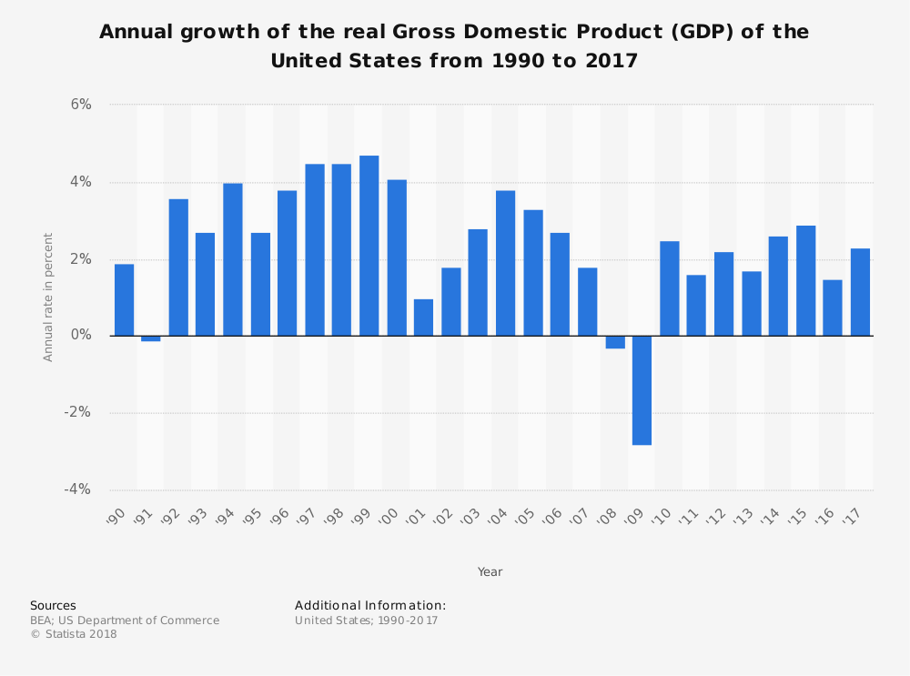
Notes:
Real gross domestic product increased at an annual rate of 2.6 percent in 2017, as reported by the Bureau of Economic Analysis.

Slide 13
Notes:
An important issue for policymakers is the extent to which government borrowing crowds out private sector access to affordable credit. The Federal Reserve Banks now hold 12.4 percent of U.S. total public debt. This does seem to have slowed down private sector borrowing. By July of 2017, total government and personal debt surpassed $41 trillion. By the end of 2017 total household debt reached $13.1 trillion.

Slide 14
Notes:
Within the political arena, there is great discussion and debate over stimulating the economy by a massive infusion of spending to repair and rebuild the nation’s infrastructure. This will certainly create employment and profits for businesses. Where will the funding come from? This is an issue with important consequences.

Slide 15
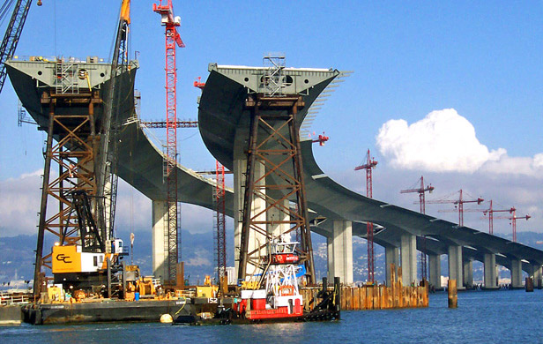
Notes:
Of course, spending on new infrastructure, such as bridges, tunnels, highways, airports or rail lines enable goods and people to move more efficiently from location to location. These investments in public goods yield strong returns to our society. They also generally result in windfall gains to owners of adjacent and nearby locations.

Slide 16
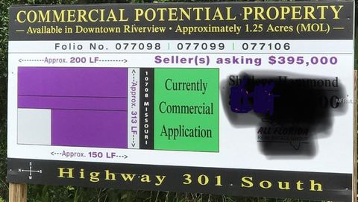
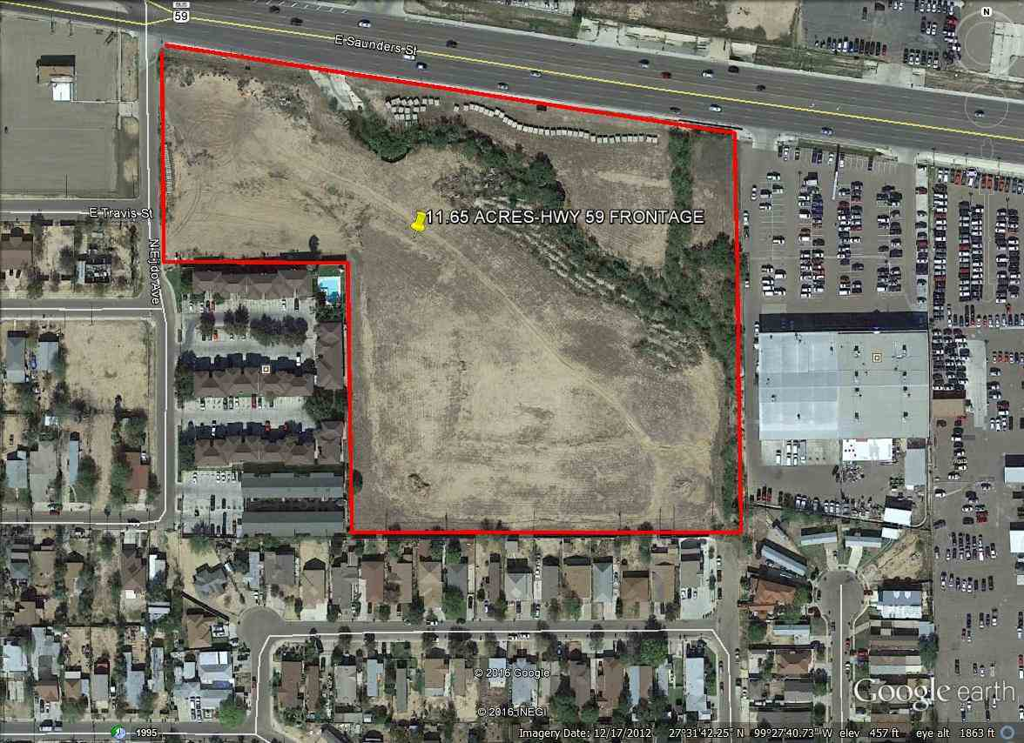
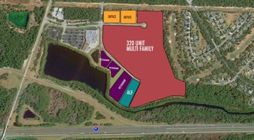
Notes:
The not so positive side-effect of rising land costs is an inflationary increase in the cost of doing business and the cost of living.

Slide 17
Notes:
It is worth taking a moment to provide an important insight into economic theory. Every parcel or tract of land has some potential annual rental value, that is, what the land would bring to its owner under an annually-adjusted lease payment. After subtracting whatever annual property tax payment is required, the owner experiences a net imputed income stream capitalized by market forces into a potential selling price for the land.

Slide 18
Notes:
The higher the annual tax payment, the lower the imputed income stream to be capitalized. Conversely, the lower the effective rate of taxation the higher will be the land prices (all other things being equal).

Slide 19
Notes:
A longer-term risk of government borrowing facilitated by adding to the money supply by quantitative easing is the prospect for hyper-inflation. However, the willingness of external trading partners to hold U.S. dollars or invest them in U.S. property markets and corporate shares has supported the exchange value of U.S. currency.

Slide 20
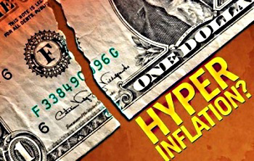
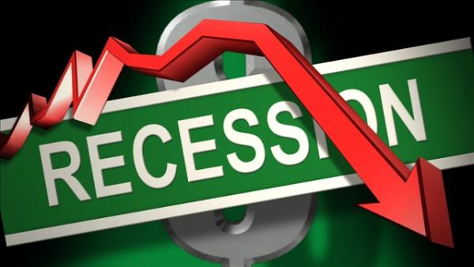
Notes:
Absent systemic reforms, the economic tools available to government and the Federal Reserve to respond to hyper-inflation are rather limited. The Federal Reserve can raise the rate of interest charged to member banks, which will then find their way through the economy and to yields on new issues of government securities. The risk, of course, is a recessionary downturn.

Slide 21
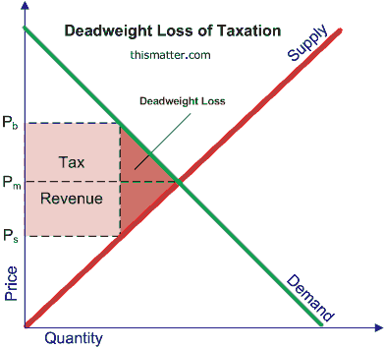
Notes:
How government at all levels raises needed revenue has huge but largely ignored implications for the health of our society. Specific public policies, including taxation policies, create monopolies and quasi-monopolies that impose what are called deadweight losses on asset production and economic output. Counter-productive policies result in a lower value of goods and services produced – and higher prices -- than would have occurred absent these policies.

Slide 22
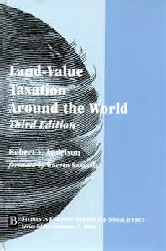
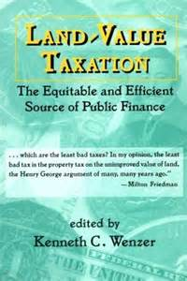
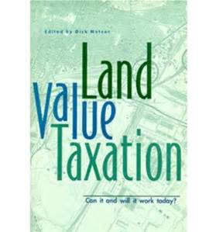
Notes:
I have come to agree with those economists who argue that only the taxation of land value – or, more specifically, the taxation of the potential annual rental value of land (and land-like assets, such as the broadcast spectrum) – impose no deadweight loss on economic output.

Slide 23
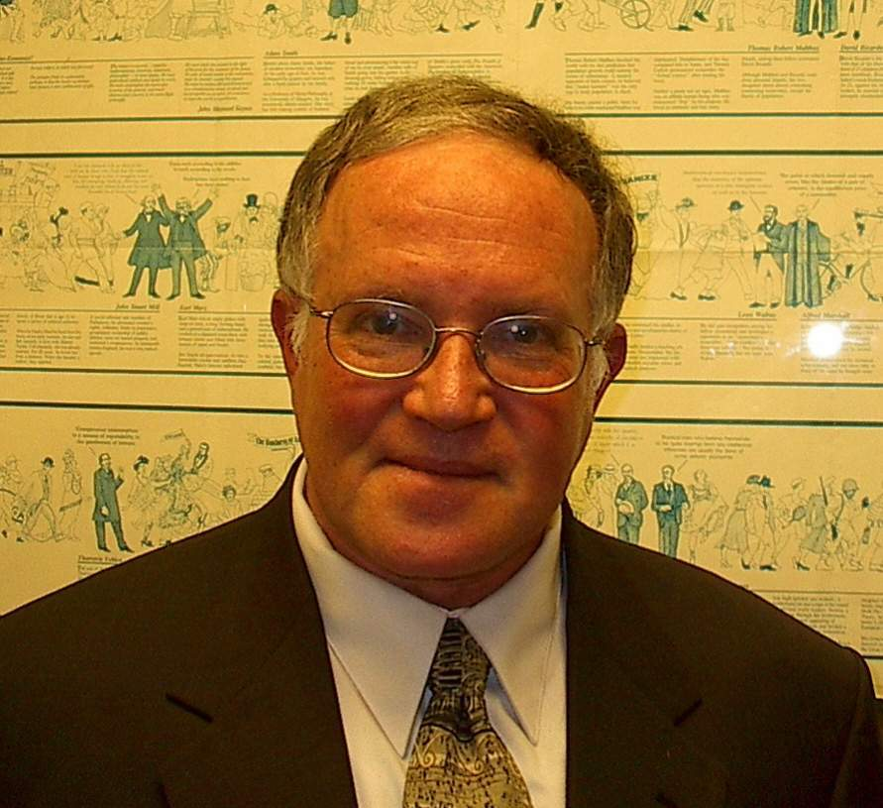
Notes:
Professor Fred Foldvary of San Jose State University explains the consequences of our current public revenue system and what the elimination of deadweight losses would do for the economy and our society:

Slide 24
“The overall excess burden of taxation in the USA has been estimated at about $1.5 trillion dollars, more than 10 percent of total output. So roughly, our standard of living would be ten percent higher if the deadweight loss were eliminated. …”
Notes:
“The overall excess burden of taxation in the USA has been estimated at about $1.5 trillion dollars, more than 10 percent of total output. So roughly, our standard of living would be ten percent higher if the deadweight loss were eliminated. …”

Slide 25
Notes:
He goes on to make the case for the elimination of most other taxes:

Slide 26
“With the elimination of taxes on wages, sales, buildings, and entrepreneurial profits, the economy would take a quantum leap up to dazzling productivity. The demand for labor would surge and wages would jump to now unimaginable levels.”
Notes:
“With the elimination of taxes on wages, sales, buildings, and entrepreneurial profits, the economy would take a quantum leap up to dazzling productivity. The demand for labor would surge and wages would jump to now unimaginable levels.” [Fred Foldvary, “Losses are staggering when taxes induce less productive land use,” The Progress Report, 3 December 2007]

Slide 27
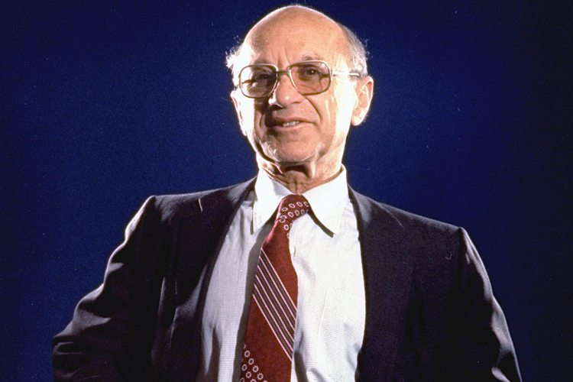
Notes:
Several decades ago the economst Milton Friedman advanced this same change in tax policy:

Slide 28
“There’s a sense in which all taxes are antagonistic to free enterprise – and yet we need taxes. …In my opinion the least bad tax is the property tax on the unimproved value of land…”
Notes:
“There’s a sense in which all taxes are antagonistic to free enterprise – and yet we need taxes. …In my opinion the least bad tax is the property tax on the unimproved value of land…” He adds:

Slide 29
“Governments can collect taxes best on things that don’t move. Land is an ideal basis of taxation because you can’t take it away.”
Notes:
“Governments can collect taxes best on things that don’t move. Land is an ideal basis of taxation because you can’t take it away.” [Source: Comment during public debate of the American Education League, reported in Human Events, 18.11.78, p.14]

Slide 30
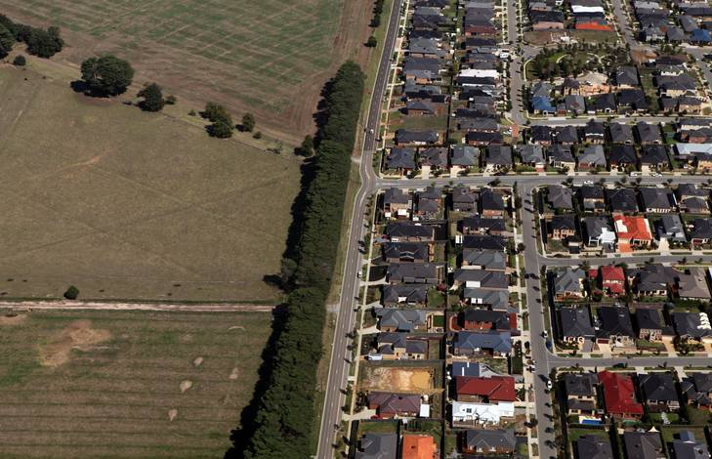
Notes:
30
A low effective annual tax on the potential rental value of locations in our towns and cities, on natural resource-laden land, and other natural assets generates this income stream. The result is intense speculation in land and high land acquisition costs for development of housing, for resource development and other uses – even as huge areas of land in a community remain vacant.

Slide 31
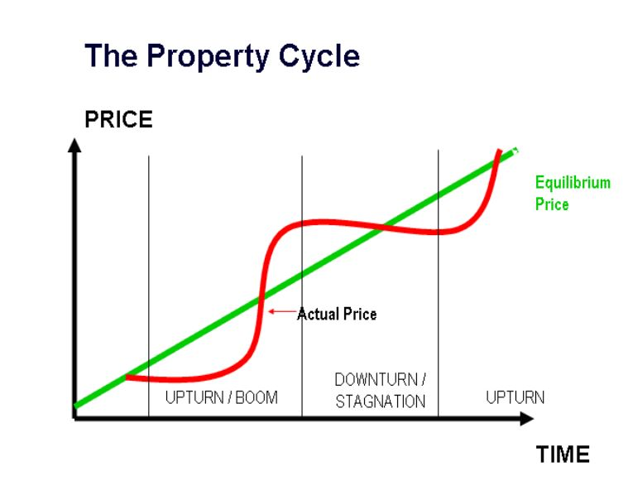
Notes:
31
Access to cheap credit adds fuel to already speculation-driven land markets. Land prices eventually reach a level where businesses can no longer absorb the cost pushed through to office, commercial and retail rents, and a growing number of households can no longer qualify for the mortgage financing to acquire housing.

Slide 32
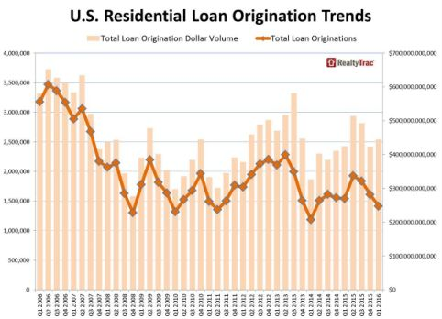
Notes:
32
In order to keep up the level of transactions, mortgage lenders and investors respond by increasing the level of permitted financing, by lowering cash down payment requirements, and by adopting more flexible creditworthiness criteria. The combined effect is to increase the aggregate level of risk in the event of a market correction or economic contraction.

Slide 33
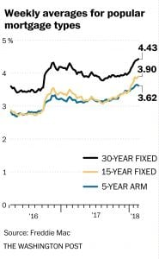
Notes:
33
Since the end of 2016, mortgage interest rates have climbed up somewhat. As a consequence, the number of property owners who refinanced existing mortgage loans fell considerably from the end of 2016 to the end of 2017. Analysts at the Mortgage Bankers Association, at Freddie Mac and at Fannie Mae have forecasted total mortgage originations for 2018 at between $1.61 to $1.75 trillion.

Slide 34
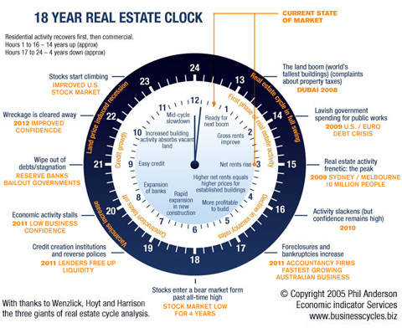
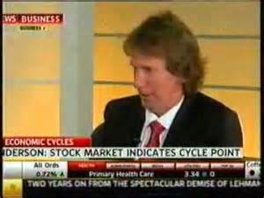
Notes:
34
The resulting stress brings on a property market crash every 18-20 years. Australian analyst Phillip Anderson has detailed this cyclical activity in his 2005 book The Secret Life of Real Estate and Banking:

Slide 35
“A study of US history … reveals a very clear (average) 18 year cycle in US real estate prices, measured from trough to trough or peak to peak. The actual cycle has never been shorter than 17 years, never longer than 21.”
Notes:
35
“A study of US history … reveals a very clear (average) 18 year cycle in US real estate prices, measured from trough to trough or peak to peak. The actual cycle has never been shorter than 17 years, never longer than 21.” [from phillipjanderson.com/18-year-real-estate-cycle]

Slide 36
Notes:
Unfortunately, few policy analysts and even fewer of the nation’s elected representatives have come to terms with the nation’s counter-productive tax structure that is at the heart of our boom-to-bust economic system.

Slide 37
Notes:
Fairness is one issue. Economic efficiency is the other. On these matters there are widely diverse opinions and very powerful vested interests doing all they can to preserve the subsidies by which they benefit. The 2017 tax bill signed by President Trump does not, in my opinion, address any of these fundamental problems for the simple reason that there is no distinction made between income that is rent-derived (and, therefore, unearned) and income earned producing goods or delivering services. In fact, unearned income receives even more advantageous tax treatment.

Slide 38
Notes:
38
The editors of the Bloomberg Report reached the following conclusion in 2013:

Slide 39
“The federal government directly spends between $75 billion and $100 billion a year on everything from farm subsidies to research grants. Include indirect benefits from things like tariffs and corporate tax exclusions, and the favors granted by local and state governments, and the total is much higher – probably more than $1 trillion.”
Notes:
39
“The federal government directly spends between $75 billion and $100 billion a year on everything from farm subsidies to research grants. Include indirect benefits from things like tariffs and corporate tax exclusions, and the favors granted by local and state governments, and the total is much higher – probably more than $1 trillion.” [Source: “Ending Corporate Welfare One Program at a Time,” BloombergView, 4 February, 2013]

Slide 40
Notes:
40
With this as an introduction, let’s look in some detail at the most important segments of our economy and at the benchmarks of who owns what and how income is distributed in our society.

Slide 41
End of Part 1
Notes:
End of Part 1

