Slide 1
The State of the United States
ECONOMY and SOCIETY
Part 4

Slide 2
Social Welfare Trends
Notes:
For some in our society, the 2008 crash had almost no impact on their quality of life. For others, the result was to destroy an already fragile existence. This presentation will offer some insight into the degree to which the lives of people at the bottom of our socio-economic ladder have improved or not improved.

Slide 3
December 2017
Notes:
The U.S. Department of Housing and Urban Development reported in December of 2017 that on any night during the year some 553,750 people were homeless in the United States. Fully one-third of this number were living in unsheltered locations, meaning they were living outside somewhere. [Source: The 2017 Annual Homeless Assessment Report to Congress, December 2017]

Slide 4
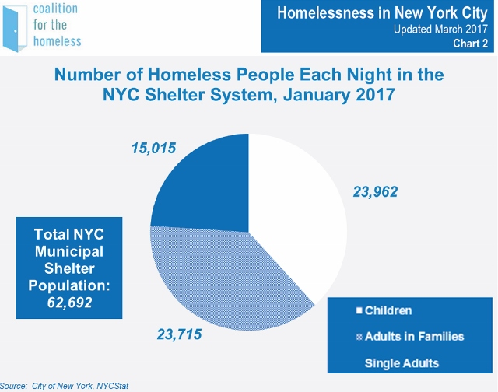
Notes:
A report issued in March of 2017 by the Coalition for the Homeless stated that in New York City there are more than 62,000 man, women and children sleeping in shelters each night. Children constitute 38 percent of all those in shelters. There is simply not enough housing available at rents even working adults can afford to pay. Clearly, the nation’s recovery from the 2008 economic crisis has not reached those most at risk in our society.

Slide 5
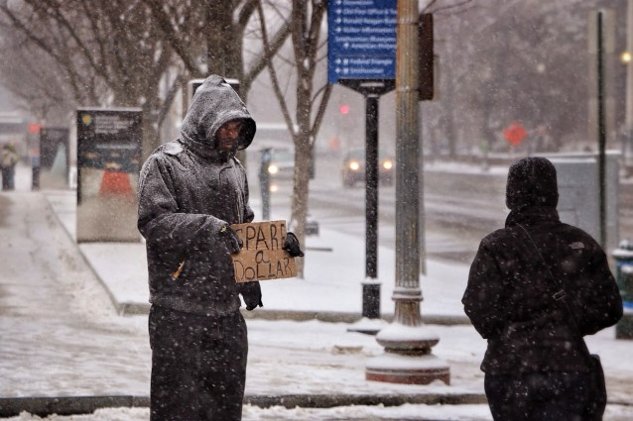
Notes:
The continued decline in the number of publicly-subsidized housing units is exacerbating the problem of homelessness. The National Alliance to End Homelessness reports that 7 million people in poor households live doubled up with family and friends. Over 6.6 million poor households pay more than 50 percent of their income toward housing.

Slide 6
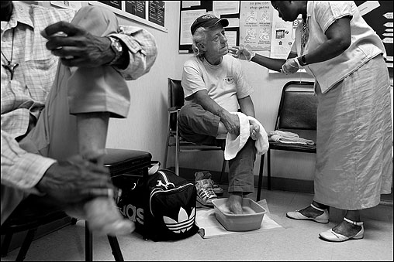
Notes:
A report issued on May 28th in the Journal of The American College of Cardiology indicates that heart disease is the major killer of those who are homeless. Over half of the homeless do not have access to a consistent source of health care, so their conditions often go untreated. Smoking is the main source of cardiovascular disease, accounting for about 60 percent of deaths each year. Alcohol and drug abuse are additional causes.

Slide 7
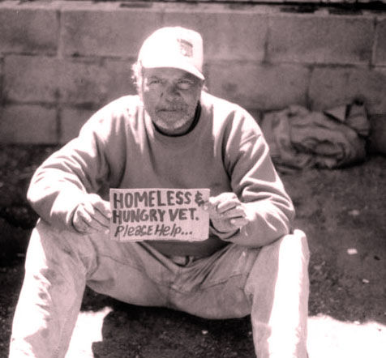
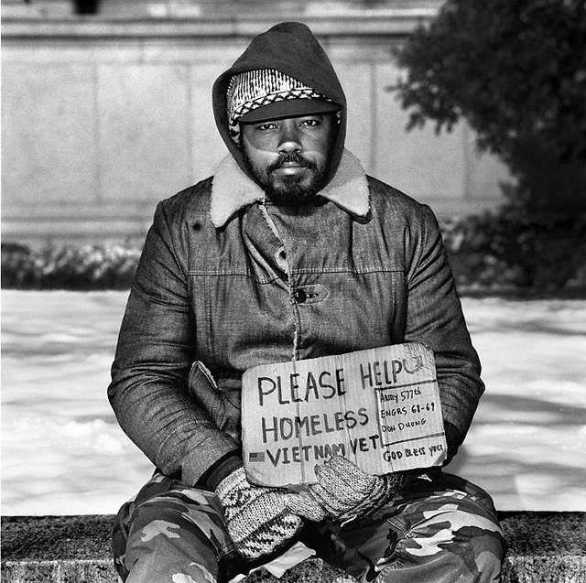
Notes:
In a January 2018 report on homelessness by Veronica Gaitan of the Urban Institute describes the situation for the nation’s military veterans:

Slide 8
“Last year, the number of veterans experiencing homelessness increased for the first time in a decade. Sixty-two percent stayed in emergency shelters or transitional housing programs, while 38 percent were unsheltered. More than 950 veterans experienced homelessness as part of a family with children. ...”
Notes:
“Last year, the number of veterans experiencing homelessness increased for the first time in a decade. Sixty-two percent stayed in emergency shelters or transitional housing programs, while 38 percent were unsheltered. More than 950 veterans experienced homelessness as part of a family with children. ...”

Slide 9
“Differences in veteran homelessness by state did not necessarily reflect differences in their population of veterans. Virginia, for example, ranked 25th in veteran homelessness but has the 8th-largest veteran population, while Oregon had the 5th-largest number of homeless veterans but ranked 25th in the size of its veteran population. In contrast to national trends, veteran homelessness declined in 36 states and Washington, DC.”
Notes:
“Differences in veteran homelessness by state did not necessarily reflect differences in their population of veterans. Virginia, for example, ranked 25th in veteran homelessness but has the 8th-largest veteran population, while Oregon had the 5th-largest number of homeless veterans but ranked 25th in the size of its veteran population. In contrast to national trends, veteran homelessness declined in 36 states and Washington, DC.”

Slide 10
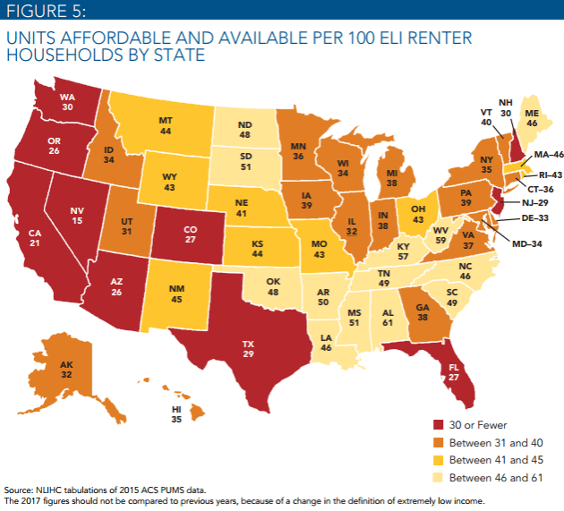
Notes:
10
The 2017 America’s Rental Housing report by the Harvard Joint Center for Housing Studies states that few new housing units affordable to low- and moderate income renters are being created. As a result, nearly one-half of renter households are cost burdened, spending more than 30 percent of their household income on housing.

Slide 11
Notes:
11
The economic problem is easily understood. Where employment is strong and household incomes are relatively high (including the income of retirees) land prices are high and tend to keep increasing beyond the ability of individuals to afford asking rents for apartments or to accumulate sufficient savings to make a down payment and cover closing costs to purchase a property. When property markets become severely stressed by rising prices a correction occurs.

Slide 12
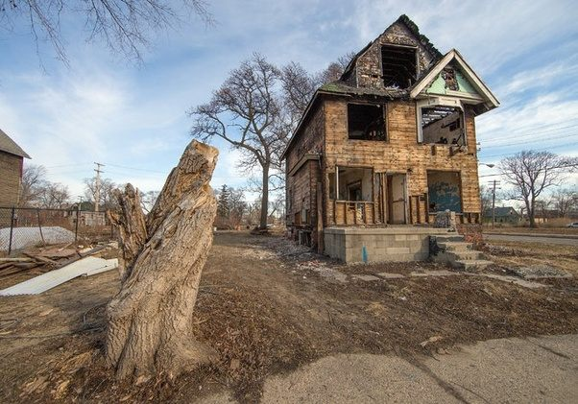
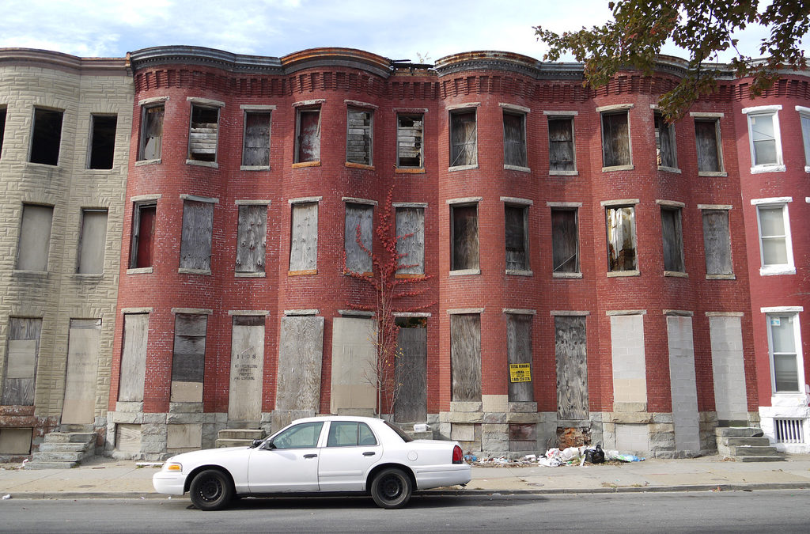
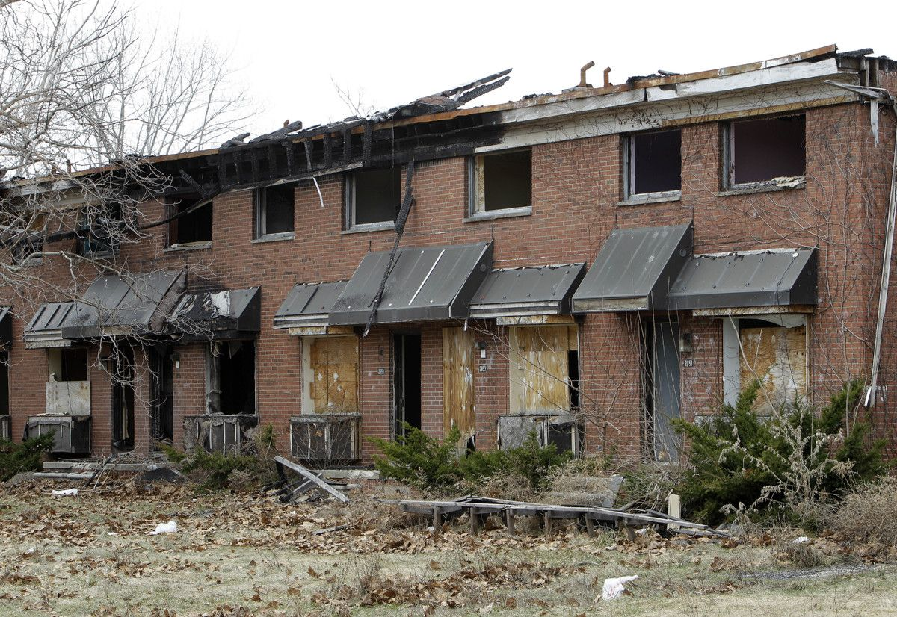
Notes:
12
Where employment is weak and household incomes low, land and property prices are low. In the most distressed neighborhoods, buildings or vacant lots cannot be sold at any price.

Slide 13
Notes:
13
When potential tenants cannot afford to pay a rent sufficient to cover the costs of ownership, absentee-owners defer maintenance, allow the property to be condemned, and walk away. The result is that all across the United States there are millions of vacant, abandoned properties.

Slide 14
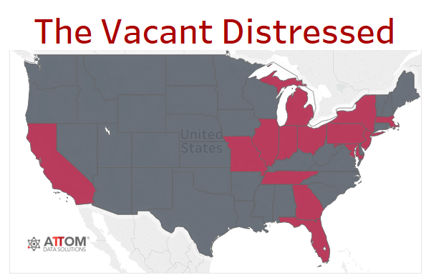
Notes:
14
ATTOM Data Solutions, which tracts the nation’s property markets, reported in October of 2017 that there are roughly 1.4 million residential properties vacant, representing 1.58 percent of all U.S. residential properties. The vacancy rate increased from the previous year in 81 of 149 metropolitan statistical areas analyzed. The states highlighted in red have the highest number of vacant properties.

Slide 15
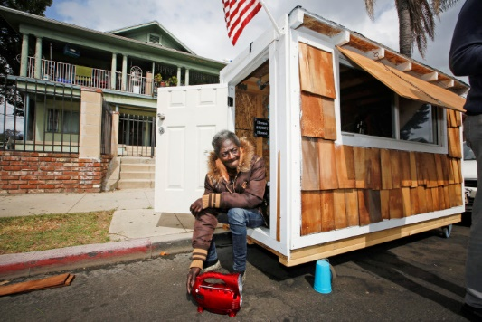
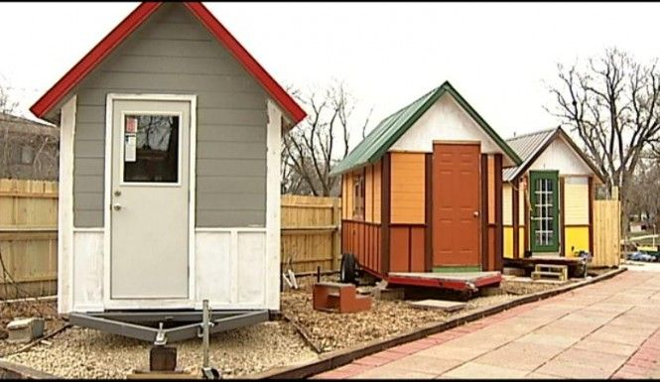
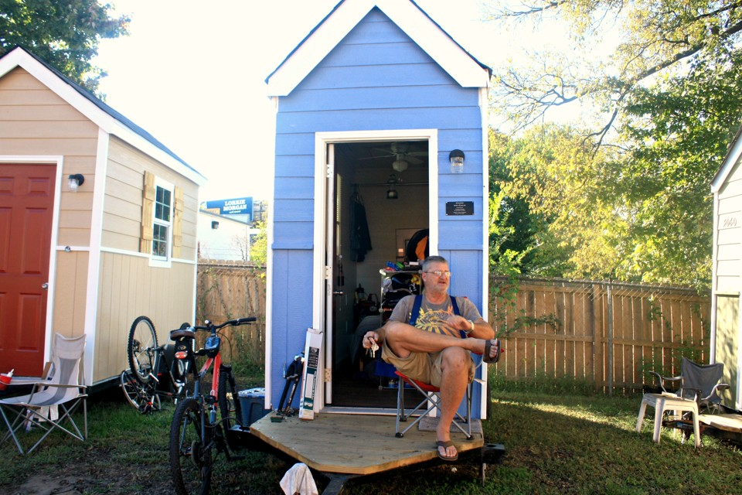
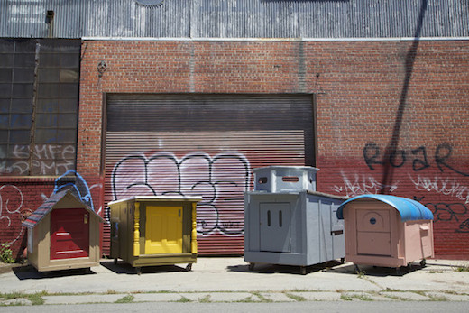
Notes:
15
One response to the problem of affordability has been the development of very small houses to serve as transitional housing for the homeless. Small villages of tiny houses have been constructed in Portland, Seattle, Austin, Madison and elsewhere.

Slide 16
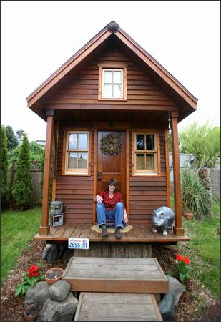
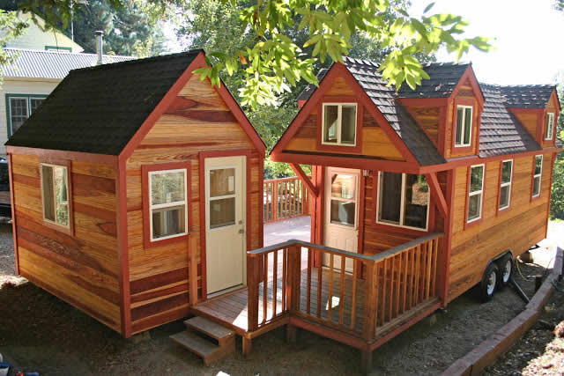
Notes:
16
Many others are choosing to purchase mobile tiny houses for reasons of affordability, reduced environmental impact, and as a lifestyle choice. These homes cost around $40,000 to have constructed. Owners need to obtain the land separately.

Slide 17
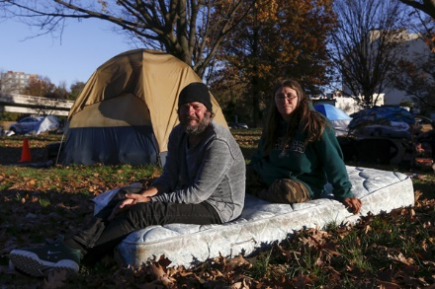
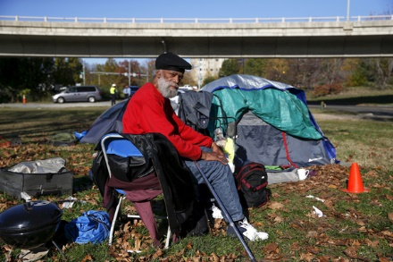
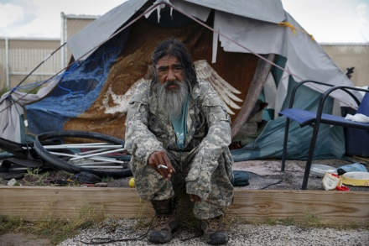
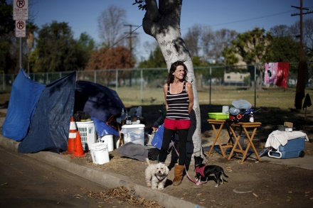
Notes:
The number of people living in tent cities scattered across the nation continues to increase. Late in December The National Law Center on Homelessness & Poverty reported a 1,342 percent increase in what they describe as “homeless encampments” between 2007 and 2017. They identify at least one such encampment in all fifty states and the District of Columbia. The response of city officials to the plight of these people is often to outlaw the encampments without providing a reasonable alternative.

Slide 18
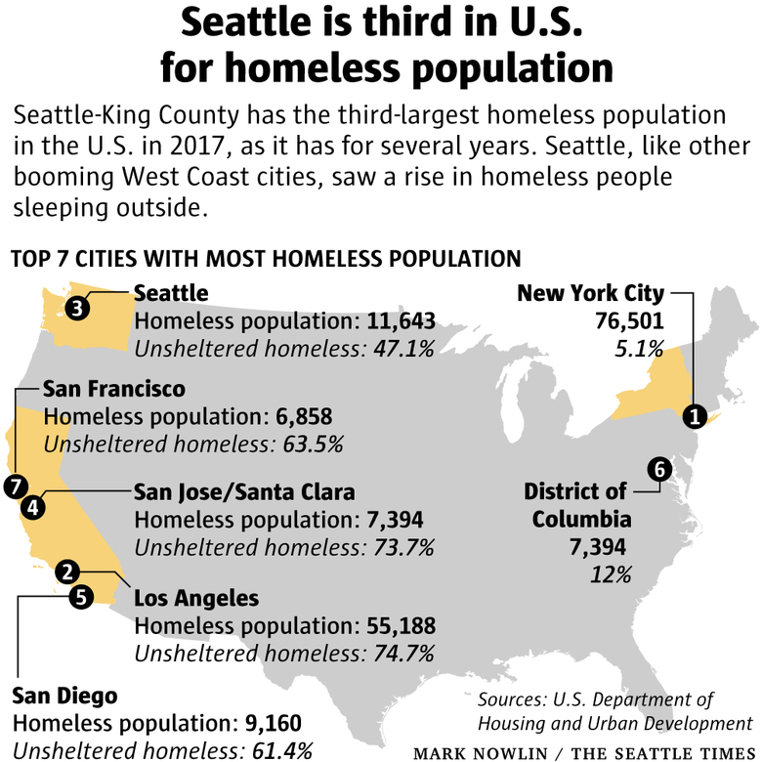
Notes:
The Seattle Times published this chart in December of 2017, observing that “As rents soar and access to affordable housing shrinks, the number of people living in states along the West Coast is trending in the wrong direction. …The crisis has prompted several local governments … to declare a civil state of emergency.”

Slide 19
Food Insecurity
Notes:
A related social issue is the extent to which people are unable to afford adequate food for themselves and their families.

Slide 20
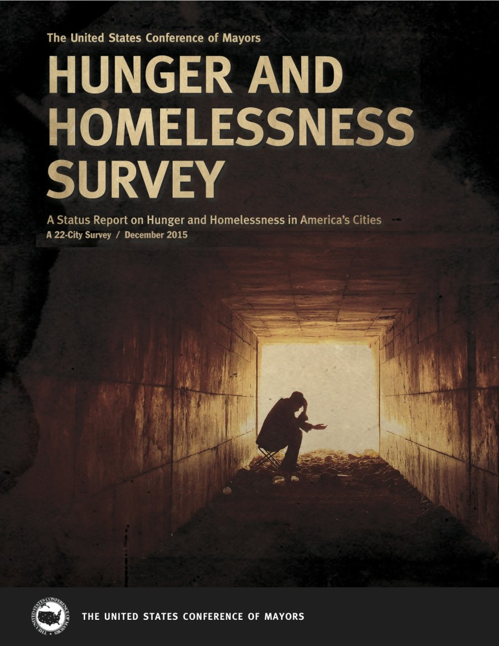
Notes:
U.S. Conference of Mayors 2017 Annual Report on Hunger and Homelessness has not yet been released. The 2016 report came out at the end of the year, with data compiled from 32 cities in 24 states. Here are some of the highlights of the report:

Slide 21
Notes:
21
Forty-one percent of the cities surveyed reported that the number of requests for emergency food assistance increased over the previous year, on average by 2 percent.

Slide 22
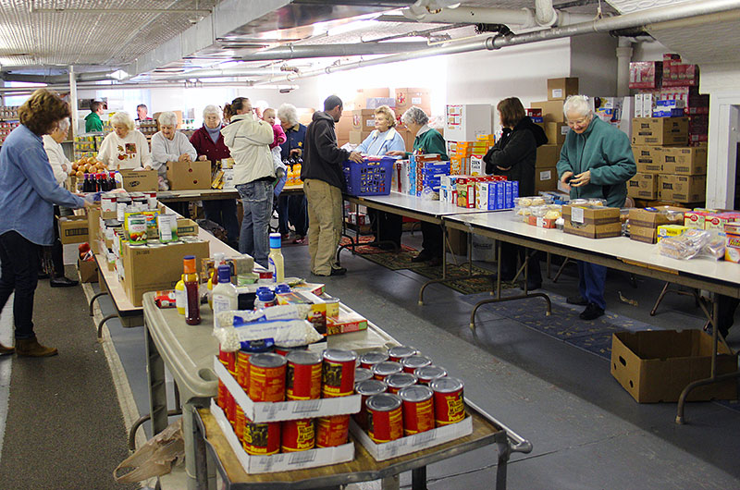
Notes:
22
Among those requesting emergency food assistance, 63 percent were persons in families, 51 percent were employed, 18 percent were elderly, and 8 percent were homeless.

Slide 23
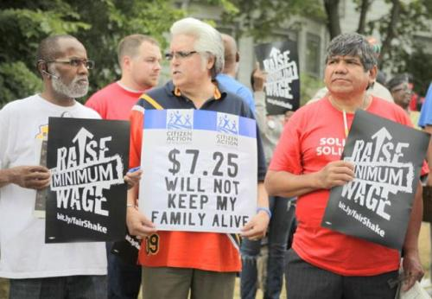
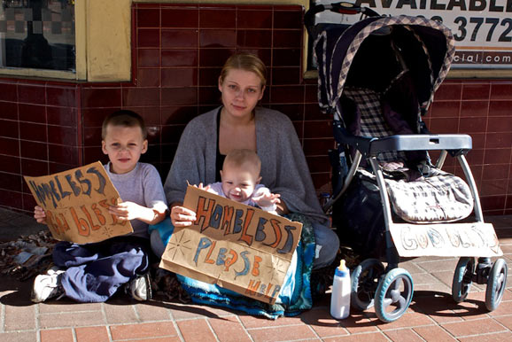
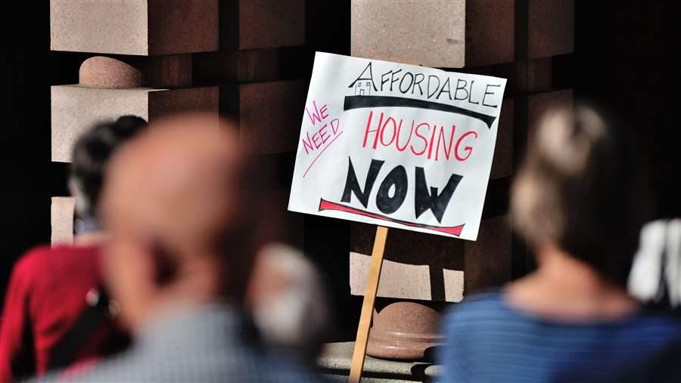
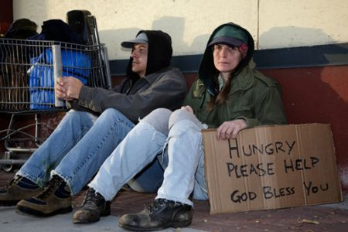
Notes:
23
Low wages led the list of causes of hunger cited by survey cities; followed by high housing costs and poverty.

Slide 24
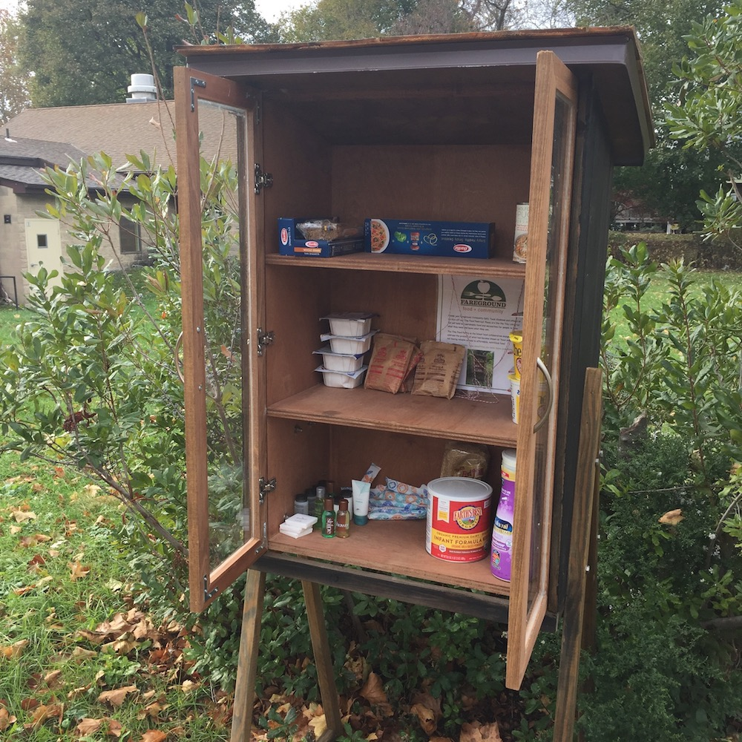
Notes:
24
Across the survey cities, 13.8 percent of the demand for emergency food assistance is estimated to have been unmet.

Slide 25
Notes:
25
In forty-seven percent of survey cities, the emergency kitchens and food pantries had to reduce the quantity of food persons could receive at each food pantry visit or the amount of food offered per meal at emergency kitchens. Also, because of lack of resources in forty-seven percent of the cities, facilities had to turn people away. The following graphs, published in September of 2017 by the U.S. Department of Agriculture provide a clear indication of the scale of the problem:

Slide 26
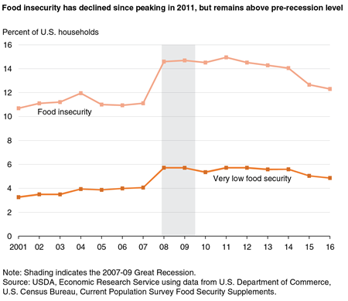
Notes:
As shown in this graph, in 2016, 12.3 percent of U.S. households were categorized as food insecure, meaning that they had difficulty at some time during the year providing enough food for all their members because of a lack of resources.

Slide 27
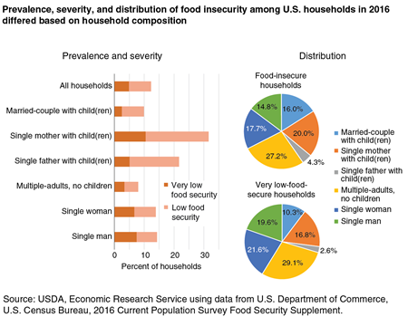
Notes:
Consistent with poverty levels, the households with the most severe food insecurity are single mothers with children.

Slide 28
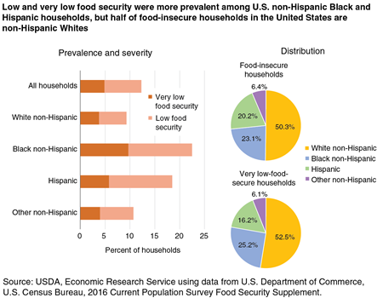
Notes:
And, as one would anticipate, households the members of which are African-American have the highest incidence of food insecurity.

Slide 29
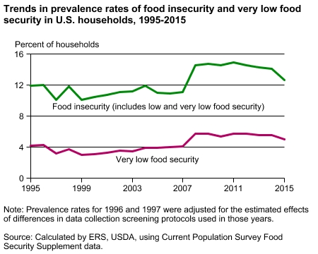
Notes:
The improved employment situation in the country has had some positive impact on the depth of food insecurity. However, the benefits are not effectively reaching those most in need.

Slide 30
Notes:
In a recent CBS Moneywatch segment, Erin McDonald, vice present of Feeding America’s Center for Applied Research in Action observed:

Slide 31
“The overall number for unemployment are lower and there are jobs … but people are making choices around paying for utilities, rent and others costs. Food is a basic need where maybe they are going without or cutting back.”
Notes:
“The overall number for unemployment are lower and there are jobs … but people are making choices around paying for utilities, rent and others costs. Food is a basic need where maybe they are going without or cutting back.”

Slide 32
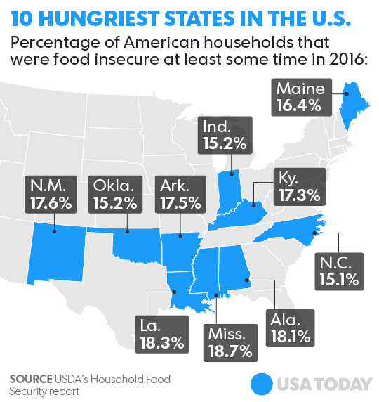
Notes:
As of 2016, Mississippi was the state where food insecurity is most severe and chronic.

Slide 33
Notes:
Food insecurity is actually greater in rural communities than in our cities. Over half of the counties with the highest rates of food insecurity are in rural areas. Key factors are lower-wage employment opportunities, higher unemployment and underemployment, lower level of education, insufficient affordable child care and an absence of public transportation.

Slide 34
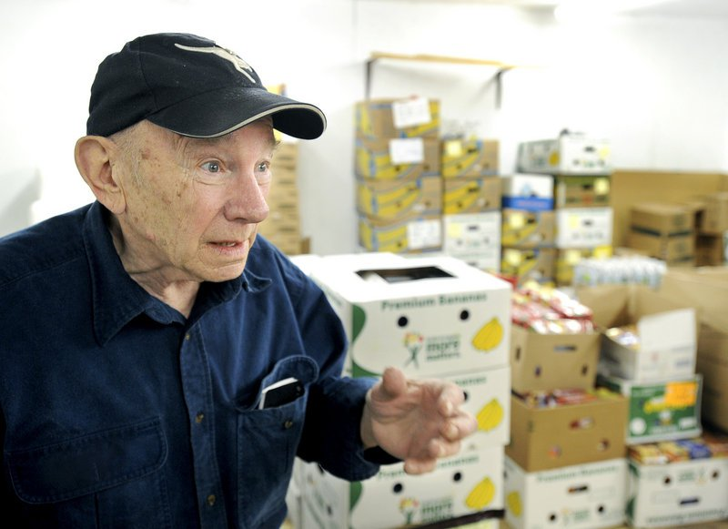
Notes:
More than 5 million senior citizens age 60 and older face hunger. Many are forced to choose between paying for groceries and paying for needed medicines. The organization Feeding America serves more than 46 million people, of which 7 million individuals are age 60 or older and an additional 6 million are age 50-59. [Source: “Senior Hunger Fact Sheet,” Feeding America, September 2017]

Slide 35
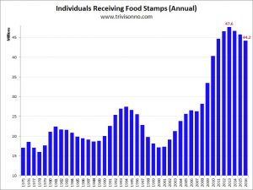
Notes:
Data released by the U.S. Department of Agriculture on the 5th of January, 2018, indicated that 45.6 million people are receiving food stamp assistance, which is up from 44.2 million in 2016. The reason for the increase was the damage caused by hurricanes. Assistance to citizens of Puerto Rico are not included in this data.

Slide 36
Notes:
The 2018 Agriculture and Nutrition Act, defeated in the House of Representatives in May, would as imposed stricter work requirement on those receiving benefits from the Supplemental Nutrition Assistance Program. Debate continues over whether this would benefit or harm low income individuals who, forced to work longer hours at one or more low-wage jobs, would have to absorb child care, transportation, and other expenses.

Slide 37
Notes:
37
The data on the number of college students who do not have a healthy or regular diet indicates this problem is worsening. In a report written by Christopher Nellum at the American Council on Education, he states:

Slide 38
“The numbers are striking. Feeding America … estimates that nearly half (49.3 percent) of its clients in college must choose between educational expenses (i.e., tuition, books and supplies, rent) and food annually, and that 21 percent did so for a full 12 months.”
Notes:
38
“The numbers are striking. Feeding America … estimates that nearly half (49.3 percent) of its clients in college must choose between educational expenses (i.e., tuition, books and supplies, rent) and food annually, and that 21 percent did so for a full 12 months.”

Slide 39
Notes:
For a college student to be eligible for food stamps they often must work 20 hours a week. A small number of colleges have responded to the problem. The New York Times recently reported that Spelman and Morehouse both agreed to allocate 14,000 free meals per year to students in need. Bunker Hill Community College in Boston is now distributing meal vouchers, and Houston Community College is providing grocery scholarships.

Slide 40
Notes:
Poverty has always been a serious problem in the United States, particularly among persons of color, the elderly and newly-arrived immigrants. While as a percentage of the total population poverty gradually declined beginning in the late 1940s, the absolute number of people living in poverty continues to increase.

Slide 41
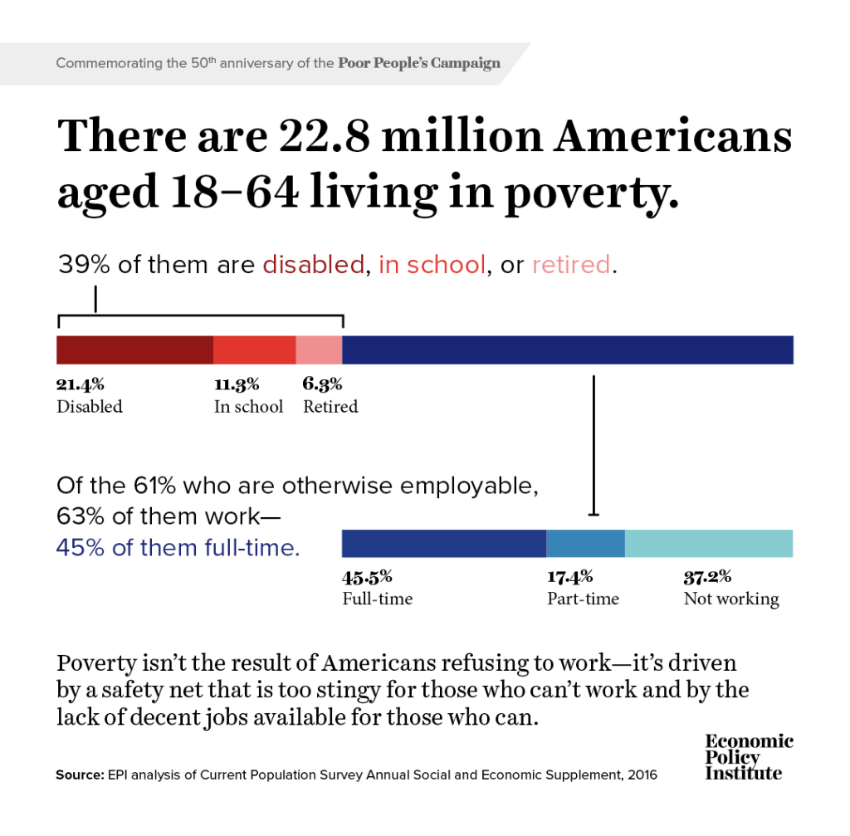
Notes:
Despite the economic recovery, there are still nearly 23 million Americans aged 18 to 64 living in poverty. The Economic Policy Institute argues that the primary reason is “a safety net that is too stingy for those who can’t work and by the lack of decent jobs available for those who can.” [Source: “Poverty persists because of a stingy safety net and a dysfunctional labor market,” EPI News, Economic Policy Institute, 25 May, 2018]

Slide 42
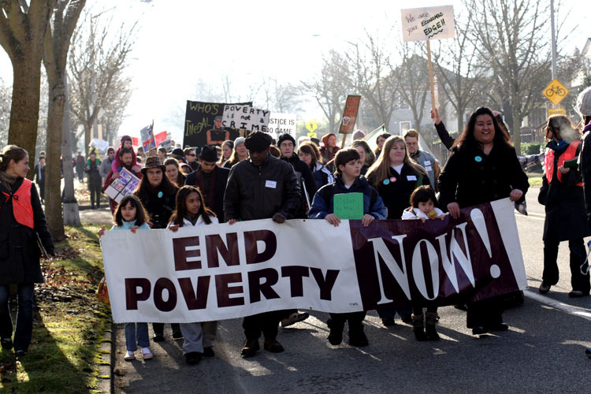
Notes:
A major societal disagreement exists over the extent to which government should intervene on behalf of the poor. There is no consensus on the causes of poverty. Is poverty primarily the result of individual behavior and decisions? Or, is poverty caused by systemic flaws in the socio-political arrangements and institutions?

Slide 43
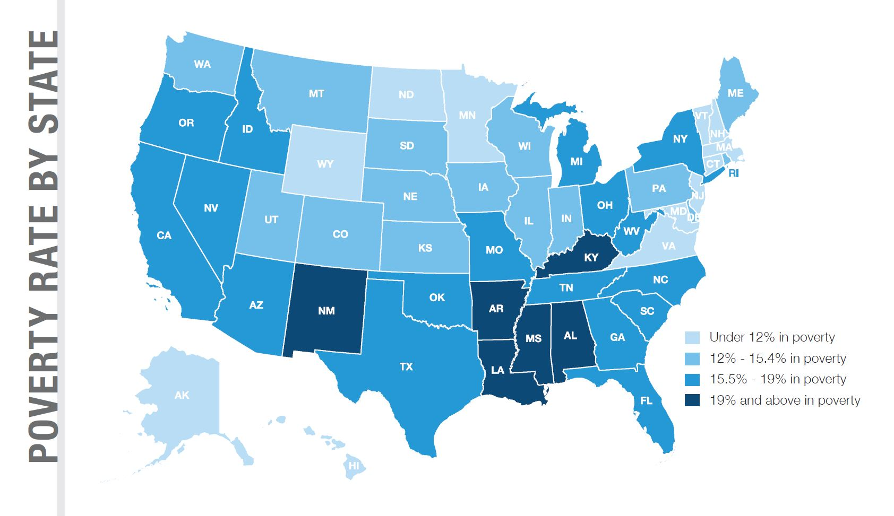
Notes:
This map indicates the level of poverty in each state, based on 2016 data analyzed by the U.S. Census Bureau and released in September of 2017. Note that six states report a poverty rate of 19 percent or higher. There is a logical correlation between poverty levels and the level of food insecurity in these states. Absolute poverty has declined each year since 2014, down to 40.6 million people in 2016.

Slide 44
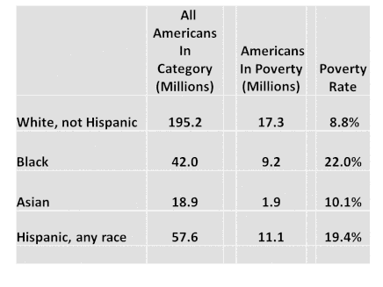
Notes:
It is no great secret that persons of color have had higher rates of poverty going back as far as these statistics were gathered and reported. Significant improvement in the living conditions of minority populations occurred with passage of Civil Rights legislation, but the percentages remain much higher than for Whites. In 2017 the national average was 13 percent, that for African Americans was 22 percent, and for Hispanics, 19.4 percent.

Slide 45
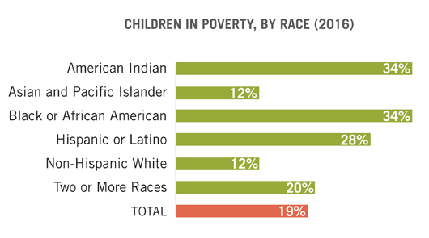
Notes:
Similar percentage differences apply to children living in poverty.

Slide 46
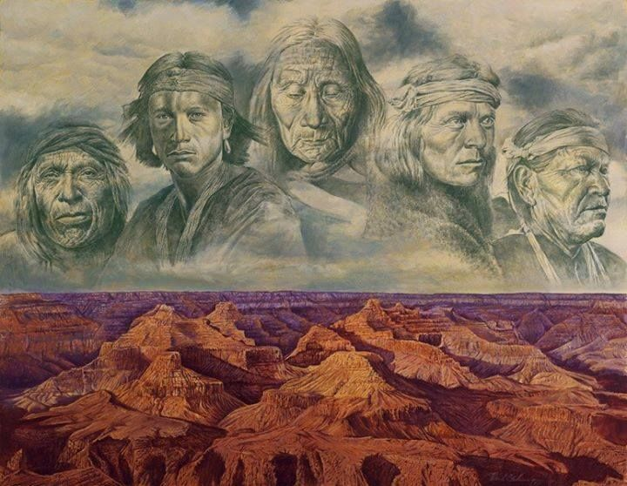
Notes:
Today, 78 percent of people whose heritage is that of a Native American tribal society do not live on a reservation. Most live in urban or suburban communities. This is the result of forced relocation by the United States government during the 1950s. Thus, the causes of poverty within the American Indian population involve factors that are qualitatively different from that of Blacks even immigrant groups, requiring separate analysis outside the scope of this update.

Slide 47
The State of Senior Americans
Notes:
The population of the United States is growing older each year. The median age as of July 2016 was 37.9 years, up from 35.3 years in 2000. There are now 51.4 million people in the United States age 65 and older, which represents 15.3 percent of the nation’s total population. [Source: U.S. Census Bureau]

Slide 48
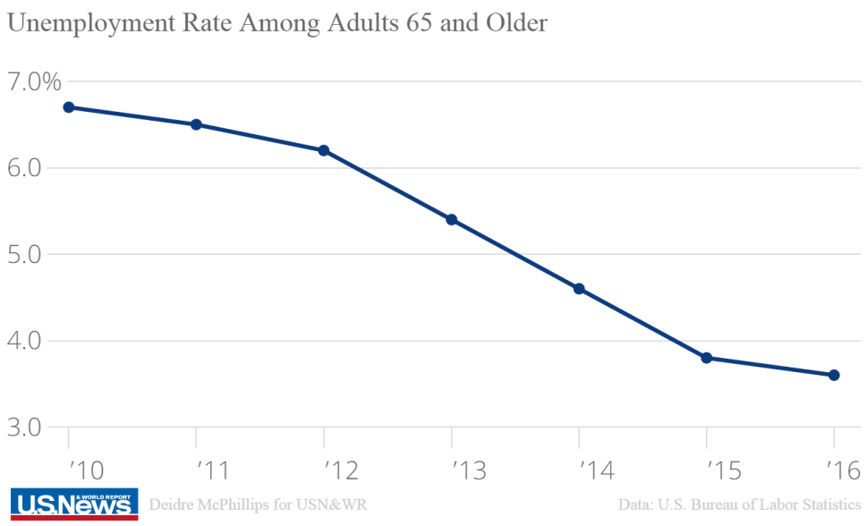
Notes:
However, reaching age 65 is no longer an automatic time for retirement. U.S. News examined employment data from the Bureau of Labor Statistics and reported that more than 9.2 million seniors held either a full-time or part-time job in August of 2017. The Social Security Administration data indicates that the average 65-year old male will live an average of 19 additional years, a woman another 21.5 years.

Slide 49
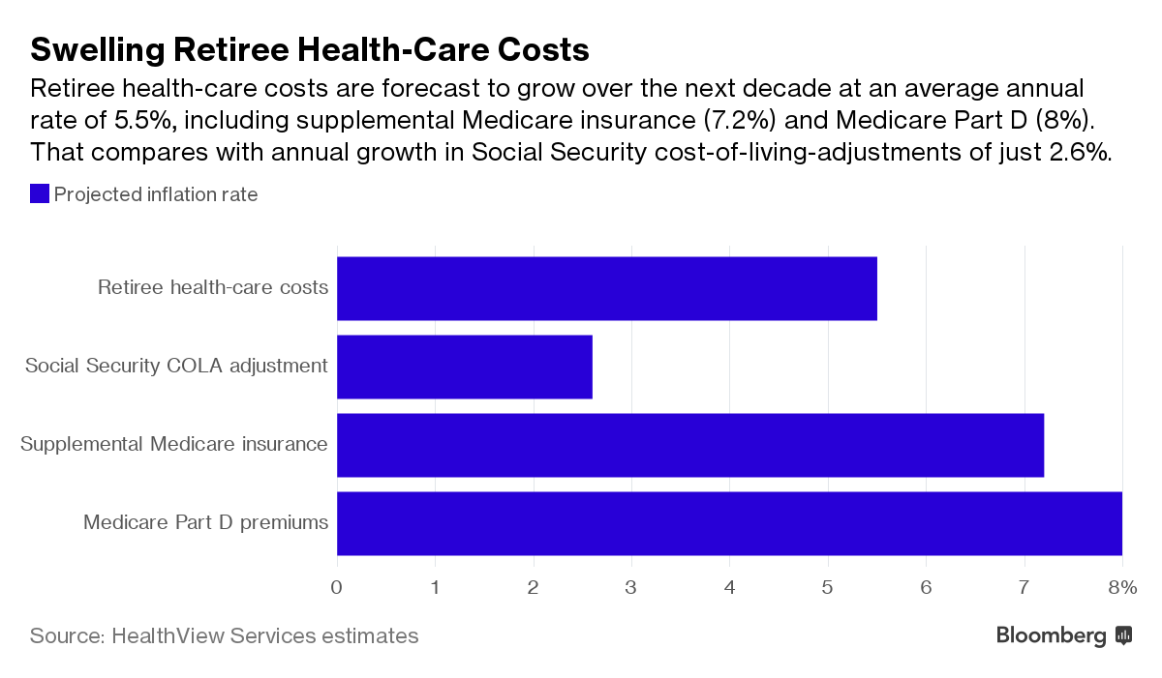
Notes:
U.S. retiree health-care costs are forecasted to increase at an average annual rate of 5.5 percent over the next decade, a rate of increase significantly higher than the anticipated general rate of inflation. [Source: Report by Health View Services, 2017]

Slide 50
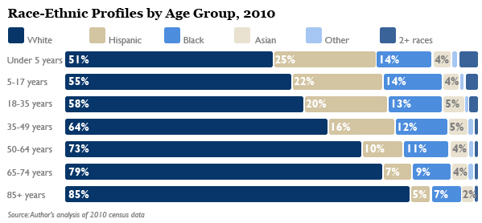
Notes:
50
As this graph indicates, people who are White make up a very large segment of the senior population.

Slide 51
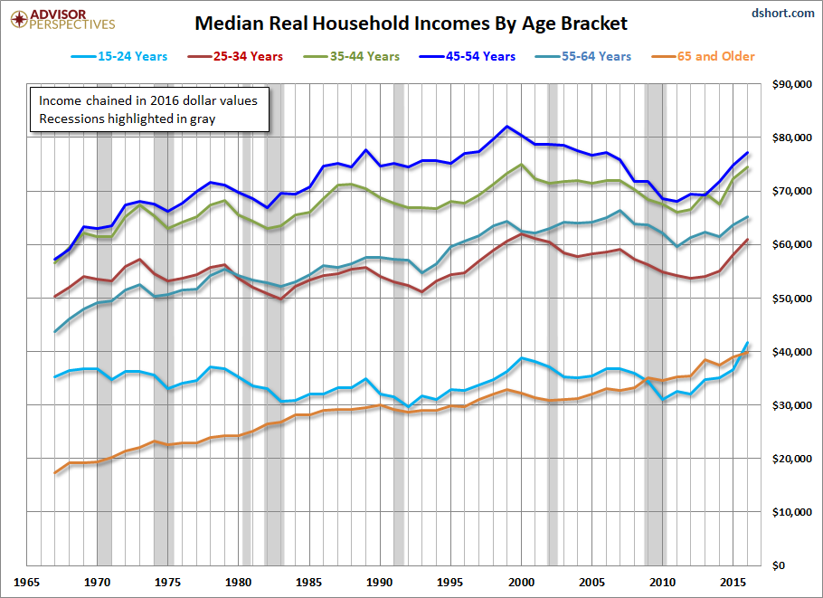
- Age 65 and older
Notes:
51
This chart shows median household incomes by age bracket. For seniors the median income is around $39,000, half of all senior households above and half below this income level.

Slide 52
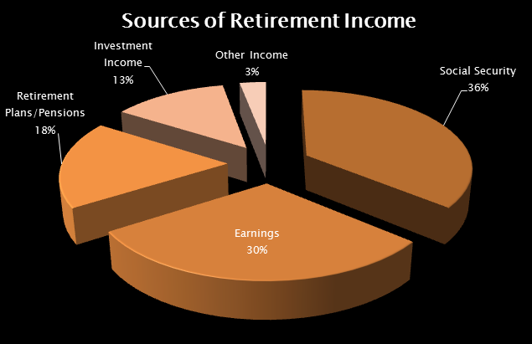
Notes:
The main sources of income for people over 65 are Social Security (36 percent), income from working (30 percent), pensions (18 percent) and savings and investments (13 percent). Younger retirees derive more income from working and investments, while over half of older retirees rely heavily or exclusively on Social Security.

Slide 53
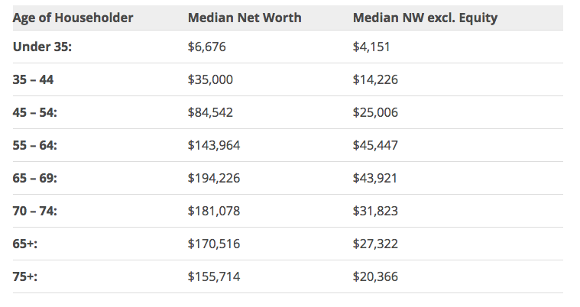
Notes:
53
Data compiled in June of 2017 by Business Insider shows the degree to which the net worth of most persons is significantly attached to the ownership of a residential property. And, of course, those who are age 55 and above are most likely to have repaid their mortgage debt or nearly so.

Slide 54
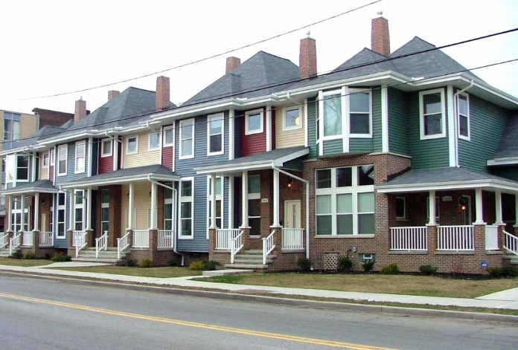
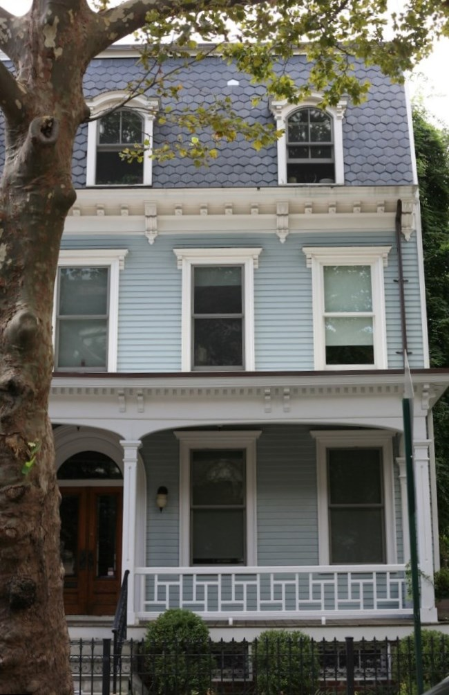
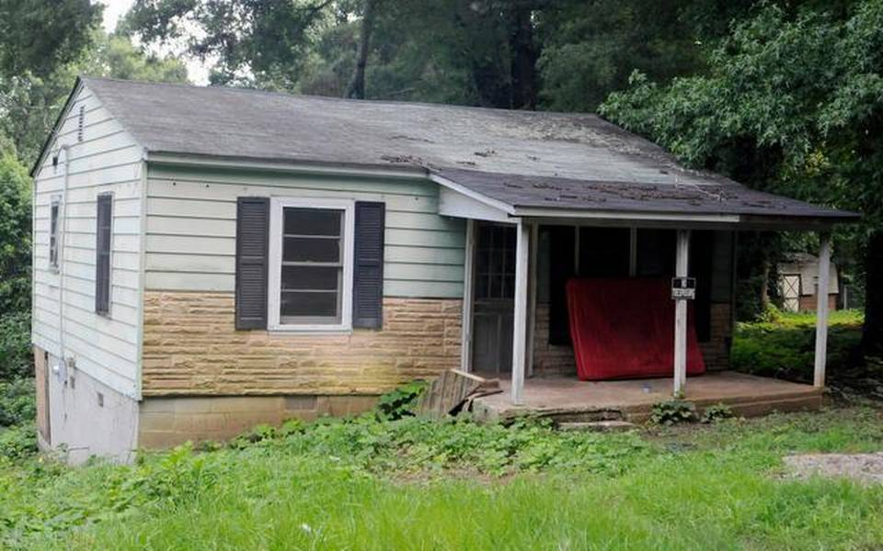
Notes:
As residential property values recovered from the 2008 market collapse, the unrealized housing net worth held by U.S. seniors has climbed to over $6 trillion, tripling since the year 2000. I have not been able to find statistics on how this equity is distributed among senior households. These examples of how we live shed some light on the question. [Source: Jason Oliva, “U.S. Seniors’ Housing Wealth Now a $5.9 Trillion Reverse Mortgage Opportunity,” Reverse Mortgage Daily, 29 September, 2016]

Slide 55
Notes:
A recent report by ATTOM researchers states that 34 percent of all American property owners have either paid our their mortgage debt or never borrowed to acquire their property. The Federal Reserve estimates that total equity in residential property equals $1.37 trillion.

Slide 56
Notes:
Some seniors continue to lose their property as a result of foreclosure after failing to meet the terms of a reverse mortgage loan. Deferring maintenance, falling behind on property taxes or not carrying homeowners insurance constitute a default of the terms of a reverse mortgage. A HUD report released in the fall of 2016 stated that around 90,000 reverse mortgages were in default. [Source: Jenifer McKim. “More seniors are taking loans against their homes – and it’s costing them,” The Washington Post, 25 August, 2017]

Slide 57
Notes:
57
The poverty rate for people age 65 and older is lower than for any other age group. Two major reasons are the equity in a residential property and benefits under the Social Security system.

Slide 58
Notes:
58
Even so, a key indicator of the well-being of seniors is the percent of household income devoted to housing expenses. The 2017 Harvard Joint Center for Housing Studies reports only a slight improvement for all households from the previously year:

Slide 59
“Despite a slight improvement from 2014, fully one-third of US households paid more than 30 percent of their incomes for housing in 2015. Renters continue to be more likely to face cost burdens. Indeed, the number of cost-burdened renters (21 million) considerably outstrips the number of cost-burdened owners (18 million) even though nearly two-thirds of US households own their homes.”
Notes:
59
“Despite a slight improvement from 2014, fully one-third of US households paid more than 30 percent of their incomes for housing in 2015. Renters continue to be more likely to face cost burdens. Indeed, the number of cost-burdened renters (21 million) considerably outstrips the number of cost-burdened owners (18 million) even though nearly two-thirds of US households own their homes.”

Slide 60
“[O]ne-third of older adults faced cost burdens in 2015, including 54 percent of renters and 43 percent of owners with mortgages on their homes. Moreover, the share of older adults with mortgage debt, as well as the median amount of that debt, is on the rise. Between 2001 and 2013 alone, the share of owners age 65 and over with mortgages increased by 12 percentage points to 36 percent, while median debt rose 26 percent to $73,000.”
Notes:
60
“[O]ne-third of older adults faced cost burdens in 2015, including 54 percent of renters and 43 percent of owners with mortgages on their homes. Moreover, the share of older adults with mortgage debt, as well as the median amount of that debt, is on the rise. Between 2001 and 2013 alone, the share of owners age 65 and over with mortgages increased by 12 percentage points to 36 percent, while median debt rose 26 percent to $73,000. ”

Slide 61
Notes:
61
Next, we’ll take a close look at property ownership in the nation.

Slide 62
End of Part 4

