Slide 1
The State of the United States
ECONOMY and SOCIETY
Part 8

Slide 2
Land Prices,
the Cost of Doing Business
and the Cost of Acquiring a Home
Notes:
In order to live, work and play, we all need access to land, even land that is actually in the form of water. We also live, work and play on and under our rivers, streams, lakes and oceans. Every location on the planet (and within the borders of the United States) has some potential annual rental value – from almost zero to around $220 per acre of good farmland to $30 per square foot per year in financial district of a major city.

Slide 3
Notes:
3
One of the few efforts by the U.S. government to calculate the value of the land in the United States was completed in 2015 by William Larson at the Bureau of Economic Analysis. The report states:

Slide 4
“Estimates suggest that this 1.89 billion acres of land are collectively worth approximately $23 trillion in 2009 (current prices), with 24% of the land area and $1.8 trillion of the value held by the federal government.”
Notes:
4
Estimates suggest that this 1.89 billion acres of land are collectively worth approximately $23 trillion in 2009 (current prices), with 24% of the land area and $1.8 trillion of the value held by the federal government. [Source: William Larson. “New Estimates of Value of Land of the United States,” Bureau of Economic Analysis, 3 April 2015]

Slide 5
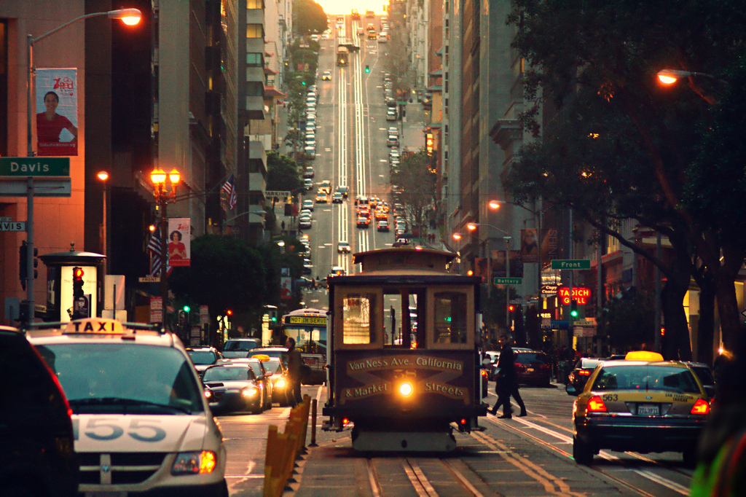
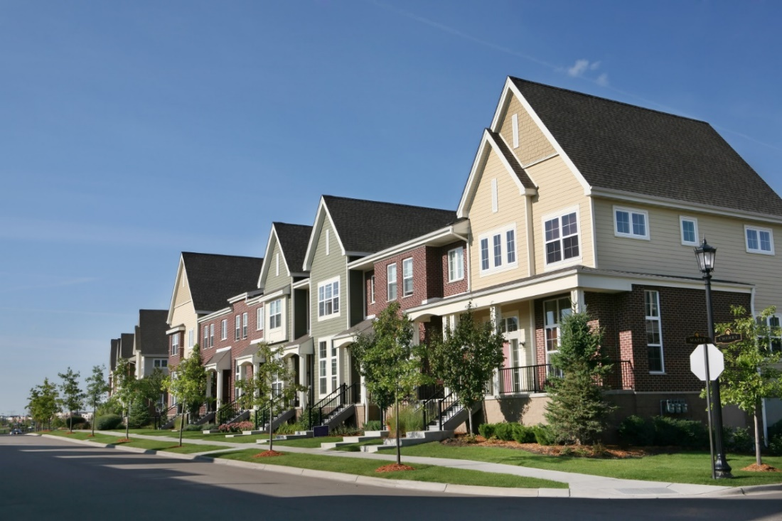
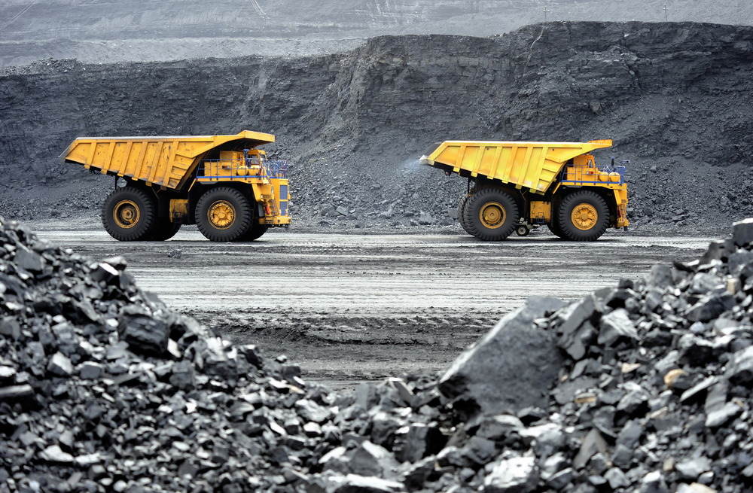
Notes:
5
Land in the cities is valued by the square foot, in the suburbs by portions of an acre, and in rural areas primarily based on the existence of exploitable natural resources or fertility and annual rainfall necessary for agricultural production.

Slide 6
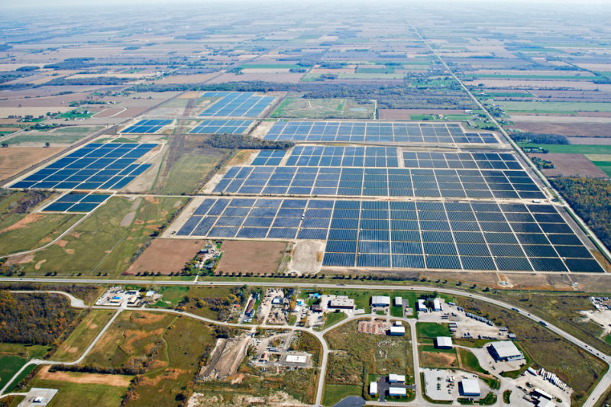
Notes:
6
However, changing technologies have dramatically increased the value of land where the sun or wind provides a reliable source of electrical energy. Once marginal agricultural land today yields significant rental income from companies that install wind or solar farms, or drill for oil or gas.

Slide 7
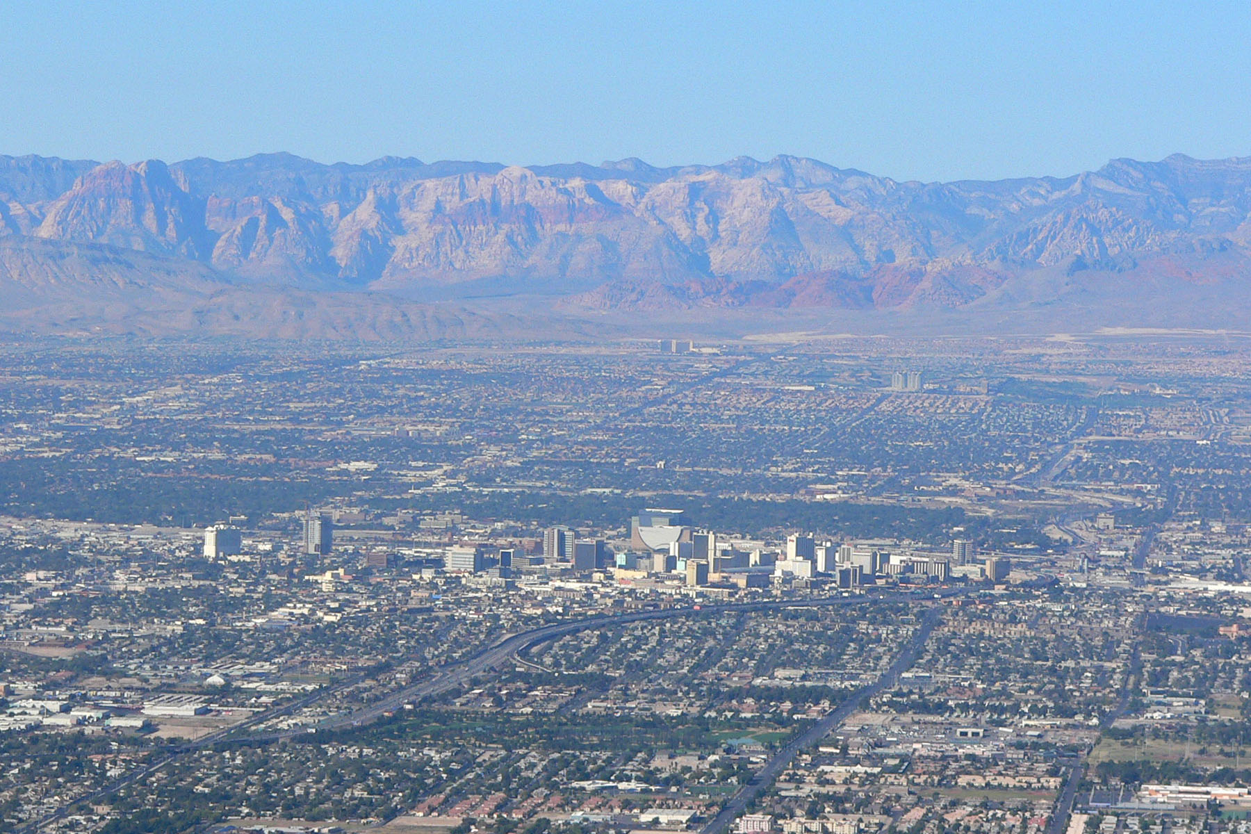
Notes:
7
Changes in permissable uses also dramatically influence land values. Legalized gambling (and a guaranteed supply of water from Lake Meade) turned Las Vegas from a sleepy desert town into a growing metropolitan region.

Slide 8
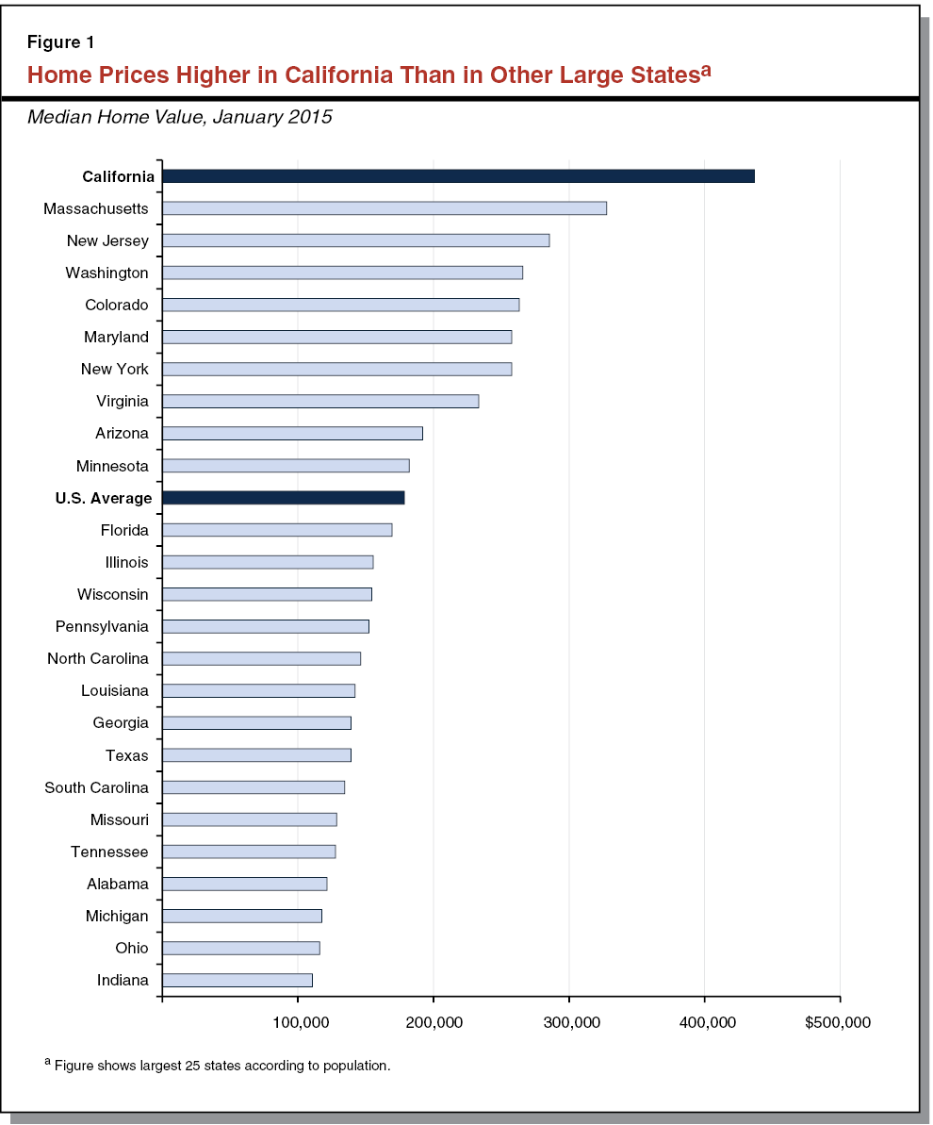
Notes:
A rough equivalence exists between the cost of land available for development and the difference in the median price of residential properties around the country. Land costs naturally tend to be much lower in rural areas than in large towns or cities.

Slide 9
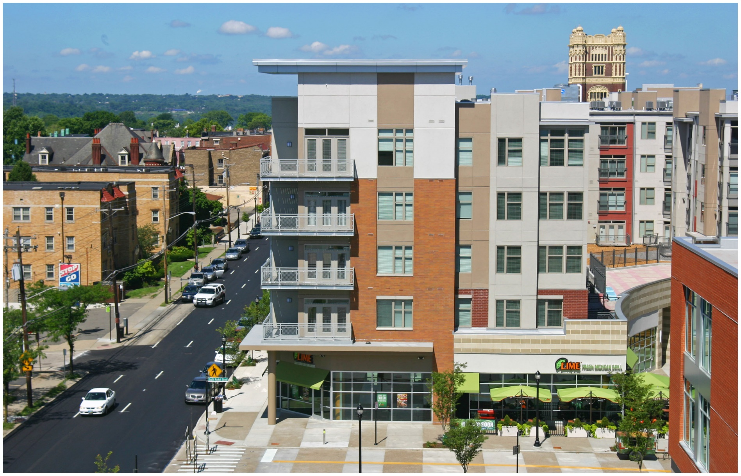
Notes:
People living in regions, cities and even neighborhoods with growing populations face high and ever-rising housing costs because demand almost always outpaces supply. At the heart of the supply problem is the failure of land to be brought to the market at prices that make development affordable except for higher income households.

Slide 10
Median value of a residential property:
$215,600
Median land-to-total value ratio (est.):
35%
Median value of the land beneath a residence:
$ 75,460
Multiplied by the number of properties owned:
86 million
Total estimated value of residentially-owned land:
$6.5 TRILLION
Notes:
10
The ownership of residential land is certainly not insignificant. As already shown, equity in the value of the land beneath one’s residential property comprises a major portion of household net worth. Out of the 120 million U.S. households, 76,8 million own the homes in which they live. Some 9.2 million also own a second home (down from 12.6 million in 2008). [Source: “People living in households that own a second home in the U.S. 2017,” Statista.com] Thus, a rough estimate of the value of residential land owned by these households (which does not include investor-owned property or vacant residential lots) is shown in this chart.

Slide 11
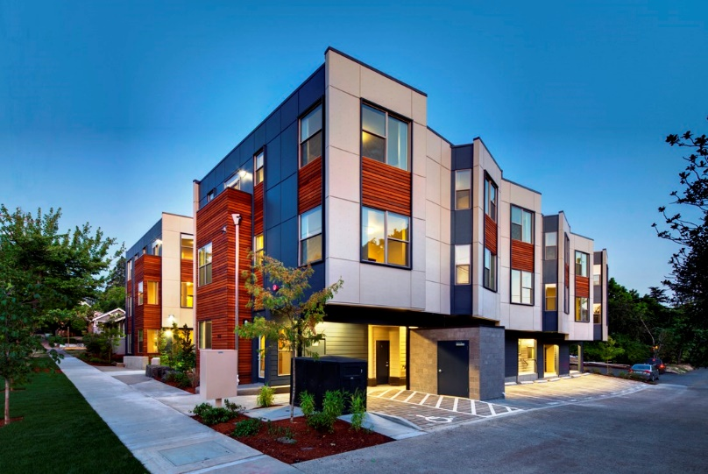
Notes:
There are many households that choose to live in a rented apartment or house. Their reasons are varied, but the chief reasons are job mobility, the lack of savings to make a down payment on a property, or insufficient household income. Few renters have the financial net worth close to the median for those who own a residential property.

Slide 12
Notes:
Every three years the Federal Reserve conducts a Survey of Consumer Finances in which they collect data across all economic and social groups. The latest survey, which includes data from 2010-2013, reports that a homeowner’s net worth is 36 times greater than that of a renter ($194,500 vs. $5,400).

Slide 13
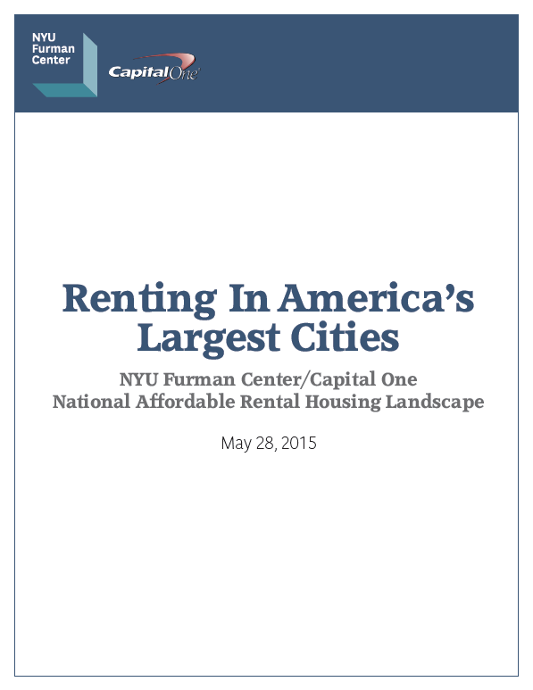
Notes:
This 2015 report by NYU’s Putman Center indicated that nine of the 11 largest U.S. cities had experienced falling vacancy rates and rising rents. Low-income renters could afford no more than 11 percent of recently available units even in the most affordable cities. However, in some cities supply has increased while demand has fallen.

Slide 14
Notes:
The City of Chicago is one market where the demographics and economics have improved for renters. Since 2013 Chicago has lost about 22,600 people, while 26,000 multifamily rental units were completed. The result has been a decline of nearly 14 percent in asking rents for a one-bedroom apartment and nearly 16 percent for a two-bedroom unit, although the average 2 bedroom until will still cost you $2,000 per month (plus utilities).

Slide 15
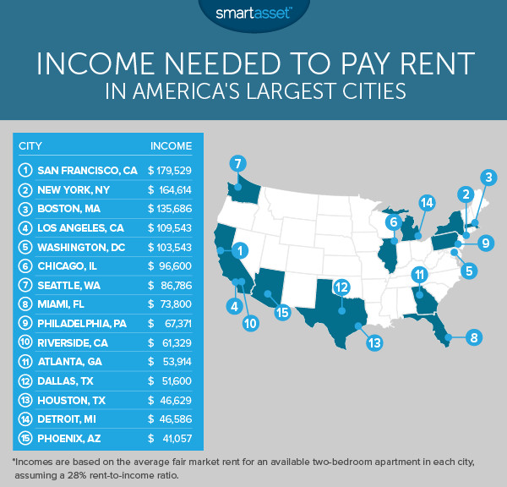
Notes:
San Francisco property owners are learning that potential renters cannot afford to meet the almost continuous increase in asking rents. Rents for a one-bedroom apartment have come down by 7.6 percent since 2015. [Source: Wolf Richter. “Rents are collapsing in some of America’s biggest cities,” Business Insider, 3 September, 2017] A studio apartment in the city costs an average of $2,500 a month.

Slide 16
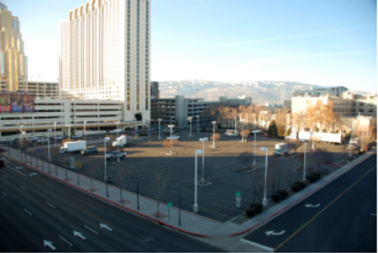
Commercial Land
Notes:
As our population grows and as people continue to migrate to cities in search of employment, the value of urban land will continue to climb. Market forces result in the construction of multi-story buildings – of skyscrapers – in part to counter the higher and higher per square foot cost of land in and near central business districts. Businesses constantly face decisions about having to downsize or relocate in order to lower the cost of doing business associated with where they operate.

Slide 17
Notes:
17
There is no publicly-available data on the ownership of land in the nation’s major cities and metropolitan regions. However, just twenty-five real estate companies own a combined total of more than 3.65 billion square feet of commercial real estate in the U.S. and overseas. Their buildings occupy the nation’s most valuable parcels of land. [Source: “America’s Biggest Commercial Landlords,” Bloomberg, 4 November, 2010]

Slide 18
Notes:
18
The Vanguard Group, based in Malvern, Pennsylvania, is now the leading owner of real estate investment trusts owning commercial real estate across the United States. Commenting on the ongoing concentration of ownership in the commercial real estate sector, Jeffrey DeMaso, research director at Adviser Investments in New York warns:

Slide 19
“When you own all the landlords, competition among them – in which REITs might improve properties and cut rents to attract the best tenants – starts to look not like a natural part of the free-market system favoring the best property managers, but like a nuisance that easts into owners’ total profits.”
Notes:
19
“When you own all the landlords, competition among them – in which REITs might improve properties and cut rents to attract the best tenants – starts to look not like a natural part of the free-market system favoring the best property managers, but like a nuisance that easts into owners’ total profits.” [Quoted in: Joseph N. DiStefano. “Vanguard Group is America’s new landlord,” The Inquirer/Daily News, 2 June, 2018]

Slide 20
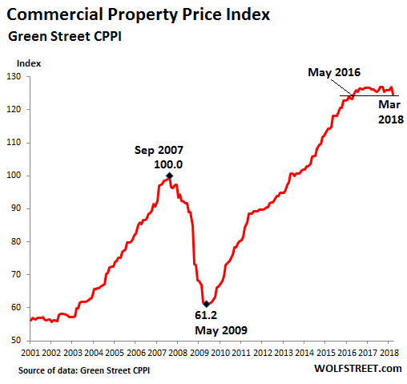
Notes:
20
Green Street Advisors tracks commercial property prices across the United States, reporting earlier this year that price were flat during 2017.

Slide 21
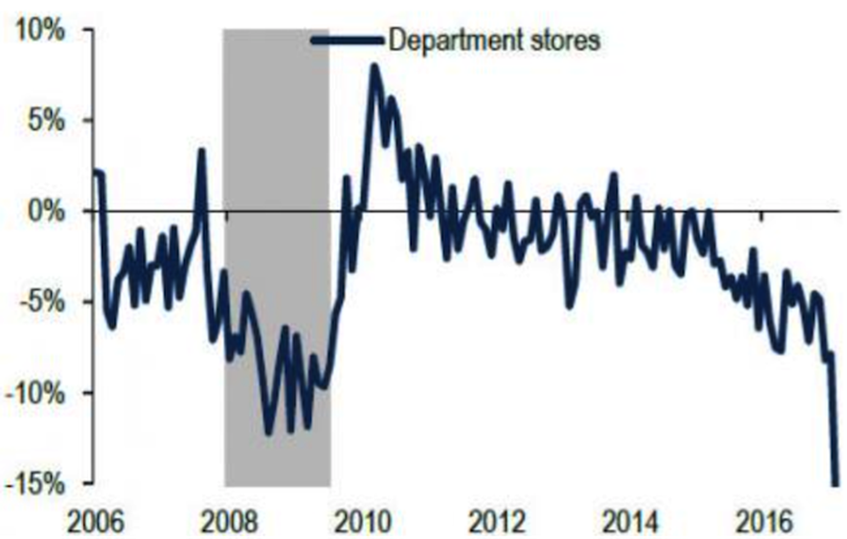
sales
Notes:
21
The sector with the greatest declines in value was retail because of the growing strength of e-commerce.

Slide 22
VACANT
LAND
Notes:
22
Following the 2008 crash in property prices, foreign and U.S. corporations began buying urban land and buildings, particularly from owners highly leveraged with mortgage debt. In just one twelve-month period – from mid-2014 to mid-2015 over $1 trillion in property changed hands in the top 100 cities. [Source: Saskia Sassen. “Who owns our cites – and why this urban takeover should concern us all.” The Guardian, 24 November 2015]

Slide 23
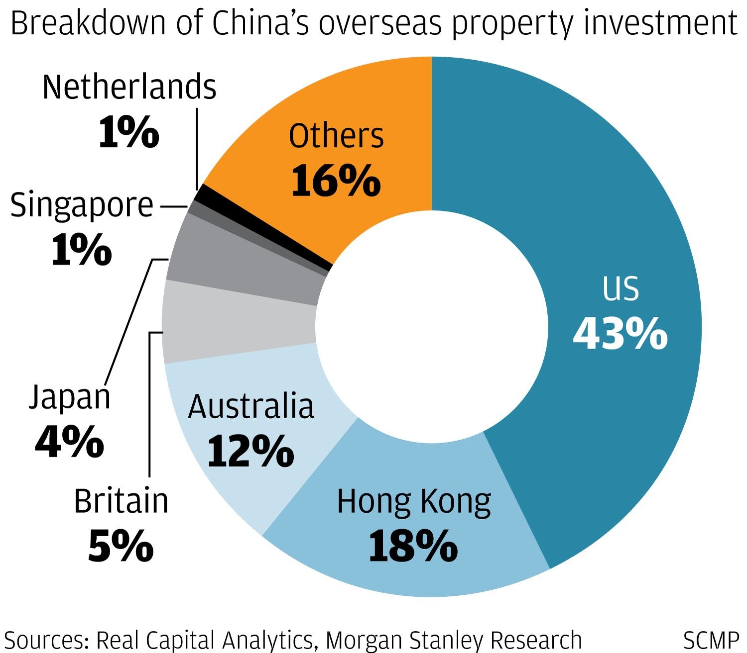
Notes:
23
During 2016, Chinese investors were the single largest group of foreign investors in commercial real estate in the United States. Chinese insurance companies were involved in many of the largest transactions. Then, last year, Chinese investments feel by 55 percent, to $7.3 billion, as a result of tighter capital controls imposed by the Chinese government (and because of more attractive investment opportunities in other countries).

Slide 24
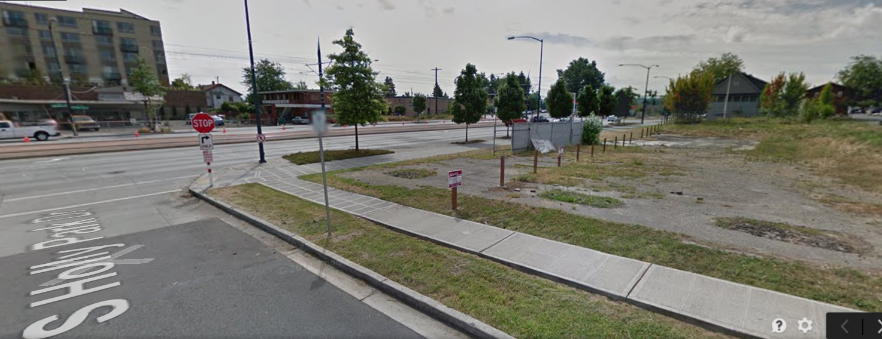
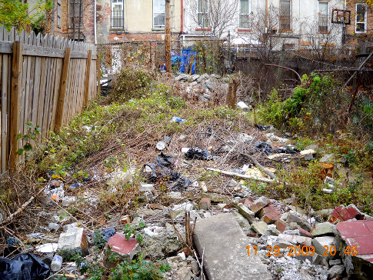
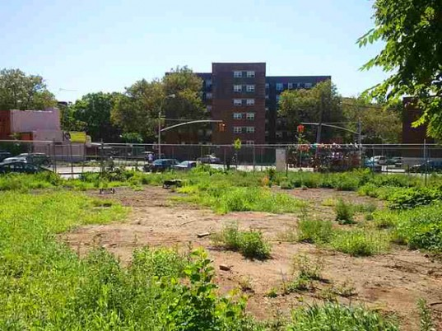
Notes:
24
Even in prosperous and growing cities there is a significant amount of vacant and underutilized land. Aerial photographs of most cities show just how much land could be developed for residential, commercial and other uses, if only public policies provided the right incentives for owners to bring the land they hold to its highest, best use. Assessment practices that fail to adjust values to current market are particularly harmful in parts of cities where demand for land is increasing. The low effective rate of taxation allows owners to hold on to land for years without real concern for the carrying cost of doing so.

Slide 25
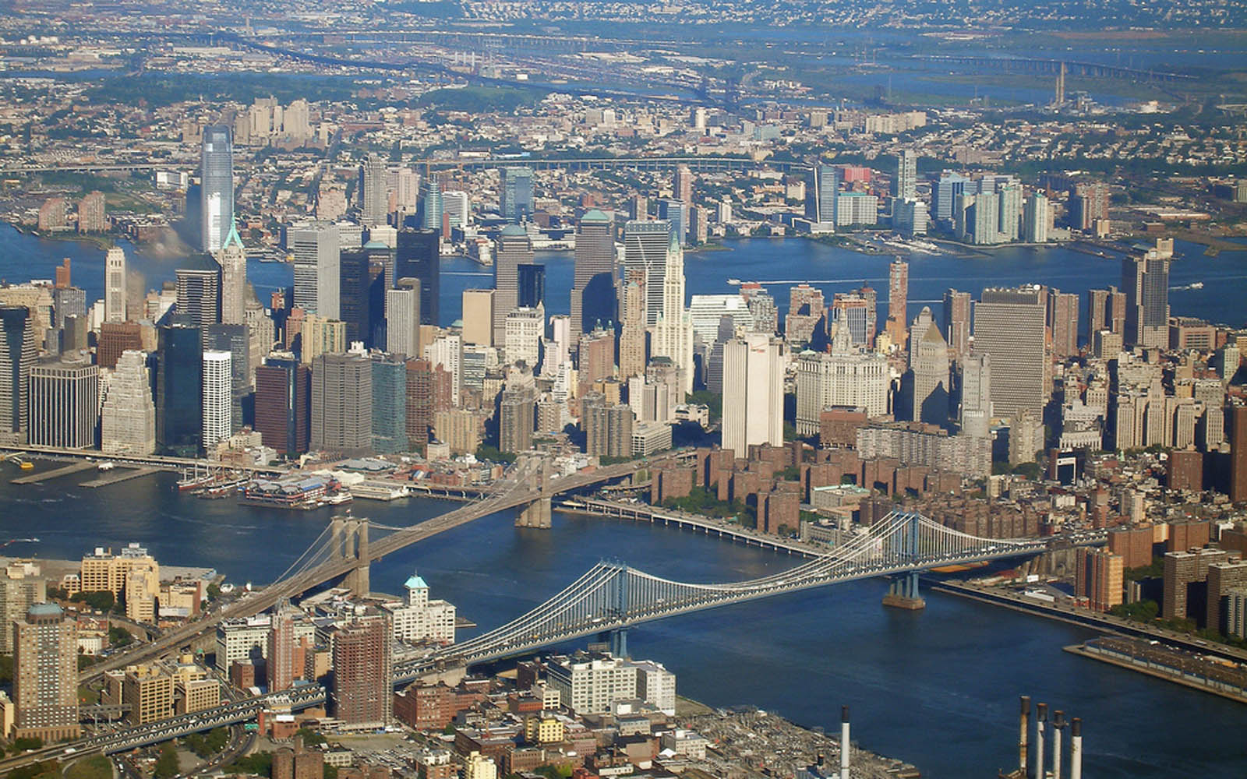
Notes:
25
Based on Manhattan land sales during 2017, the land and buildings are estimated to have an aggregate value of $1.25 trillion.

Slide 26
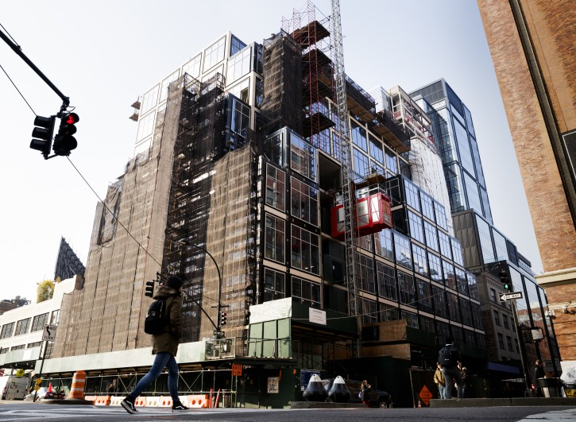
Notes:
26
Land development in Manhattan was down 74 percent in 2016 from 2015, in part because banks became concerned about an oversupply of high-end luxury condominiums. In order to achieve desired profit margins paying $800 per square foot for land (or even the $600-$700 now being asked) a developer has to construct a huge building to be filled with tenants, whether commercial, retail or residential.

Slide 27
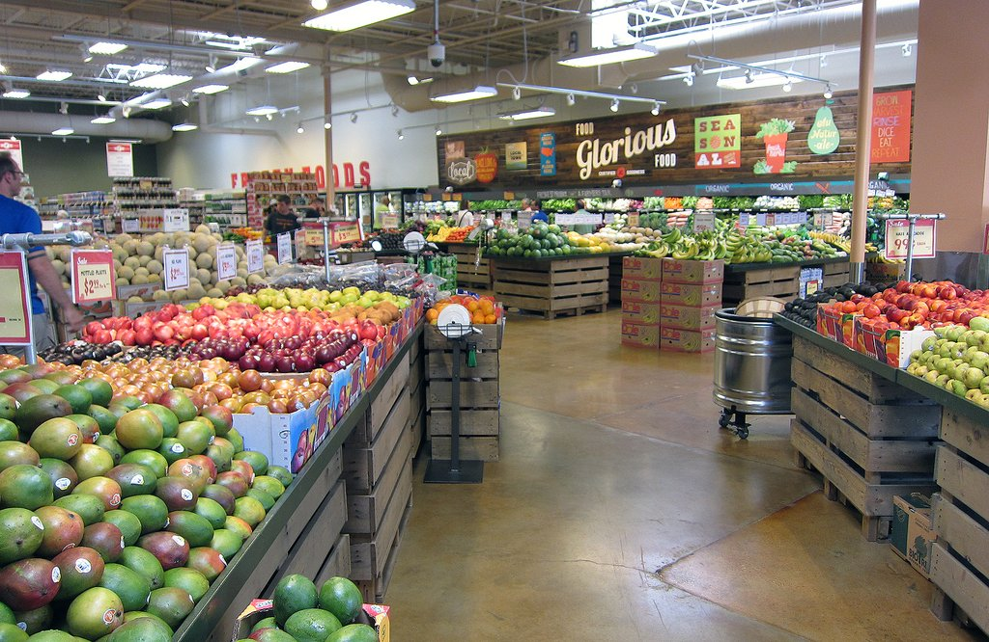
Notes:
27
While most of us live in towns and cities, we could not do so if others were not hard at work producing the food we consume. Let’s look at this complex and integrated system of how food is produced and delivered to market.

Slide 28
End Part 8

