Slide 1
A Dialogue on
Political Economy

Slide 2
Written by
Edward J. Dodson, M.L.A.
Director
School of Cooperative Individualism
Notes:
Welcome to this roundtable discussion on issues important to an understanding of political economy.

Slide 3
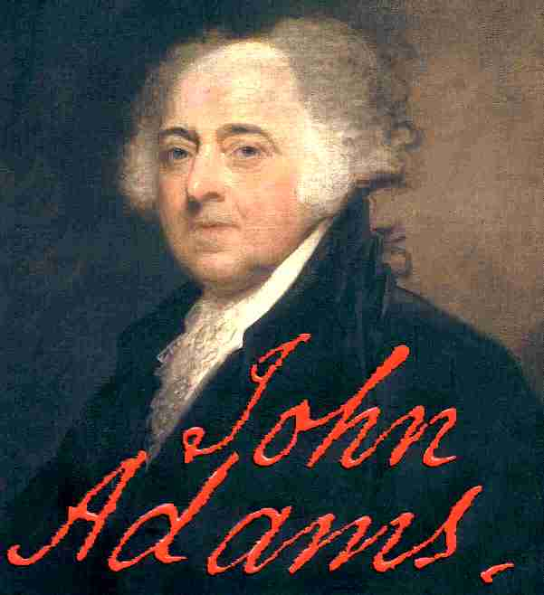
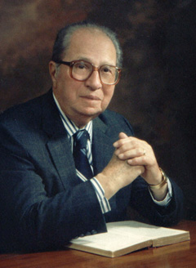
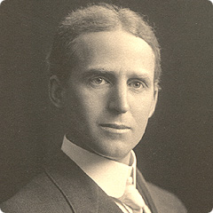
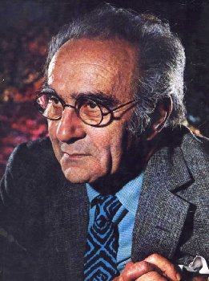
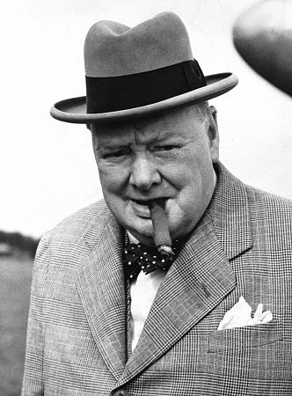
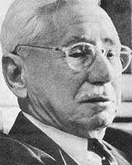
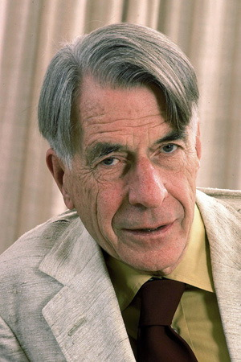
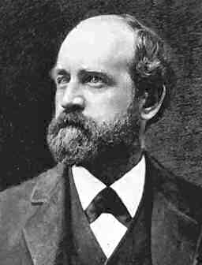
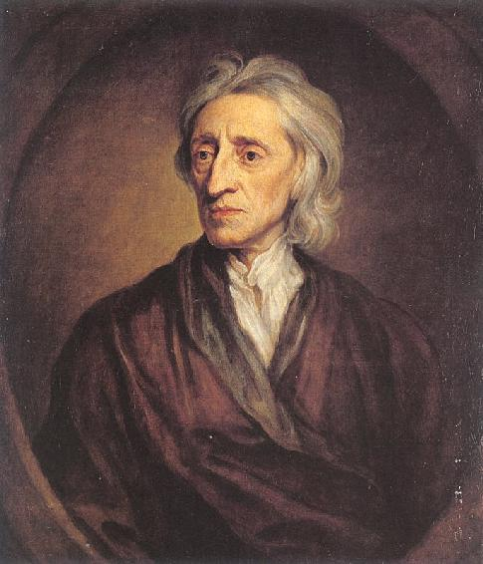
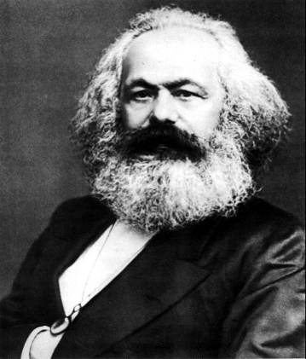
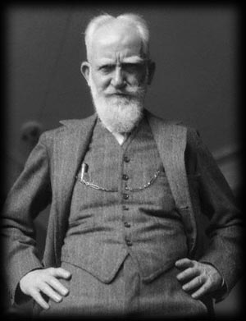
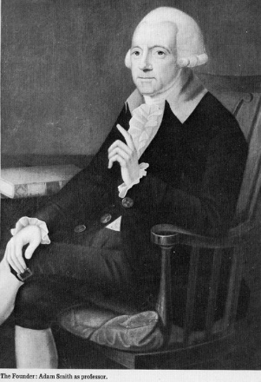
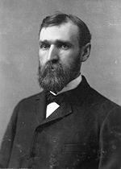
Notes:
Our participants include some well-respected authorities on the subject and spokespersons for certain particular points of view where policies, prescriptions and issues are concerned.

Slide 4
We will begin our discussion by asking Henry George about his long quest to reconstruct political economy into an objective, scientific discipline.
Notes:
MODERATOR: We will begin our discussion by asking Henry George about his long quest to reconstruct political economy into an objective, scientific discipline.

Slide 5
Man masters material nature by studying her laws, and in conditions and powers that seemed most forbidding, has already found his richest storehouses and most powerful servants. The domain of law is not confined to physical nature. ...
Henry George
Notes:
HENRY GEORGE: Man masters material nature by studying her laws, and in conditions and powers that seemed most forbidding, has already found his richest storehouses and most powerful servants. The domain of law is not confined to physical nature.

Slide 6
It just as certainly embraces the mental and moral universe, and social growth and social life have their laws as fixed as those of matter and of motion. Would we make social life healthy and happy, we must discover those laws, and seek our ends in accordance with them.
Henry George
Notes:
HENRY GEORGE: It just as certainly embraces the mental and moral universe, and social growth and social life have their laws as fixed as those of matter and of motion. Would we make social life healthy and happy, we must discover those laws, and seek our ends in accordance with them.

Slide 7
As a contemporary of Mr. George, perhaps Karl Marx will provide a rather different perspective on the need to bring manmade law into conformance with that of natural law.
Notes:
MODERATOR: As a contemporary of Mr. George, perhaps Karl Marx will provide a rather different perspective on the need to bring manmade law into conformance with that of natural law.

Slide 8
I believe that even when a society has got upon the right track for the discovery of the natural laws of its movement it can neither clear by bold leaps, nor remove by legal enactments, the obstacles offered by the successive phases of its normal development. But it can shorten and lessen the birth-pangs.
Karl Marx
Notes:
KARL MARX: I believe that even when a society has got upon the right track for the discovery of the natural laws of its movement it can neither clear by bold leaps, nor remove by legal enactments, the obstacles offered by the successive phases of its normal development. But it can shorten and lessen the birth-pangs.

Slide 9
Is there, then, a conflict between the apparent lessons of history and what Henry George and Karl Marx see as natural laws governing the organization of human societies? I recognize Mortimer Adler to respond.
Notes:
MODERATOR: Is there, then, a conflict between the apparent lessons of history and what Henry George and Karl Marx see as natural laws governing the organization of human societies? I recognize Mortimer Adler to respond.

Slide 10
What is new in the world today and distinctive of our time is the conflict between those who think that, where our institutions are defective, the defects can be removed by institutional changes of one sort or another and those who despair of institutional change itself and who turn, in their desperation, to noninstitutional means of reaching the promised land of a better day.
Mortimer J. Adler
Notes:
MORTIMER J. ADLER: What is new in the world today and distinctive of our time is the conflict between those who think that, where our institutions are defective, the defects can be removed by institutional changes of one sort or another and those who despair of institutional change itself and who turn, in their desperation, to noninstitutional means of reaching the promised land of a better day.

Slide 11
Noninstitutional means Dr. Adler?
Notes:
MODERATOR: Noninstitutional means Dr. Adler?

Slide 12
I am referring to Revolutionary violence.
Mortimer J. Adler
Notes:
MORTIMER J. ADLER: I am referring to Revolutionary violence.

Slide 13
Is the violent overthrow of a society’s long-standing laws and institutions morally justifiable, given the loss of life that always occurs? I see that Jacob Bronowski would like to comment.
Notes:
MODERATOR: Is the violent overthrow of a society’s long-standing laws and institutions morally justifiable, given the loss of life that always occurs? I see that Jacob Bronowski would like to comment.

Slide 14
That Jefferson, like Locke, was very serious about the right of revolution is supported by his comment that the tree of liberty needs to be watered by the blood of patriots from time to time.
Jacob Bronowski
Notes:
JACOB BRONOWSKI: That Jefferson, like Locke, was very serious about the right of revolution is supported by his comment that the tree of liberty needs to be watered by the blood of patriots from time to time.

Slide 15
Mr. Shaw, I am sure you have something to add to further enlighten us.
Notes:
MODERATOR: Mr. Shaw, I am sure you have something to add to further enlighten us.

Slide 16
Jefferson’s perspective aside, heroic aspirations, devoted services, dauntless bravery, unsparing bloodshed are worse than useless when the combatants understand neither what is wrong nor how to set it right.
George Bernard Shaw
Notes:
GEORGE BERNARD SHAW: Jefferson’s perspective aside, heroic aspirations, devoted services, dauntless bravery, unsparing bloodshed are worse than useless when the combatants understand neither what is wrong nor how to set it right.

Slide 17
Of course, the perspectives held by a Jefferson, who enjoyed a life characterized by a unique combination of privilege, property and individual liberty must differ from those of, say, Karl Marx. Is that not correct, Herr Marx?
Notes:
MODERATOR: Of course, the perspectives held by a Jefferson, who enjoyed a life characterized by a unique combination of privilege, property and individual liberty must differ from those of, say, Karl Marx. Is that not correct, Herr Marx?

Slide 18
Such misunderstanding is nearly universal. That bourgeois society in the United States of the mid-nineteenth century was not yet developed far enough to make the class struggle obvious and comprehensible was most strikingly proved by Henry Carey, the only American economist of importance. All he proved was that he took the undeveloped social conditions of the United States to be normal social conditions.
Karl Marx
Notes:
KARL MARX: Such misunderstanding is nearly universal. That bourgeois society in the United States of the mid-nineteenth century was not yet developed far enough to make the class struggle obvious and comprehensible was most strikingly proved by Henry Carey, the only American economist of importance. All he proved was that he took the undeveloped social conditions of the United States to be normal social conditions.

Slide 19
And yet, when Henry George was writing these signs were certainly evident. Does the history of uprisings against those who hold power reveal an explosion of dissent against economic deprivation, against political oppression, or both? I recognize Jacob Bronowski.
Notes:
MODERATOR: And yet, when Henry George was writing these signs were certainly evident. Does the history of uprisings against those who hold power reveal an explosion of dissent against economic deprivation, against political oppression, or both? I recognize Jacob Bronowski.

Slide 20
Emperors go, but empires remain. And, as Karl Marx might agree, neither he nor Friedrich Engels in The Communist Manifesto [created] the revolutions in Europe; but they gave them the voice. It was the voice of insurrection. Is that not so, Herr Marx?
Jacob Bronowski
Notes:
JACOB BRONOWSKI: Emperors go, but empires remain. And, as Karl Marx might agree, neither he nor Friedrich Engels in The Communist Manifesto [created] the revolutions in Europe; but they gave them the voice. It was the voice of insurrection. Is that not so, Herr Marx?

Slide 21
Where the working class is not yet far enough advanced in its organization to undertake a decisive campaign against the political power of the ruling classes, it must at any rate be trained for this by continual agitation against, and a hostile attitude toward, the policies of the ruling classes. Otherwise, it remains a plaything in their hands.
Karl Marx
Notes:
KARL MARX: Where the working class is not yet far enough advanced in its organization to undertake a decisive campaign against the political power of the ruling classes, it must at any rate be trained for this by continual agitation against, and a hostile attitude toward, the policies of the ruling classes. Otherwise, it remains a plaything in their hands.

Slide 22
But, many modern societies have embraced the principles of social democracy. John Galbraith has documented this history in his writings. Professor Galbraith, would you care to elaborate?
Notes:
MODERATOR: But, many modern societies have embraced the principles of social democracy. John Galbraith has documented this history in his writings. Professor Galbraith, would you care to elaborate?

Slide 23
The revolutionary uprising you embraced had obvious points of vulnerability. There was the threat posed to it by reform, the possibility that the hardships of capitalism would be so mitigated that they would no longer arouse the revolutionary anger of the workers. Liberal reformers in the twentieth century were in step with much of The Communist Manifesto.
John Kenneth Galbraith
Notes:
JOHN KENNETH GALBRAITH: The revolutionary uprising you embraced had obvious points of vulnerability. There was the threat posed to it by reform, the possibility that the hardships of capitalism would be so mitigated that they would no longer arouse the revolutionary anger of the workers. Liberal reformers in the twentieth century were in step with much of The Communist Manifesto.

Slide 24
Do you concur, Mr. George?
Notes:
MODERATOR: Do you concur, Mr. George?

Slide 25
Neither the liberal reformers nor those who embraced the perspectives offered by Herr Marx allowed themselves to see that his analysis is materially flawed because he fails to properly distinguish between ownership "classes" which are productive, and therefore advance the progress of society, and those which are nonproductive. …
Henry George
Notes:
HENRY GEORGE: Neither the liberal reformers nor those who embraced the perspectives offered by Herr Marx allowed themselves to see that his analysis is materially flawed because he fails to properly distinguish between ownership "classes" which are productive, and therefore advance the progress of society, and those which are nonproductive. …

Slide 26
By its very nature ownership of capital must involve production in order to generate new wealth. Ownership of land, on the other hand, requires no such ownership activity, only the growth of the community.
Henry George
Notes:
HENRY GEORGE: By its very nature ownership of capital must involve production in order to generate new wealth. Ownership of land, on the other hand, requires no such ownership activity, only the growth of the community.

Slide 27
Mr. George, some have characterized your program to collect the rent of land for public purposes as socialistic. I wonder whether George Bernard Shaw, who credits hearing you speak with turning him into a social activist, agrees.
Notes:
MODERATOR: Mr. George, some have characterized your program to collect the rent of land for public purposes as socialistic. I wonder whether George Bernard Shaw, who credits hearing you speak with turning him into a social activist, agrees.

Slide 28
Mr. George does not see that if the State confiscated rent without being prepared to employ it instantly as capital in industry, production would cease and the country be starved.
George Bernard Shaw
Notes:
GEORGE BERNARD SHAW: Mr. George does not see that if the State confiscated rent without being prepared to employ it instantly as capital in industry, production would cease and the country be starved.

Slide 29
My own reading of Henry George indicates he makes a strong distinction between the role of the community versus that of the state. His reform is best left in the hands of the members of each community as this makes sense. What many people have come to fear is the power of corporations. Mr. Durant, I see you would like to join this conversation.
Notes:
MODERATOR: My own reading of Henry George indicates he makes a strong distinction between the role of the community versus that of the state. His reform is best left in the hands of the members of each community as this makes sense. What many people have come to fear is the power of corporations. Mr. Durant, I see you would like to join this conversation.

Slide 30
I do not relish the control of economic lives by vast corporations. To keep the benefits and check the power of these mastodons I would favor public ownership of natural resources, including the land and all its minerals, fuels, and other subsoil wealth.
Will Durant
Notes:
WILL DURANT: I do not relish the control of economic lives by vast corporations. To keep the benefits and check the power of these mastodons I would favor public ownership of natural resources, including the land and all its minerals, fuels, and other subsoil wealth.

Slide 31
Such proposals are not new, of course. Herr Marx and other communists and socialists have argued this case repeatedly. Herr Marx?
Notes:
MODERATOR: Such proposals are not new, of course. Herr Marx and other communists and socialists have argued this case repeatedly. Herr Marx?

Slide 32
Long before the period of Modern Industry, cooperation and the concentration of the instruments of labor in the hands of a few, gave rise, to great, sudden, and forcible revolutions in the modes of production, and consequentially, in the conditions of existence, and the means of employment of the rural populations.
Karl Marx
Notes:
KARL MARX: Long before the period of Modern Industry, cooperation and the concentration of the instruments of labor in the hands of a few, gave rise, to great, sudden, and forcible revolutions in the modes of production, and consequentially, in the conditions of existence, and the means of employment of the rural populations.

Slide 33
I suspect most of us here acknowledge how changes in land use from subsistence food production to commercial agricultural and resource extraction were fostered by the land monopoly described by Henry George and, of course, Adam Smith. Do you challenge the historical record?
Notes:
MODERATOR: I suspect most of us here acknowledge how changes in land use from subsistence food production to commercial agricultural and resource extraction were fostered by the land monopoly described by Henry George and, of course, Adam Smith. Do you challenge the historical record?

Slide 34
I concede to Mr. George that this contest at first took place more between the large and the small landed proprietors, than between capital and wage-labor; on the other hand, when the laborers are displaced by the instruments of labor, by sheep, horses, etc., in this case force is directly resorted to in the first instance as the prelude to the industrial revolution. The laborers are first driven from the land. Land grabbing on a great scale is the first step in creating a field for the establishment of agriculture on a great scale.
Karl Marx
Notes:
KARL MARX: I concede to Mr. George that this contest at first took place more between the large and the small landed proprietors, than between capital and wage-labor; on the other hand, when the laborers are displaced by the instruments of labor, by sheep, horses, etc., in this case force is directly resorted to in the first instance as the prelude to the industrial revolution. The laborers are first driven from the land. Land grabbing on a great scale is the first step in creating a field for the establishment of agriculture on a great scale.

Slide 35
We cannot turn back the clock to a time before the great enclosures of the commons and the removal of so many millions of peasants from the land. Mr. George, what would you have us do?
Notes:
MODERATOR: We cannot turn back the clock to a time before the great enclosures of the commons and the removal of so many millions of peasants from the land. Mr. George, what would you have us do?

Slide 36
I do not propose either to purchase or to confiscate private property in land. The first would be unjust; the second, needless. Let the individuals who now hold it still retain … possession of what they are pleased to call their land. Let them buy and sell, and bequeath and devise it. …
Henry George
Notes:
HENRY GEORGE: I do not propose either to purchase or to confiscate private property in land. The first would be unjust; the second, needless. Let the individuals who now hold it still retain … possession of what they are pleased to call their land. Let them buy and sell, and bequeath and devise it. …

Slide 37
We may safely leave them the shell, if we take the kernel. It is not necessary to confiscate land; it is only necessary to confiscate rent. I take much of this analysis from our great predecessors, Smith, Turgot and Patrick Edward Dove.
Henry George
Notes:
HENRY GEORGE: We may safely leave them the shell, if we take the kernel. It is not necessary to confiscate land; it is only necessary to confiscate rent. I take much of this analysis from our great predecessors, Smith, Turgot and Patrick Edward Dove.

Slide 38
I see that Adam Smith, who has sat patient and quite to this point would like to respond.
Notes:
MODERATOR: I see that Adam Smith, who has sat patient and quiet to this point, would like to respond.

Slide 39
As soon as the land of any country has all become private property, the landlords, like all other men, love to reap where they never sowed, and demand a rent even for its natural produce, the wood of the forest, the grass of the field, and all the natural fruits of the earth, which, when land was in common, cost the labourer only the trouble of gathering them, come, even to him, to have an additional price fixed upon them. He must give up to the landlord a portion of what his labour either collects or produces.
Adam Smith
Notes:
ADAM SMITH: As soon as the land of any country has all become private property, the landlords, like all other men, love to reap where they never sowed, and demand a rent even for its natural produce, the wood of the forest, the grass of the field, and all the natural fruits of the earth, which, when land was in common, cost the labourer only the trouble of gathering them, come, even to him, to have an additional price fixed upon them. He must give up to the landlord a portion of what his labour either collects or produces.

Slide 40
That, Mr. Smith, is certainly what has occurred throughout much of history. Mr. George, for one, challenges the very foundation of law that permits this confiscation and redistribution of wealth from producers to a non-producing rentier elite. Is he correct, Mr. Locke?
Notes:
MODERATOR: That, Mr. Smith, is certainly what has occurred throughout much of history. Mr. George, for one, challenges the very foundation of law that permits this confiscation and redistribution of wealth from producers to a non-producing rentier elite. Is he correct, Mr. Locke?

Slide 41
Where the land is concerned, we must identify the moral principles attached to our occupancy and use. God, who hath given the world to men in common, hath also given them reason to make use of it to the best advantage of life and convenience. The earth and all that is therein is given to men for the support and comfort of their being.
John Locke
Notes:
JOHN LOCKE: Where the land is concerned, we must identify the moral principles attached to our occupancy and use. God, who hath given the world to men in common, hath also given them reason to make use of it to the best advantage of life and convenience. The earth and all that is therein is given to men for the support and comfort of their being.

Slide 42
Rarely, however, has this moral principle served as our guide for our systems of law. Even in the case of North America the principle you established – that individuals are entitled to claim land so long as as much of equal value remains available to all others – proved to be short-lived. The land of North America almost from the beginning of European settlement was held by a small number of privileged aristocratic families. Do you not agree, Mr. Adams?
Notes:
MODERATOR: Rarely, however, has this moral principle served as our guide for our systems of law. Even in the case of North America the principle you established – that individuals are entitled to claim land so long as as much of equal value remains available to all others – proved to be short-lived. The land of North America almost from the beginning of European settlement was held by a small number of privileged aristocratic families. Do you not agree, Mr. Adams?

Slide 43
I, too, believe that property in the soil is the natural foundation of power and authority. …[I]f the lands are held and owned by the people and prevented from drifting into one or a few hands, the true power will rest with the people, and that government will, essentially, be a Democracy, whatever it may be called. Under such a constitution the people will constitute the State.
Notes:
JOHN ADAMS: I, too, believe that property in the soil is the natural foundation of power and authority. …[I]f the lands are held and owned by the people and prevented from drifting into one or a few hands, the true power will rest with the people, and that government will, essentially, be a Democracy, whatever it may be called. Under such a constitution the people will constitute the State.

Slide 44
The vast unsettled territory allowed those who occupied North America to envision a future of universal opportunity, to be sure. Of course, those who crossed the ocean from Britain were escaping from a land where privilege was deeply entrenched. Is that not how you see the situation, Mr. Shaw?
Notes:
MODERATOR: The vast unsettled territory allowed those who occupied North America to envision a future of universal opportunity, to be sure. Of course, those who crossed the ocean from Britain were escaping from a land where privilege was deeply entrenched. Is that not how you see the situation, Mr. Shaw?

Slide 45
Very much so. As long as there is plenty of land for everybody private property in land works very well. But this state of things never lasts long with a growing population, because at last all the land gets taken up, and there is none left for the later comers. ...Mr. Churchill once described our history very similarly.
George Bernard Shaw
Notes:
GEORGE BERNARD SHAW: Very much so. As long as there is plenty of land for everybody private property in land works very well. But this state of things never lasts long with a growing population, because at last all the land gets taken up, and there is none left for the later comers. ...Mr. Churchill once described our history very similarly.

Slide 46
Quite right, Mr. Shaw. Mr. Churchill, during your early political life in league with the Liberals, you displaced a keen understanding of the problems caused by landed privilege. Remind us of how to saw the issues, if your would.
Notes:
MODERATOR: Quite right, Mr. Shaw. Mr. Churchill, during your early political life in league with the Liberals, you displaced a keen understanding of the problems caused by landed privilege. Remind us of how to saw the issues, if your would.

Slide 47
It does not matter where you look or what examples you select, you will see that every form of enterprise, every step in material progress, is only undertaken after the land monopolist has skimmed the cream off for himself. And everywhere today the man or the public body that wishes to put land to its highest use is forced to pay a preliminary fine in land values to the man who is putting it to an inferior use, and in some cases to no use at all. ...
Winston Churchill
Notes:
WINSTON CHURCHILL: It does not matter where you look or what examples you select, you will see that every form of enterprise, every step in material progress, is only undertaken after the land monopolist has skimmed the cream off for himself. And everywhere today the man or the public body that wishes to put land to its highest use is forced to pay a preliminary fine in land values to the man who is putting it to an inferior use, and in some cases to no use at all. ...

Slide 48
All comes back to the land value, and its owner for the time being is able to levy his toll upon all other forms of wealth and upon every form of industry.
Winston Churchill
Notes:
WINSTON CHURCHILL: All comes back to the land value, and its owner for the time being is able to levy his toll upon all other forms of wealth and upon every form of industry.

Slide 49
Somehow, this arrangement has become accepted and even defended by those who are left out of the economic system. Is it the case, Mr. George, that the majority of people hope they, too, can get in the game and become wealthy by speculation in land?
Notes:
MODERATOR: Somehow, this arrangement has become accepted and even defended by those who are left out of the economic system. Is it the case, Mr. George, that the majority of people hope they, too, can get in the game and become wealthy by speculation in land?

Slide 50
The long-term effects are best illustrated by the constant existence of speculation where private ownership has been protected by the governing authority. Essentially, the influence of speculation in land in increasing rent is a great fact which cannot be ignored in any complete theory of the description of wealth in progressive countries. ...
Henry George
Notes:
HENRY GEORGE: The long-term effects are best illustrated by the constant existence of speculation where private ownership has been protected by the governing authority. Essentially, the influence of speculation in land in increasing rent is a great fact which cannot be ignored in any complete theory of the description of wealth in progressive countries. ...

Slide 51
It is the force, evolved by material progress, which tends constantly to increase rent in a greater ratio than progress increases production, and thus constantly tends, as material progress goes on and productive power increases, to reduce wages, not relatively, but absolutely.
Henry George
Notes:
HENRY GEORGE: It is the force, evolved by material progress, which tends constantly to increase rent in a greater ratio than progress increases production, and thus constantly tends, as material progress goes on and productive power increases, to reduce wages, not relatively, but absolutely.

Slide 52
And yet, Mr. George, a combination of many factors has improved the living standards for every new generation – despite the concentrated control over land and the existence of land speculation. Still, you are certain this cannot continue.
Notes:
MODERATOR: And yet, Mr. George, a combination of many factors has improved the living standards for every new generation – despite the concentrated control over land and the existence of land speculation. Still, you are certain this cannot continue.

Slide 53
What has destroyed every previous civilization has been the tendency to the unequal distribution of wealth and power. This same tendency, operating with increasing force, is observable in our civilization today, showing itself in every progressive community, and with greater intensity the more progressive the community. Surely, George Bernard Shaw appreciates this insight.
Henry George
Notes:
HENRY GEORGE: What has destroyed every previous civilization has been the tendency to the unequal distribution of wealth and power. This same tendency, operating with increasing force, is observable in our civilization today, showing itself in every progressive community, and with greater intensity the more progressive the community. Surely, George Bernard Shaw appreciates this insight.

Slide 54
Even long before this happens the best land is all taken up, and later comers find that they can do as well by paying rent for the use of the best land as by owning poorer land themselves, the amount of rent being the difference between the yield of the poorer land and the better. At this point the owners of the best land can let their land; stop working; and live on the rent: that is, on the labor of others, or, as they call it, by owning.
George Bernard Shaw
Notes:
GEORGE BERNARD SHAW: Even long before this happens the best land is all taken up, and later comers find that they can do as well by paying rent for the use of the best land as by owning poorer land themselves, the amount of rent being the difference between the yield of the poorer land and the better. At this point the owners of the best land can let their land; stop working; and live on the rent: that is, on the labor of others, or, as they call it, by owning.

Slide 55
And, of course, in the process creating an ever more powerful and destructive rentier class. Other than the societal collection of rent, is there any other measure to counter this inevitability? Mr. Locke, remind us again of the moral principle you see as governing our claim to land.
Notes:
MODERATOR: And, of course, in the process creating an ever more powerful and destructive rentier class. Other than the societal collection of rent, is there any other measure to counter this inevitability? Mr. Locke, remind us again of the moral principle you see as governing our claim to land.

Slide 56
I have argued that as much land as a man tills, plants, improves, cultivates, and can use the product of, so much is his property. He by his labour does, as it were, enclose it from the common. Such private enclosure is limited to conditions where there is still enough and as good left, and more than the yet unprovided could use. …
John Locke
Notes:
JOHN LOCKE: I have argued that as much land as a man tills, plants, improves, cultivates, and can use the product of, so much is his property. He by his labour does, as it were, enclose it from the common. Such private enclosure is limited to conditions where there is still enough and as good left, and more than the yet unprovided could use.

Slide 57
Had this proviso been adopted in North America, the future of its citizenry might have been characterized by less conflict and greater harmony. Do you not agree, Mr. Adams?
John Locke
Notes:
JOHN LOCKE: Had this proviso been adopted in North America, the future of its citizenry might have been characterized by less conflict and greater harmony. Do you not agree, Mr. Adams?

Slide 58
The balance of power in a society, accompanies the balance of property in land. The only possible way, then, of preserving the balance of power on the side of equal liberty and public virtue, is to make the acquisition of land easy to every member of society; to make a division of land into small quantities, so that the multitude may be possessed of landed estates. ...
Notes:
JOHN ADAMS: The balance of power in a society, accompanies the balance of property in land. The only possible way, then, of preserving the balance of power on the side of equal liberty and public virtue, is to make the acquisition of land easy to every member of society; to make a division of land into small quantities, so that the multitude may be possessed of landed estates. ...

Slide 59
If the multitude is possessed of the balance of real estate, the multitude will take care of the liberty, virtue, and interest of the multitude, in all acts of government.
Notes:
JOHN ADAMS: If the multitude is possessed of the balance of real estate, the multitude will take care of the liberty, virtue, and interest of the multitude, in all acts of government.

Slide 60
That sounds very much like what Thomas Jefferson wrote early on by his vision of a society of self-reliant farmers working the land. Was Jefferson unrealistic, Mr. George?
Notes:
MODERATOR: That sounds very much like what Thomas Jefferson wrote early on by his vision of a society of self-reliant farmers working the land. Was Jefferson unrealistic, Mr. George?

Slide 61
It seems to me that those who look upon the small farmers of the United States as forming an impregnable bulwark to private property in land very much miscalculate.
Henry George
Notes:
HENRY GEORGE: But beyond this, it seems to me that those who look upon the small farmers of the United States as forming an impregnable bulwark to private property in land very much miscalculate.

Slide 62
Time has shown this to be true, Mr. George, as the number of family-owned farms has dwindled in many countries. At the same time agriculture is widely subsidized by price supports and tariffs on imports. Even so, technology has replaced large numbers of farm workers, who migrate to the cities to compete for employment there. No society has been able to fully employ its citizens. Is the monopoly of land the primary reason?
Notes:
MODERATOR: Time has shown this to be true, Mr. George, as the number of family-owned farms has dwindled in many countries. At the same time agriculture is widely subsidized by price supports and tariffs on imports. Even so, technology has replaced large numbers of farm workers, who migrate to the cities to compete for employment there. No society has been able to fully employ its citizens. Is the monopoly of land the primary reason?

Slide 63
This strange and unnatural spectacle of large numbers of willing men who cannot find employment is enough to suggest the true cause to whosoever can think consecutively. …Is it not the fact that labor is thus shut off from nature which can alone explain the state of things that compels men to stand idle who would willingly supply their wants by their labor?
Henry George
Notes:
HENRY GEORGE: This strange and unnatural spectacle of large numbers of willing men who cannot find employment is enough to suggest the true cause to whosoever can think consecutively. …Is it not the fact that labor is thus shut off from nature which can alone explain the state of things that compels men to stand idle who would willingly supply their wants by their labor?

Slide 64
Mr. George, your fundamental dogma is that everything would be all right if ground rent were paid to the state. …This is a frank expression of the hatred the industrial capitalist dedicates to the landed proprietor, who seems to him a useless and superfluous element in the general total of bourgeois production.
Karl Marx
Notes:
KARL MARX: Mr. George, your fundamental dogma is that everything would be all right if ground rent were paid to the state. …This is a frank expression of the hatred the industrial capitalist dedicates to the landed proprietor, who seems to him a useless and superfluous element in the general total of bourgeois production.

Slide 65
We ourselves … adopted this appropriation of ground rent by the state among numerous other transitional measures, which, as we also remarked in the Manifesto, are and must be contradictory in themselves.
Karl Marx
Notes:
KARL MARX: We ourselves … adopted this appropriation of ground rent by the state among numerous other transitional measures, which, as we also remarked in the Manifesto, are and must be contradictory in themselves.

Slide 66
Well, Henry George challenges your assessment by arguing that the system we think of as “capitalism” can be restructured on the base of a fulfilled promise of individual liberty, one that ensures equality of opportunity. Mr. Shaw, why did you align with Herr Marx’s conclusions rathan than those of Mr. George?
Notes:
MODERATOR: Well, Henry George challenges your assessment by arguing that the system we think of as “capitalism” can be restructured on the base of a fulfilled promise of individual liberty, one that ensures equality of opportunity. Mr. Shaw, why did you align with Herr Marx’s conclusions rathan than those of Mr. George?

Slide 67
I had no difficulty in shewing that even if the largest construction was placed on George’s propaganda, so as to make his single tax a tax on the rents of capital and ability as well as land, the socialization of these rents by means of the single tax would involve the socialization of industry, for which there was no provision whatsoever in George’s scheme; ...
George Bernard Shaw
Notes:
GEORGE BERNARD SHAW: I had no difficulty in shewing that even if the largest construction was placed on George’s propaganda, so as to make his single tax a tax on the rents of capital and ability as well as land, the socialization of these rents by means of the single tax would involve the socialization of industry, for which there was no provision whatsoever in George’s scheme; …

Slide 68
In fact the Single Tax was advocated by capitalists who opposed Socialism and who saw the advantage to themselves of diverting attention and taxation from their own enormous gains to those of the landlord. …Except as a stepping stone to Socialism Mr. George’s Single Tax propaganda is a waste of time.
George Bernard Shaw
Notes:
GEORGE BERNARD SHAW: In fact the Single Tax was advocated by capitalists who opposed Socialism and who saw the advantage to themselves of diverting attention and taxation from their own enormous gains to those of the landlord. …Except as a stepping stone to Socialism Mr. George’s Single Tax propaganda is a waste of time.

Slide 69
As a Fabian, Mr. Shaw, you still hold faith in democratic processes and institutions, as does Mortimer J. Adler, whose proposals for achieving a more humane type of capitalism have found a degree of support from employers and their employees.
Notes:
MODERATOR: As a Fabian, Mr. Shaw, you still hold faith in democratic processes and institutions, as does Mortimer J. Adler, whose proposals for achieving a more humane type of capitalism have found a degree of support from employers and their employees.

Slide 70
Can the problem be solved? I think it can. With every technological advance, the increasing productiveness of capital instruments also makes the solution of the problem more feasible. …
Mortimer J. Adler
Notes:
MORTIMER J. ADLER: Can the problem be solved? I think it can. With every technological advance, the increasing productiveness of capital instruments also makes the solution of the problem more feasible. ...

Slide 71
That solution is based on principles of economic justice which not only respect property rights but also recognize that each person has a natural human right to participate in the production of wealth through the ownership and application of productive property to a degree sufficient to earn for that person a decent standard of living.
Mortimer J. Adler
Notes:
MORTIMER J. ADLER: That solution is based on principles of economic justice which not only respect property rights but also recognize that each person has a natural human right to participate in the production of wealth through the ownership and application of productive property to a degree sufficient to earn for that person a decent standard of living.

Slide 72
Yet, you must agree that even with the creation of Employee Stock Ownership Plans we have not even slowed the power of rentier interests to control the sources of what we all need in order to live. There has been only very limited progress toward the form of universal capitalism you and Louis Kelso campaigned for. I think that Henry George would say your proposals fall short of the real objective. Mr. George?
Notes:
MODERATOR: Yet, you must agree that even with the creation of Employee Stock Ownership Plans we have not even slowed the power of rentier interests to control the sources of what we all need in order to live. There has been only very limited progress toward the form of universal capitalism you and Louis Kelso campaigned for. I think that Henry George would say your proposals fall short of the real objective. Mr. George?

Slide 73
We single taxers point to the one sufficient cause. Wherever these phenomena are to be seen the natural element on which and from which all men must live, if they are to live at all, is the property, not of the whole people, but of the few. We point to the adequate cure; the restoration to all men of their natural rights in the soil -- the assurance to every child, as it comes into the world, of the enjoyment of its natural heritage -- the right to live, the right to work, the right to enjoy the fruits of its work; …
Henry George
Notes:
HENRY GEORGE: We single taxers point to the one sufficient cause. Wherever these phenomena are to be seen the natural element on which and from which all men must live, if they are to live at all, is the property, not of the whole people, but of the few. We point to the adequate cure; the restoration to all men of their natural rights in the soil -- the assurance to every child, as it comes into the world, of the enjoyment of its natural heritage -- the right to live, the right to work, the right to enjoy the fruits of its work; …

Slide 74
…rights necessarily conditioned upon the equal right to that element which is the basis of production; that element which is indispensable to human life; that element which is the standing place, the storehouse, the reservoir of men; that element from which all that is physical in man is drawn.
Henry George
Notes:
HENRY GEORGE: …rights necessarily conditioned upon the equal right to that element which is the basis of production; that element which is indispensable to human life; that element which is the standing place, the storehouse, the reservoir of men; that element from which all that is physical in man is drawn.

Slide 75
Until we can discover some way of making something out of nothing there is no possible discovery or invention which can lessen the dependence of labor upon land. And, this being the case, the effect of these labor-saving devices, land being the private property of some, would simply be to increase the proportion of the wealth produced that landowners could demand for the use of their land.
Henry George
Notes:
HENRY GEORGE: Until we can discover some way of making something out of nothing there is no possible discovery or invention which can lessen the dependence of labor upon land. And, this being the case, the effect of these labor-saving devices, land being the private property of some, would simply be to increase the proportion of the wealth produced that landowners could demand for the use of their land

Slide 76
This is certainly demonstrated in today’s property markets. In some of the major cities around the world, the land cost can exceed 50 percent or more of a residence. The dynamic is not new, of course, as even wage workers have managed to become land owners, landlords and speculators, as I know Herr Marx can attest to.
Notes:
MODERATOR: This is certainly demonstrated in today’s property markets. In some of the major cities around the world, the land cost can exceed 50 percent or more of a residence. The dynamic is not new, of course, as Herr Marx can attest to.

Slide 77
We should note that the capitalized rent, the price of land, now becomes an important aspect; and that not only can the former rent-payer transform himself in this way into an independent peasant proprietor, but also urban and other holders of money can buy plots of land with a view to leasing them either to peasants or to capitalists, and enjoy the rent on their capital thus invested as a form of interest.
Karl Marx
Notes:
KARL MARX: We should note that the capitalized rent, the price of land, now becomes an important aspect; and that not only can the former rent-payer transform himself in this way into an independent peasant proprietor, but also urban and other holders of money can buy plots of land with a view to leasing them either to peasants or to capitalists, and enjoy the rent on their capital thus invested as a form of interest.

Slide 78
Yes, many of us see investment in land as just one of many ways of securing income. We lease land to actual farmers. We construct buildings offering space for lease to residential or commercial tenants. We might even lease land to someone else to construct a building, charging ground rent. And, very few of us recognize this as destructive to our communities as does Mr. George.
Notes:
MODERATOR: Yes, many of us see investment in land as just one of many ways of securing income. We lease land to actual farmers. We construct buildings offering space for lease to residential or commercial tenants. We might even lease land to someone else to construct a building, charging ground rent. And, very few of us recognize this as destructive to our communities as does Mr. George.

Slide 79
If one man owned all the land accessible to any community, he would, of course, demand any price or condition for its use that he saw fit; and, as long as his ownership was acknowledged, the other members of the community would have but death or emigration as the alternative to submission to his terms. ...
Henry George
Notes:
HENRY GEORGE: If one man owned all the land accessible to any community, he would, of course, demand any price or condition for its use that he saw fit; and, as long as his ownership was acknowledged, the other members of the community would have but death or emigration as the alternative to submission to his terms. ...

Slide 80
This has been the case in many communities; but in the modern form of society, the land is in the hands of too many different persons to permit the price which can be obtained for its use to be fixed by mere caprice or desire.
Henry George
Notes:
HENRY GEORGE: This has been the case in many communities; but in the modern form of society, the land is in the hands of too many different persons to permit the price which can be obtained for its use to be fixed by mere caprice or desire.

Slide 81
So, the market does work to some degree, if imperfect and with serious negative consequences. While this may continue to be the case for land owned for homeownership, we observe today an ongoing concentrated control over natural resource laden lands by corporate interests. As Frederick Jackson Turner will attest, even with the population of the United States still rather low the ideal of free land and the frontier opportunity had already disappeared by the end of the 19th century.
Notes:
MODERATOR: So, the market does work to some degree, if imperfect and with serious negative consequences. While this may continue to be the case for land owned for homeownership, we observe today an ongoing concentrated control over natural resource laden lands by corporate interests. As Frederick Jackson Turner will attest, even with the population of the United States still rather low the ideal of free land and the frontier opportunity had already disappeared by the end of the 19th century.

Slide 82
The American frontier is sharply distinguished from the European frontier--a fortified boundary line running through dense populations. The most significant thing about the American frontier is, that it lies at the hither edge of free land. …
Frederick Jackson Turner
Notes:
FREDERICK JACKSON TURNER: The American frontier is sharply distinguished from the European frontier--a fortified boundary line running through dense populations. The most significant thing about the American frontier is, that it lies at the hither edge of free land. …

Slide 83
In the settlement of America we have to observe how European life entered the continent, and how America modified that life and reacted on Europe. Who shall measure the effect on Europe of free land in America? America has given occasion for a new Migration of the Peoples comparable to the older one.
Frederick Jackson Turner
Notes:
FREDERICK JACKSON TURNER: In the settlement of America we have to observe how European life entered the continent, and how America modified that life and reacted on Europe. Who shall measure the effect on Europe of free land in America? America has given occasion for a new Migration of the Peoples comparable to the older one.

Slide 84
Of course, one of history’s most studied migrations is that of the people of Ireland to the far corners of the globe. I see Professor Galbraith asking to be recognized.
Notes:
MODERATOR: Of course, one of history’s most studied migrations is that of the people of Ireland to the far corners of the globe. I see Professor Galbraith asking to be recognized.

Slide 85
Ricardian landlords were also amply present in Ireland – or more often absent in England which was socially much more congenial and frequently also a safer place for a landlord to live. ...
John Kenneth Galbraith
Notes:
JOHN KENNETH GALBRAITH: Ricardian landlords were also amply present in Ireland – or more often absent in England which was socially much more congenial and frequently also a safer place for a landlord to live. ...

Slide 86
As the Irish population expanded, so did the competition for land and so did the return that was extracted by the absentee landlords. Grain was grown to pay the rent; potatoes were grown to feed the people. Even when people starved, the grain was sold and the rent was paid.
John Kenneth Galbraith
Notes:
JOHN KENNETH GALBRAITH: As the Irish population expanded, so did the competition for land and so did the return that was extracted by the absentee landlords. Grain was grown to pay the rent; potatoes were grown to feed the people. Even when people starved, the grain was sold and the rent was paid.

Slide 87
And, in many parts of the world today people are starving even as agricultural land is reallocated to grow crops for export markets. Mr. George, you toured Ireland extensively and tried to build support for your proposals there. What are your thoughts on the Irish land question?
Notes:
MODERATOR: And, in many parts of the world today people are starving even as agricultural land is reallocated to grow crops for export markets. Mr. George, you toured Ireland extensively and tried to build support for your proposals there. What are your thoughts on the Irish land question?

Slide 88
To drop a man in the middle of the Atlantic Ocean and tell him he is at liberty to walk ashore, would not be more bitter irony than to place a man where all the land is appropriated as the property of other people and to tell him that he is a free man, at liberty to work for himself and to enjoy his own earnings. That is the situation in which our Irishman, and a worker nearly everywhere, finds himself.
Henry George
Notes:
HENRY GEORGE: To drop a man in the middle of the Atlantic Ocean and tell him he is at liberty to walk ashore, would not be more bitter irony than to place a man where all the land is appropriated as the property of other people and to tell him that he is a free man, at liberty to work for himself and to enjoy his own earnings. That is the situation in which our Irishman, and a worker nearly everywhere, finds himself.

Slide 89
Yes, to be landless in an agrarian society is to live a short and brutish life. This is certainly borne out by history, would you not agree Mr. Durant?
Notes:
MODERATOR: Yes, to be landless in an agrarian society is to live a short and brutish life. This is certainly borne out by history, would you not agree Mr. Durant?

Slide 90
We may derive endless instruction from the economic analysis of the past. We observe that the invading barbarians found Rome weak because the agricultural population which had formerly supplied the legions with hardy and patriotic warriors fighting for land had been replaced by slaves laboring listlessly on vast farms owned by one man or a few.
Will Durant
Notes:
WILL DURANT: We may derive endless instruction from the economic analysis of the past. We observe that the invading barbarians found Rome weak because the agricultural population which had formerly supplied the legions with hardy and patriotic warriors fighting for land had been replaced by slaves laboring listlessly on vast farms owned by one man or a few.

Slide 91
Are the lessons to be learned by how the land was settled in North America different from those of the Old World, of Europe or Asia?
Notes:
MODERATOR: Are the lessons to be learned by how the land was settled in North America different from those of the Old World, of Europe or Asia?

Slide 92
When we consider the public domain from the point of view of the sale and disposal of the public lands of the United States the story is in sharp contrast with the European system of scientific administration. Efforts to make this domain a source of revenue, and to withhold it from emigrants in order that settlement might be compact, were in vain. Perhaps Mr. Beard has additional thoughts on the matter.
Frederick Jackson Turner
Notes:
FREDERICK JACKSON TURNER: When we consider the public domain from the point of view of the sale and disposal of the public lands of the United States the story is in sharp contrast with the European system of scientific administration. Efforts to make this domain a source of revenue, and to withhold it from emigrants in order that settlement might be compact, were in vain. Perhaps Mr. Beard has additional thoughts on the matter.

Slide 93
As population increased along the Atlantic coast, speculation in western lands was one of the leading activities of capitalists. Large areas had been bought outright for a few cents an acre and were being held for a rise in value. ...
Charles A. Beard
Notes:
CHARLES A. BEARD: As population increased along the Atlantic coast, speculation in western lands was one of the leading activities of capitalists. Large areas had been bought outright for a few cents an acre and were being held for a rise in value. ...

Slide 94
The chief obstacle in the way of the rapid appreciation of these lands was the weakness of the national government which prevented the complete subjugation of the Indians, the destruction of old Indian claims, and the orderly settlement of the frontier.
Charles A. Beard
Notes:
CHARLES A. BEARD: The chief obstacle in the way of the rapid appreciation of these lands was the weakness of the national government which prevented the complete subjugation of the Indians, the destruction of old Indian claims, and the orderly settlement of the frontier.

Slide 95
Most important during the period of settlement of America has been the fact that an area of free land was continually lain on the western border of the settled area. Whenever social conditions tended to crystallize in the East, whenever capital tended to press upon labor there was this gate of escape to the free conditions of the frontier.
Frederick Jackson Turner
Notes:
FREDERICK JACKSON TURNER: Most important during the period of settlement of America has been the fact that an area of free land was continually lain on the western border of the settled area. Whenever social conditions tended to crystallize in the East, whenever capital tended to press upon labor there was this gate of escape to the free conditions of the frontier.

Slide 96
When did this situation begin to disappear. Mr.Galbraith?
Notes:
MODERATOR: When did this situation begin to disappear. Mr.Galbraith.\?

Slide 97
Until the Civil War and even after, what distinguished the American scene was a spacious abundance, a prospect of income and opportunity for farmer and worker, as well as businessman and capitalist, unimaginable in England or on the Continent. …
John Kenneth Galbraith
Notes:
JOHN KENNETH GALBRAITH: Until the Civil War and even after, what distinguished the American scene was a spacious abundance, a prospect of income and opportunity for farmer and worker, as well as businessman and capitalist, unimaginable in England or on the Continent. ...

Slide 98
If the worker could at any moment express his dissatisfaction by deserting to the frontier, there was not much foundation for a theory of wages. If farmers could own and farm their own land, there was no need for a theory of rent.
John Kenneth Galbraith
Notes:
JOHN KENNETH GALBRAITH: If the worker could at any moment express his dissatisfaction by deserting to the frontier, there was not much foundation for a theory of wages. If farmers could own and farm their own land, there was no need for a theory of rent.

Slide 99
So, a serious examination of political economy had to wait until land became a scarce commodity? What would account for the intense speculation in land by every generation of Europeans who set foot in North America? Mr. George?
Notes:
MODERATOR: So, a serious examination of political economy had to wait until land became a scarce commodity? What would account for the intense speculation in land by every generation of Europeans who set foot in North America? Mr. George?

Slide 100
[I]n communities like the United States, where the user of land generally prefers, if he can, to own it, and where there is a great extent of land to overrun, [speculation] operates with enormous power. I feel certain that Frederick Jackson Turner’s research confirms this.
Henry George
Notes:
HENRY GEORGE: [I]n communities like the United States, where the user of land generally prefers, if he can, to own it, and where there is a great extent of land to overrun, [speculation] operates with enormous power.

Slide 101
“It is a proposition too plain to require elucidation, wrote Richard Rush, Secretary of the Treasury, in his report of 1827, “that the creation of capital is retarded rather than accelerated by the diffusion of a thin population over a great surface of soil.” ...
Frederick Jackson Turner
Notes:
FREDERICK JACKSON TURNER: “It is a proposition too plain to require elucidation, wrote Richard Rush, Secretary of the Treasury, in his report of 1827, “that the creation of capital is retarded rather than accelerated by the diffusion of a thin population over a great surface of soil.” ...

Slide 102
Thirty years before Rush wrote these words Albert Gallatin declared in Congress that “if the cause of the happiness of this country were examined into, it would be found to arise as much from the great plenty of land in proportion to the inhabitants which their citizens enjoyed as from the wisdom of their political institutions.”
Frederick Jackson Turner
Notes:
FREDERICK JACKSON TURNER: Thirty years before Rush wrote these words Albert Gallatin declared in Congress that “if the cause of the happiness of this country were examined into, it would be found to arise as much from the great plenty of land in proportion to the inhabitants which their citizens enjoyed as from the wisdom of their political institutions. “

Slide 103
Clearly, then, the advantage people had in the United States was as much the opportunity to acquire land at affordable prices as the rule of law.
Notes:
MODERATOR: Clearly, then, the advantage people had in the United States was as much the opportunity to acquire land at affordable prices as the rule of law.

Slide 104
We had for our public domain the best part of an immense continent. It had been our boast that here every one who wished it could have a farm. We have not merely common schools, but high schools and universities, open to all who may choose to attend. Yet here the same social difficulties apparent on the other side of the Atlantic appeared. It is clear that our democracy is a vain pretense, our make-believe of equality a sham and a fraud.
Henry George
Notes:
HENRY GEORGE: We had for our public domain the best part of an immense continent. It had been our boast that here every one who wished it could have a farm. We have not merely common schools, but high schools and universities, open to all who may choose to attend. Yet here the same social difficulties apparent on the other side of the Atlantic appeared. It is clear that our democracy is a vain pretense, our make-believe of equality a sham and a fraud.

Slide 105
The relative equality of Americans before 1776 has been overwhelmed by a thousand forms of physical, mental, and economic differentiation, so that the gap between the wealthiest and the poorest is now greater than at any time since Imperial plutocratic Rome.
Will Durant
Notes:
WILL DURANT: The relative equality of Americans before 1776 has been overwhelmed by a thousand forms of physical, mental, and economic differentiation, so that the gap between the wealthiest and the poorest is now greater than at any time since Imperial plutocratic Rome.

Slide 106
Yet, within the mainstream of political dialogue the discussion rarely, if ever, gives serious treatment to the issues we have raised here today relating to land and resources provided to us by nature. We do tax land to some extent but at a far lower level than its full rental value. What about us, Mr. Shaw, causes us to favor land ownership above other assets and rent above wages?
Notes:
MODERATOR: Yet, within the mainstream of political dialogue the discussion rarely, if ever, gives serious treatment to the issues we have raised here today relating to land and resources provided to us by nature. We do tax land to some extent but at a far lower level than its full rental value. What about us, Mr. Shaw, causes us to favor land ownership above other assets and rent above wages?

Slide 107
Unfortunately , the ordinary man is an Anarchist. He wants to do as he likes. He may want his neighbor to be governed, but he himself doesn’t want to be governed. He loathes tax collectors. This Anarchism has been at work in the world since the beginnings of civilization. Perhaps Henry George has a different view on the nature of our species.
George Bernard Shaw
Notes:
GEORGE BERNARD SHAW: Unfortunately , the ordinary man is an Anarchist. He wants to do as he likes. He may want his neighbor to be governed, but he himself doesn’t want to be governed. He loathes tax collectors. This Anarchism has been at work in the world since the beginnings of civilization. Perhaps Henry George has a different view on the nature of our species.

Slide 108
I believe a civilization is possible in which all could be civilized. But it must be a civilization based on justice and acknowledging the equal rights of all to natural opportunities.
Henry George
Notes:
HENRY GEORGE: I believe a civilization is possible in which all could be civilized. But it must be a civilization based on justice and acknowledging the equal rights of all to natural opportunities.

Slide 109
Well, gentlemen, we have reached the end of our allotted time together. I thank you for your insightful contributions to this discussion. We have, perhaps, renewed an ancient but essential dialogue on the foundations of political economy. .
Notes:
MODERATOR: Well, gentlemen, we have reached the end of our allotted time together. I thank you for your insightful contributions to this discussion. We have, perhaps, renewed an ancient but essential dialogue on the foundations of political economy.

Slide 110
The End

