Slide 1
BUILDING MOMENTUM TO A GLOBAL ECONOMIC COLLAPSE The Untold Story of the Inevitable Consequences of Centuries of Entrenched Privilege
EPISODE 3

Slide 2
Explosion on the Secondary Mortgage Markets

Slide 3
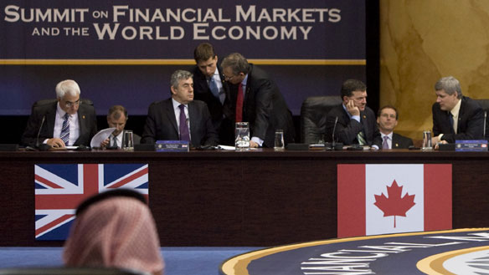
Written by
Edward J. Dodson, M.L.A.

Slide 4
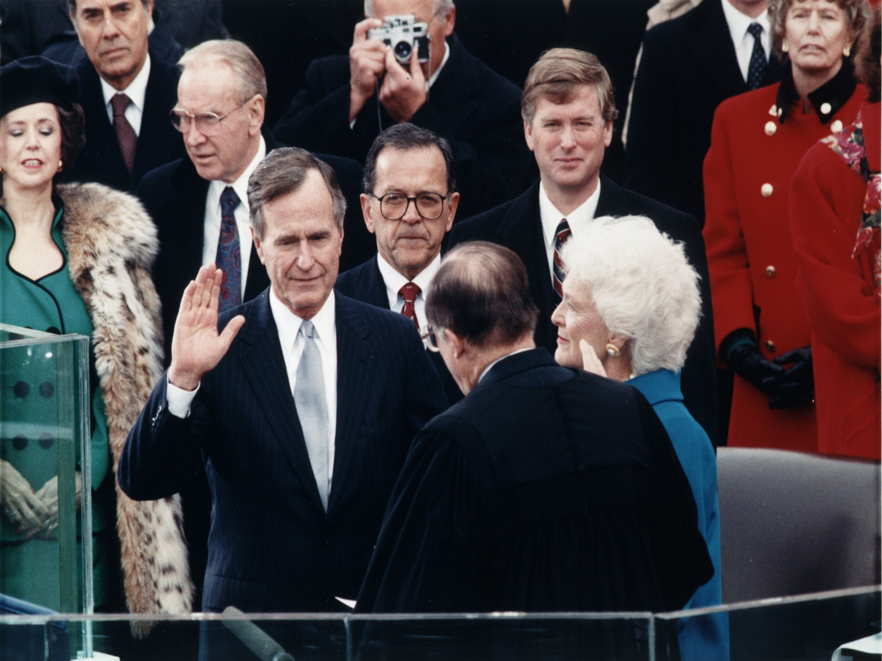
Notes:
The Reagan-era deregulation of financial markets caused a dramatic change in how and where government revenue was raised. Not broadly appreciated is that deregulation supercharged the inherently dysfunctional nature of property markets to bring the U.S. to the brink of yet another recession as the first President George Bush entered the White House.

Slide 5
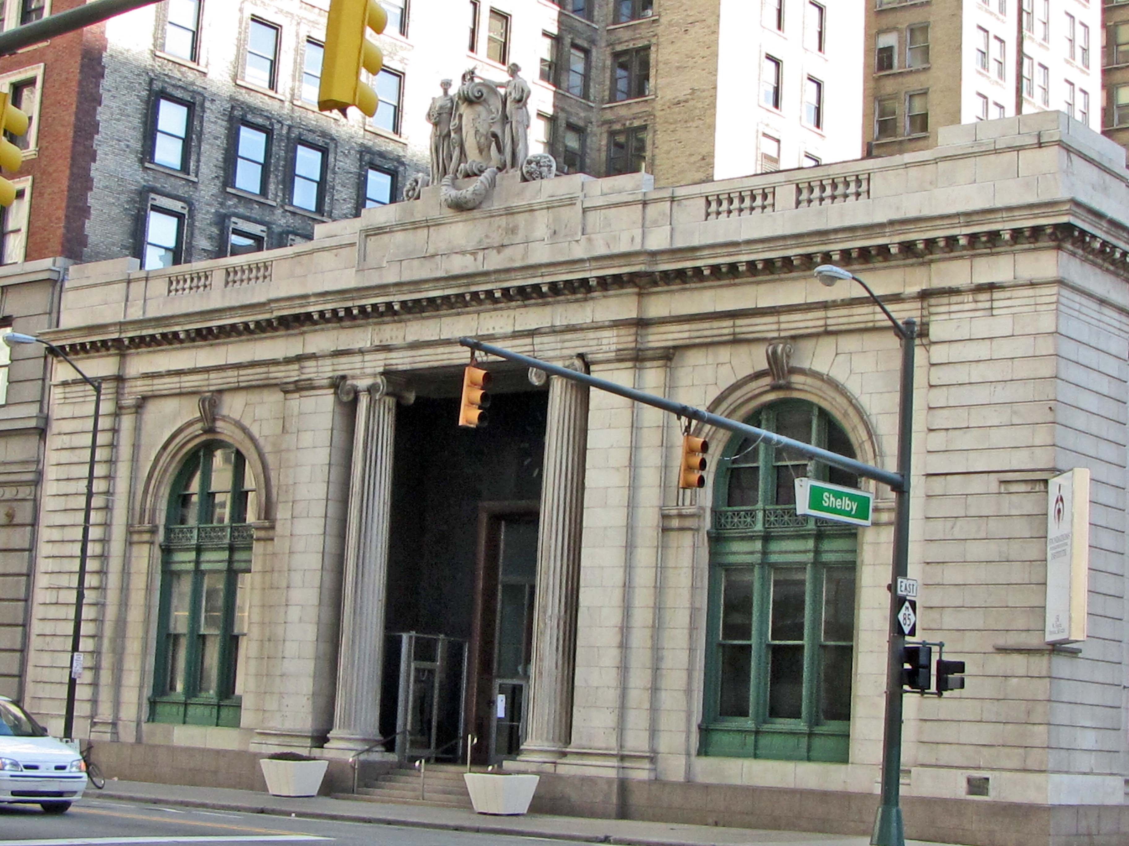
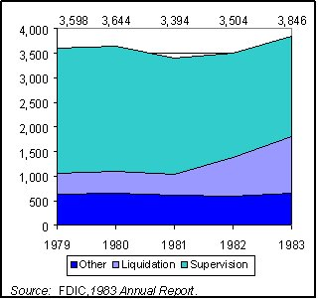
Notes:
Thanks to negative spreads, U.S. financial institutions experienced losses of $4.6 billion in 1981 and $4.1 billion in 1982. From 1980 thru 1983, 118 savings and loan associations with $43 billion in assets closed their doors, costing the FSLIC an estimated $3.5 billion to make depositors whole.

Slide 6
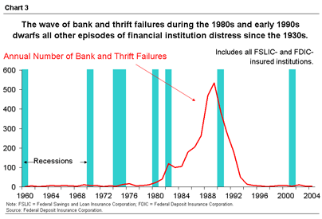
John Kenneth Galbraith
Notes:
Before the end of the financial crisis, more than 1,000 Thrifts failed. Economist John Kenneth Galbraith described the situation as "the largest and costliest venture in public misfeasance, malfeasance and larceny of all time.“ Galbraith did not live long enough to reconsider his judgment based on current conditions.

Slide 7
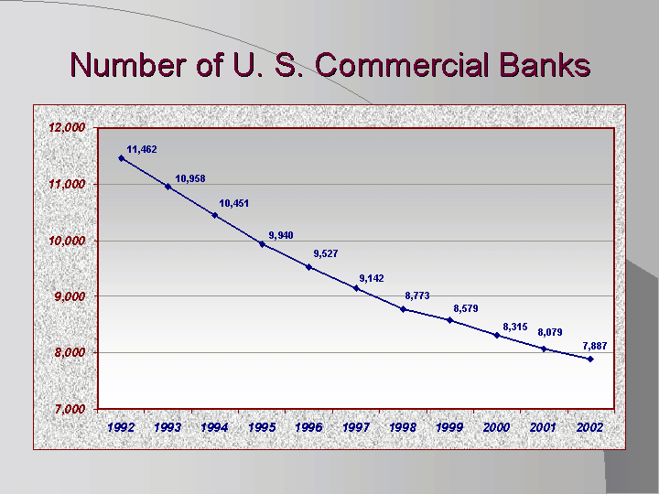
Notes:
Deregulation permitted mergers and acquisitions, creating mega-bank holding companies. European and Asian banks entered the U.S. market as major players.

Slide 8
Notes:
The perceived benefits to the banks included the opportunity to disperse risk geographically and across industries and consumer segments. The risk management challenges associated with lending on a global scale were not thought to be a serious problem. Experience has shown that bigger is not necessarily better.

Slide 9
Notes:
High interest rates brought down property prices by creating a huge inventory of unsold housing units. Then, once again by the mid-1980s, property markets – fueled by gradually falling interest rates and growth of the secondary market for mortgage loans – began another upward climb.

Slide 10
Notes:
The Reagan economic program was not generating higher paying jobs, but new financing innovations such as adjustable rate mortgages and minimal down payments made mortgage financing more broadly available.

Slide 11
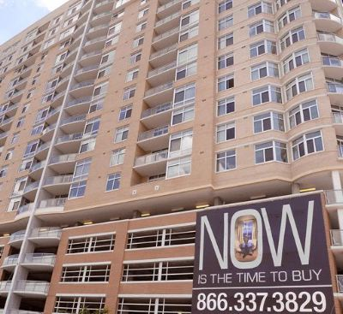
Notes:
Yet, the renewed window of affordability for many potential homebuyers rapidly closed. Escalating property prices lured developers and financial institutions into a false sense of confidence in the future. Speculative building – particularly of condominiums – ran well ahead of a conservative forecast of demand.

Slide 12
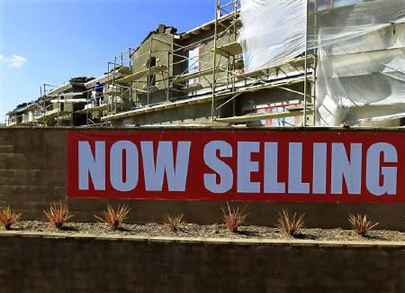
Notes:
By the end of the decade, property markets ran up against the inability of businesses and homeowners to take on the additional amount of debt required to pay the skyrocketed property prices.

Slide 13
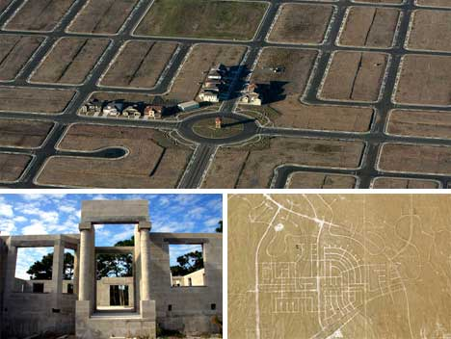
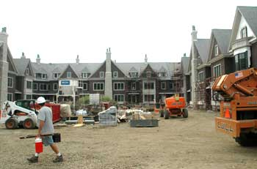
Notes:
Even as interest rates fell, housing affordability was not uniform across the U.S. Much depended on the amount of new construction underway just prior to the downturn.

Slide 14
Notes:
Local property markets experienced the deepest downturns where banks acquired unsold and partially-completed housing inventory from developers who defaulted on construction loans. Banks are not equipped to hold properties for extended periods of time following acquisition by foreclosure. Thus, bank-owned properties presented a great opportunity for investors who had the cash and could afford to buy and hold property until the property market recovered.

Slide 15
Notes:
At the same time, there were several demographic trends contributing to modest nominal improvements in household income, at least for some. These included increasing educational attainment and a dramatic increase in the number of women employed full-time in higher earning positions.

Slide 16
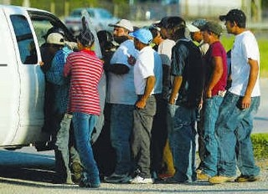
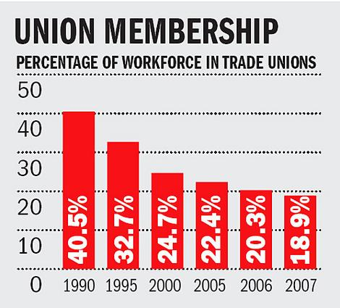
Notes:
These trends were countered by an ongoing decline in higher-paying manufacturing jobs, the decline in the number of unionized workers outside the public sector and a constantly growing population of illegal immigrants forced to accept whatever terms of employment they could obtain outside the protection of government and labor laws.

Slide 17
Notes:
With the deregulation of interest rates and the shift in policy by the Fed to money supply growth management, Fannie Mae and Freddie Mac were put in great jeopardy. They were in the same position as the savings banks, holding portfolios of fixed rate mortgage loans while their cost of funds was subject to short-term swings.

Slide 18
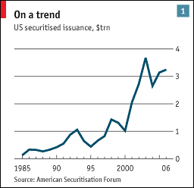
Notes:
New options were needed to generate fee income, offset low-yielding assets and raise capital. Pooling mortgage loans and issuing mortgage-backed securities generated “guarantee fees” – essentially insurance premiums – for Fannie Mae and Freddie Mac. Wall Street provided the investors and the financial capital, so that the two GSEs did not need to access the credit markets directly or take on interest rate risk.

Slide 19
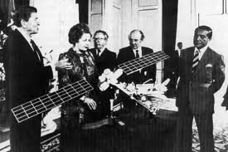
Notes:
The leaders of the major industrialized economies met in London in June of 1984. The following September they agreed to coordinate economic policy. Tariffs and other restrictions on international trade were gradually lowered. The Japanese agreed to reduce taxes on imports and to stimulate domestic demand. The signatories also pledged to intervene in foreign exchange markets in an effort to drive down a U.S. dollar widely perceived as overvalued.

Slide 20
Notes:
Despite (or because of) this international cooperation, an explosion of speculation erupted at the close of the 1980s. In 1987 the stock market melted down.

Slide 21
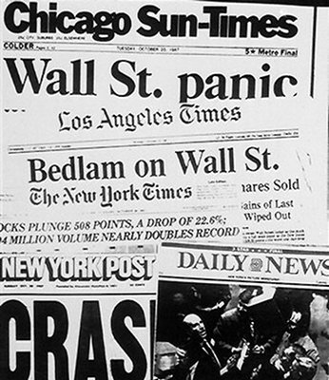
Notes:
On the 19th of October, 1987, the stock market experienced its largest one day decline in history – to that point. The Dow lost 22.6% of its nominal value, or $500 billion.

Slide 22
PRECIOUS METALS CLASSIC AUTOMOBILES WORKS OF ART
Notes:
In truth, no one really knew what the aggregate value of corporate shares really was. All it took for nominal values to decline was enough shareholders who believed the market was about to fall and keep falling to generate a major sell-off at lower and lower prices. Investors pulled billions of dollars out of the stock market and shifted to real estate, precious metals, collectible art work and classic automobiles.

Slide 23
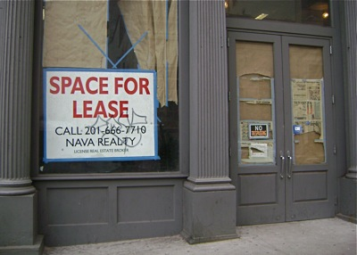
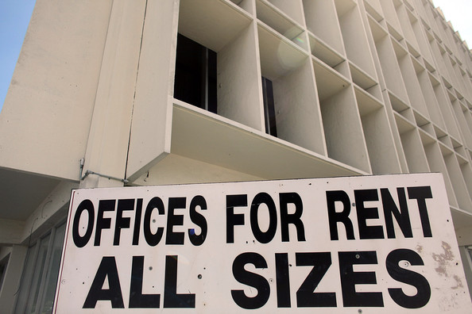
Notes:
Beginning in late 1988, a downturn in leasing fees generated by income-producing properties began all around the globe. Property values fell in many regions of the United States, in some cases by as much as one-third.

Slide 24
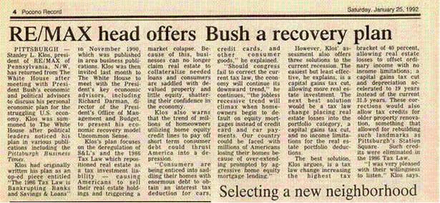
Notes:
The number of new homes constructed during the first year of the Bush presidency dropped to 1 million, the lowest number since the Second World War. Although the stock market had recovered from the losses of 1987, the U.S. economy was in serious trouble, as another round of bank failures followed on the heels of an expanding crash of the nation’s property markets. With each passing year, the situation worsened, opening the door for a change of leadership at the end of George Bush’s first term as President.

Slide 25
Notes:
The situation drifted and worsened as the Bush presidency came to an end. Challenged by Bill Clinton and by Ross Perot, Bush became a one-term President. In Episode 4, we will explore the Clinton years and his commitment to what he championed as a Third Way to economic growth and a deeper sharing of prosperity.

Slide 26
End of Episode 3

