Slide 1
Geo-libertarianism: Across the Left-right divide
Toward a World Governed by the Principles of Cooperative Individualism

Slide 2
By Edward J. Dodson, M.L.A.

Slide 3
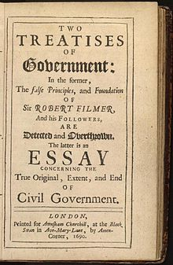
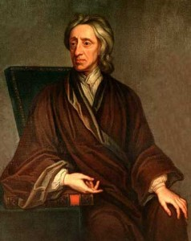
Notes:
Thoughtful people can and do disagree over the extent to which government ought to be authorized to intervene in the behavior of and between individuals. The debate received intellectual depth from John Locke, who sparked the debate that is fundamental to the quest for the just society:

Slide 4
Notes:
Do we possess natural rights? If so, what are our rights? Is natural law a just basis for positive law? Or, are natural laws merely descriptive rather than prescriptive? Locke offered his view:

Slide 5
“The state of nature has a law of nature to govern it which obliges every one; and reason, which is that law, teaches all mankind who will but consult it that, being all equal and independent, no one ought to harm another in his life, health, liberty, or possessions; …”
Notes:
“The state of nature has a law of nature to govern it which obliges every one; and reason, which is that law, teaches all mankind who will but consult it that, being all equal and independent, no one ought to harm another in his life, health, liberty, or possessions; …”

Slide 6
Notes:
The deep problem for us today, is that the laws of the societies in which we live have their origins in a time when hierarchical privilege was an accepted norm and rights were defined for the defense of privilege. Bravely, Locke argued that as members of society we have the moral authority (if not the practical means) to rise up against those who exercise licence in violation of our liberty:

Slide 7
“The reason why men enter into society is the preservation of their property; …Whenever the legislators endeavor to take away and destroy the property of the people, or to reduce them to slavery under arbitrary power, they put themselves into a state of war with the people who are thereupon absolved from any further obedience…”
Notes:
“The reason why men enter into society is the preservation of their property; …Whenever the legislators endeavor to take away and destroy the property of the people, or to reduce them to slavery under arbitrary power, they put themselves into a state of war with the people who are thereupon absolved from any further obedience…”

Slide 8
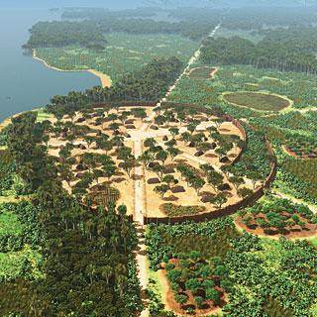
Notes:
Even a superficial knowledge of human history reveals that few societies have escaped the establishment of hierarchical privilege, the origins of which are to be found wherever groups settled in one place and began to develop rules governing access to what nature provided to support life.

Slide 9
Notes:
Fast forward to the sixteenth century and our forefathers began to migrate in large numbers, having reasonably mastered the technologies required to travel over the oceans thousands of miles to lands more sparsely populated or populated by peoples less advanced in the technologies required for success in warfare.

Slide 10
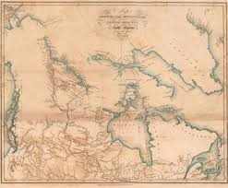
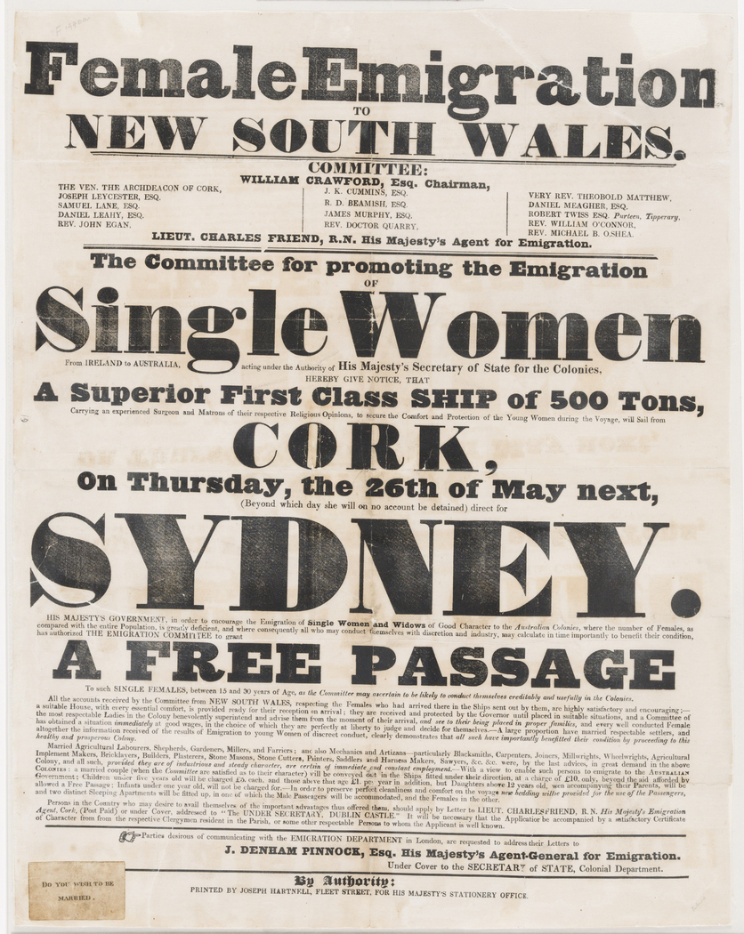
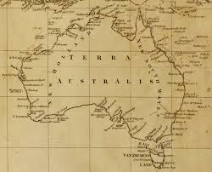
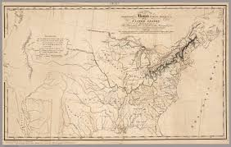
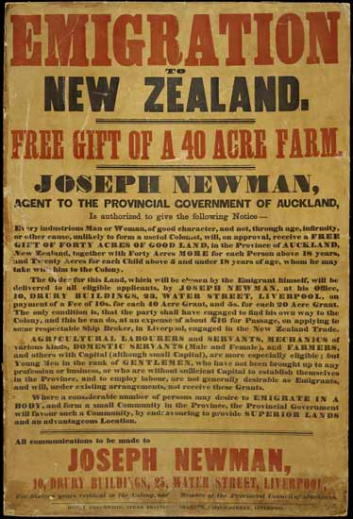
Notes:
In the emerging conflicts over territory and resources, the victors imposed their system of socio-political arrangements and institutions on the vanquished survivors. These systems – of law and taxation – encountered practical obstacles to enforcement, not the least of which were the vast, unsettled (unsettled by the newly-arrived invaders) lands beyond the established settlements.

Slide 11
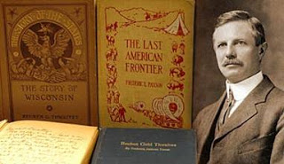
Notes:
An American historian, Frederick Jackson Turner, observed that in the process of settlement, conquering indigenous peoples and subduing nature, the attitudes and values of generations was forged:

Slide 12
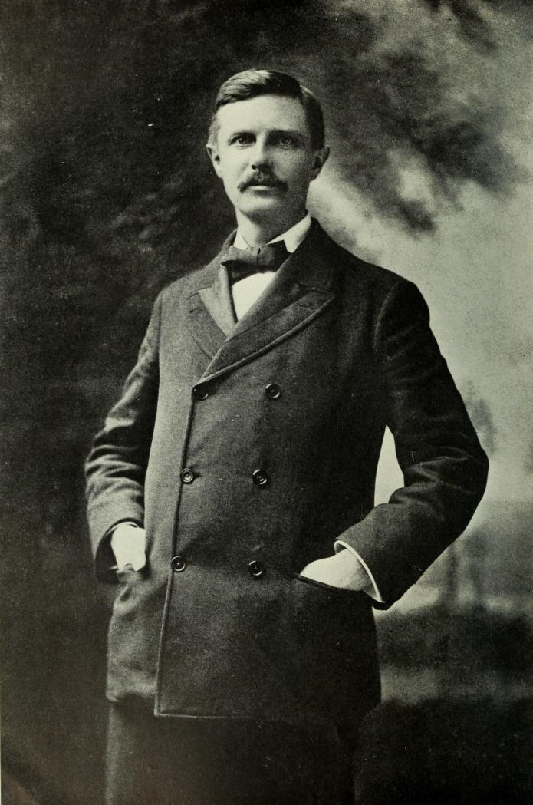
“In this advance, the frontier is the outer edge of the wave – the meeting point between savagery and civilization.”
Notes:
“In this advance, the frontier is the outer edge of the wave – the meeting point between savagery and civilization.”

Slide 13
“The most significant thing about the American frontier is, that it lies at the hither edge of free land. …The stubborn American environment is there with its imperious summons to accept its conditions; the inherited ways of doing things are also there; and yet, in spite of environment, and in spite of custom, each frontier did indeed furnish a new field of opportunity, a gate of escape from the bondage of the past; and freshness, and confidence, and scorn of older society, impatience of its restraints and its ideas, and indifference to its lessons, have accompanied the frontier.”
Notes:
“The most significant thing about the American frontier is, that it lies at the hither edge of free land. …The stubborn American environment is there with its imperious summons to accept its conditions; the inherited ways of doing things are also there; and yet, in spite of environment, and in spite of custom, each frontier did indeed furnish a new field of opportunity, a gate of escape from the bondage of the past; and freshness, and confidence, and scorn of older society, impatience of its restraints and its ideas, and indifference to its lessons, have accompanied the frontier.”

Slide 14
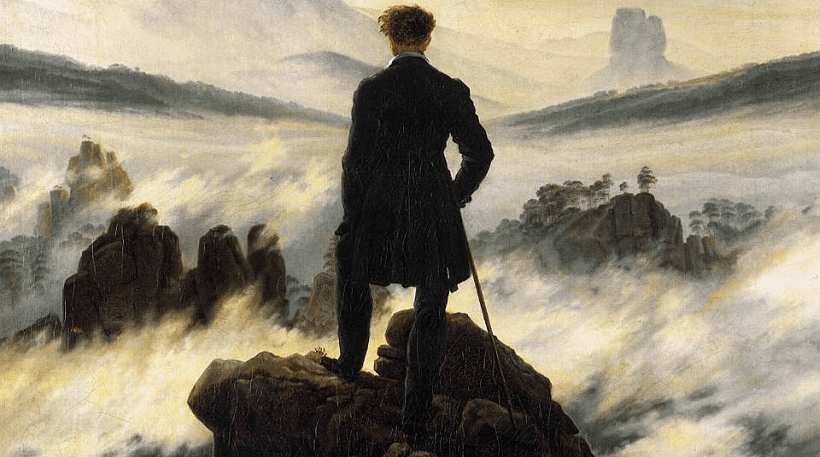
Notes:
And, it is from the centuries of frontier conflict and settlement that emerges the myths of rugged individualism, the deeply-held perspective that government is an instrument created to restrict the exercise of individual freedom, one such freedom claimed being the freedom to gain and retain ownership and control of nature, of land.

Slide 15
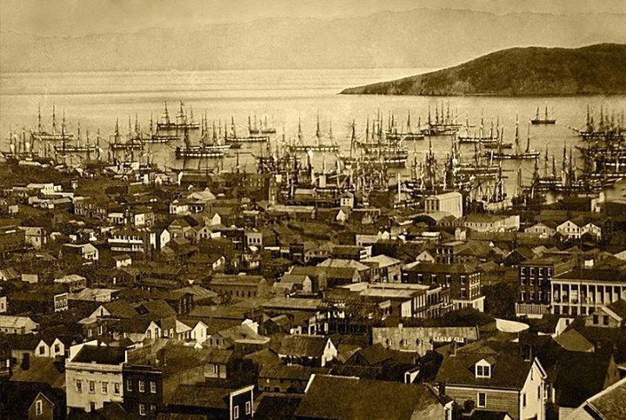
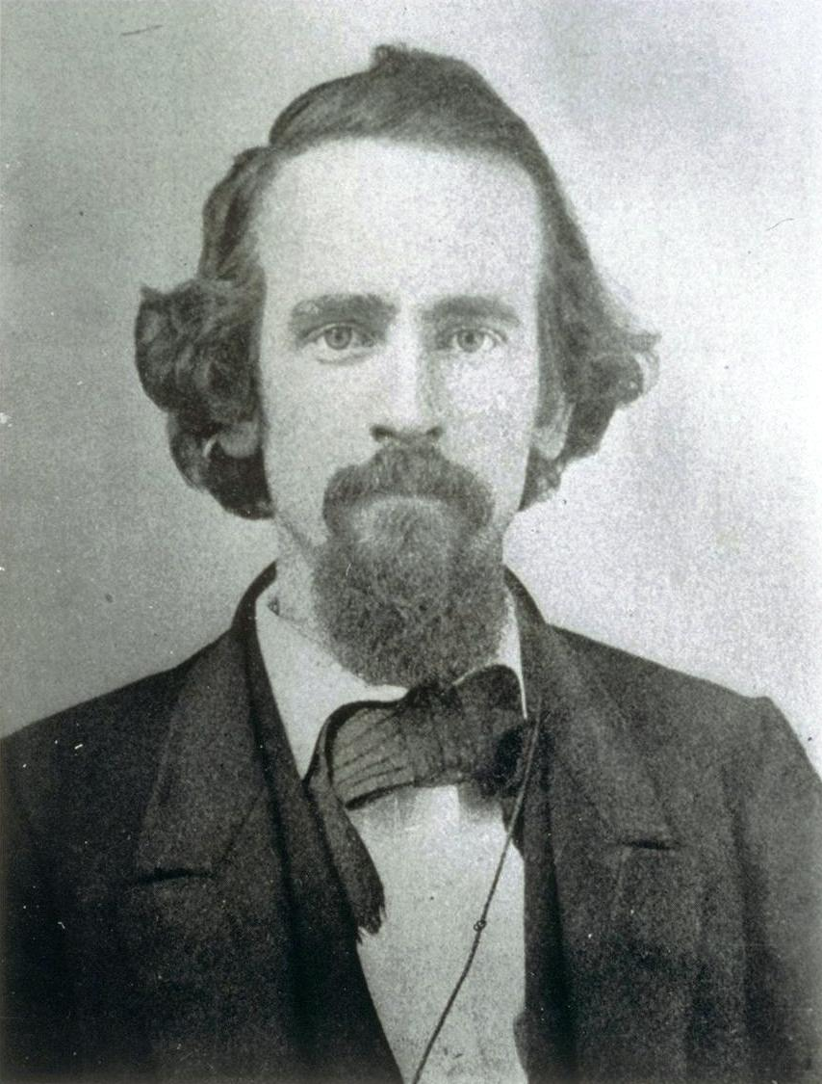
Notes:
Such was the state of the world in which Henry George emerged as a profound observer and analyst of the human condition. Henry was one of those individuals who, born with an adventurous spirit and pulled by both desire and necessity, left home and family in Philadelphia to seek his fortune in San Francisco. And, by 1868, in his first published writing, an article titled “What the Railroad Will Bring Us,” young Henry George had already come to understand what the future held for most people:

Slide 16
“Increase in population and in wealth past a certain point means simply an approximation to the condition of older countries, the Eastern States and Europe. …[I]t is certain that the tendency of the new era -- the more dense population and more thorough development of the wealth of the State -- will be to a reduction both of the rate of interest and the rate of wages, particularly the latter. …”
Notes:
“Increase in population and in wealth past a certain point means simply an approximation to the condition of older countries, the Eastern States and Europe. …[I]t is certain that the tendency of the new era -- the more dense population and more thorough development of the wealth of the State -- will be to a reduction both of the rate of interest and the rate of wages, particularly the latter. …”

Slide 17
“This crowding of people into immense cities, this aggregation of wealth into large lumps, this marshalling of men into big gangs under the control of the great "captains of industry," does not tend to foster personal independence -- the basis of all virtues…”
Notes:
“This crowding of people into immense cities, this aggregation of wealth into large lumps, this marshalling of men into big gangs under the control of the great "captains of industry," does not tend to foster personal independence -- the basis of all virtues…”

Slide 18
“We will have to deal, in time, with all the social problems that are forcing themselves on older communities, (like the riddles of a Sphinx, which not to answer is death) with one of them, the labor question, rendered peculiarly complex by our proximity to Asia. Public spirit, public virtue, the high resolve of men and women who are capable of feeling the "enthusiasm of humanity," will be needed in the future more than ever.”
Notes:
“We will have to deal, in time, with all the social problems that are forcing themselves on older communities, (like the riddles of a Sphinx, which not to answer is death) with one of them, the labor question, rendered peculiarly complex by our proximity to Asia. Public spirit, public virtue, the high resolve of men and women who are capable of feeling the "enthusiasm of humanity," will be needed in the future more than ever.”

Slide 19
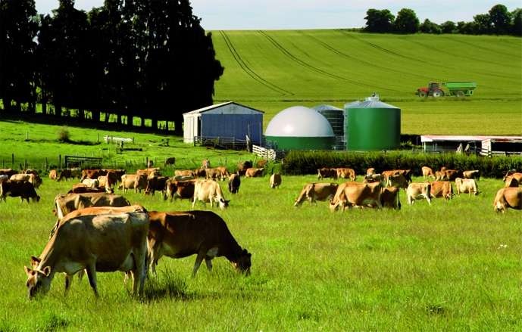
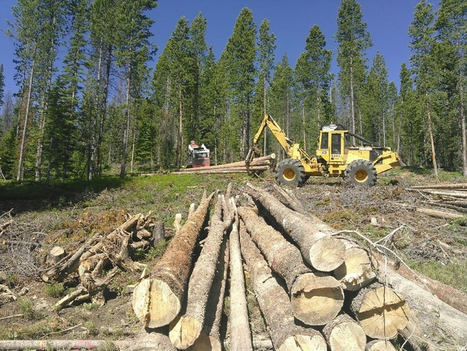
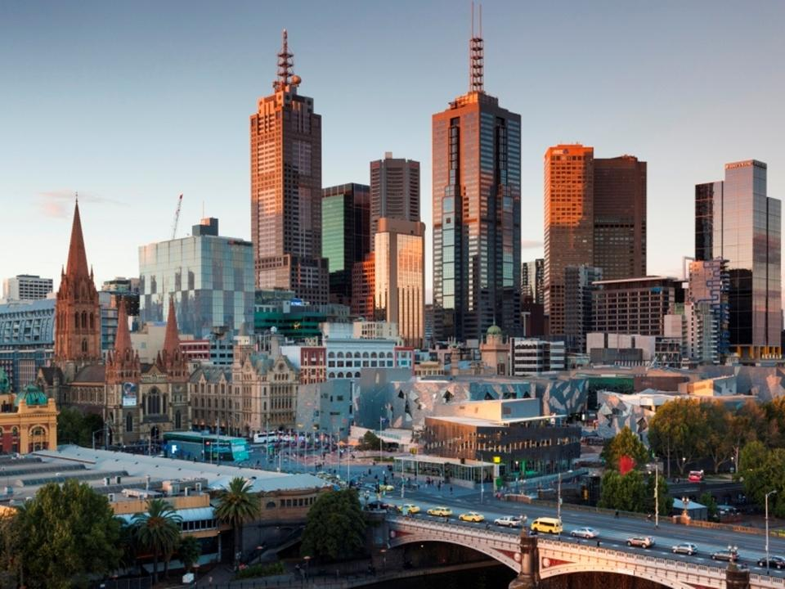
Notes:
The solution Henry George came to was deceptively simple: the public collection of the potential annual rental value of all locations as well as those land-like assets with a supply fixed by nature, such as the broadcast spectrum or even take-off and landing slots at airports.

Slide 20
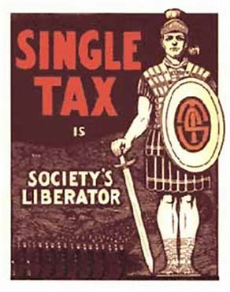
Notes:
Of course, Henry George went much further, calling for the elimination of the taxation of all capital goods, of the income earned by the use of capital goods or from labor employed in the production of goods or delivery of services. Further, he argued the case against tariffs, quotas and other restraints of trade but with a warning:

Slide 21
“[T]hat violation of natural rights which imposes tariff duties is inseparably linked with that violation of natural rights which compels the masses to pay tribute for the privilege of living. The one cannot be abolished without the other. …”
Notes:
“[T]hat violation of natural rights which imposes tariff duties is inseparably linked with that violation of natural rights which compels the masses to pay tribute for the privilege of living. The one cannot be abolished without the other. …”

Slide 22
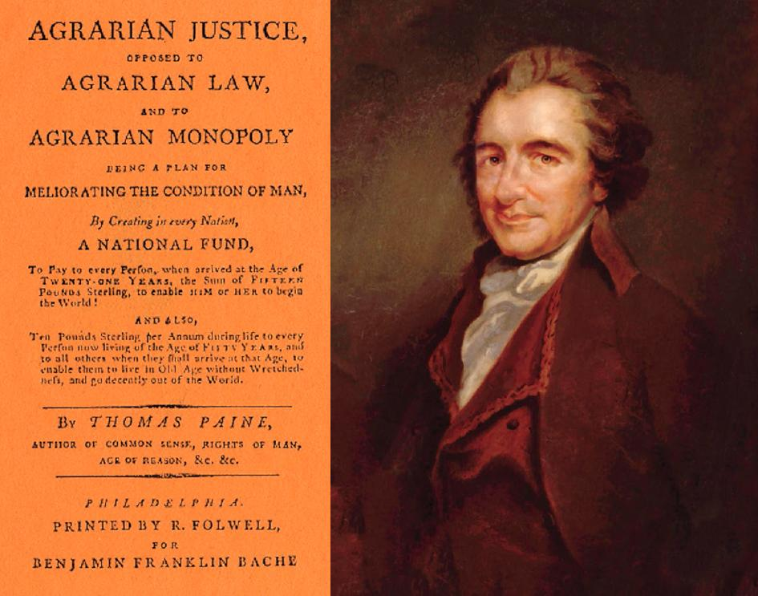
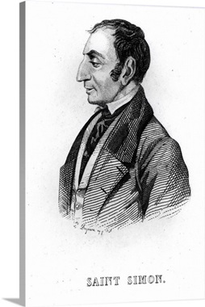
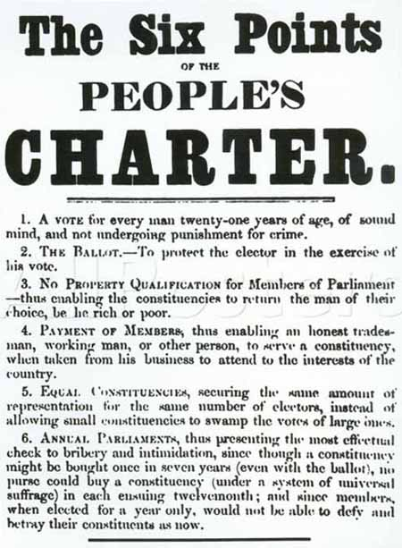
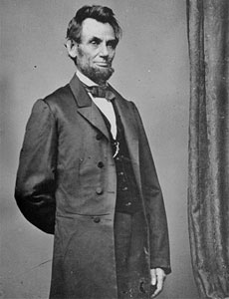
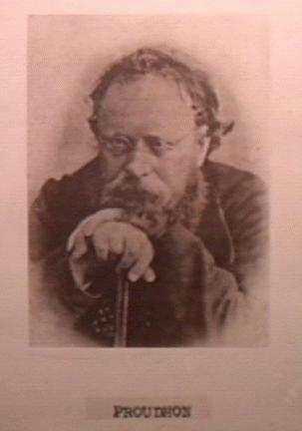
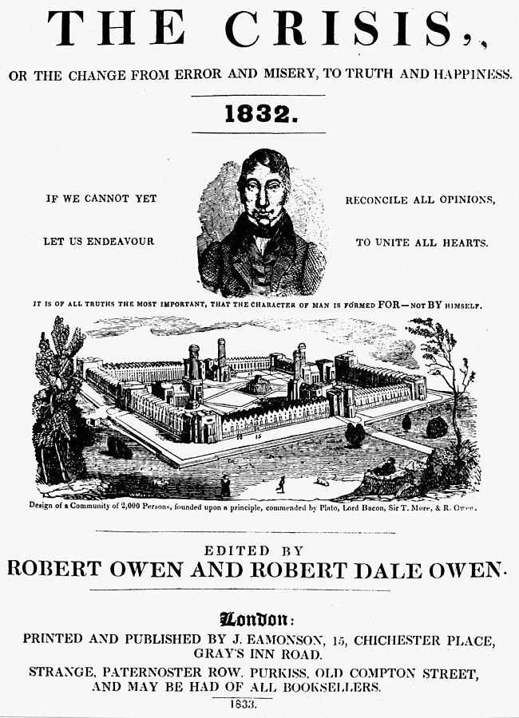
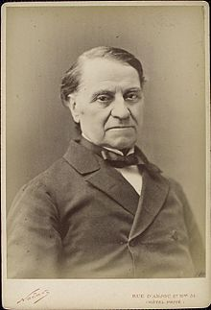
“Labor is prior to, and independent of, capital. Capital is only the fruit of labor, and could never have existed if labor had not first existed. Labor is the superior of capital, and deserves much the higher consideration.”
Louis Blanc
Notes:
All around the world, others began to pay attention. The rising tide of resentment against the tyranny, despotism, colonialism, imperialism and social Darwinism of the 19th century included many leading figures. Thomas Paine’s plan detailed in Agrarian Justice set the bar for others committed to ending hierarchical privilege. Robert Owen, Charles Fourier, Pierre-Joseph Proudhon, Louis Blanc and Claude Henri de Saint-Simon and even Abraham Lincoln each contributed to a growing recognition that change had to be fought for against those who possessed both property and political power. As Lincoln wrote: “Labor is prior to, and independent of, capital. Capital is only the fruit of labor, and could never have existed if labor had not first existed. Labor is the superior of capital, and deserves much the higher consideration.”

Slide 23
Notes:
Marx agreed, but argued this would require an uprising by “the proletariat” to take control of the means of production. Critics of Marx point to the fact that throughout much of his life held no job and was financially dependent on Friedrich Engles, the son of a wealthy factory owner. Yet, from Marx came a good deal of accurate observations, including: “The oppressed are allowed once every few years to decide which particular representatives of the oppressing class are to represent and repress them.”

Slide 24
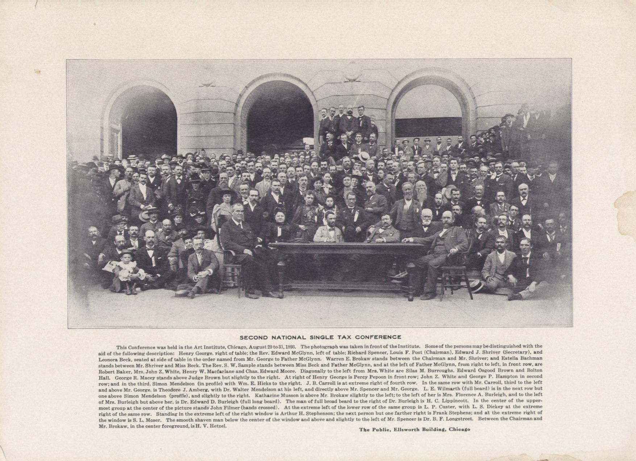
Notes:
Surrounding Henry George as the momentum of the Single Tax movement rose and fell, were many people attracted to the man, Henry George, because of his strong, moral character. However, the political world into which George by necessity was thrown made him both friend and opponent of worker and capitalist interests. George offered all equality of opportunity; what they all pursued was special status under law.

Slide 25
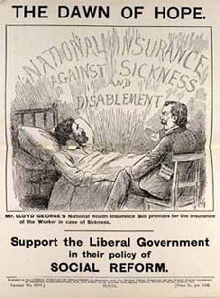
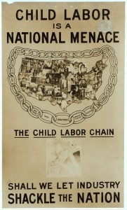
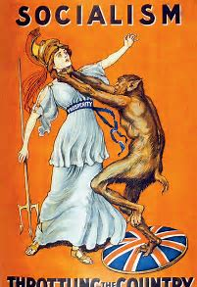
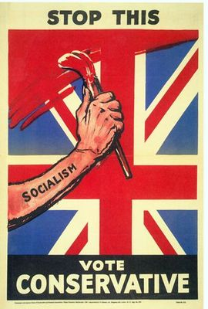
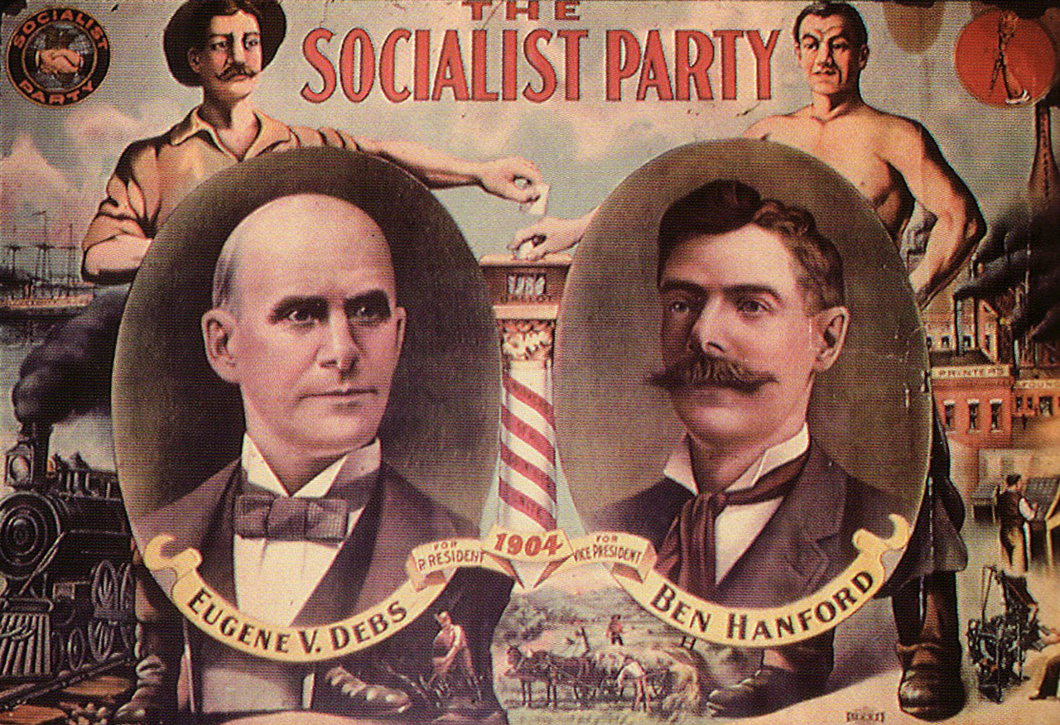
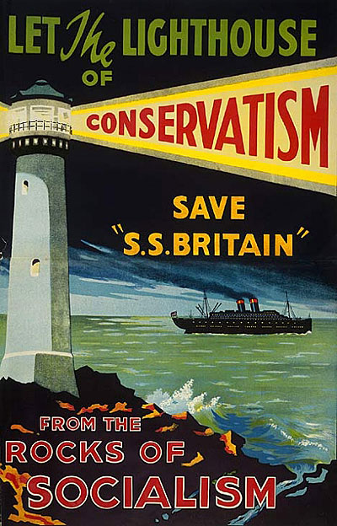
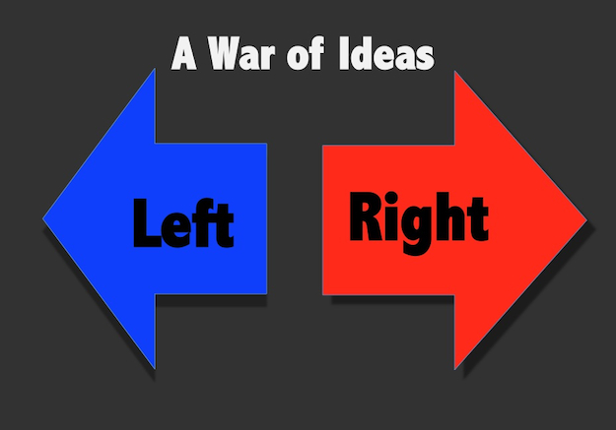
Notes:
Without Henry George’s presence after his death in October of 1897, the movement he initiated splintered and quickly disappeared as a counter to the mass appeal of democratic- or the more extreme state-socialism, or the reactionary attachment to ultra-conservative strains of social-Darwinism. The Left-Right ideological framework that has dominated public discourse ever since took over. Single-taxers found themselves marginalized and essentially ignored.

Slide 26
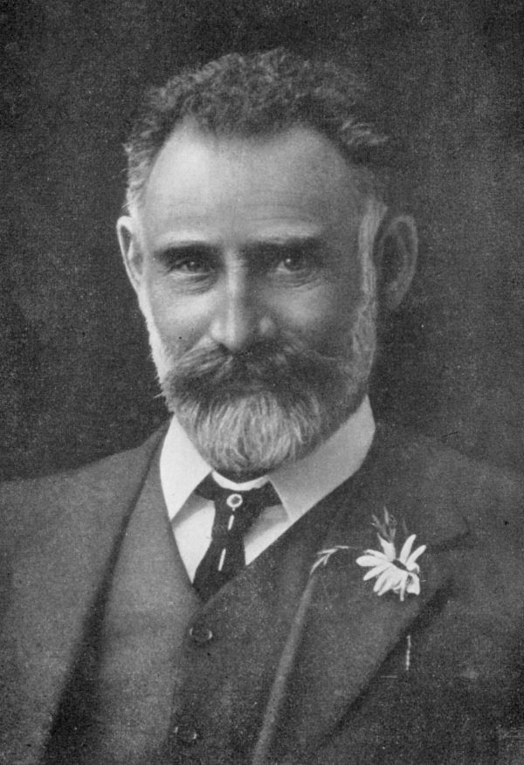
Notes:
Rising to a position of influence in the surviving Single Tax movement, Max Hirsch took on the job of explaining what Socialism would mean to people if adopted. In 1904 he spoke to large audiences brought together in the Athenaeum Hall in Melbourne. He had come to the conclusion that Socialism presented huge risks to the liberty of the individual:

Slide 27
“Man does not live by bread alone. There are higher boons than material wealth. Freedom, equality of rights, the purity and jobs of family life – these are the higher fruits of the social state. For the partial attainment of these boons generation after generation of men have sacrificed wealth and life itself. Socialism must not only stop further progress in these directions, but will lead to the loss of the progress so far made in its long and weary upward struggle.”
Notes:
“Man does not live by bread alone. There are higher boons than material wealth. Freedom, equality of rights, the purity and jobs of family life – these are the higher fruits of the social state. For the partial attainment of these boons generation after generation of men have sacrificed wealth and life itself. Socialism must not only stop further progress in these directions, but will lead to the loss of the progress so far made in its long and weary upward struggle.”

Slide 28
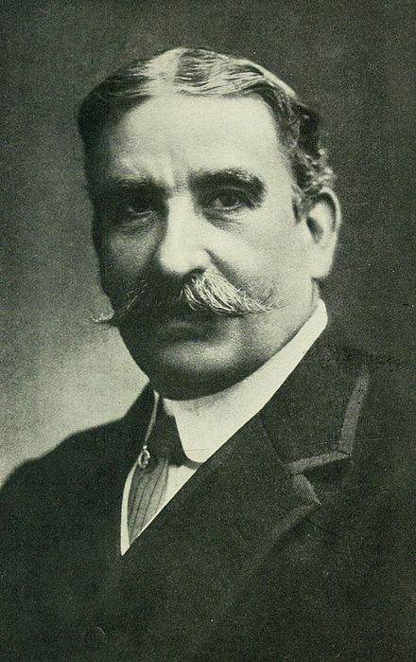
Notes:
For the first three decades of the twentieth century, surviving Single Taxers struggled for standing in the political realm of country after country. By 1909, Henry George’s work in Ireland was forgotten as Irish leaders focused all their energy on Home Rule. In Australia, Labour held power. Robert Donald, editor of the Daily Chronicle, in a letter to the movement’s principal financier, Joseph Fels, described the result:

Slide 29
“Its policy generally is a kind of mongrel Socialism combined with the most hopeless conservatism. The Party, as a party, profess no particular fiscal faith, but at the same time are strongly protectionist. They profess to believe in the nationalization of the land, and at the same time hold to the old lunacy that the nationalization of machinery is equally essential.”
Notes:
“Its policy generally is a kind of mongrel Socialism combined with the most hopeless conservatism. The Party, as a party, profess no particular fiscal faith, but at the same time are strongly protectionist. They profess to believe in the nationalization of the land, and at the same time hold to the old lunacy that the nationalization of machinery is equally essential.”

Slide 30
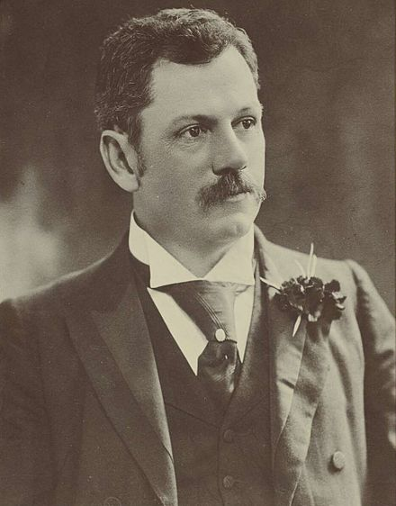
Notes:
Australian Single Taxers had reason for hope when, in 1904, Joseph Carruthers became Premier, remaining until 1907. Labour won the 1910 federal election and introduced a land tax in an effort to break up large estates and encourage small-scale farming.

Slide 31
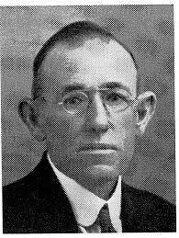
Notes:
Australians elected Edward Craigie, an independent, a free trader, and a land taxer, to the South Australia House of Assembly in 1930, serving several terms until defeated in 1941. Liberals and Labour members paid little attention to his efforts to put single tax theories into legislative form.

Slide 32
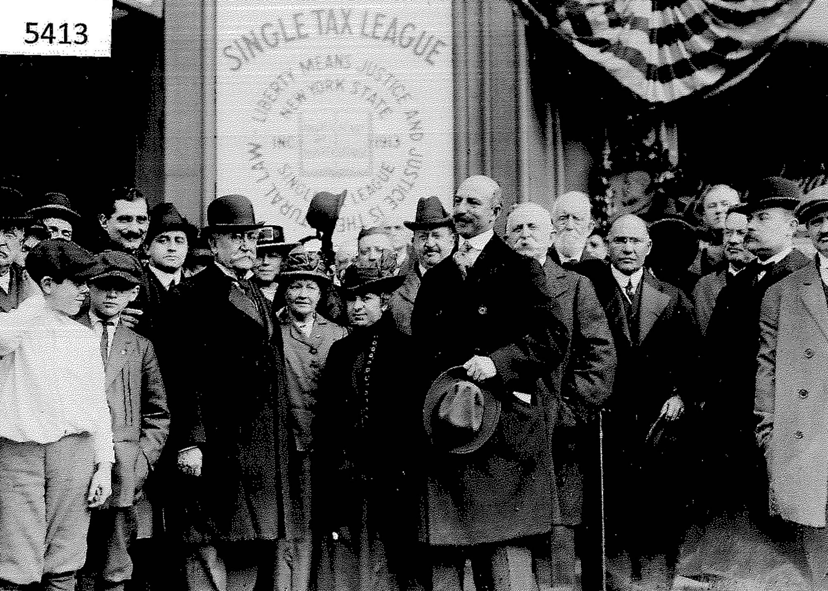
Notes:
The movement in the United States was, perhaps, the most divided over ideological principles as well as how to achieve even a modest degree of success. Commenting on the state of the Single Tax movement in 1918, an editorial in The Single Tax Review warned of “the academic state of mind into which the Single Taxers of the country had fallen.” Those still committed to challenging the existing political party dominance met in New York City during June 1919 to found a national Single Tax Party. A year later the party offered its slate of candidates for election to the nation’s highest offices.

Slide 33
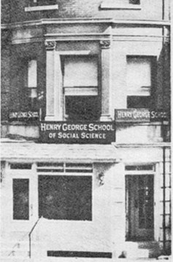
Notes:
Others disdained political activism in favor of public education and began to self-describe themselves as “Georgists” rather than “Single Taxers.” In 1914, Oscar Geiger urged the creation of Reading Circles, attracting individuals who would begin with various Single Tax readings, then go on to read and discuss George’s Social Problems and eventually Progress and Poverty. It took until 1932 for his vision to evolve into the founding of the Henry George School of Social Science. Course materials he developed presented Henry George’s system of political economy as an alternative way the world could be and should be organized in order to create just societies.

Slide 34
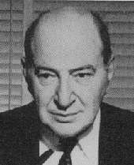
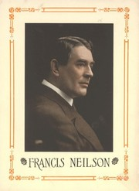
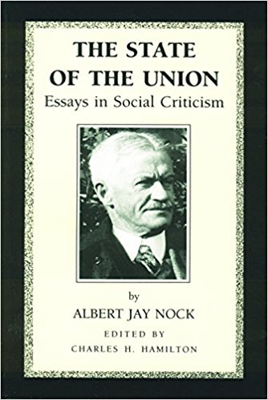
Frank Chodorov
Notes:
In the United States, the school found a receptive and growing audience within the remnant of classic liberals, such as Francis Neilson and Albert Jay Nock. A dedicated Single Taxer turned Georgist named Frank Chodorov fully embraced Geiger’s campaign to establish Henry George Schools everywhere possible. In an issue of Land and Freedom (successor to the The Single Tax Review) in 1935, Chodorov challenged Georgists to take responsibility for the survival of the movement:

Slide 35
“[T]he answer to ‘What am I going to do about it’ is quite definite. First, get students; second, organize classes; third, be a teacher. If every follower of Henry George will follow this personal programme faithfully the success of the educational campaign is assured. And upon the success of this campaign depends the success of any political endeavor that the movement may eventually decide to engage in. …”
Notes:
“[T]he answer to ‘What am I going to do about it’ is quite definite. First, get students; second, organize classes; third, be a teacher. If every follower of Henry George will follow this personal programme faithfully the success of the educational campaign is assured. And upon the success of this campaign depends the success of any political endeavor that the movement may eventually decide to engage in. …”

Slide 36
“The task is yours. It is not a question of ‘what are we going to do about it?’ but ‘what am I going to do about it?’ The problem is an individual one, and its solution is directly dependent upon, and in exact ratio to, the effort and ability of every one who has acquired a knowledge of Henry George to spread this knowledge. Do not wait for somebody else. Do not waste time in praying for a leader. Progress and Poverty is your guide, Henry George is your inspiration, and you are the disciple on whom the mantle has fallen. Go forth into the highways and the by-ways and teach the gospel of economic liberty.”
Notes:
“The task is yours. It is not a question of ‘what are we going to do about it?’ but ‘what am I going to do about it?’ The problem is an individual one, and its solution is directly dependent upon, and in exact ratio to, the effort and ability of every one who has acquired a knowledge of Henry George to spread this knowledge. Do not wait for somebody else. Do not waste time in praying for a leader. Progress and Poverty is your guide, Henry George is your inspiration, and you are the disciple on whom the mantle has fallen. Go forth into the highways and the by-ways and teach the gospel of economic liberty.”

Slide 37
Notes:
Two years later, Frank Chodorov was appointed Director of the Henry George School in New York City. He regularly taught classes and wrote for the school’s publication. With the expanding influence of communist ideology among intellectuals as well as workers disenchanted with The American System, Chodorov saw Georgism as the only credible response. In the February 1938 issue of The Freeman he wrote:

Slide 38
“Democracy – this is the ideal to hold up to youth. But a real democracy. Not one identical with the laissez-faire doctrine of the last century, the doctrine of robbery within the law made by the robbers. Rather, the democracy of a fair field and no favor. Economic democracy.”
Notes:
“Democracy – this is the ideal to hold up to youth. But a real democracy. Not one identical with the laissez-faire doctrine of the last century, the doctrine of robbery within the law made by the robbers. Rather, the democracy of a fair field and no favor. Economic democracy.”

Slide 39
Notes:
Chodorov was forced to resign during the Second World War. A pacifist, his views ran counter to the majority of those who served as trustees of the school, sensitive to any criticism of not being sufficiently patriotic. Over the next twenty-five years his writing focused less and less on the philosophy of Henry George and mainly on individualism.

Slide 40
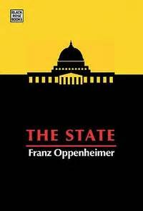
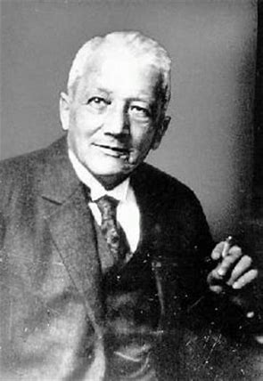
Notes:
This individualist contingent existed within the Georgist ranks but was growing elsewhere as a result of the writing, lecturing and activism of anti-statists who embraced quite divergent views on almost all matters relating to the limits to freedom. One of the most influential writers was the German professor of economics and sociology, Franz Oppenheimer, who emigrated to the United States in 1938. Three years later he became one of the co-founders of the American Journal of Economics and Sociology and frequent contributor to The Freeman until his death in 1943. Franz Oppenheimer certainly admired and respected Henry George. However, he had his own solution to the land problem, as explained in a 1948 article published in the American Journal of Economics and Sociology:

Slide 41
“The land monopoly can be broken. All that is needed is to stop the proletarian migration from the rural districts into the cities by offering the foot-loose people much better chances in the country itself. This can be done by creating agricultural co-operative settlements of the type this writer created in Germany – settlements which were acknowledged to be an unqualified success by the pre-Hitler German government.”
Notes:
“The land monopoly can be broken. All that is needed is to stop the proletarian migration from the rural districts into the cities by offering the foot-loose people much better chances in the country itself. This can be done by creating agricultural co-operative settlements of the type this writer created in Germany – settlements which were acknowledged to be an unqualified success by the pre-Hitler German government.”

Slide 42
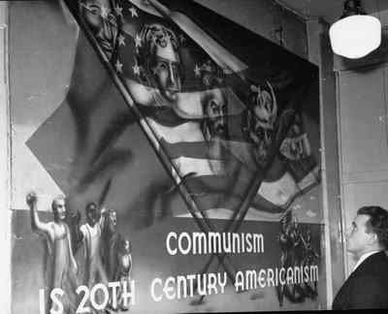
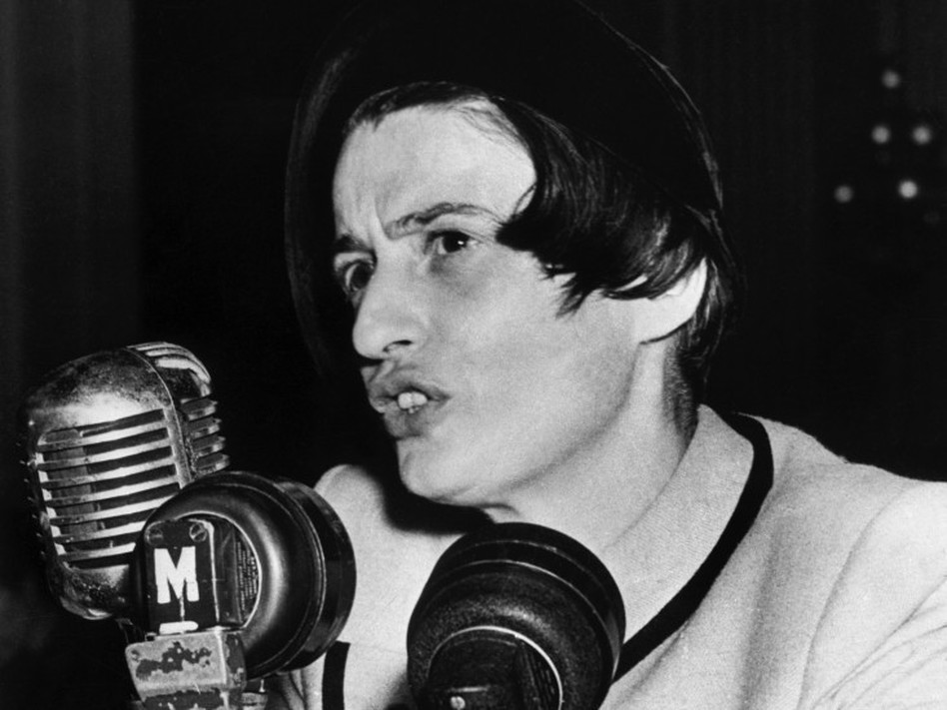
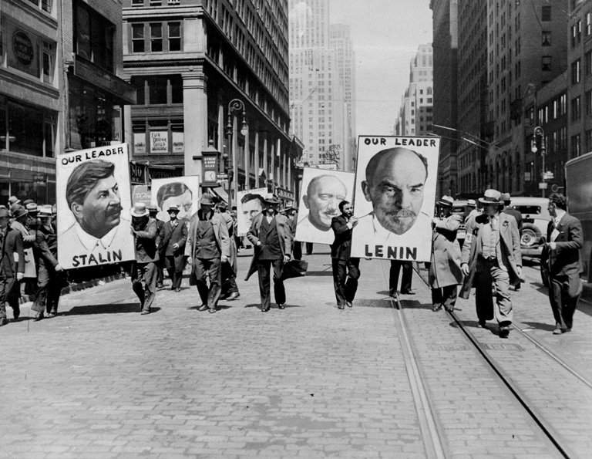
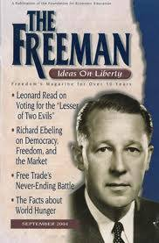
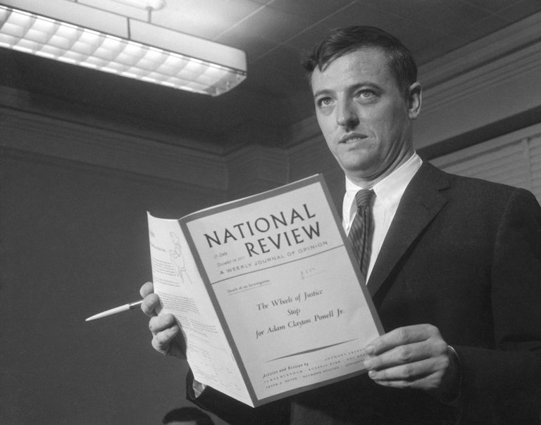
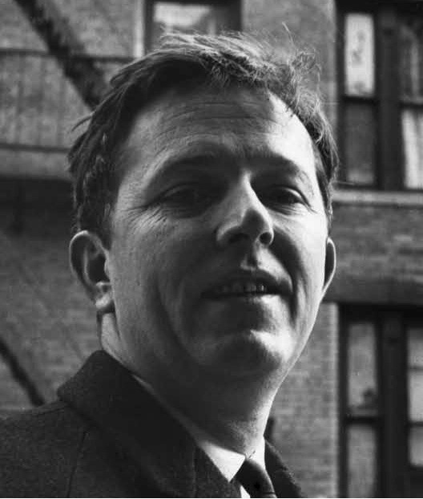
Notes:
Headquartered in New York City as they have been since their founding in 1926 and 1932, respectively, the Robert Schalkenbach Foundation and the Henry George School of Social Science had board members, directors, teachers and students who were in some way intellectually involved in the dynamic cross-fertilization of ideologies that blossomed there.

Slide 43
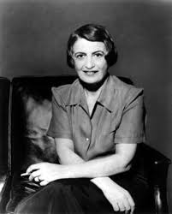
Notes:
New York City became home to Alisa Rosenbaum, who escaped from Bolshevik Russia in 1926, changing her name to Ayn Rand. Her first successful novel, The Fountainhead, was published in 1943. And, in 1957, her fame as an intellectual of the Right was secured with publication of Atlas Shrugged. Reviewing Atlas Shrugged in 1960, the stalwart individualist Georgist Oscar Johannsen wrote:

Slide 44
“The book is a brilliant, fighting defense of the dignity of the individual and of private enterprise. …This is not to say that she is without faults. …Unfortunately, Miss Rand suffers from the same misconception of the rulership of the world that Plato, the socialists and the libertarians have. All of them believe that the mass of people must be led by some ruling intelligentsia.”
Notes:
“The book is a brilliant, fighting defense of the dignity of the individual and of private enterprise. …This is not to say that she is without faults. …Unfortunately, Miss Rand suffers from the same misconception of the rulership of the world that Plato, the socialists and the libertarians have. All of them believe that the mass of people must be led by some ruling intelligentsia.”

Slide 45
Notes:
Oscar Johannsen (an electrical engineer), Sydney Mayer (an attorney) and Jack Schwartzman (an attorney and professor of English literature), formed a Georgist cadre of surviving individualists huddled in New York and contributing articles to their occasionally produced publication, Fragments. The Schwartzman family fled Kiev in the early 1920s, were smuggled into Roumania, and eventually made their way to the United States. Jack Schwartzman’s world view is aptly expressed in a brief article he wrote appearing in a 1964 issue of Fragments:

Slide 46
“But what are morals, health and safety except personal concepts? Only the individual can ever determine their meaning. No ‘absolute’ power can do so. Does it mean, therefore, that there are no absolutes in the universe? Far from it! The cosmos is regulated by inexorable natural laws. Adherence to them would – of necessity – cause each person to act in harmony with absolute morality and hygiene.”
Notes:
“But what are morals, health and safety except personal concepts? Only the individual can ever determine their meaning. No ‘absolute’ power can do so. Does it mean, therefore, that there are no absolutes in the universe? Far from it! The cosmos is regulated by inexorable natural laws. Adherence to them would – of necessity – cause each person to act in harmony with absolute morality and hygiene.”

Slide 47
Notes:
To Professor Schwartzman, natural law is both descriptive and prescriptive. In his usage, he adheres to the same logic as did Henry George, that the natural law is also the moral law.

Slide 48
Notes:
When Frank Chodorov died in 1966, a long list of individualist, conservative and libertarian intellectuals reflected on Chodorov’s importance to the development of their own thinking. One of these was, in fact, a family friend, William F. Buckley, Jr. In Buckley’s remembrance of Chodorov, he conveyed Chodorov’s concerns over what was happening – as he saw it – within the community of people who continued to claim Henry George as their guiding light:

Slide 49
“Having for many years … cultivated what he grew to believe was the unique social vision of [Henry] George, he became the director of the Henry George School. But in due course, there was a falling out, and he resigned. One cannot truly understand George, he once remarked, without understanding his antipathy to socialism. But George’s most modern exegetes, he feared, were disposed to traduce George, to put his social philosophy at the service of the state. And it was the centralized state that Frank Chodorov was born, and lived, to oppose.”
Notes:
“Having for many years … cultivated what he grew to believe was the unique social vision of [Henry] George, he became the director of the Henry George School. But in due course, there was a falling out, and he resigned. One cannot truly understand George, he once remarked, without understanding his antipathy to socialism. But George’s most modern exegetes, he feared, were disposed to traduce George, to put his social philosophy at the service of the state. And it was the centralized state that Frank Chodorov was born, and lived, to oppose.”
Fast forward to the year 2000. Interviewed about his latest book, Buckley responded to a caller who asked:

Slide 50
“I’ve heard you describe yourself as a Georgist, a follower of Henry George, but I haven’t heard much in having you promote land value taxation and his theories, and I’m wondering why that is the case.”
Notes:
“I’ve heard you describe yourself as a Georgist, a follower of Henry George, but I haven’t heard much in having you promote land value taxation and his theories, and I’m wondering why that is the case.”
To which Buckley responded:

Slide 51
“It's mostly because I'm beaten down by my right-wing theorists and intellectual friends. They always find something wrong with the Single-Tax idea. What I'm talking about Mr. Lamb is Henry George who said there is infinite capacity to increase capital and to increase labor, but none to increase land, and since wealth is a function of how they play against each other, land should be thought of as common property. The effect of this would be that if you have a parking lot and the Empire State Building next to it, the tax on the parking lot should be the same as the tax on the Empire State Building, because you shouldn't encourage land speculation. …”
Notes:
“It's mostly because I'm beaten down by my right-wing theorists and intellectual friends. They always find something wrong with the Single-Tax idea. What I'm talking about Mr. Lamb is Henry George who said there is infinite capacity to increase capital and to increase labor, but none to increase land, and since wealth is a function of how they play against each other, land should be thought of as common property. The effect of this would be that if you have a parking lot and the Empire State Building next to it, the tax on the parking lot should be the same as the tax on the Empire State Building, because you shouldn't encourage land speculation.”

Slide 52
“Anyway I've run into tons of situations where I think the Single-Tax theory would be applicable. We should remember also this about Henry George, he was sort of co-opted by the socialists in the 20s and the 30s, but he was not one at all. Alfred J. Nock's book on him makes that plain. Plus, also, he believes in only that tax. He believes in zero income tax.”
Notes:
“Anyway I've run into tons of situations where I think the Single-Tax theory would be applicable. We should remember also this about Henry George, he was sort of co-opted by the socialists in the 20s and the 30s, but he was not one at all. Alfred J. Nock's book on him makes that plain. Plus, also, he believes in only that tax. He believes in zero income tax.”

Slide 53
Notes:
Browse through the various Georgist publications during the heightened period of anti-communism and one finds many views expressed that are anti-statist. Individualist Georgists embraced the sentiment expressed by Benjamin Franklin:

Slide 54
“Those who would give up essential Liberty, to purchase a little temporary Safety, deserve neither Liberty nor Safety.”
Notes:
“Those who would give up essential Liberty, to purchase a little temporary Safety, deserve neither Liberty nor Safety.”

Slide 55
Notes:
At the end of 1980, an article by Robert V. Andelson titled “Neo-Georgism and the Quest for Justice” appeared in Land & Liberty. Andelson, a professor of philosophy, made the case that Henry George’s fiscal reform was the most practical path to realization of the libertarian objective of the minimal state. However, Andelson suggested that accepting the term “Georgist” as descriptive of one’s belief system implied full agreement with all that George put forward. His own perspectives were better described, he said, as “Neo-Georgist.”

Slide 56
Notes:
Andelson’s article was followed in 1981 by a second article written in support of Geo-Libertarianism, this one by Fred Foldvary, by then a member of the Libertarian Party in California. He explained to readers what distinguished Libertarians from most persons who described themselves as Georgists:

Slide 57
“To reconcile libertarianism to Georgism, we must return to the basic premises of libertarianism: that each individual has dominion over his own life, equal to that of others, and that the sole function of government is to secure the right of an individual to be free from the coercion of others. …”
Notes:
“To reconcile libertarianism to Georgism, we must return to the basic premises of libertarianism: that each individual has dominion over his own life, equal to that of others, and that the sole function of government is to secure the right of an individual to be free from the coercion of others. …”

Slide 58
“Geo-libertarians recognize that a tax on production is a blight on production, whereas a payment for the use of natural resources is a just compensation to humanity for the privilege of using part of our equal natural heritage. Moreover, the social inequalities arising from the private appropriation of ground rent can cause, and have caused, the destruction of the liberty libertarians cherish.”
Notes:
“Geo-libertarians recognize that a tax on production is a blight on production, whereas a payment for the use of natural resources is a just compensation to humanity for the privilege of using part of our equal natural heritage. Moreover, the social inequalities arising from the private appropriation of ground rent can cause, and have caused, the destruction of the liberty libertarians cherish.”

Slide 59
Notes:
As the people I was coming to know personally and by their writings engaged in this debate over what it means to self-describe oneself as a Single Taxer, a Georgist, Neo-Georgist or Geo-Libertarian, I wondered what term Henry George might be comfortable with describing his moral philosophy and the public policies following therefrom. And, then, in summer of 1988 I attended the annual conference of the Council of Georgist Organizations, that year held at Oglethorpe University in Atlanta, Georgia. One of the speakers was historian Paul Gaston. His topic was the origin and history of the intentional community of Fairhope, Alabama, the co-founder of which, Ernest Gaston, was his grandfather:

Slide 60
“E.B. Gaston came to what he called ‘cooperative individualism’ out of his original advocacy of a Bellamy-like socialist colony and his subsequent experience with the Populist Party. … [He] was searching for that elusive balance between unfettered individualism (which he regarded as the great curse of his time) and excessive community control.”
Notes:
“E.B. Gaston came to what he called ‘cooperative individualism’ out of his original advocacy of a Bellamy-like socialist colony and his subsequent experience with the Populist Party. … [He] was searching for that elusive balance between unfettered individualism (which he regarded as the great curse of his time) and excessive community control.”

Slide 61
Notes:
Cooperative Individualism, it seemed to me, was the one phrase that best described what Henry George was after. In my own writing about Henry George I began to describe him as one of the key architects of the philosophy of cooperative individualism. I then began a fairly long process of discussion with others in the Georgist community in an effort to succinctly state the principles of cooperative individualism. In 1997 I took the next step, establishing the online project, the School of Cooperative Individualism. These principles achieve, I believe, what Neo-Georgists and Geo-Libertarians have sought: the securing of individual liberty within a cooperative societal framework. Cooperative Individualism asserts:

Slide 62
That, all persons share the same species-specific characteristics and have a similar need for the goods (e.g., adequate food, clothing, shelter, nurturing, medical care, education, leisure, culture and civic involvement) for a decent human existence.
Notes:
That, all persons share the same species-specific characteristics and have a similar need for the goods (e.g., adequate food, clothing, shelter, nurturing, medical care, education, leisure, culture and civic involvement) for a decent human existence.

Slide 63
That, we join together in society to enhance our ability to acquire such goods and for our mutual benefit and enjoyment.
Notes:
That, we join together in society to enhance our ability to acquire such goods and for our mutual benefit and enjoyment.

Slide 64
That, the source of the material goods necessary for our survival is the earth, equal access to which is the birthright of all persons, as is the full enjoyment of what individuals produce therefrom.
Notes:
That, the source of the material goods necessary for our survival is the earth, equal access to which is the birthright of all persons, as is the full enjoyment of what individuals produce therefrom.

Slide 65
That, liberty is the basis for moral human behavior, inherent in which is the constraint that such behavior in no way infringes on the liberty of others.
Notes:
That, liberty is the basis for moral human behavior, inherent in which is the constraint that such behavior in no way infringes on the liberty of others.

Slide 66
That human behavior falls outside the realm of liberty and within the realm of criminal license when such behavior violates the liberty of others.
Notes:
That human behavior falls outside the realm of liberty and within the realm of criminal license when such behavior violates the liberty of others.

Slide 67
That, the orderly functioning of society requires the granting to individuals of licenses that distribute privileges not enjoyed by others. To the extent such licenses come to have exchange value in the marketplace, this value is acknowledged to be societally-created. Justice requires, therefore, that society collect this value as a fund for equal distribution to all members of society and/or for societal expenditures democratically agreed upon; and
Notes:
That, the orderly functioning of society requires the granting to individuals of licenses that distribute privileges not enjoyed by others. To the extent such licenses come to have exchange value in the marketplace, this value is acknowledged to be societally-created. Justice requires, therefore, that society collect this value as a fund for equal distribution to all members of society and/or for societal expenditures democratically agreed upon; and

Slide 68
That, a society is just the extent to which liberty is fully realized, equality of opportunity prevails, criminal license is appropriately penalized, the full exchange value of economic licenses is collected for distribution and/or societal use, and the wealth produced by one’s individual labor (directly, or indirectly, with the assistance of capital goods) is protected as one’s naturally rightful property and not subject to taxation or other forms of confiscation.
Notes:
That, a society is just the extent to which liberty is fully realized, equality of opportunity prevails, criminal license is appropriately penalized, the full exchange value of economic licenses is collected for distribution and/or societal use, and the wealth produced by one’s individual labor (directly, or indirectly, with the assistance of capital goods) is protected as one’s naturally rightful property and not subject to taxation or other forms of confiscation.

Slide 69
Notes:
I end here, with an observation about the United States of America by Martin Luther King, Jr.

Slide 70
The End
Notes:
“This country has socialism for the rich, rugged individualism for the poor.”

