Slide 1
Understanding our Political Economy

Slide 2
LECTURE 4
What History Tells Us About Land Settlement
Notes:
We now take a minor detour from theoretical discussion to examine how we have come to live together in settled communities.

Slide 3
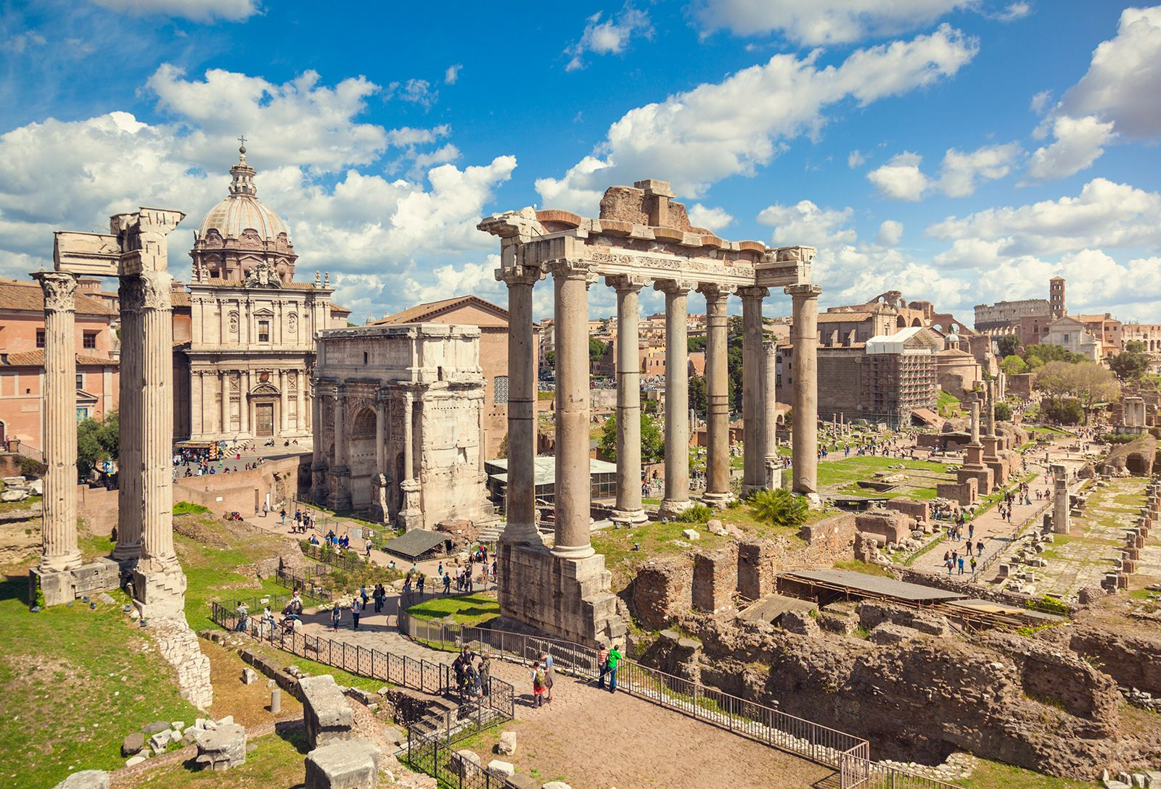
Notes:
Political economists were students of history. And, they applied their skills to the lessons of the history of land settlement. Henry George reexamined their findings and their description of history before making any generalizations regarding how we tended to behave and organize ourselves.

Slide 4
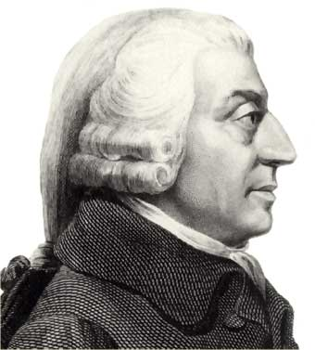
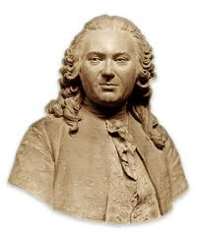
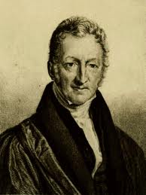
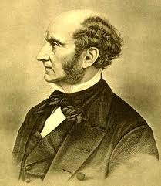
Adam Smith A.R.J. Turgot David Ricardo John Stuart Mill
Notes:
Among the most prominent voices in their discipline stood Adam Smith, Anne Robert Jacques Turgot, David Ricardo and John Stuart Mill.

Slide 5
Notes:
What, then, does history teach us about how we are organized?

Slide 6
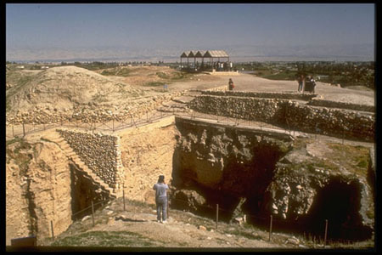
Notes:
When groups stopped migrating and settled in one place, societal organization changed and became more formalized. Jericho, the world's first city, some 11,000 years ago in the Jordan River Valley.

Slide 7
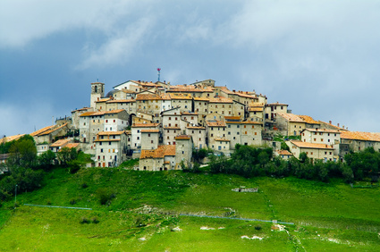
Notes:
Permanent settlement required the introduction of laws allocating access to land, water and other natural resources. Settlement required that societies distinguish between public – or common -- and private property.

Slide 8
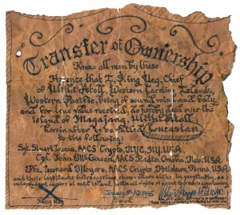
Notes:
The outcomes were determined by traditional decision-making processes and also by evolving power relations. With the appearance of hierarchy in societies came entrenched privileges foo some, including the power to claim a portion of what others produced by working the land.

Slide 9
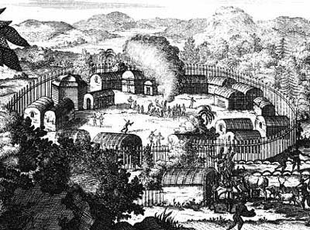
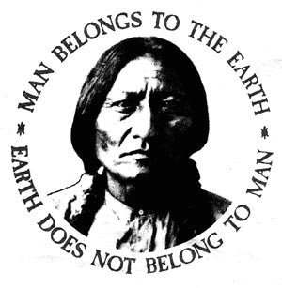
Notes:
Throughout North America, the “First Americans” living here when Europeans arrived were yet to establish permanent cities in the same way as the Aztec, Inca or other peoples to the south. Theirs was, generally, a communitarian form of social organization, and they did not yet adopt the concept of individual land ownership.

Slide 10
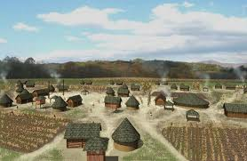
Notes:
However, within a few generations of contact with Europeans, at least some leaders of the First American tribes – such as the Cherokee -- adapted their cultural norms to accommodate the new reality with which they were faced. The Cherokee, the Iroquois and other tribes located close to European-American settlements began to construct permanent settlements, erect European-style houses and cultivate the soil extensively.

Slide 11
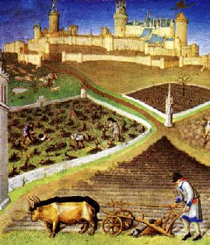
Notes:
Thus, from the earliest period of permanent settlement, a fundamental need – access to nature – was denied to some, often the majority, in favor of a privileged minority.

Slide 12
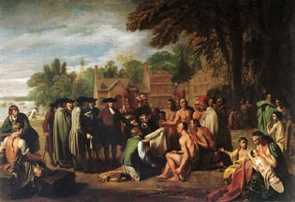
Notes:
The historical record is remarkably detailed and clear. In one instance, that of the founding of the North American colony of Pennsylvania the process was essentially peaceful.

Slide 13
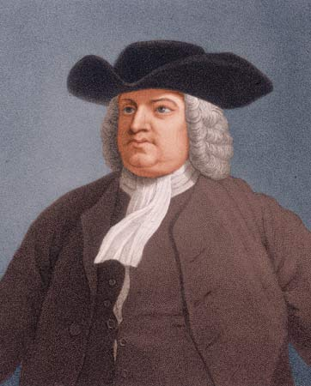
William Penn
Notes:
William Penn became "Absolute Proprietor" of the Province of Pennsylvania, established as a refuge for the migration of English Quakers. During the 1670s and 1680s, Quakers (including Penn) also purchased from the British Crown most of the land settled as New Jersey. Penn was then one of the world’s largest private landowners. In return, at the beginning of each year, Penn was to give the King of England two beaver skins and a fifth of any gold and silver mined within the territory.

Slide 14
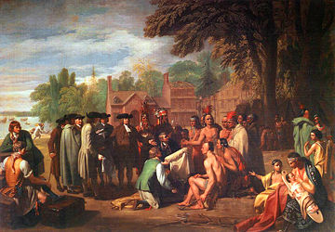
Notes:
Penn arrived in the New World in the Fall of 1682, determined to establish peaceful relations with the local tribal people – primarily the Lenni Lenape, known to Europeans as the Delaware. He gained their respect by moving among them without weapons or guards, then learned Indian dialects so he could conduct negotiations without interpreters. Penn shrewdly acquired territory controlled by the Indians through peaceful, voluntary exchange, although these First Americans had a very different understanding of what these negotiations granted to the Europeans.

Slide 15
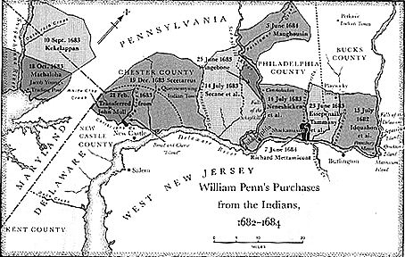
Notes:
Penn understood that the prospect of owning land was, to many, a more powerful reason to migrate than freedom to practice one’s religion.

Slide 16
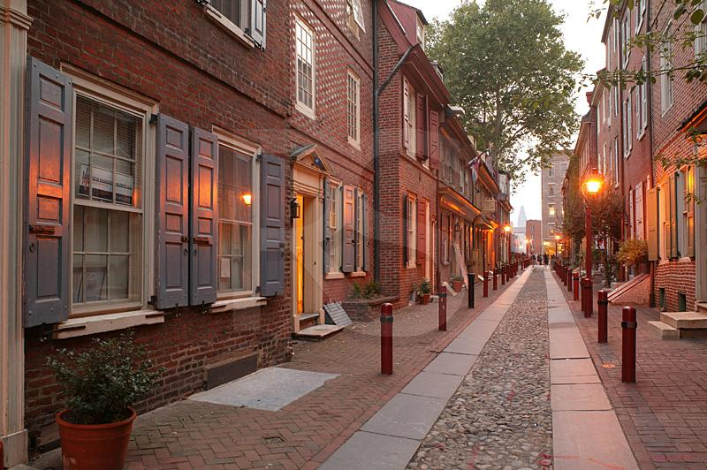
Notes:
With great care, Penn laid out the design for Philadelphia as a:

Slide 17
“greene country town, which will never be burnt, and always wholesome”.
Notes:
“greene country town, which will never be burnt, and always wholesome”.

Slide 18
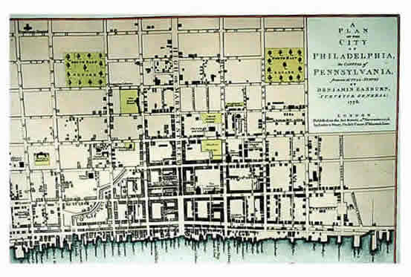
Notes:
His design for the city set out a rectangular grid with large lots, dividing the municipality into four quadrants, with two main streets going east-west and north-south, and the other east-west streets named after trees.

Slide 19
Notes:
In his First Frame of Government, which Penn and initial land purchasers adopted on the 25th of April, 1682, Penn established the colony as a society open to previously unknown diversity.

Slide 20
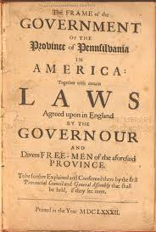
Protections for private property
Free enterprise
A free press
Trial by jury
Religious toleration
Notes:
The document provided for secure private property, free enterprise, a free press, trial by jury and religious toleration.

Slide 21
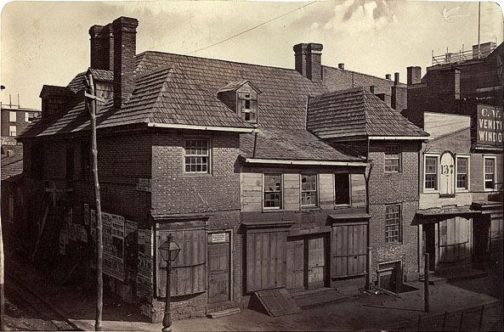
Notes:
When he lived in Philadelphia, William Penn lived in this house on Second Street, between Chestnut and Walnut Streets. The Slate Roof house was demolished in 1867 to make way for the Commercial Exchange Building, which shortly after burned down. The Exchange was rebuilt and sold to the Keystone Telephone Company, who in turn sold it to its competitor Bell Telephone. In 1976 that building was torn down. Thus, the historic location went through number changes in land use over the centuries.

Slide 22
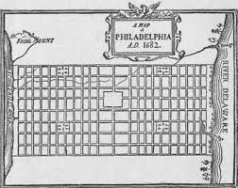
Notes:
For Pennsylvania, Penn adopted the head-right system of land allotment, with each colonist granted 50 acres of farmland. He and his heirs sold and leased land to colonists (collecting ground rents); however, during his lifetime he did not collect enough in rents to offset the costs of administration paid out of his personal assets. However, his descendants became very wealthy landowners who were exempt from taxation by the colony.

Slide 23
Notes:
Penn offered a pragmatic view of how public revenue raised from the land could pay for public goods and services, without the need for taxes. He wrote:

Slide 24
“If all men were so far tenants to the public that the superfluities of grain and expense were applied to the exigencies thereof, it would put an end to taxes.”
Notes:
“If all men were so far tenants to the public that the superfluities of grain and expense were applied to the exigencies thereof, it would put an end to taxes.”

Slide 25
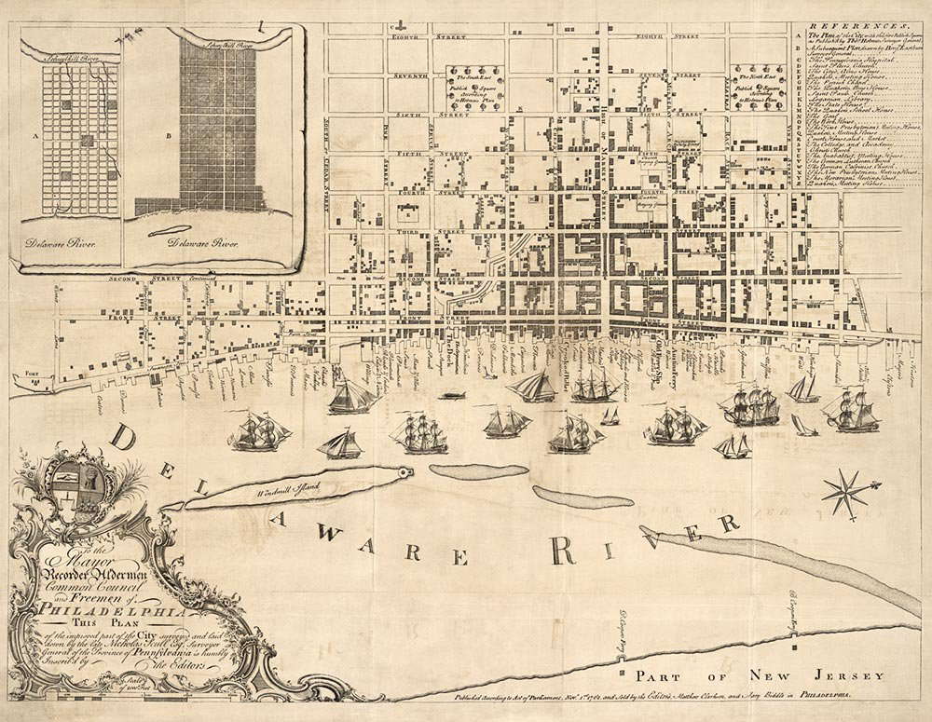
Notes:
In modern terms, this meant that if land was held by the community and leased to individuals under competitive bidding the amount of revenue raised would make taxes unnecessary.

Slide 26
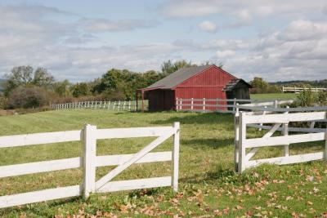
Notes:
Penn was, in a very real sense, a visionary, ahead of his time. During the early decades when settlers arrived in the Philadelphia region, land was abundant and very affordable. The settlement of the vast North American coastal regions provided real opportunities for a better life for the sons and daughters of European farming families unable to further divide their land holdings. The question was how long this happy circumstance would continue.

Slide 27
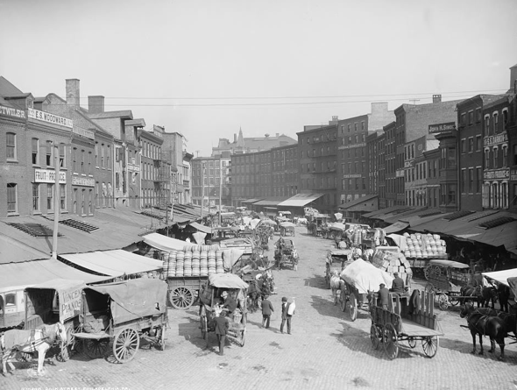
Dock Street market - 1906
Notes:
The fertile land within and around Philadelphia continued to attract newcomers, and farmers brought their produce to the city’s main market area. After the end of the Civil War, the Dock Street section became the city’s principal food market. Always, with increased population came changing land uses and, generally, rising land rental values. Market forces capitalized these rents in selling prices wherever owners offered their land holdings for sale.

Slide 28
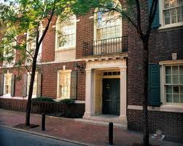
Notes:
As people come together to compete with one another for the best locations, whether for commerce in cities, for a residence or to grow agricultural crops, the demand for land increases. With minor exceptions, every parcel or tract of land eventually comes to have a rental value; that is, a value a potential user will give in exchange for access and control over the land. In this sense, land is said to yield a rent, determined by what advantages people see as associated with a given location over other locations.

Slide 29
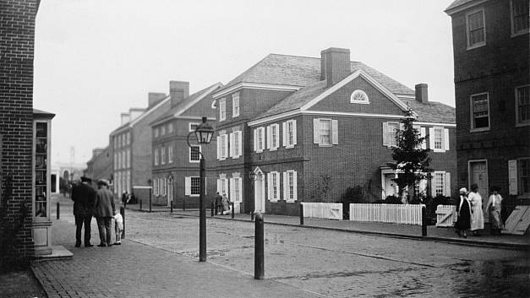
Notes:
Looking at the development of the City of Philadelphia, we find that Penn’s design for a Greene Country Town was soon overwhelmed by population increase and the changing highest, best use for locations. Another dynamic was that more and more land was acquired not for development of homes or businesses but purely for speculation. Land had almost from the beginning taken on the character of a commodity rather than an essential part of the commons to be shared by all in the community.

Slide 30
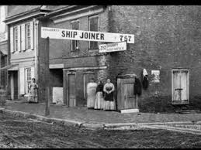
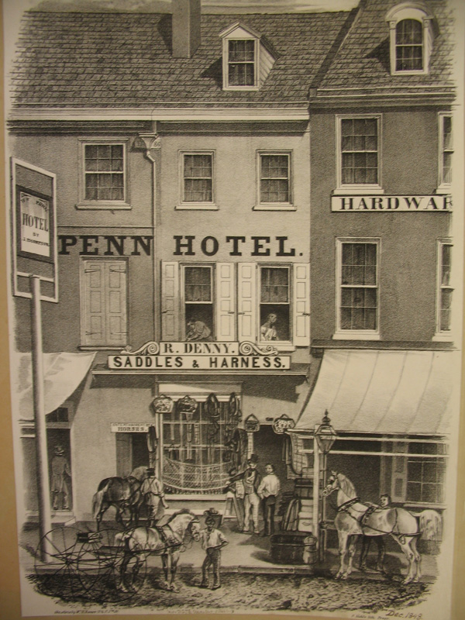
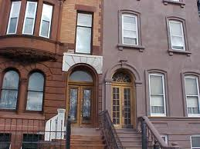
Notes:
As I have stated, population growth leads to changing land uses. Agricultural land is converted to business and residential use. Land parcels are divided and divided again to accommodate more buildings. With the appearance of steel girder construction and elevators, buildings rise ever higher. More reliable heating systems and air-conditioning opened up regions for high levels of economic activity year-round.

Slide 31
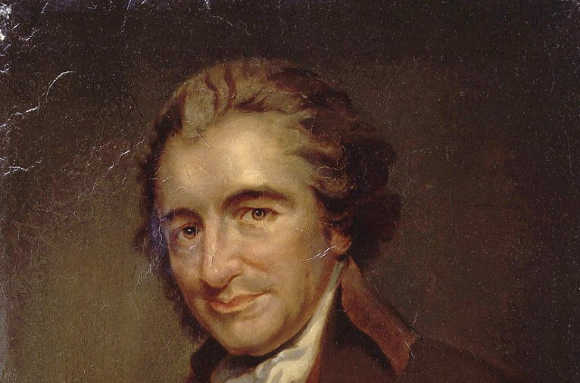
“We have it in our power to begin the world over again.”
Notes:
Now, we will conduct an experiment, working together to establish the basis for forming a new society. Think about how to best achieve a just allocation of land, so that there is equality of opportunity for all within a community.

Slide 32
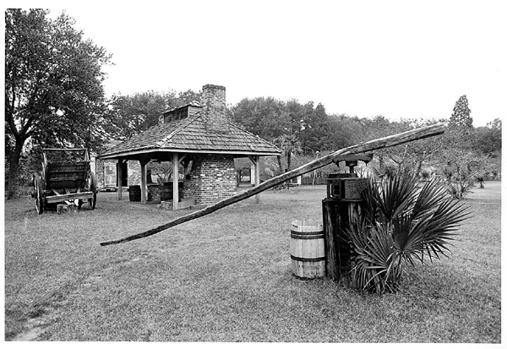
Notes:
Assume we are a community of farmers living in the Old World. Our lands are losing fertility. Our leadership is oppressive and takes -- in rents and taxes -- much of what we produce. New laws are allowing the Commons to be enclosed so that we cannot gather wood or graze our animals. Moreover, we are fearful of invasion by armies sent by neighboring princes seeking to add to their territory.

Slide 33
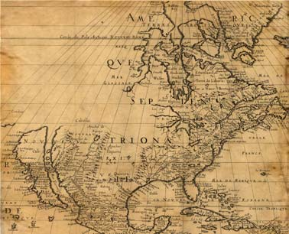
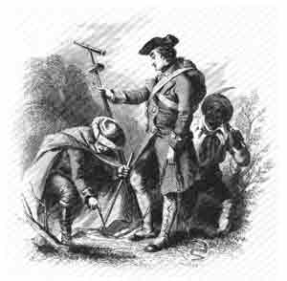
Notes:
We decide to leave our homeland to establish an independent society in the New World. So, we send a small group ahead to locate and survey an area for settlement.

Slide 34
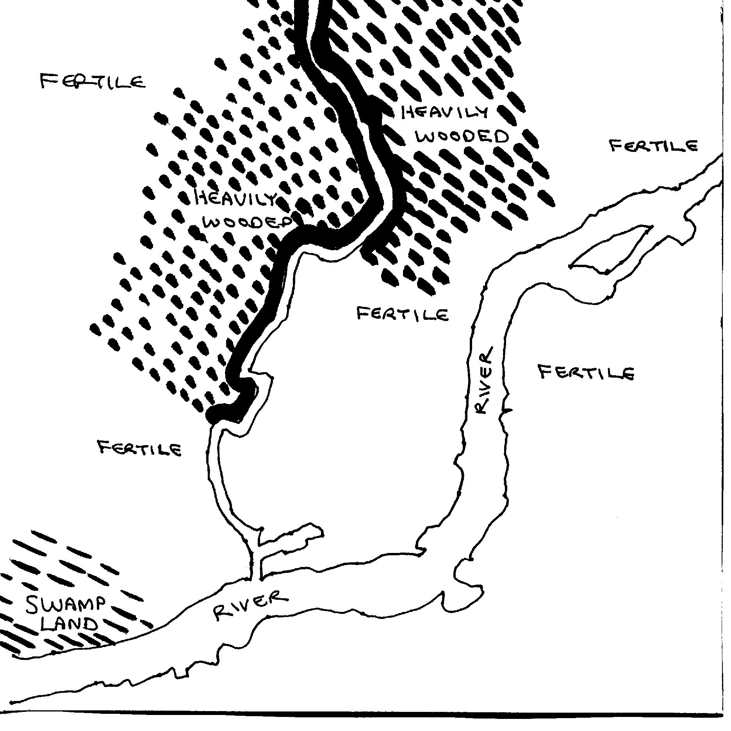
Notes:
Here is the map our surveyors create to help us decide on how to fairly allocate the land. How might we achieve equality of opportunity in the division of the land we are to settle? To start with, our group of settlers consists of ten family units.

Slide 35
Subsistence requires 60 units of goods annually
Enough land is allocated to each family to produce 100 units of goods
Notes:
Meeting our annual needs requires that the land we occupy will yield a minimum of 60 units of wealth (i.e., of production). The colonists decide that each family will be allotted enough land to produce 100 units of wealth each year, which will permit a standard of well-being none had enjoyed in the Old World.

Slide 36
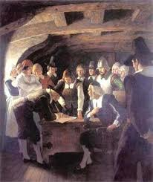
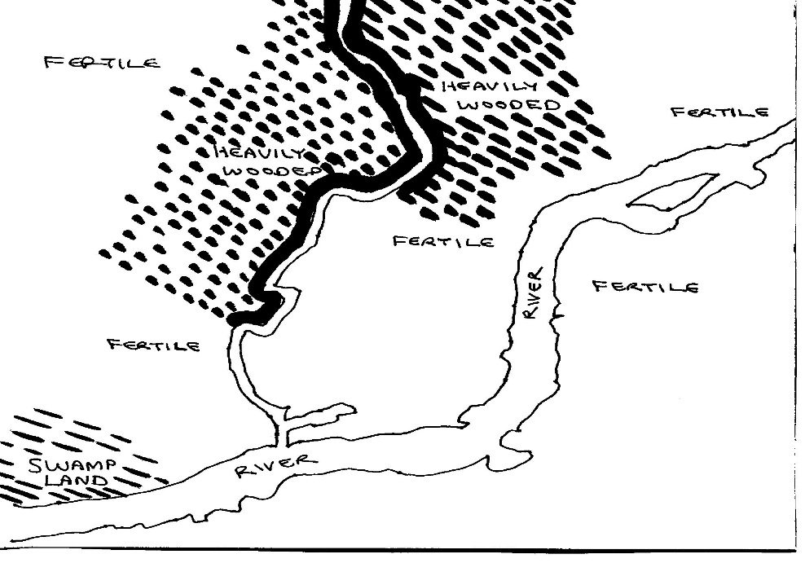
Notes:
So, how do you think they did it?

Slide 37
SOLUTION: Each family gets enough land to account for differences in advantages provided by nature
Notes:
Their answer is to allocate different sized plots of land to each colonist – based on estimates of potential wealth production using like inputs of labor and capital goods. There is not enough highly fertile land with direct access to the rivers, but the heavily wooded areas could compensate by creating opportunities for specialization.

Slide 38
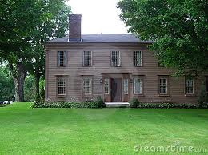
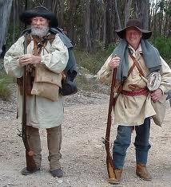
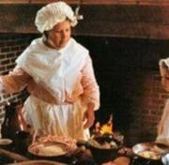
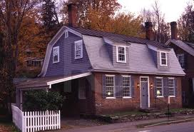
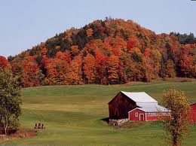
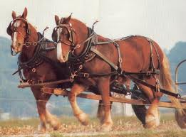
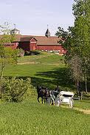
Notes:
Some members of the community would plant crops, others would harvest timber and other plants from the forests. An equitable division of the land would set the stage for a more advanced system of wealth production stimulated by trade and commerce – at least for a time.

Slide 39
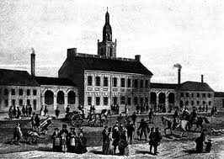
Notes:
The long-term outcome would depend on whether equality of opportunity could be maintained as the population of the community increased and as land uses began to change with the development of a town, with the depletion of soil fertility, the clearing of forests, the increased need for access to water and the many other issues that arise with an increase in population density.

Slide 40
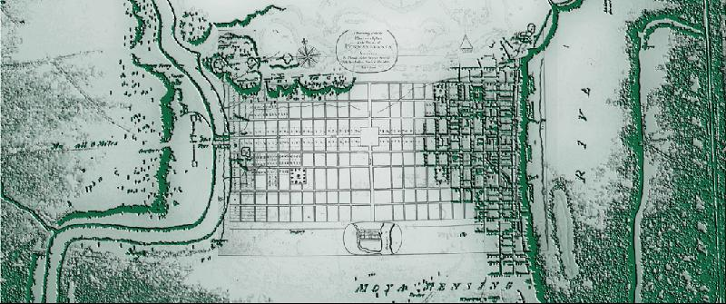
Notes:
What actually happened when Europeans arrived to settle in our hypothetical region? This rough map is actually the location where the City of Philadelphia was established.

Slide 41
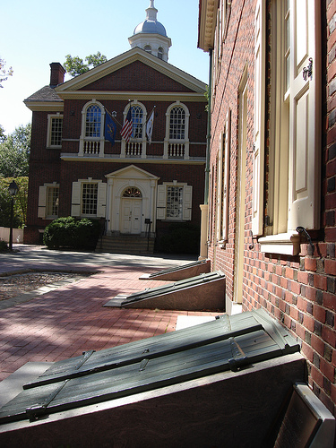
Notes:
We might ask, then, what happens to the initial equality of opportunity achieved in our ideal community?

Slide 42
The Law of Rent and Rising Land Values
Notes:
Political economy offers the answers in the form of certain natural laws of tendency that operate, yielding very predictable outcomes as land comes to have an increasing rental value over time.

Slide 43
END OF LECTURE 4
Notes:
We now take a minor detour from theoretical discussion to examine how we have come to live together in settled communities.

