Slide 1
Understanding our Political Economy

Slide 2
LECTURE 5
The Natural Laws Concerning the Production and Distribution of Wealth

Slide 3
RENT
WAGES
INTEREST
Notes:
Henry George brought his analytical skills to the challenge of explaining the processes by which wealth is produced and then distributed back to the factors of production – rent to land, wages to labor and interest to capital goods. These processes were, he concluded, governed by natural laws of tendency that flow from consistent human behavior.

Slide 4
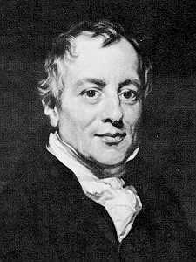
Notes:
It was David Ricardo who made the first attempt to apply scientific observation to how land is chosen for development. Ricardo’s focus was on agriculture and the differences in natural fertility:

Slide 5
“After all the fertile land in the immediate neighbourhood of the first settlers were cultivated, if capital and population increased, more food would be required, and it could only be procured from land not so advantageously situated.”
Notes:
“After all the fertile land in the immediate neighbourhood of the first settlers were cultivated, if capital and population increased, more food would be required, and it could only be procured from land not so advantageously situated.”

Slide 6
“Thus by bringing successively land of a worse quality, or less favourably situated into cultivation, rent would rise on the land previously cultivated.”
Notes:
“Thus by bringing successively land of a worse quality, or less favourably situated into cultivation, rent would rise on the land previously cultivated.”

Slide 7
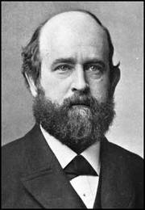
Henry George
Notes:
Henry George extended Ricardo’s analysis well beyond a treatment of agricultural land and applied it to locations in cities and towns and to all that George came to describe as natural monopolies. The definition of rent Henry George came to is as follows:

Slide 8
“Rent is that portion of production (or, wealth) claimed in return for access to land, when land of equal quality is no longer freely available. …”
Notes:
“Rent is that portion of production (or, wealth) claimed in return for access to land, when land of equal quality is no longer freely available. …”

Slide 9
“Rent is determined by the margin of production. That is, rent equals the amount of produce in excess of what could be produced from the poorest land in use with the same amount of labor and capital.”
Progress and Poverty, p.86
Notes:
“Rent is determined by the margin of production. That is, rent equals the amount of produce in excess of what could be produced from the poorest land in use with the same amount of labor and capital.”

Slide 10
Notes:
Note that Henry George’s definition is descriptive here. He will later in his analysis add moral judgments with regard to the distribution of rent to private individuals and entities rather than the community as a whole.

Slide 11
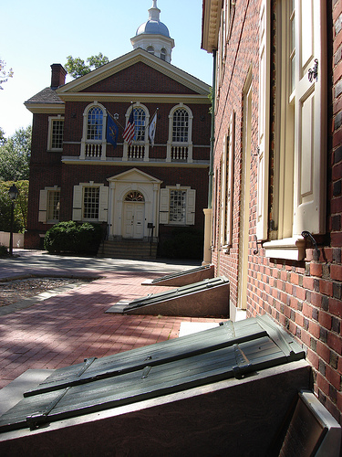
Notes:
Returning to the theoretically ideal community we earlier established, we might ask whether we can take a scientific look at what happens to the initial equality of opportunity achieved by our Old World forefathers.

Slide 12
Subsistence requires 60 units of wealth
Commercial land now yields 300 units of wealth
Notes:
Subsistence remains 60 units of wealth. A generation after the city is established, the same size land parcel – now used for commerce rather than agriculture -- yields 300 units of wealth, now acquired by exchange of goods and services. There is no longer any land in the city that can be settled on for free. Let’s look at this process using some simple graphs.

Slide 13
Rent Graphically Illustrated
50 | 60 | 70 | 80 | 90 | 100
50 | 60 | 70 | 80 | 90 | 100
50 | 60 | 70 | 80 | 90 | 100
50 | 60 | 70 | 80 | 90 | 100
50 | 60 | 70 | 80 | 90 | 100
50 | 60 | 70 | 80 | 90 | 100
50 | 60 | 70 | 80 | 90 | 100
50 | 60 | 70 | 80 | 90 | 100
50 | 60 | 70 | 80 | 90 | 100
50 | 60 | 70 | 80 | 90 | 100
Best land yielding 100 units of wealth
Notes:
Returning again to the earliest stage of settlement. When all land initially is freely accessible, the best locations will potentially yield 100 units of wealth. The entire yield is wages (the return to labor) and interest (the return to capital goods) in some proportion, determined by the productivity of labor and the quality of the capital goods available.

Slide 14
LAND STILL NOT FULLY OCCUPIED AND FREELY AVAILABLE / NOW FULL
 | 50 | 60 | 70 | 80 | 90 | 100
 | 50 | 60 | 70 | 80 | 90 | 100
 | 50 | 60 | 70 | 80 | 90 | 100
 | 50 | 60 | 70 | 80 | 90 | 100
 | 50 | 60 | 70 | 80 | 90 | 100
 | 50 | 60 | 70 | 80 | 90 | 100
 | 50 | 60 | 70 | 80 | 90 | 100
 | 50 | 60 | 70 | 80 | 90 | 100
 | 50 | 60 | 70 | 80 | 90 | 100
 | 50 | 60 | 70 | 80 | 90 | 100
 |  | 0 | 0 | 0 | 0 | 10
RENT’S CLAIM ON WEALTH
Notes:
When land yielding 100 units of wealth is fully occupied, the next best locations still freely accessible yield 90 units of wealth.
Now, the best locations can command rent of 10 units. Political economy describes the best freely accessible land as the “margin of production.”

Slide 15
STILL FREE / NOW FULLY OCCUPIED AND YIELDING RENT
 | 50 | 60 | 70 | 80 | 90 | 100
 | 50 | 60 | 70 | 80 | 90 | 100
 | 50 | 60 | 70 | 80 | 90 | 100
 | 50 | 60 | 70 | 80 | 90 | 100
 | 50 | 60 | 70 | 80 | 90 | 100
 | 50 | 60 | 70 | 80 | 90 | 100
 | 50 | 60 | 70 | 80 | 90 | 100
 | 50 | 60 | 70 | 80 | 90 | 100
 | 50 | 60 | 70 | 80 | 90 | 100
 | 50 | 60 | 70 | 80 | 90 | 100
 |  | 0 | 10 | 20 | 30 | 40
RENT’S CLAIM ON WEALTH
Notes:
Looking into the future when all land able to provide subsistence or greater production is fully occupied, the best locations now have an advantage equal to 40 units of output. These 40 units are what constitutes the rent attached to these locations. Producers cannot afford to turn over more than 40 units of wealth as rent because 60 units is the minimum required for subsistence. Only when labor productivity increases by the introduction of new forms of capital goods and new technologies will rents continue their upward climb.

Slide 16
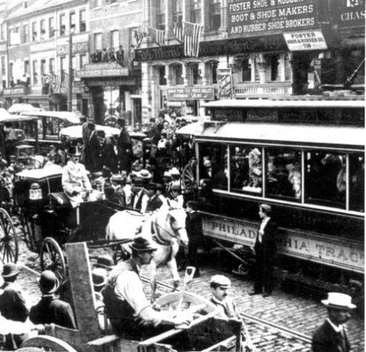
Notes:
There is another way to show these relationships that might make the impact clearer.

Slide 17
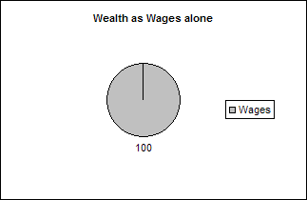
Wealth Distribution Stage One
Notes:
Presented in a somewhat different way by using a circle graph, we see that before we learned to make and use tools all wealth was produced by labor – and all wealth was returned to labor as wages.

Slide 18
Wealth Distribution Stage Two
Notes:
As people learned new technologies and developed more efficient tools, total wealth produced grew dramatically. So long as there were no permanent settlements, wealth was distributed to labor (as wages) and to capital goods (as interest). At a time when people were largely self-sufficient, working on the land in agriculture and other crafts, this basic relationship was clear. The modern economy, in which most people are employed by business entities and paid a monetary wage, obscures the fact that labor may be producing greater wealth – that is, wages – than the worker is receiving in monetary compensation.

Slide 19
Wealth Distribution Stage Three
Notes:
Settlement meant that eventually the best locations were taken (sometimes used, sometimes held idle). These locations command an increasing amount of rent, as a claim on the total wealth produced. Over time, as population generates an increasing demand for land, wages tend to be driven down as even quite marginally-productive land commands rent.

Slide 20
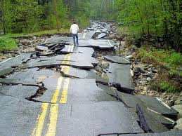
Notes:
Externalities abound to affect the quantity and quality of wealth produced by labor and capital goods. Natural disasters, for example, destroy enormous amounts of what we produce. Yet, the basic distribution of wealth is governed by the fundamental relations described earlier.

Slide 21
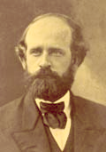
Notes:
As Henry George explains:

Slide 22
“Where land is free and labor is assisted by capital, wages will consist of the whole produce less what is necessary to induce the storing up of labor as capital. Where land is subject to ownership and rent arises, wages will be fixed by what labor could secure from the highest natural opportunities open to it without paying rent (i.e., the margin of production). ...”
Notes:
“Where land is free and labor is assisted by capital, wages will consist of the whole produce less what is necessary to induce the storing up of labor as capital. Where land is subject to ownership and rent arises, wages will be fixed by what labor could secure from the highest natural opportunities open to it without paying rent (i.e., the margin of production). ...”

Slide 23
“Where all natural opportunities are monopolised, wages may be forced by competition among laborers to the minimum at which they will consent to reproduce.”
Progress and Poverty, p.116
Notes:
“Where all natural opportunities are monopolized, wages may be forced by competition among laborers to the minimum at which they will consent to reproduce.”

Slide 24
EXTERNALITY
tendency
NATURAL LAW
Notes:
These natural laws described by Henry George are, however, laws of tendency, influenced by a long list of what economists call “externalities.” The form of government, the system of law, and how government raises its revenue are at the top of this list.

Slide 25
END OF LECTURE 5

