Slide 1
Understanding our Political Economy

Slide 2
LECTURE 6
Wealth Distribution Effects on Evolving Societies
Notes:
Let us now examine the wealth distribution effects on evolving societies.

Slide 3
Notes:
We now examine how the natural laws of distribution operate. At the same time, we look prescriptively at the outcomes and apply moral judgments regarding equity and fairness. Philosophically, the distinction is between questions of “what is” and questions of “what ought to be”.

Slide 4
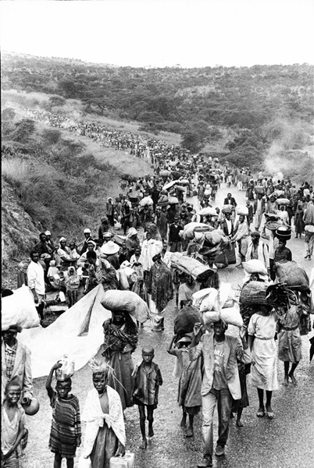
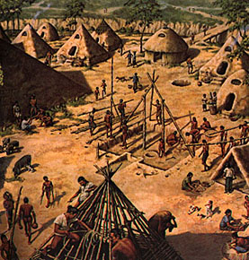
Notes:
What we know about the behavior of ancient groups is that they migrated as their sources of food diminished, as weather patterns changed, as internal disputes arose, as external threats appeared, or -- as signs from the gods directed them. People continue to move from one place to another for similar reasons today.

Slide 5
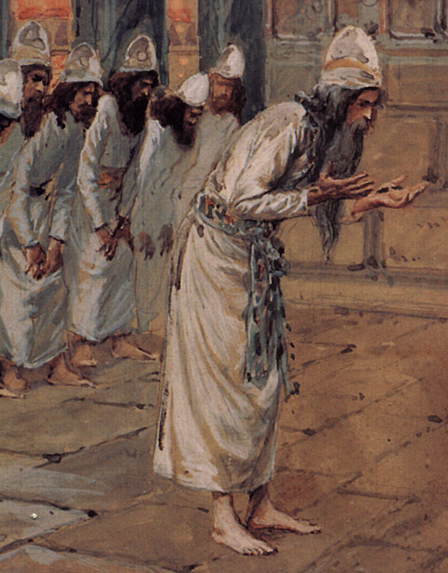
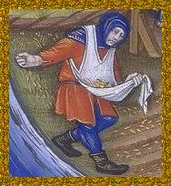
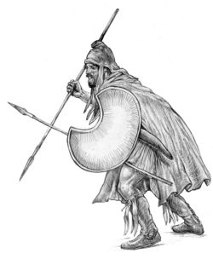
Notes:
Within virtually every society there eventually emerged three distinct subgroups:

Slide 6
Hunters became warrior-protectors
Knowledge bearers developed into the priestcraft; and …
Those who produced the food and other goods required by all three subgroups for their survival
Notes:
Hunters became warrior-protectors. Knowledge bearers developed into the priestcraft. And … there were those who produced the food and other goods required by all three subgroups for their survival. Over time, the majority were coerced into subservient status as serfs or peasants or slaves.

Slide 7
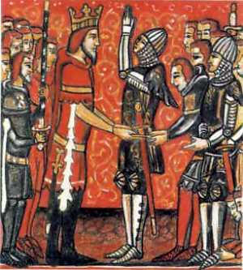
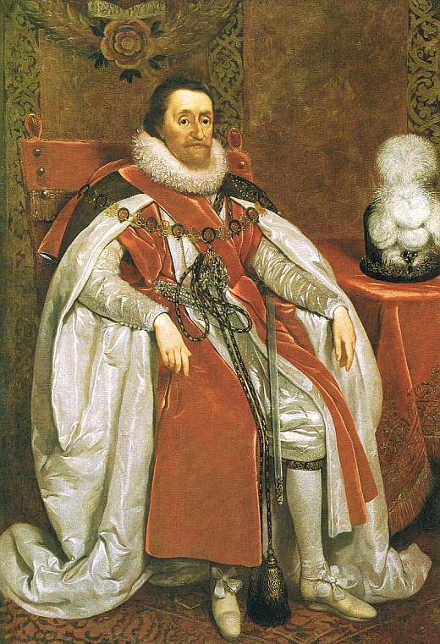
Notes:
Warrior-protectors adopted their own rituals and means of leadership selection. Hereditary transfer of positions emerged – sanctioned by the gods as communicated through the priestcraft. The end result was a hierarchy of power characterized by systems of aristocracy and monarchy, with the claimed divine right to rule.

Slide 8
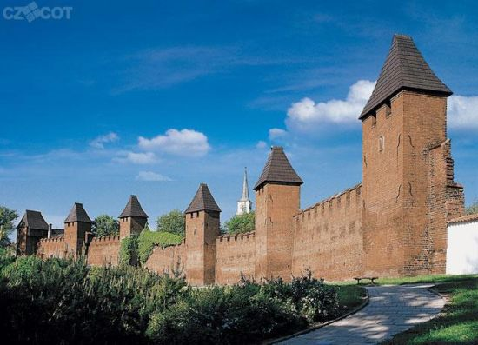
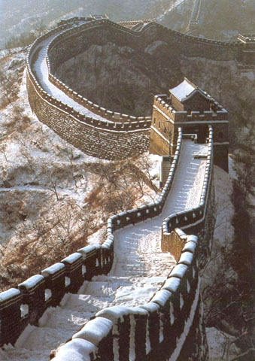
Notes:
Consolidation of power over a population also meant control over territory and all that occurred within that territory. Borders needed to be protected and the interests of those close to those who governed nurtured and supported. Regulation of trade and commence to limit competition and reward loyal supporters became an ingrained responsibility and power of those who governed.

Slide 9
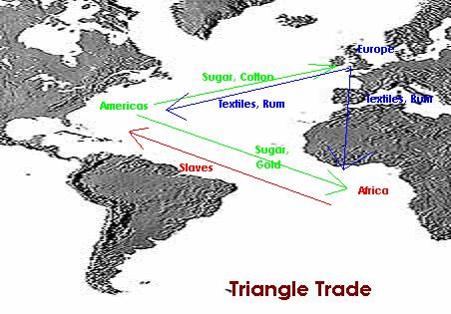
Notes:
As wars were fought in the Old World to consolidate minor fiefdoms into nation-states, writers on political economy tended to defend the idea that national strength required a closed economic system, that the nation must be as self-sufficient as possible, and that self-sufficiency required the establishment of colonies from which raw materials could be drawn and to which finished goods sold. Ideally, all goods had to be carried on ships owned by interests in the “mother country”. This closed economic system was referred to as Mercantilism.

Slide 10
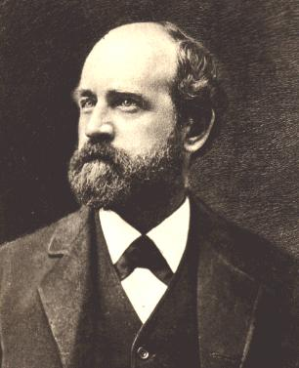
Notes:
In his criticism of Mercantilism, Henry George wrote:

Slide 11
“The truth is that merchants and manufacturers, as merchants and manufacturers, are not the ultimate beneficiaries of the protective system, and that mercantile interests can long profit by it only when sheltered behind some special monopoly. ...”
Notes:
“The truth is that merchants and manufacturers, as merchants and manufacturers, are not the ultimate beneficiaries of the protective system, and that mercantile interests can long profit by it only when sheltered behind some special monopoly. ...”

Slide 12
“This has been shown in the United States, where the owners of coal and mineral and timber and sugar land have constituted the backbone of the political strength that has carried protection to such monstrous length.”
Henry George. The Science of Political Economy, p.176
Notes:
“This has been shown in the United States, where the owners of coal and mineral and timber and sugar land have constituted the backbone of the political strength that has carried protection to such monstrous length.”

Slide 13
Notes:
After discarding the protectionist views he embraced as a young man, Henry George consistently championed free trade. However, real free trade meant -- in his thinking -- that government had the essential responsibility to secure and protect what he called “a fair field with no favors.” With this regulatory environment established, the benefits to all of a healthy commerce would be realized. He observed:

Slide 14
“While diversities of climate, soil, and geography at first separate mankind, they also act to encourage exchange. Commerce also promotes civilization. It is in itself a form of association or cooperation.”
Progress and Poverty, p.278
Notes:
“While diversities of climate, soil, and geography at first separate mankind, they also act to encourage exchange. Commerce also promotes civilization. It is in itself a form of association or cooperation.”

Slide 15
Notes:
Henry George also argued that there is a great harmony between free exchange of goods and political liberty, writing:

Slide 16
“Modern civilization has gone so much higher than any before due to the great extension of association – not just in larger and denser communities, but in the increase of commerce, and the numerous exchanges knitting each community together, and linking them with others far apart; and also in the growth of international and municipal law, advances in security of property and person, strides in individual liberty, and movement towards democratic government.”
Progress and Poverty, pp. 284-285
Notes:
“Modern civilization has gone so much higher than any before due to the great extension of association – not just in larger and denser communities, but in the increase of commerce, and the numerous exchanges knitting each community together, and linking them with others far apart; and also in the growth of international and municipal law, advances in security of property and person, strides in individual liberty, and movement towards democratic government.”

Slide 17
Notes:
Our instinct is to cooperate, but within our nature is also an unfortunate tendency toward aggression that must be recognized and controlled, if not wholly prevented. What Henry George observed in his study of our behavior brought him to a fundamental generalization:

Slide 18
“Political economy proceeds from the following simple axiom: People seek to satisfy their desires with the least exertion.”
Progress and Poverty, p.6
Notes:
“Political economy proceeds from the following simple axiom: People seek to satisfy their desires with the least exertion.”

Slide 19
This part of the world is mine. I inherited the deed given to my family by the government after the indigenous people were removed. Go steal your own land from someone else. I have weapons to defend my claims and will use them!
Notes:
And, in so doing, we exhibit a strong tendency to attempt to monopolize access to nature and resist competition. Our attitude toward the land is, sadly, expressed above: “This part of the world is mine. I inherited the deed given to my family by the government after the indigenous people were removed. Go steal your own land from someone else. I have weapons to defend my claims and will use them!”

Slide 20
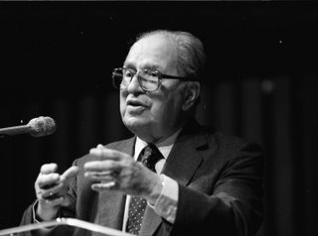
Mortimer J. Adler
Notes:
The philosopher Mortimer Adler observed that in a society governed by just law, citizens would enjoy leisure, time to engage in civic affairs, and possess goods sufficient for a decent, human existence. He wrote:

Slide 21
“The size of a population directly effects the division of labor that is possible in a community, and indirectly its productivity of consumable wealth – the means of subsistence. But productivity is also affected by the technology available. ...”
Notes:
“The size of a population directly effects the division of labor that is possible in a community, and indirectly its productivity of consumable wealth – the means of subsistence. But productivity is also affected by the technology available. ...”

Slide 22
“A more populous community with a primitive technology may be less productive than a less populous community with an advanced technology. The productivity of a community determines the amount of wealth available to its members and the amount of human time that can be freed from toil or subsistence-work.”
Mortimer J. Adler. The Common Sense of Politics, p.86
Notes:
“A more populous community with a primitive technology may be less productive than a less populous community with an advanced technology. The productivity of a community determines the amount of wealth available to its members and the amount of human time that can be freed from toil or subsistence-work.”

Slide 23
Notes:
And, Henry George adds that the:

Slide 24
“… division of labor, when fairly established, benefits all by common pursuit. It is used instead of individuals attempting to satisfy all of their wants by directly resorting to nature on their own.”
Progress and Poverty, p.15
Notes:
“Division of labor, when fairly established, benefits all by common pursuit. It is used instead of individuals attempting to satisfy all of their wants by directly resorting to nature on their own.”

Slide 25
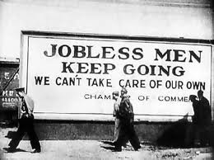
Notes:
Thus, because one of our natural inclinations is to behave monopolistically and use the force of law to create privileges for ourselves if we can, we must look deeply at how we are organized. Where there is widespread poverty, where there are periodic business depressions and prolonged unemployment, the one thing we can be certain of is that the division of labor is not fairly established. Knowing this, the next challenge is to know what must be done.

Slide 26
END OF LECTURE 6

