Slide 1
Understanding our Political Economy

Slide 2
LECTURE 7
Money, Currency and Credit
Old World Origins
Notes:
We are now ready to examine the nature and history of money, currency and credit.

Slide 3
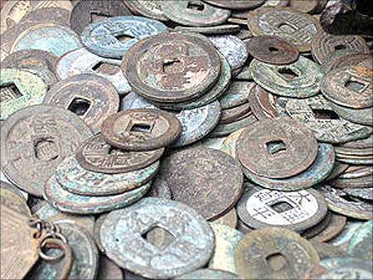
Notes:
The arguments over what constitutes a just system of money, credit and banking have been ongoing for – well, several thousand years. We will now examine some of this history of how money came into use and how its use and abuse contributed to the growth and collapse of societies over throughout the ancient and modern eras.

Slide 4
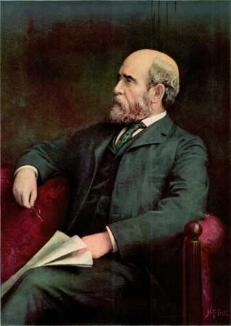
Henry George
Notes:
Henry George offers this definition of money as he sees its role in political economy:

Slide 5
“Money is a general medium of exchange, the common flow through which wealth is transformed from one form to another.”
Progress and Poverty, p.35
Notes:
“Money is a general medium of exchange, the common flow through which wealth is transformed from one form to another.”

Slide 6
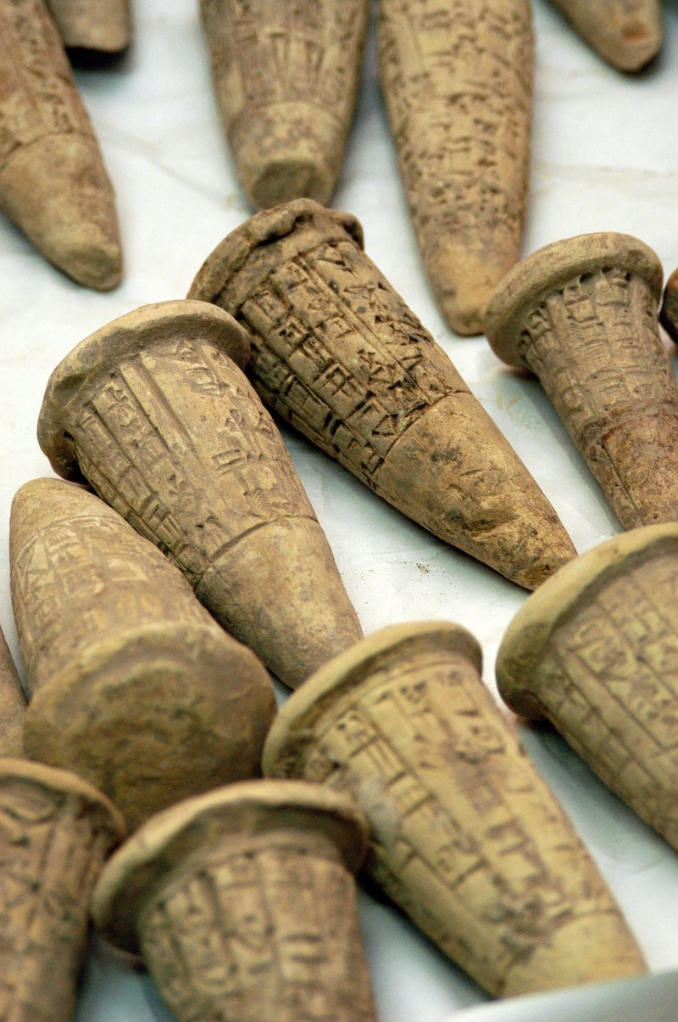
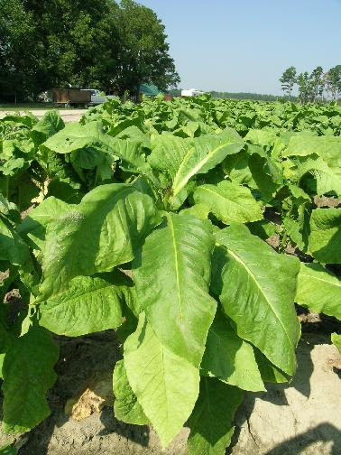
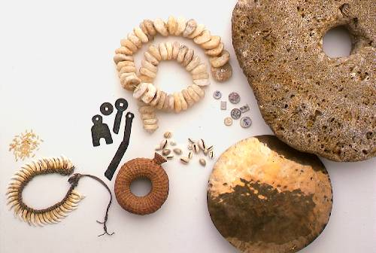
Notes:
Throughout history, everything from cattle, beads, salt, barley, whiskey and tobacco served as a medium of exchange. Commodity money circulated based on wide acceptance, scarcity; and/or a high amount of labor required to produce the commodity.

Slide 7
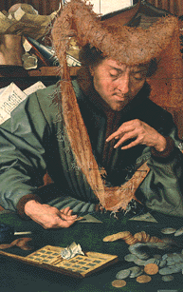
TOUCHSTONES
Notes:
The touchstone made it possible to test soft metals for purity, allowing one to quickly determine the content of a particular metal in a coin or raw metal. From this point on, gold and silver, although relatively scarce, spread around the entire globe as standard forms of money. An important characteristic was the fact that they are virtually indestructible.

Slide 8
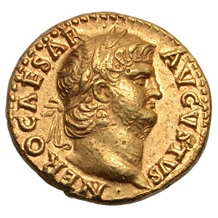
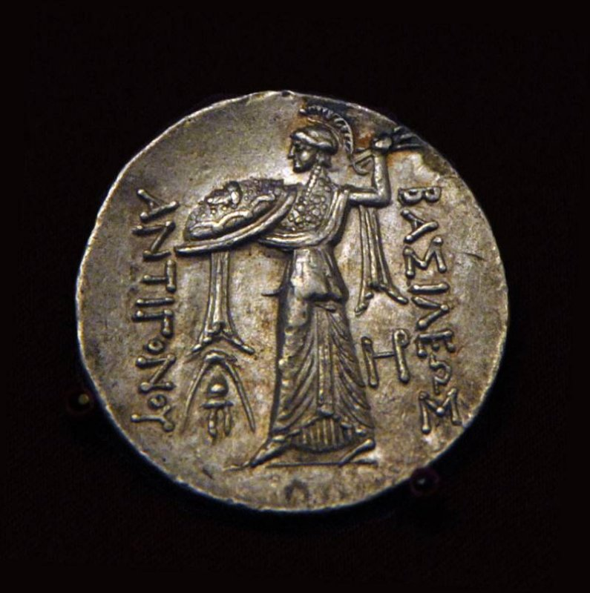
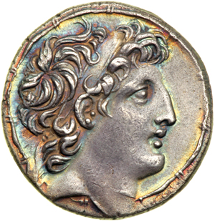
Notes:
Early coins where subject to counterfeiting, that is, debasement. Stamping of coins with images made counterfeiting more difficult. Coins could still be shaved to produce a small amount of raw metal, eventually producing enough new metal to mint a new (counterfeit) coin. So, additional innovations were needed.

Slide 9
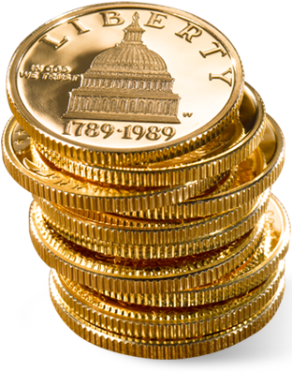
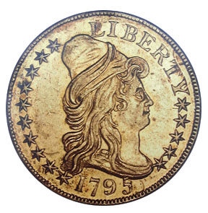
Notes:
In response, issuers of money added one new important feature to coins. Coins with ridged edges could no longer be shaved, thus preventing the debasement of the coinage. It is worth noting that this innovation prevented kings and princes from shaving the coins taken in as rents and taxes.

Slide 10
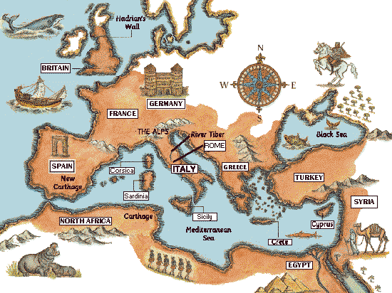
Notes:
A powerful state – such as the Roman Empire – could mandate use of copper or even wood coins. Roman power assured its coinage was accepted as legal tender and the coinage was needed to pay ground rents for leased land, for dwellings, taxes and tribute.

Slide 11
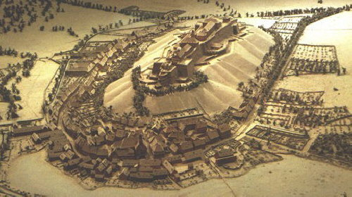
Notes:
From the fall of the Western Roman Empire, a gradual expansion of feudal manors led to a decline in money circulation. The lords of the feudal manors took a share of crops from peasants in lieu of money rents and taxes. Peasants engaged in barter but had little in surplus to trade.

Slide 12
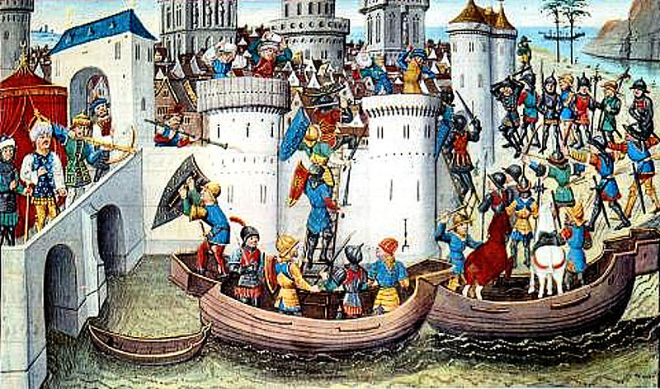
Notes:
Then came the Crusades. In 1204 the Fourth Crusade began. The Christian armies of Europe sacked Constantinople and returned home with huge quantities of precious stones, gold and silver worth nearly 1 million silver marks. And when the European princes and knights returned home …

Slide 13
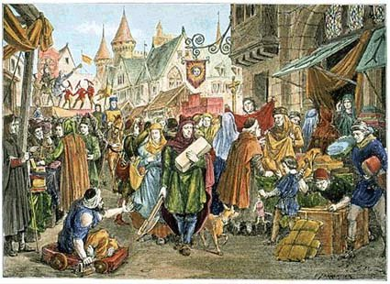
Notes:
… the gold and silver they brought with them set the stage for replacement of feudal arrangements with cash- and credit-driven markets. Peasants were now required to sell their crops for cash, from which they paid ground rents and taxes to the land baron. Feudal obligations broke down, and the peasants assumed the risks of a failed crop or insufficient prices for what they sold.

Slide 14
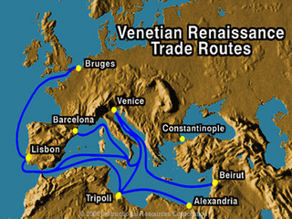
Genoa
Florence
Notes:
The end of the Crusades left many European princes holding new estates in the Eastern Mediterranean. Trade was renewed, and the flow of money created a need for merchant bankers. Blessed by their locations, Venice and Genoa became major centers of Mediterranean commerce. Florence emerged as a center of banking.

Slide 15
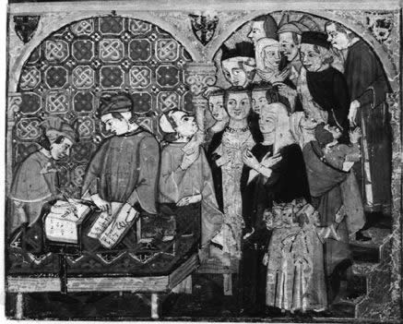
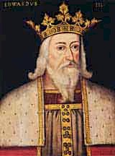
Edward III 1312-1377
Notes:
The Bardi and Peruzzi families were dominant in Florence in the 14th century and established branches in other parts of Europe to facilitate their trading activities. Both of these banking families extended substantial loans to Edward III of England to finance the 100 Years War against France. But Edward defaulted, and the banks failed.

Slide 16
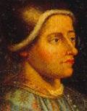
Jacques Coeur
1395-1456
Notes:
About 1429 Jacques Coeur formed a commercial partnership with two brothers named Godard. In 1432 he was in Damascus, purchasing goods for shipment back to France. Four years later, he was appointed master of the Paris mint and other high offices. By 1450 he was by many estimates the wealthiest Frenchman. Then, he was accused of poisoning an aristocratic woman and arrested, his property confiscated by the king. He later escaped and made his way to Rome.

Slide 17
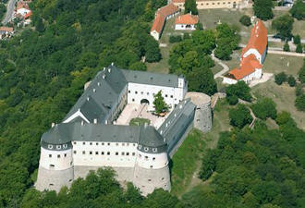
Fugger family castle, Western Slovakia
Notes:
In southern Germany the Fugger family financed the house of Habsburg. They made their first loan to a Habsburg archduke in 1487, taking as security an interest in silver and copper mines. In 1491 and again in 1505 loans were made to Maximilian, secured by the feudal rights to two Austrian counties. In 1519, the bankers financed the campaign of Maximilian's grandson, Charles to be elected emperor. However, by the end of the 16th century the family withdrew from financial risk-taking, after some disastrous ventures, and settled into an aristocratic existence.

Slide 18
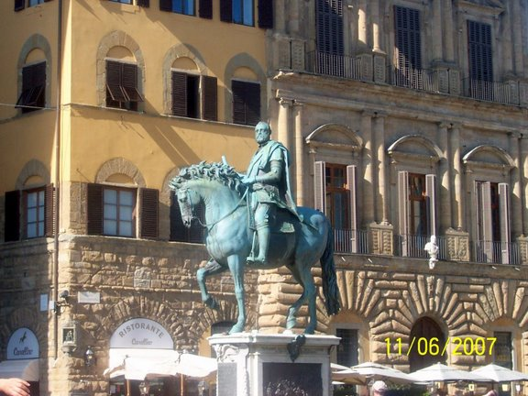
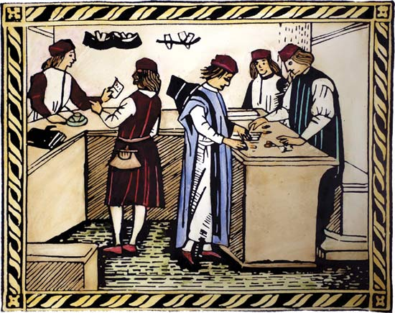
The Medici
FINANCING THE RENAISSANCE
Notes:
The Medici family emerged as banker to the Catholic Church in the early 15th century, collecting tithes from church members. The Medici refrained from making loans to princes and kings, known to be very poor risks, and so remained profitable until its London operation made loans to Edward IV, whose treasury was emptied by the War of the Roses.

Slide 19
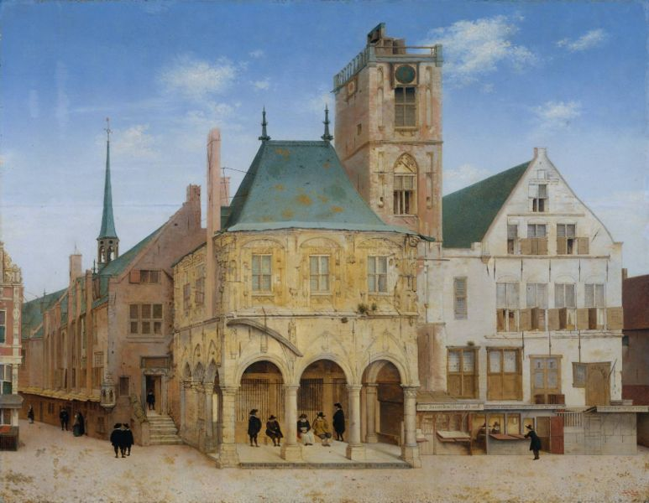
Modern Banking Arrives
Notes:
The stage was now set for the development of the first modern banking institutions.

Slide 20
The Bank of Amsterdam
The old town hall in Amsterdam where the bank was founded, 1609
Notes:
The Bank of Amsterdam was founded as a deposit bank, protected by the City of Amsterdam. The bank took in both foreign and local coinage which was re-minted, as well as gold and silver bullion. After taking a small minting and management fee, depositors were credited for the balance.

Slide 21
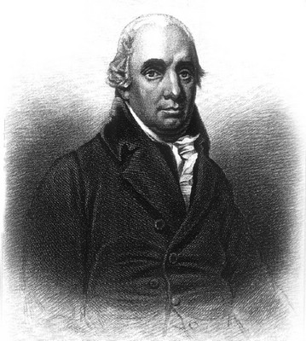
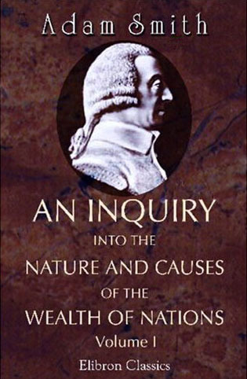
Notes:
From the great Scottish political economist and moral philosopher Adam Smith, we learn of the chaotic conditions existing before the Bank of Amsterdam was established. Smith wrote:

Slide 22
“Before 1609 the great quantity of clipt and worn foreign coin, which the extensive trade of Amsterdam brought from all parts of Europe, reduced the value of its currency about nine per cent below that of good money fresh from the mint. Such money no sooner appeared than it was melted down or carried away, as it always is in such circumstances. ...”
Notes:
“Before 1609 the great quantity of clipt and worn foreign coin, which the extensive trade of Amsterdam brought from all parts of Europe, reduced the value of its currency about nine per cent below that of good money fresh from the mint. Such money no sooner appeared than it was melted down or carried away, as it always is in such circumstances. ...”

Slide 23
“The merchants, with plenty of currency, could not always find a sufficient quantity of good money to pay their bills of exchange; and the value of those bills, in spite of several regulations which were made to prevent it, became in a great measure uncertain.”
The Wealth of Nations, 1776, Book Four, Chapter III
Notes:
“The merchants, with plenty of currency, could not always find a sufficient quantity of good money to pay their bills of exchange; and the value of those bills, in spite of several regulations which were made to prevent it, became in a great measure uncertain.”

Slide 24
Notes:
And, then, once the Bank of Amsterdam began doing business. Smith continues:

Slide 25
“In order to remedy these inconveniences, a bank was established in 1609 under the guarantee of the city. This bank received both foreign coin, and the light and worn coin of the country at its real intrinsic value in the good standard money of the country, deducting only so much as was necessary for defraying the expense of coinage, and the other necessary expense of management. ...”
Notes:
“In order to remedy these inconveniences, a bank was established in 1609 under the guarantee of the city. This bank received both foreign coin, and the light and worn coin of the country at its real intrinsic value in the good standard money of the country, deducting only so much as was necessary for defraying the expense of coinage, and the other necessary expense of management. ...”

Slide 26
“For the value which remained, after this small deduction was made, it gave a credit in its books. This credit was called bank money, which, as it represented money exactly according to the standard of the mint, was always of the same real value, and intrinsically worth more than current money.”
Notes:
“For the value which remained, after this small deduction was made, it gave a credit in its books. This credit was called bank money, which, as it represented money exactly according to the standard of the mint, was always of the same real value, and intrinsically worth more than current money.”

Slide 27
Notes:
Unfortunately, problems developed during the 1630s, when officers of the Bank engaged in speculations in the tulip market.

Slide 28
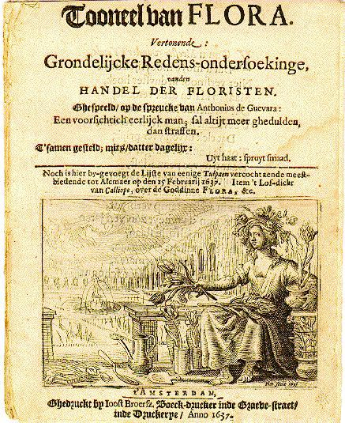
Notes:
In 1637 the “tulip bubble” burst, and with the burst the bank’s assets disappeared. The Bank was also making loans to the City of Amsterdam and to the Dutch East India Company – far above its own assets and leaving the bank with only fractional reserves. Even so, the Bank’s central role as intermediary in the global economy enabled it to survive until dissolved in 1796.

Slide 29
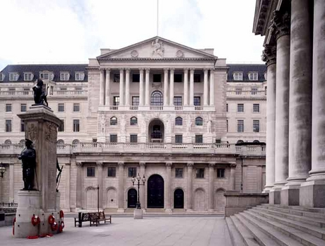
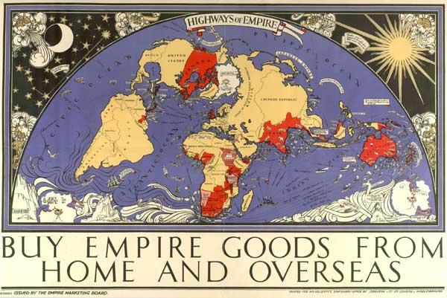
Notes:
The Bank of Amsterdam’s importance was eventually eclipsed by the Bank of England, which financed Britain’s bid for a global colonial empire. The Bank was chartered in 1694 with specie (hard money) raised from investors. This specie was then loaned to the British government. Nonetheless, the Bank was permitted to issue bank notes equal to its original specie, with redemption guaranteed by the government. The era of “fractional reserve banking” as the common practice had arrived.

Slide 30
END OF LECTURE 7

