Slide 1



Slide 2


Slide 3


Slide 4


Slide 5


Slide 6


Slide 7
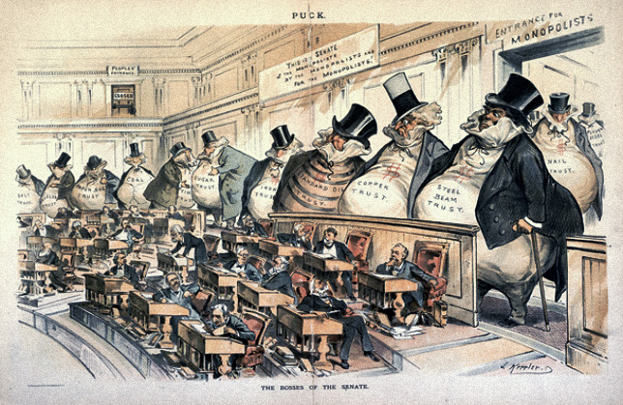

Slide 8


Slide 9


Slide 10
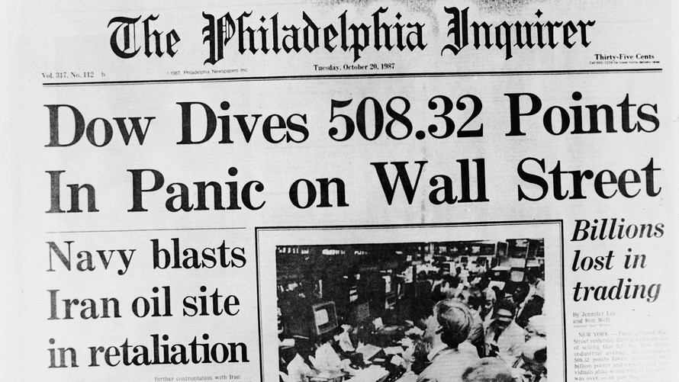

Slide 11


Slide 12

MONEY
Notes:
Money, get away

Slide 13

Get a good job with more pay.
Notes:
Get a good job with more pay

Slide 14


Notes:
And you’re OK

Slide 15

Notes:
Money, it’s a gas

Slide 16
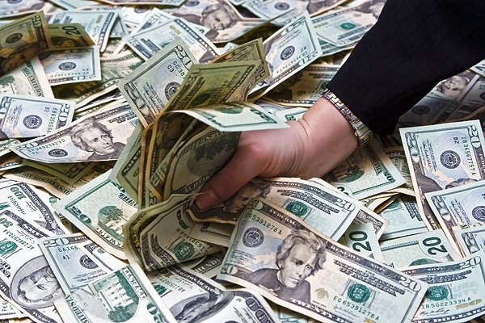
Grab that cash with both hands,
Notes:
Grab that cash with both hands

Slide 17
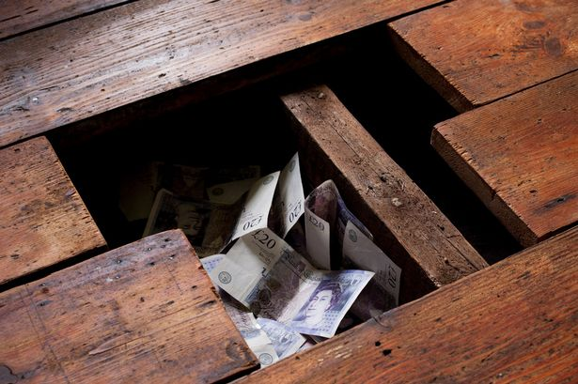
And make a stash
Notes:
And make a stash

Slide 18
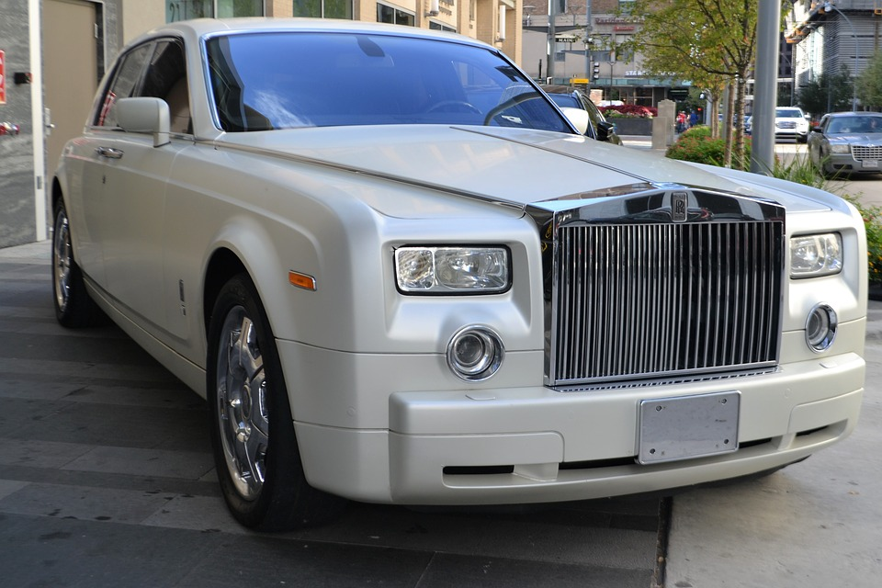
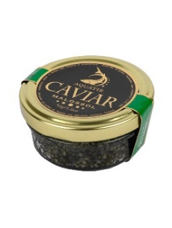

New car, caviar, four star daydream
Notes:
New car, caviar, four star daydream

Slide 19

Think I’ll buy me a football team.
Notes:
Think I’ll buy me a football team

Slide 20
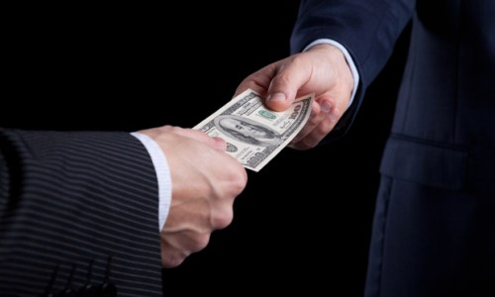
Money, get back
Notes:
Money, get back

Slide 21
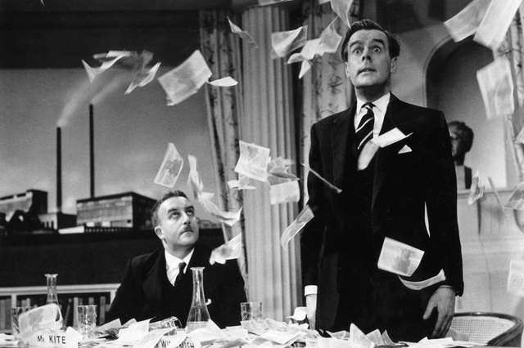
I’m all right Jack
Notes:
I’m all right Jack

Slide 22
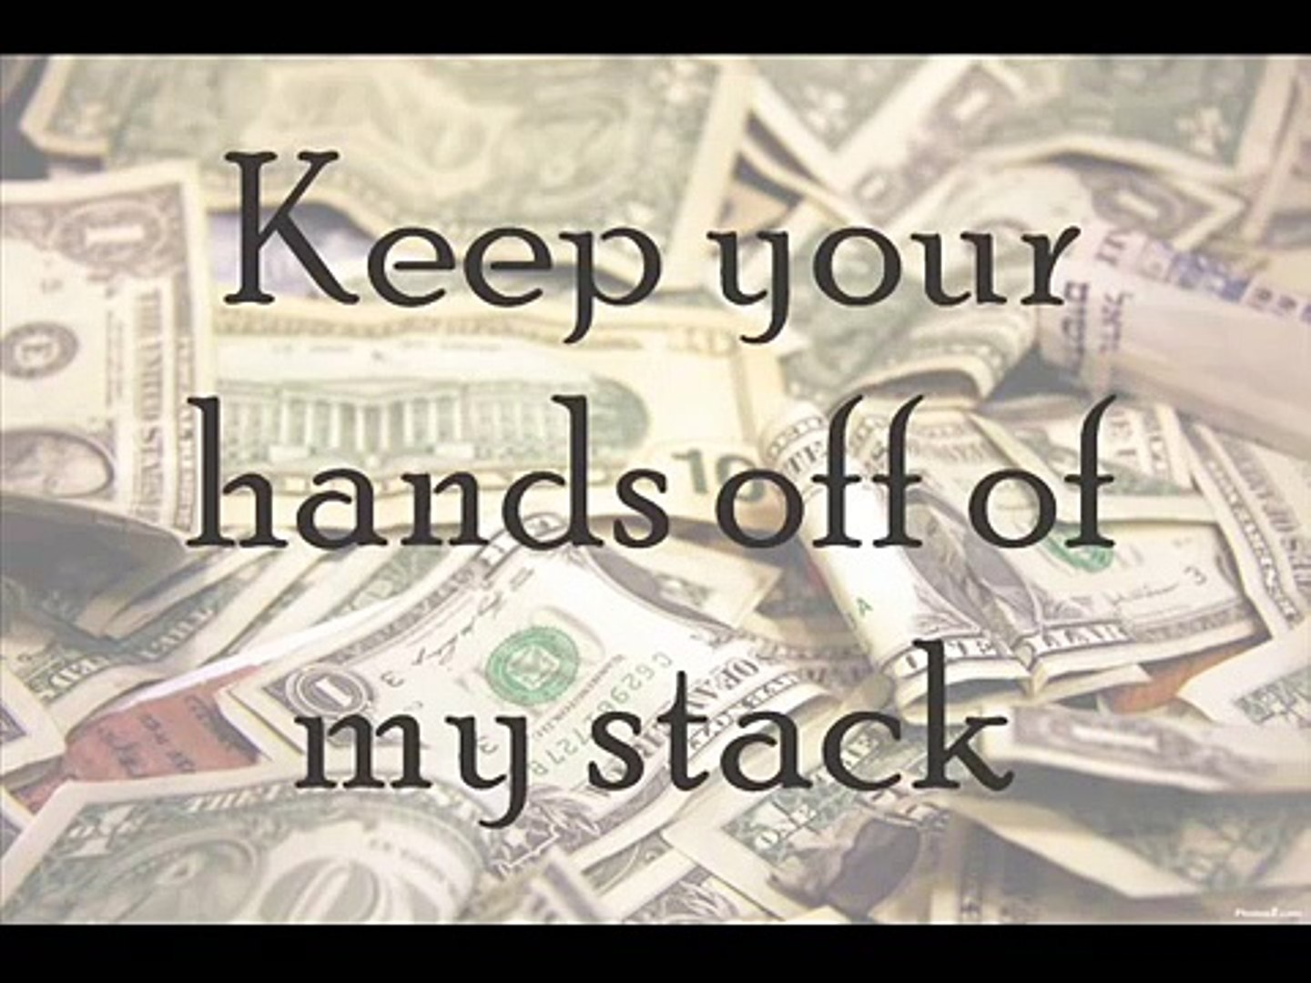
Notes:
Keep your hands off my stack

Slide 23


Money
Notes:
Money, it’s a hit

Slide 24




Notes:
Don’t give me that

Slide 25



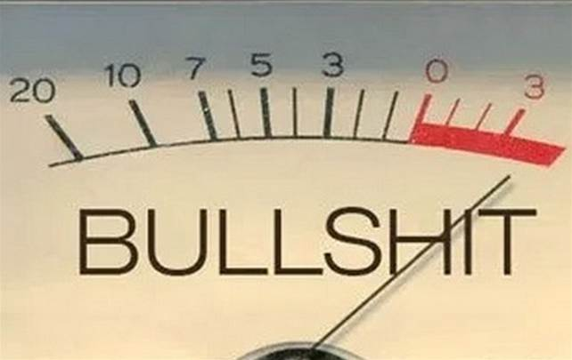
Notes:
Do goody good bullshit

Slide 26
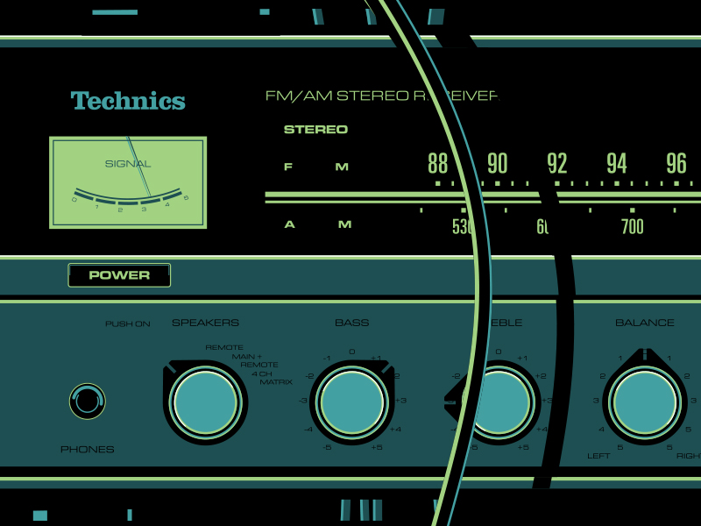
I’m in the hi-fidelity
Notes:
I’m in the hi-fidelity

Slide 27
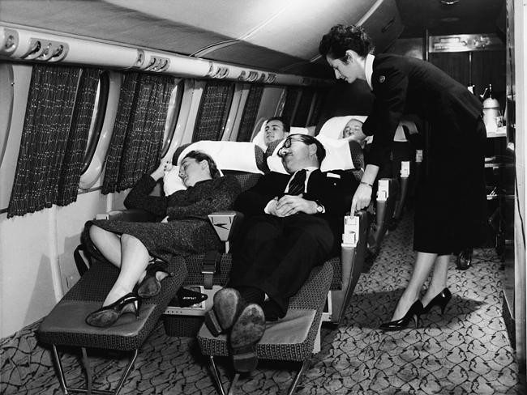
First class traveling set
Notes:
First class traveling set

Slide 28

And I think I need a Lear jet.
Notes:
And I think I need a Lear jet

Slide 29
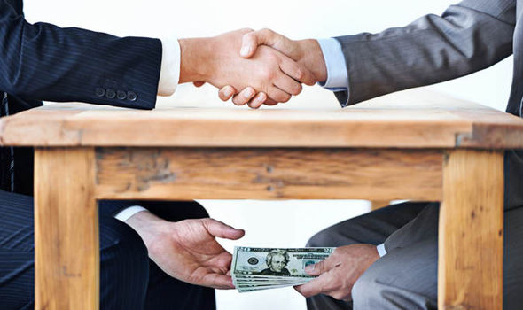
Notes:
SAX ABD GUITAR SOLOS

Slide 30

Notes:
SAX ABD GUITAR SOLOS

Slide 31

Notes:
SAX ABD GUITAR SOLOS

Slide 32

Notes:
SAX ABD GUITAR SOLOS

Slide 33
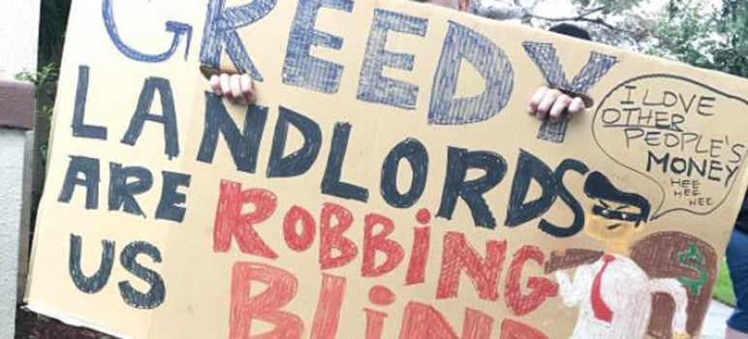
Notes:
SAX ABD GUITAR SOLOS

Slide 34
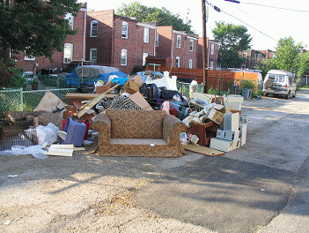
Notes:
SAX ABD GUITAR SOLOS

Slide 35

Notes:
SAX ABD GUITAR SOLOS

Slide 36
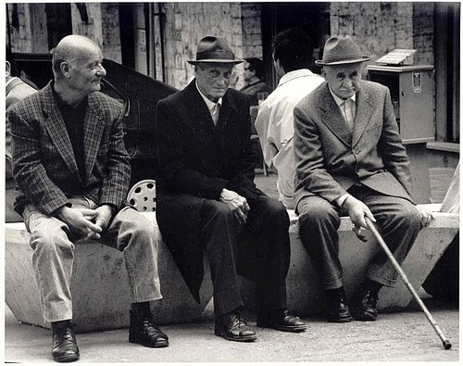
Notes:
SAX ABD GUITAR SOLOS

Slide 37
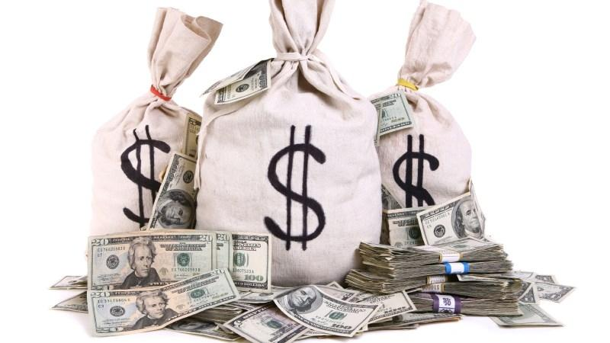
Notes:
SAX ABD GUITAR SOLOS

Slide 38

Notes:
SAX ABD GUITAR SOLOS

Slide 39
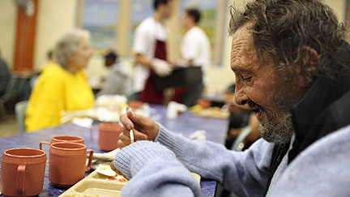
Notes:
SAX ABD GUITAR SOLOS

Slide 40
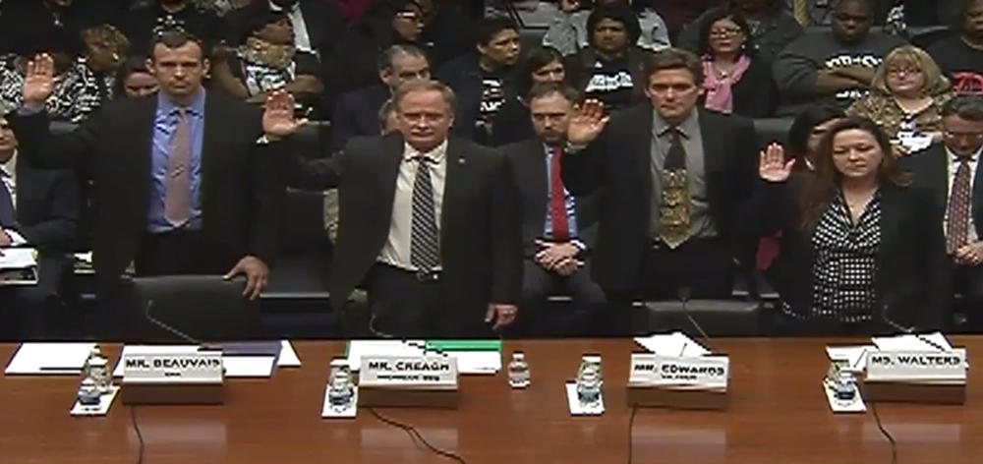
Notes:
SAX ABD GUITAR SOLOS

Slide 41
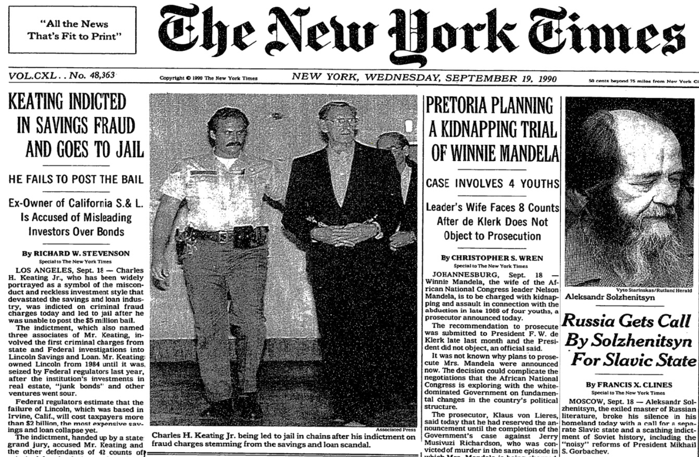
Notes:
SAX ABD GUITAR SOLOS

Slide 42
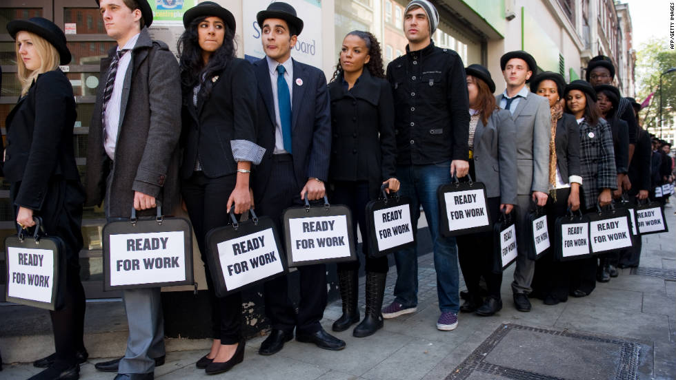
Notes:
SAX ABD GUITAR SOLOS

Slide 43
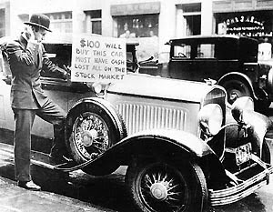
Notes:
SAX ABD GUITAR SOLOS

Slide 44
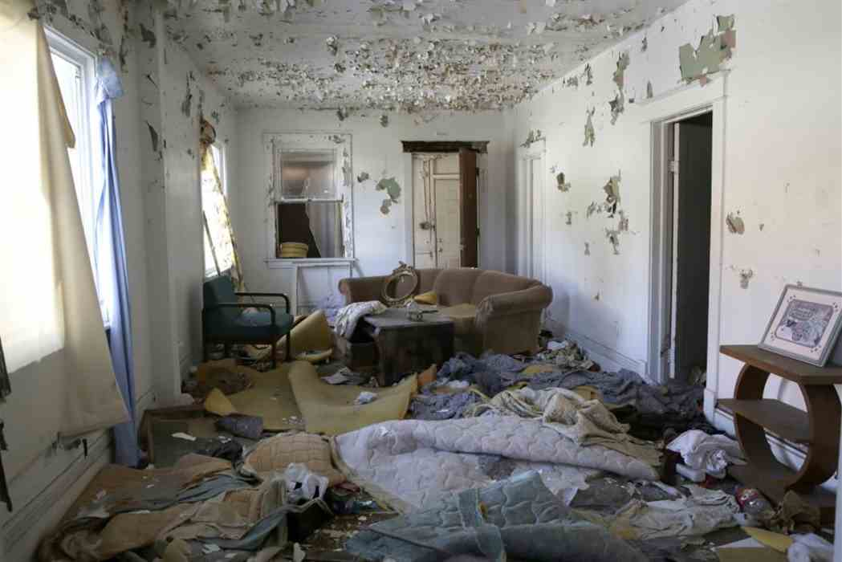
Notes:
SAX ABD GUITAR SOLOS

Slide 45
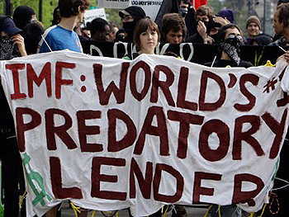
Notes:
SAX ABD GUITAR SOLOS

Slide 46

Notes:
SAX ABD GUITAR SOLOS

Slide 47

Notes:
SAX ABD GUITAR SOLOS

Slide 48
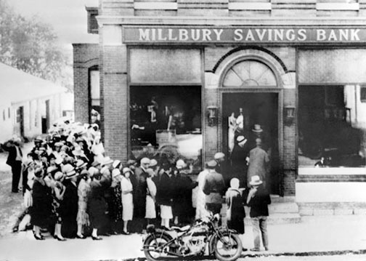
Notes:
SAX ABD GUITAR SOLOS

Slide 49
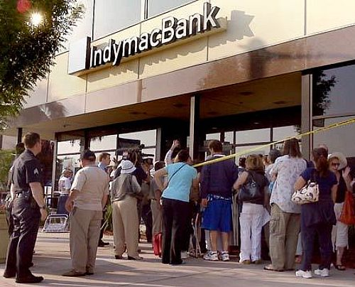
Notes:
SAX ABD GUITAR SOLOS

Slide 50
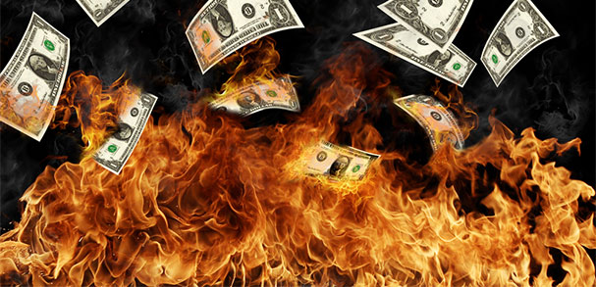
Notes:
SAX ABD GUITAR SOLOS

Slide 51
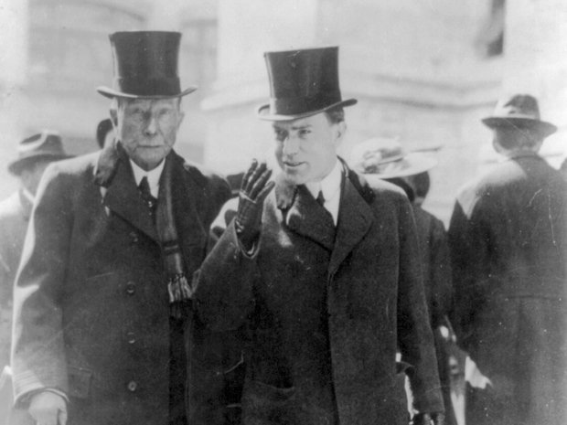
Notes:
SAX ABD GUITAR SOLOS

Slide 52
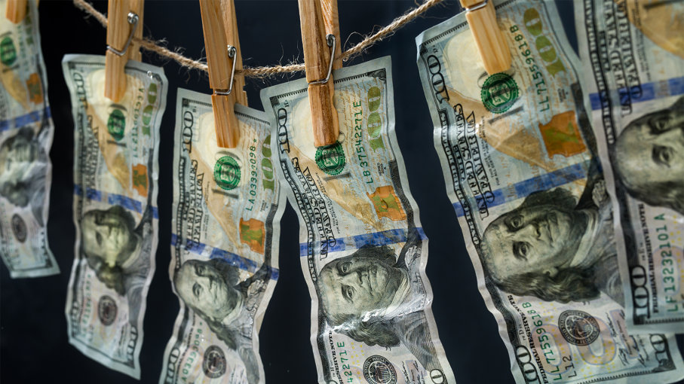
Notes:
SAX ABD GUITAR SOLOS

Slide 53
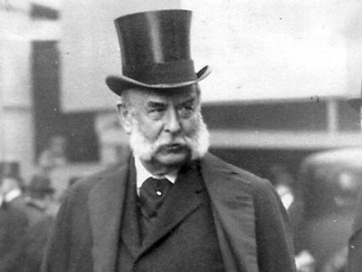
Notes:
SAX ABD GUITAR SOLOS

Slide 54
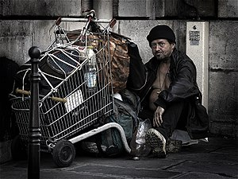
Notes:
SAX ABD GUITAR SOLOS

Slide 55

Notes:
SAX ABD GUITAR SOLOS

Slide 56
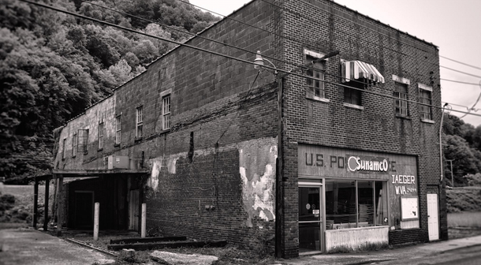
Notes:
SAX ABD GUITAR SOLOS

Slide 57
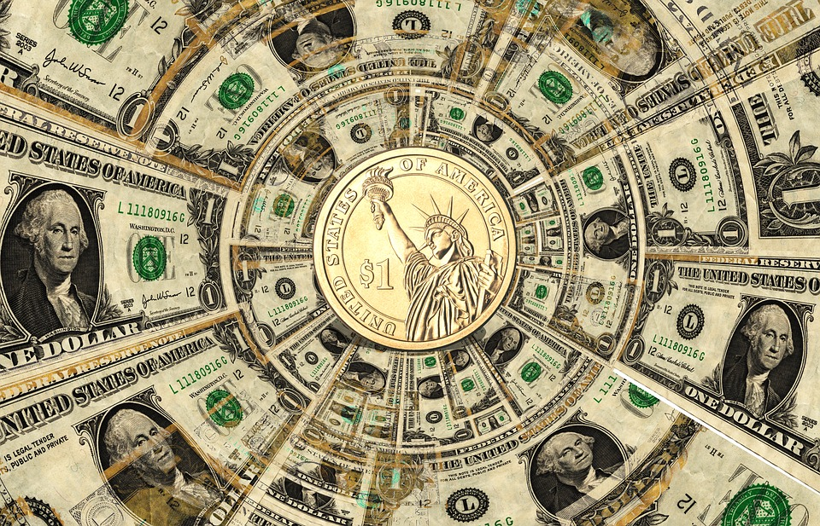
Notes:
SAX ABD GUITAR SOLOS

Slide 58

Notes:
SAX ABD GUITAR SOLOS

Slide 59

Notes:
SAX ABD GUITAR SOLOS

Slide 60

Notes:
SAX ABD GUITAR SOLOS

Slide 61

Notes:
SAX ABD GUITAR SOLOS

Slide 62
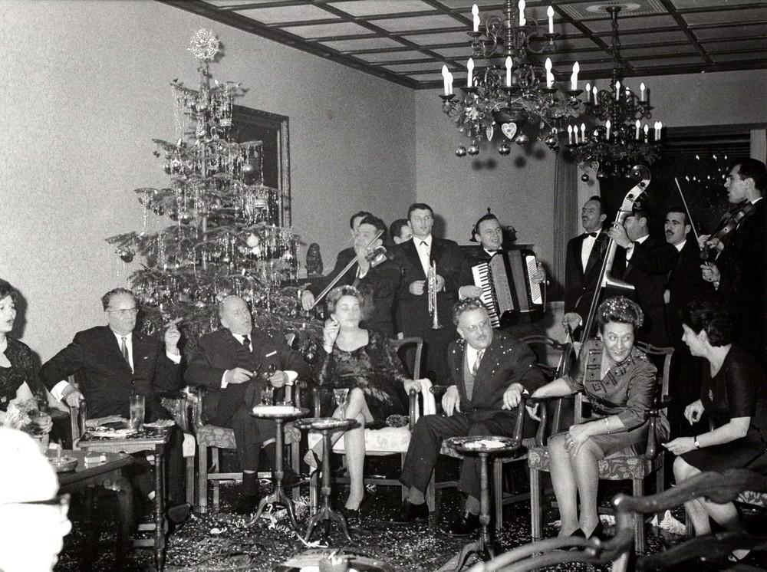
Notes:
SAX ABD GUITAR SOLOS

Slide 63
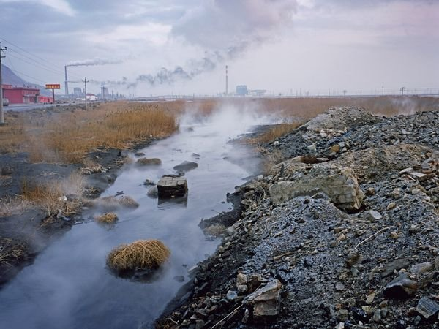
Notes:
SAX ABD GUITAR SOLOS

Slide 64

Notes:
SAX ABD GUITAR SOLOS

Slide 65
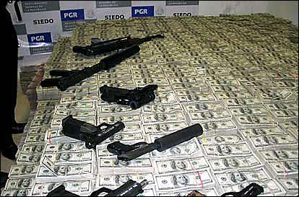
Notes:
SAX ABD GUITAR SOLOS

Slide 66
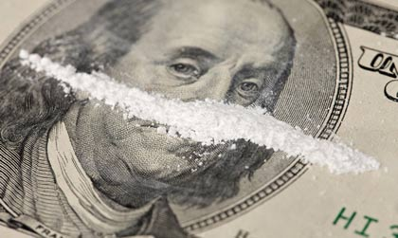
Notes:
SAX ABD GUITAR SOLOS

Slide 67
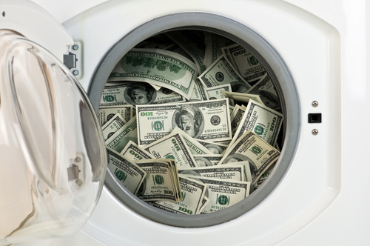
Notes:
SAX ABD GUITAR SOLOS

Slide 68
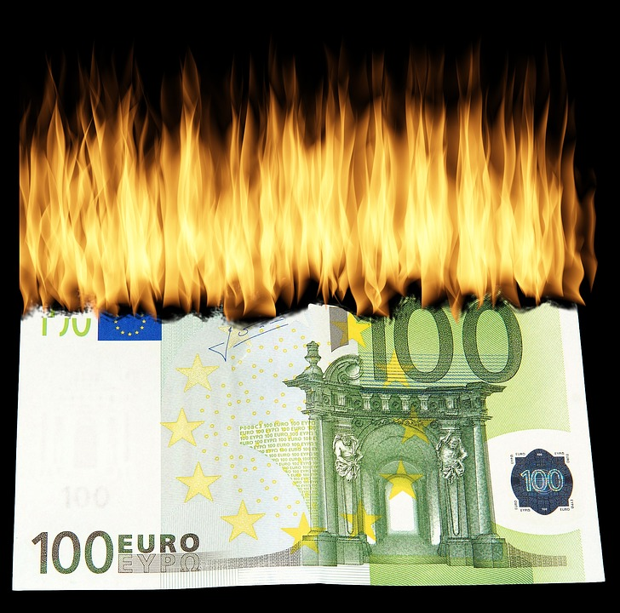
Notes:
SAX ABD GUITAR SOLOS

Slide 69

Notes:
Money

Slide 70

It’s a crime
Notes:
It’s a crime

Slide 71
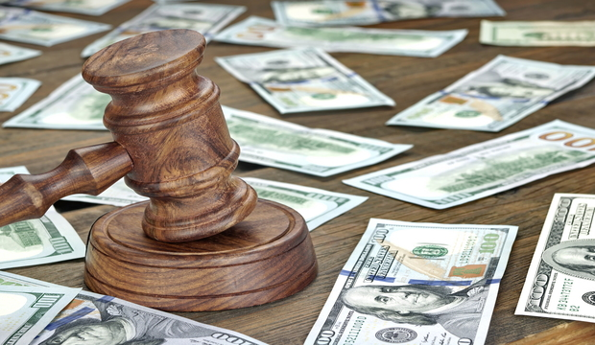
Share it fairly
Notes:
Share it fairly

Slide 72
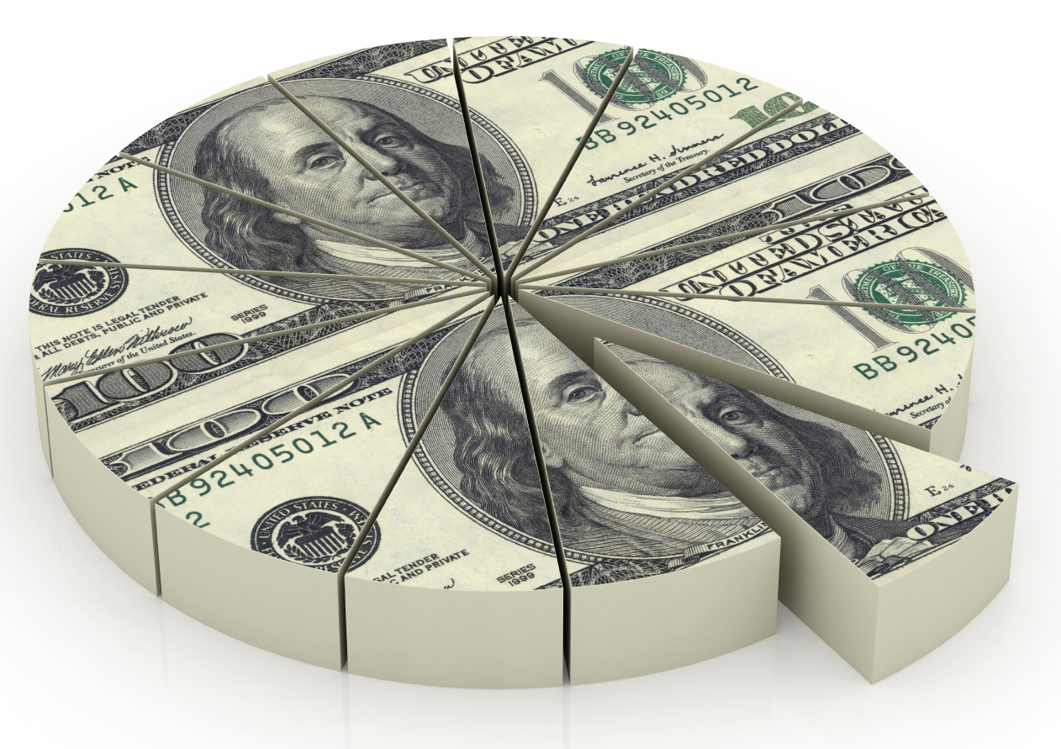
But don’t take a slice of my pie
Notes:
But don’t take a slice of my pie

Slide 73


SO THEY SAY
Notes:
Money, so they say

Slide 74
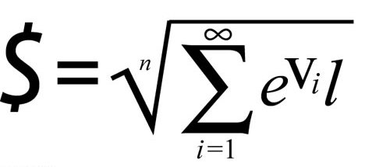
Is the root of all evil
Notes:
Is the root of all evil

Slide 75


Notes:
Today

Slide 76
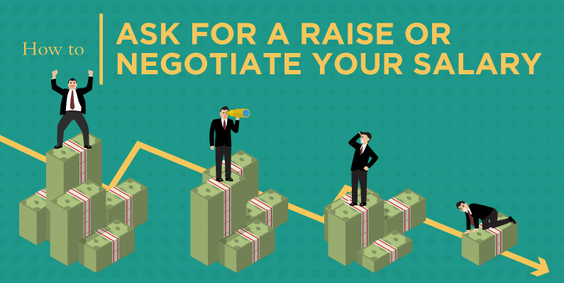

BUT
IF YOU ASK FOR A RAISE
Notes:
But if you ask for a raise

Slide 77
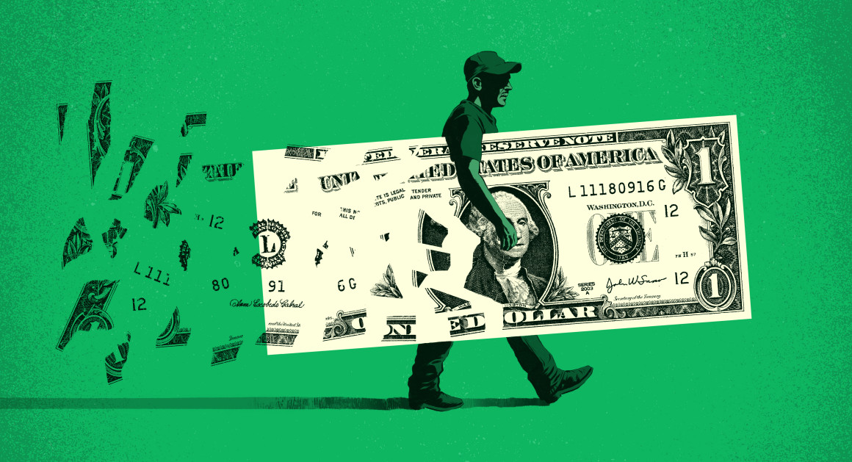
It’s no surprise they they’re
Notes:
It’s no surprise they they’re

Slide 78
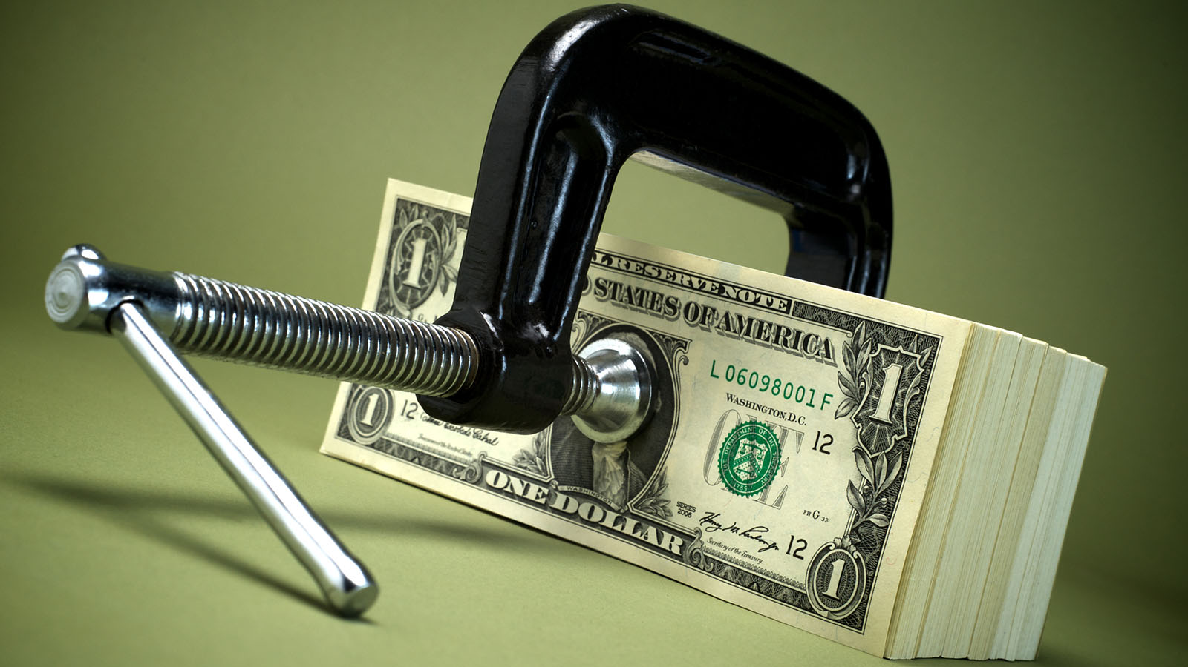
GIVING NONE AWAY!
Notes:
Giving none away

Slide 79


Notes:
Away

Slide 80
Notes:
Away

Slide 81
Notes:
Away

Slide 82
Notes:
Away

Slide 83
Notes:
Away

Slide 84
Notes:
Away

Slide 85
Notes:
Away

Slide 86
Notes:
Away

Slide 87
Notes:
Away

