Slide 1
The State of the United States
ECONOMY AND SOCIETY
Part 3

Slide 2
Workforce Trends
Notes:
The population of the United States is aging rapidly. Millions of adults born after the Second World War are now eligible for benefits under the Social Security System. Millions are relatively well off. Millions of others are not. Some percentage remain in the workforce, either in their long-term, full-time positions, in second or third careers or in part-time positions taken for economic or other personal reasons. Immigration and the impact of the new restrictions on immigration are already affecting workforce trends.

Slide 3
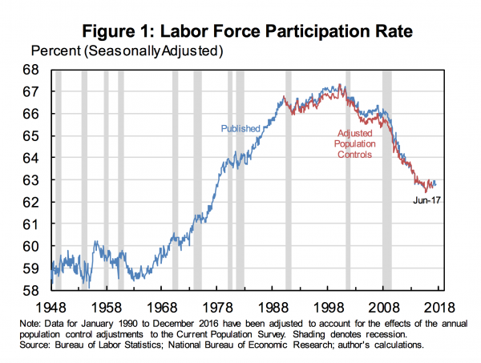
Notes:
3
Roughly one-half of our population – 159.5 million people -- comprises the nation’s civilian workforce. Of course, not all of these persons are employed. The downward sloping direction of the line on this graph reveals that a rising number of people included in the statistical labor force are not employed. A 2017 Brookings Institution paper written by Princeton University economics professor Alan Krueger provided some of the answers:

Slide 4
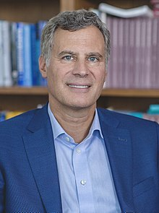
“The opioid epidemic and labor-force participation are now intertwined. If we are to bring a large number of people back into the labor force who have left the labor force, I think it’s important that we take serious steps to address the opioid crisis.”
Notes:
“The opioid epidemic and labor-force participation are now intertwined. If we are to bring a large number of people back into the labor force who have left the labor force, I think it’s important that we take serious steps to address the opioid crisis.” [Source: Alan Krueger. “Where Have All the Workers Gone? An Inquiry into the Decline of the U.S. Labor Force Participation Rate.” Brookings Institution, 2017]

Slide 5
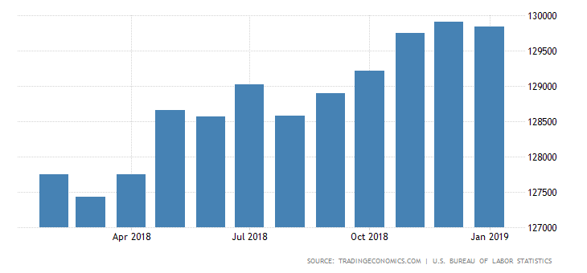
Notes:
5
The number of people employed full-time peaked in December of 2018 at 129.9 million.

Slide 6
Unemployment
Notes:
When the government announces the official rate of unemployment, this statistic is based on a survey of households taken by the U.S. Census Bureau. They report the percentage of the labor force that is without work, but seeking employment. Anyone who responds that they have given up looking for employment is categorized as no longer in the workforce and, therefore, not unemployed.

Slide 7
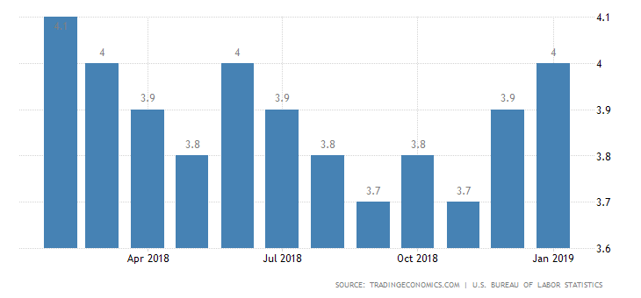
Unemployment Rate: 4.0%
Notes:
The report released by the Bureau of Labor Statistics for January, 2019 states the unemployment rate to be 4.0%. The number of unemployed increased by 241,000 to 6.54 million. Analysts point to the partial federal government shutdown as a significant factor in the uptick in both the unemployment rate and the number of unemployed persons.

Slide 8
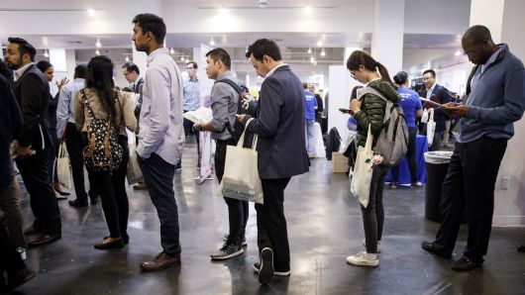
Notes:
Among the major worker groups, the unemployment rate for Hispanics increased to 4.9 percent in January. The jobless rates for adult men (3.7 percent), adult women (3.6 percent), teenagers (12.9 percent), Whites (3.5 percent), Blacks (6.8 percent), and Asians (3.1 percent) showed little change over the month. [Source: Trading Economics]

Slide 9
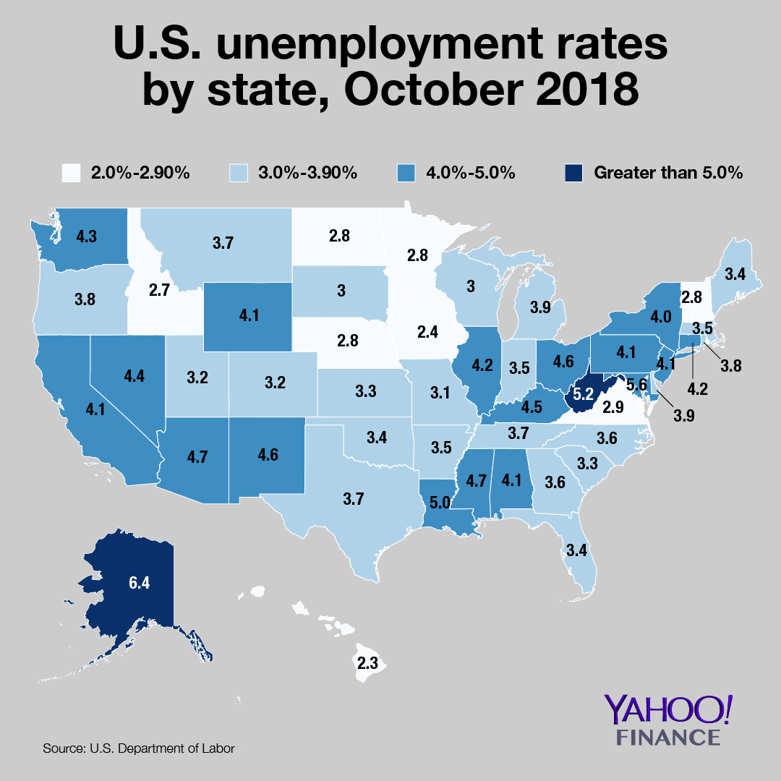
Notes:
9
Across the United States, the demand for workers is, as always, uneven. The reasons for this are many. As reported by the Bureau of Labor Statistics, Iowa, Hawaii, New Hampshire, Idaho and North Dakota had the lowest jobless rates as of December 2018. Alaskans had the highest rate of unemployment at 6.3%, with the District of Columbia next highest at 5.5%.

Slide 10
Notes:
10
Despite a general recovery in employment across the nation, some states continue to loss jobs. Alaska has been losing jobs since October of 2015. An important factor has been the steep drop in oil prices from above $100 a barrel to below $30.

Slide 11
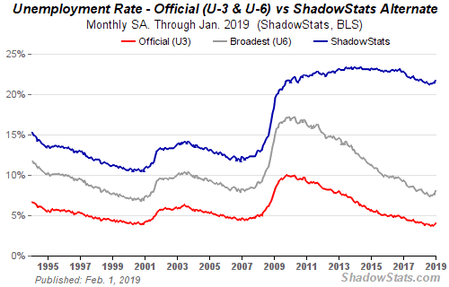
Notes:
A broader definition of unemployment, described as U-6, indicates that the rate of unemployment in January of 2019 was calculated to be was up slightly. This calculation includes the underemployed, the marginally employed and discouraged workers. However, the analysts at Shadowstats.com suggest the number of people who have dropped out of the workforce or are marginally employed is even much larger than what is revealed by the Census Bureau’s survey.

Slide 12
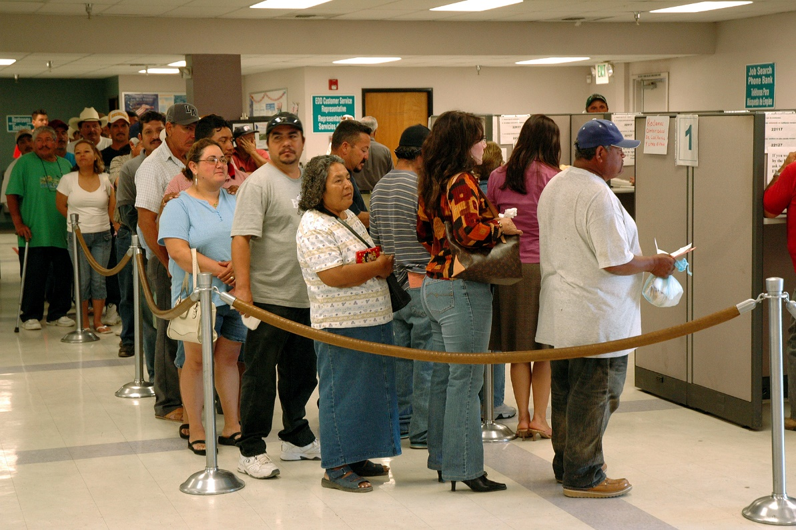
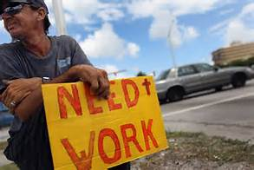
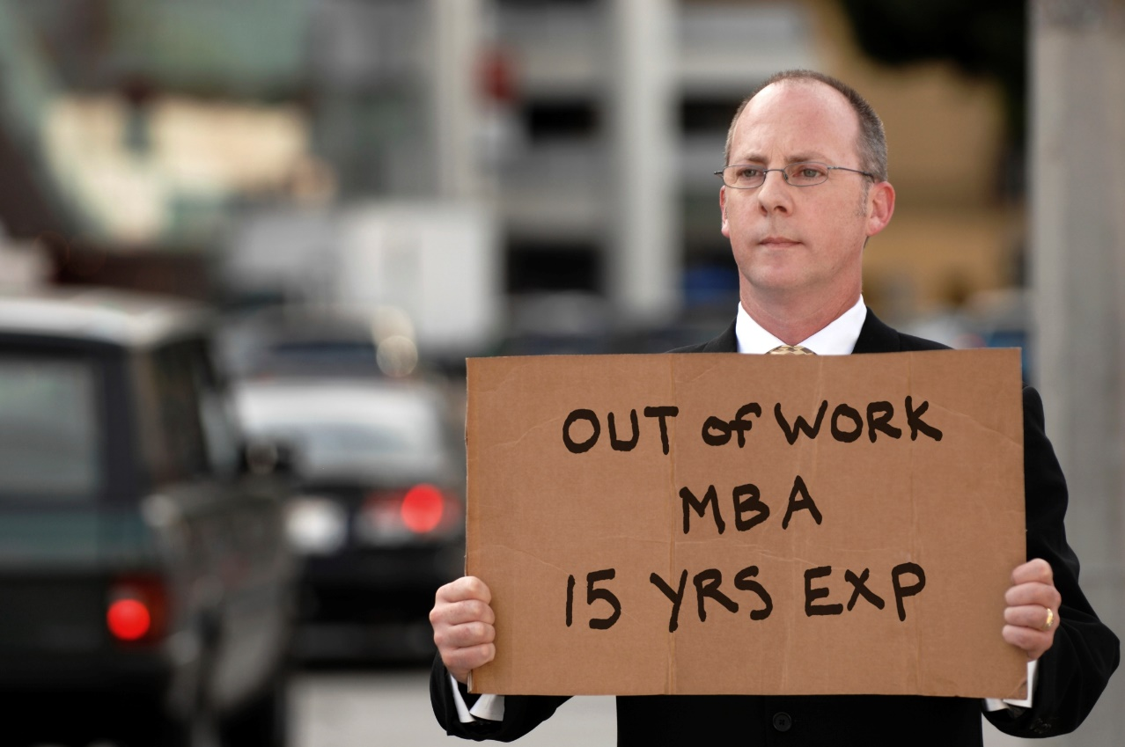
Notes:
12
Is it that people are unwilling to take what jobs are available or lack the skills required for available jobs? It is my position that the problem is systemic, that our economic system is unable to offer employment to a growing number of persons at a wage sufficient to meet even very basic living expenses.

Slide 13
Mandating a Higher Minimum Wage
Notes:
Across the United States, millions of people work full-time but do not earn enough to meet housing expenses and other basic living expenses. Some states have mandated a higher minimum wage for at least some workers. There are a number of concerns expressed by employers whose profit margins are already tight because of competition from lower-wage and lower-tax locations, domestic and foreign. The cost of living in the United States varies significantly.

Slide 14
Notes:
14
The Massachusetts Institute of Technology has developed a Living Wage Calculator to put the problem in perspective based on where people live. You can access the data for your state or metropolitan area. However, M.I.T.’s analysis of the data indicates the disconnect between the cost of living and wage levels is a national problem:

Slide 15
“An analysis of the living wage, compiling geographically specific expenditure data for food, childcare, health care, housing, transportation, and other basic necessities, finds that:
The living wage in the United States is $16.07 per hour in 2017, before taxes for a family of four (two working adults, two children), compared to $15.84 in 2016.
The minimum wage does not provide a living wage for most American families. A typical family of four (two working adults, two children) needs to work nearly four full-time minimum-wage jobs (a 75-hour work week per working adult) to earn a living wage.”
Notes:
“An analysis of the living wage, compiling geographically specific expenditure data for food, childcare, health care, housing, transportation, and other basic necessities, finds that:
The living wage in the United States is $16.07 per hour in 2017, before taxes for a family of four (two working adults, two children), compared to $15.84 in 2016.
The minimum wage does not provide a living wage for most American families. A typical family of four (two working adults, two children) needs to work nearly four full-time minimum-wage jobs (a 75-hour work week per working adult) to earn a living wage.”

Slide 16
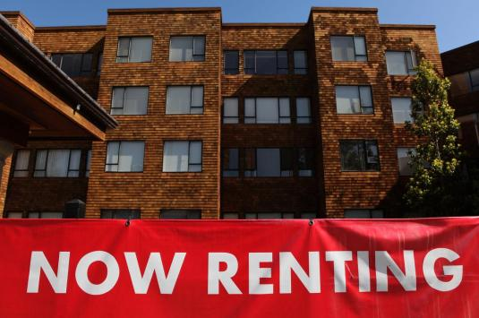
Notes:
16
A word of caution is required for those who advocate for an increase in the minimum wage independent of one extremely important other need of families: decent, affordable housing. The economics is easy to understand. Increase the demand side of a market without increasing the supply side and prices will increase. Thus, for many people whose dollar income would increase by a legislated increase in the minimum wage, the increase will eventually (and in some markets quickly) be capitalized into higher rental charges for existing apartments and high prices for houses suitable for first-time homebuyers.

Slide 17
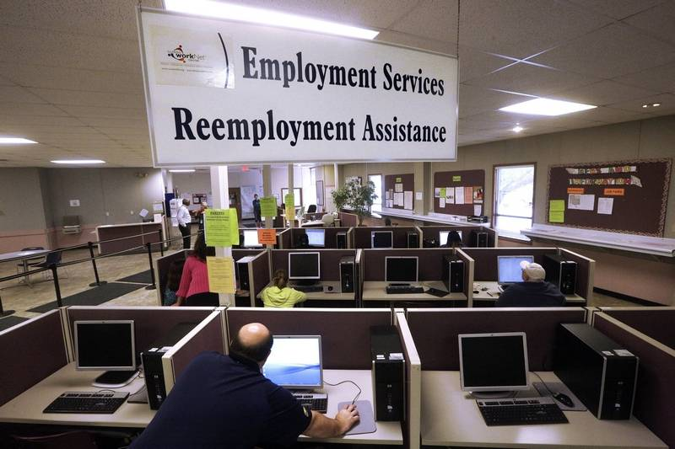
Notes:
17
At the same time, there are some sectors of the economy and some regions that have difficulty filling job openings. Low pay, difficult or dangerous working conditions, a shortage of decent, affordable housing and transportation obstacles all contribute to the problem. Some employers say they have great difficulty finding people with the needed skills and knowledge. Potential candidates may have undesirable criminal records or are found to be using illegal or addictive drugs.

Slide 18
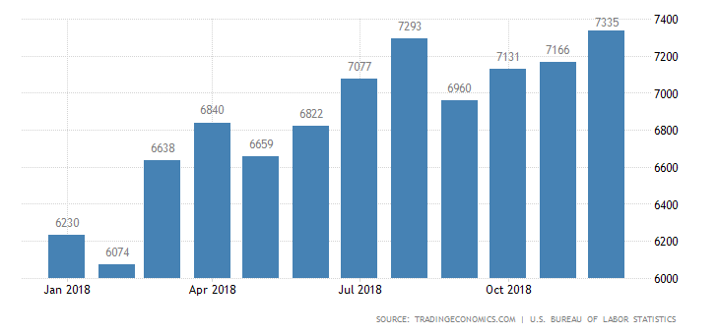
Job Openings
Notes:
18
The number of job openings in the US reached an all-time high of 7.335 million in December 2018. Across industries, the largest increases in the job openings level were recorded in construction (+88,000), accommodation & food services (+84,000), and health care & social assistance (+79,000). Meanwhile, job openings declined in non-durable goods manufacturing (-37,000), federal government (-32,000), and real estate & rental and leasing (-31,000).

Slide 19
Notes:
19
Bob Bryan, of Business Insider covered the story in 2016, and described one of the important demographic issues:

Slide 20
“While the outlook is bright for the younger generation, there will be a transition period as baby boomers and older members of the workforce shift out of the labor market and more and more millennials hit working age. This will mean the giant gap between experienced workers with the skills for the new jobs America is creating and those available in the labor poor will remain wide for a while.”
Notes:
20
“While the outlook is bright for the younger generation, there will be a transition period as baby boomers and older members of the workforce shift out of the labor market and more and more millennials hit working age. This will mean the giant gap between experienced workers with the skills for the new jobs America is creating and those available in the labor poor will remain wide for a while.”

Slide 21
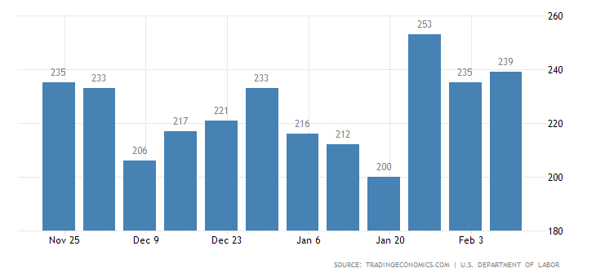
Notes:
If you happen to be one of the 239,000 people who just applied for state unemployment benefits, it is probably not encouraging to you that claims have been held below the 300,000 level for the longest period since 1969.

Slide 22
Notes:
22
Data published by the National Employment Law Project in December 2017 indicated that only 27 percent of unemployed workers continued to receive unemployment insurance. The author of the report, George Wentworth, explains:

Slide 23
“While trust fund recovery has accelerated, less than half of all state UI trust funds currently meet the federal standard for recession preparedness. Rather than increase the revenue generated by employer taxes to shore up the trust funds, many states decreased UI payouts through dramatic reductions in weeks of available benefits, stricter eligibility conditions and harsh new disqualifications. At the same time, some ‘modernized’ online filing systems are making it harder for many workers to apply for benefits.”
Notes:
23
“While trust fund recovery has accelerated, less than half of all state UI trust funds currently meet the federal standard for recession preparedness. Rather than increase the revenue generated by employer taxes to shore up the trust funds, many states decreased UI payouts through dramatic reductions in weeks of available benefits, stricter eligibility conditions and harsh new disqualifications. At the same time, some ‘modernized’ online filing systems are making it harder for m any workers to apply for benefits.” [Source: George Wentworth. “Closing Doors on the Unemployed: Why Most Jobless Workers Are Not Receiving Unemployment Insurance and What States Can Do About It,” National Employment Law Project Report, 19 December, 2017]

Slide 24
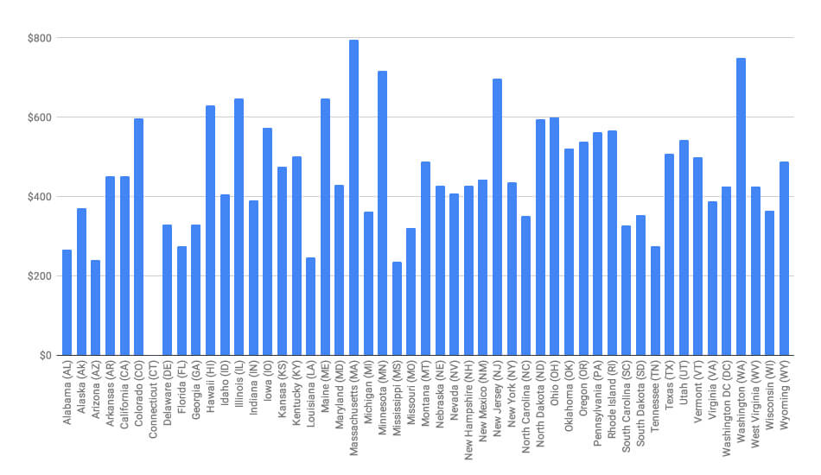
Notes:
24
It is worth noting that some states are far more generous providing unemployment benefits than others. Benefits are the highest in the state of Massachusetts, ranging up to $1,537, depending on one’s eligibility. Benefits in Mississippi and Arizona are the least generous. The policy issue involved is whether the benefit level allows individuals to be overly-selective in their search for re-employment.

Slide 25
Does education matter?
Notes:
Education levels and specialized training have always helped protect people from prolonged periods of unemployment, if not necessarily from underemployment.

Slide 26
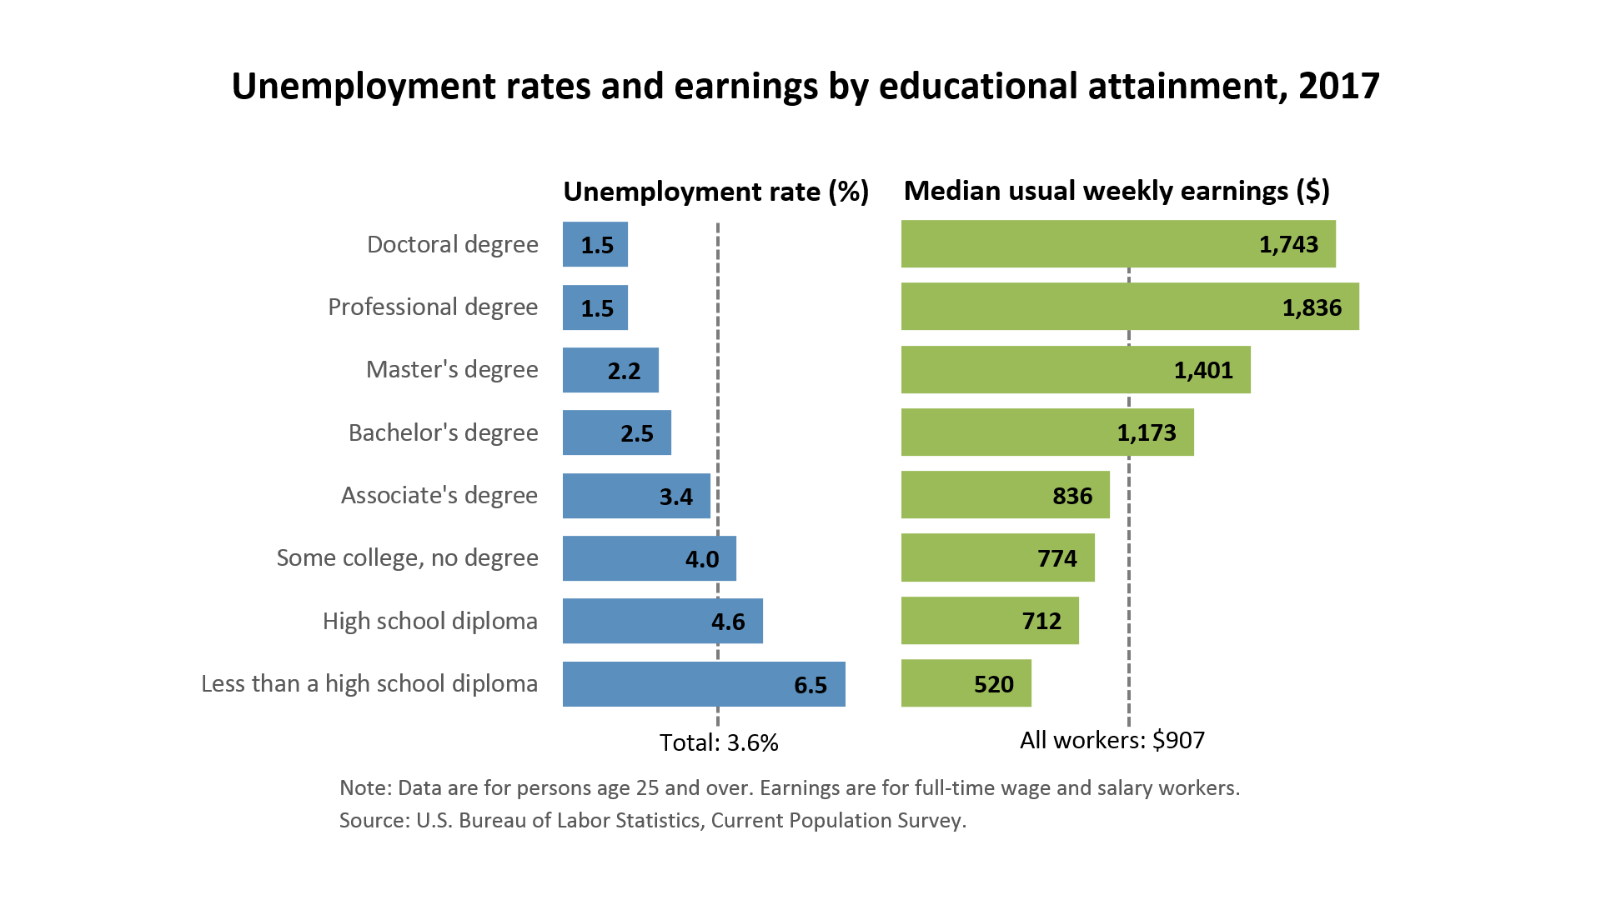
* 2019 percentages
1.3*
1.7*
2.2*
2.8*
3.2*
4.0*
4.3*
7.4*
Notes:
26
Data from the Bureau of Labor Statistics was used to prepare this graph, which validates what our intuition would conclude. There is a very strong correlation between formal education, employment stability and income level. The 2019 percentages have been added to this chart issued for 2017.

Slide 27
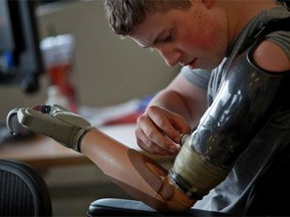
Notes:
27
A 2018 U.S. Bureau of Labor and Statistics report indicated that veteran unemployment feel to an all-time low of 3.8 percent. However, this figure is derived from a questionnaire sent out to veterans that is not considered by veteran organizations as sufficiently specific. As with other individuals, anyone who has given up trying to obtain employment is not counted.

Slide 28
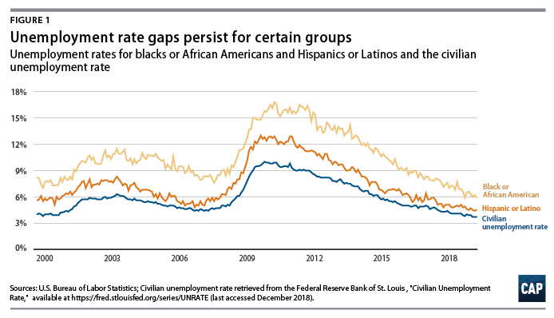
Notes:
28
Despite the positive trend in employment growth, that statistics on individual and household savings indicate that 40 percent of all households are unable to cover the cost of even a minority emergency expense. An analysis of the Economic Policy Institute indicates that labor incomes fro the bottom 90 percent has shrunk by more than 10 percent since 1979. This translates into about $10,800 of lost pay per household.

Slide 29
Coping with Disability
Notes:
There are some 20 million working-age- people with some disability in the United States. Of this total, 7.5 million are working. During 2016 the economy added 343,000 new jobs for people with disabilities, and another 111,804 people with a disability entered the workforce in 2017. Statistics for 2019 are not yet published.

Slide 30
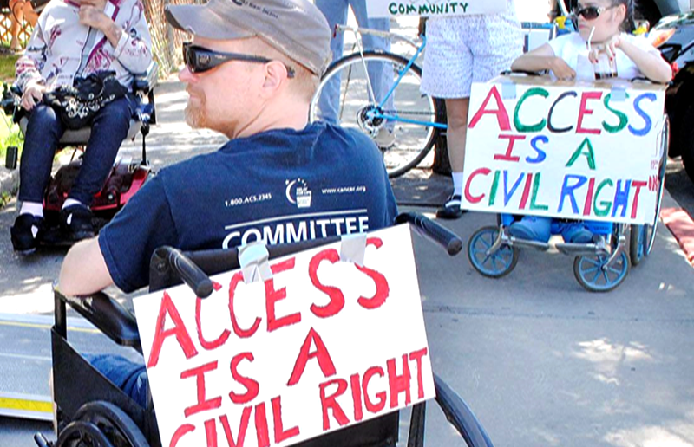
Notes:
As reported in previous updates, another consequence of long-term unemployment has been a significant increase in the number of people applying for Social Security Disability benefits.

Slide 31
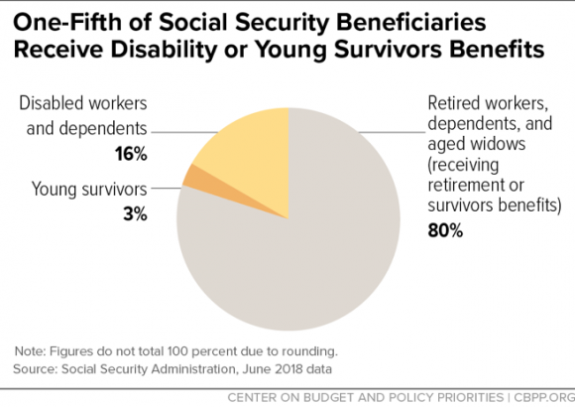
Notes:
The Center on Budget and Policy Priorities reported last August that 62 million people – one in every six U.S. residents, collected Social Security benefits in June 2018. Older Americans make up about 4 in 5 beneficiaries, another one-fifth of beneficiaries received Social Security Disability Insurance (SSDI) or were young survivors of deceased workers.

Slide 32
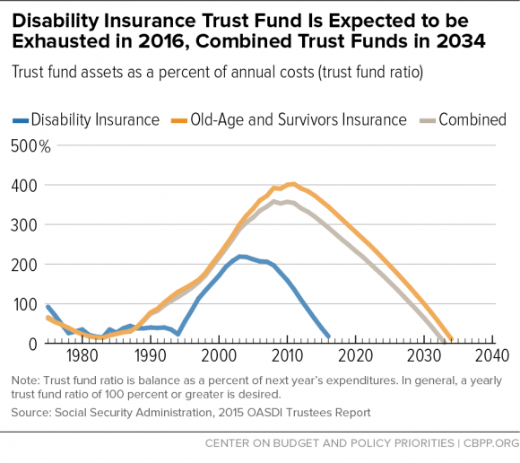
Notes:
The financial obligations to those now collecting disability insurance benefits are rapidly depleting the reserves of the trust fund. The 2017 report of the Social Security trustees indicates the fund will be depleted by 2028.

Slide 33
Notes:
33
An internal audit revealed that Social Security paid out $2 billion from fraudulent disability claims approved by 44 administrative law judges between 2007 and 2014. In response, the Social Security Administration and the Justice Department created the Cooperative Disability Investigation Unit, now operating in 34 states, the District of Columbia and Puerto Rico. The SSA’s Office of the Inspector General reported to Congress that between October 2017 and March 2018, their investigations of fraud resulted in 400 criminal convictions, recovering $40 million.

Slide 34
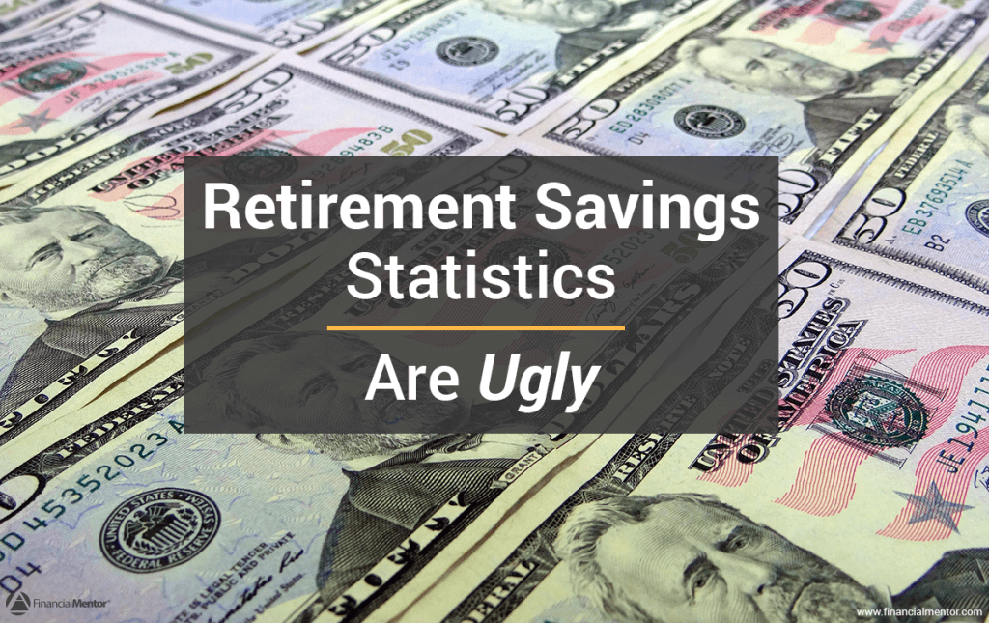
Notes:
34
The bottom line for most Americans is that we are very dependent on continuous employment to make ends meet. Any interruption in employment, even for a short period can result in indebtedness and even homelessness. Next, we will look at social welfare trends.

Slide 35
End of Part 3

